Slide 1
CET 3510 Microcomputer Systems Tech. Lecture 2
Professor:
Dr. José M. Reyes Álamo

Slide 2
The Intel 80x86 CPU Family
Intel CPU family is generally classified as a Von Neumann Architecture Machine
Von Neumann computer systems contain three main building blocks
Central Processing Unit (CPU)
Memory
Input/Output Devices (I/O).
These three components are connected together using the system bus

Slide 3
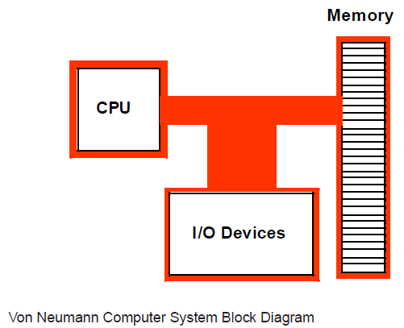
Von Neumann Architecture

Slide 4
CPU
The most prominent items within the CPU are the registers
Intel CPU registers can be classified in four categories:
General purpose registers
Special purpose: application accessible registers
Segment registers
Special purpose: kernel mode registers
Registers are used for nearly every calculation, therefore they are very important

Slide 5
General purpose registers
8-bit registers:
AL, AH, BL, BH, CL, CH, DL, and DH
16-bit registers:
AX, BX, CX, DX, SI, DI, BP, and SP
32-bit registers:
EAX, EBX, ECX, EDX, ESI, EDI, EBP, and ESP
E stands for “Extended”
These are not 24 separate registers, they are overlaid
Careful is needed when modifying a register

Slide 6
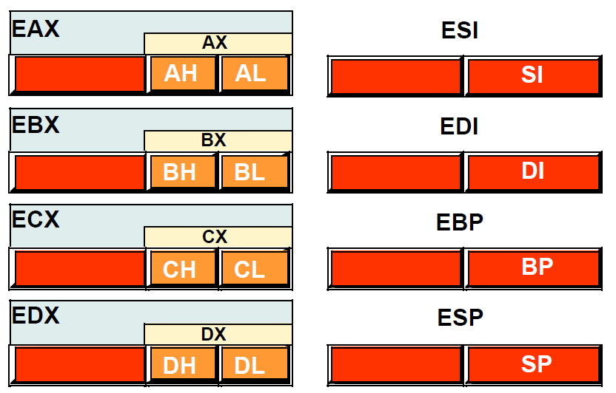
Intel CPU registers

Slide 7
Special Purpose Register - EFLAGS
EFLAGS is a 32-bit register that encapsulates several single-bit (Boolean) values
Most bits are reserved for kernel mode functions
Assembly programmers are especially interested in 8 of these bits:
Overflow
Direction
Interrupt disable
Sign
Zero
Auxiliary carry
Parity
Carry flags

Slide 8
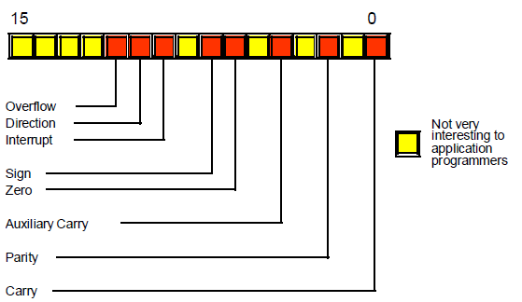
EFLAGS Architecture

Slide 9
Special Purpose Register - EIP
EIP is a 32-bit register know as the instruction pointer register
It contains the memory address of the next machine instruction to execute

Slide 10
The Memory Subsystem
A typical 80x86 processor addresses a maximum of 2^{n} different memory locations, where n is the number of bits on the address bus (theoretical bound)
Memory locations are addressed in bytes
32-bit: 4,294,967,296 ≈ 4 GB
64-bit: 18,446,744,073,709,551,616 = 18 Exabytes (EB) … A LOT!!!

Slide 11
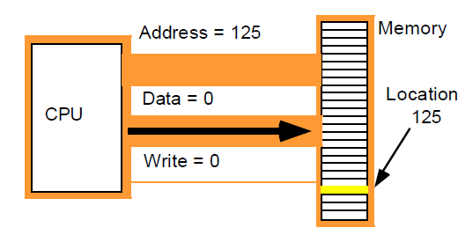
Memory Write Operation

Slide 12
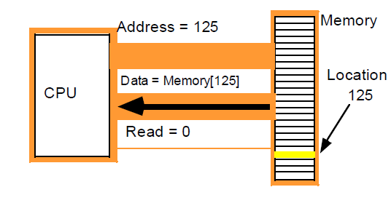
Memory Read Operation

Slide 13
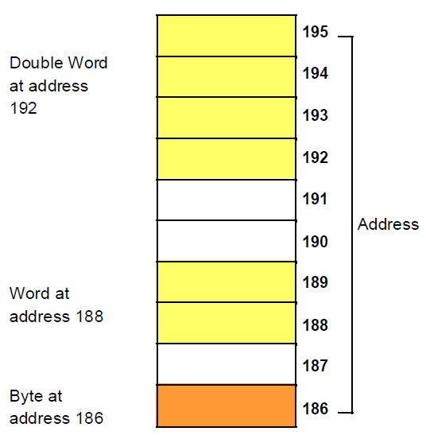
Memory Allocations
Byte = 8 bits
Word = 16 bits
Double = 32 bits

Slide 14
Little Endian vs. Big Endian
Endianness refers to the byte ordering, another major architectural consideration.
Data may be stored with the least significant byte followed by the most significant byte or vice versa.
In little endian machines, the least significant byte is followed by the most significant byte.
In Big endian machines, the most significant byte is followed by the least significant byte.

Slide 15
Little Endian vs. Big Endian
Example, suppose we want to store the number 12345678 in memory.
The following figure shows how this number will be stored in memory under both.

Slide 16
Little Endian vs. Big Endian
Big endian:
Looks more natural.
The sign of the number is easily determined.
Strings and integers are stored in the same order.
Little endian:
Easier to place values on non-word boundaries.
Conversion from a 16-bit integer address to a 32-bit integer address does not require arithmetic.
Used by Intel processors.

Slide 17
About Machine Instructions
Some CPUs have hundreds or thousands of instructions
Fortunately you will only need a few, including:
mov( source_operand, destination_operand );
add( source_operand, destination_operand );
sub( source_operand, destination_operand );

Slide 18
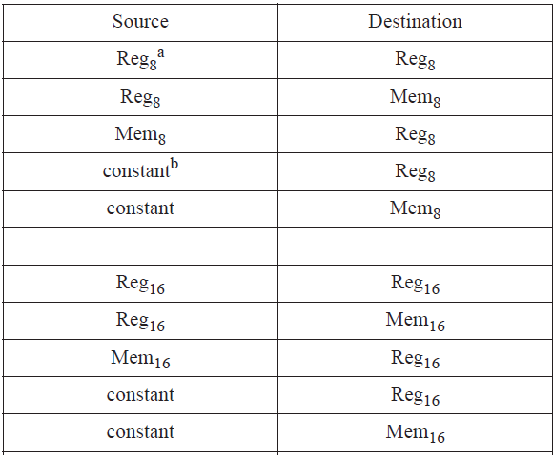
Legal MOV Instruction Operands

Slide 19
HLA Syntax

Slide 20
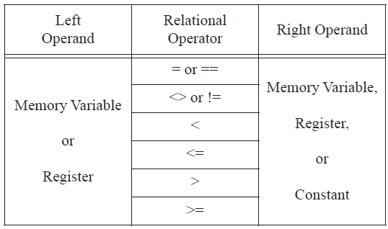
HLA Syntax – Boolean Expressions

Slide 21
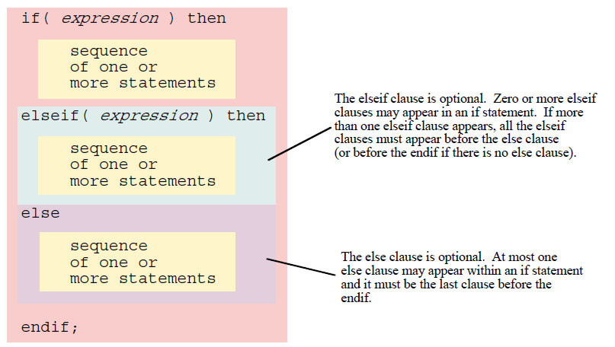
HLA Syntax – If Statement

Slide 22
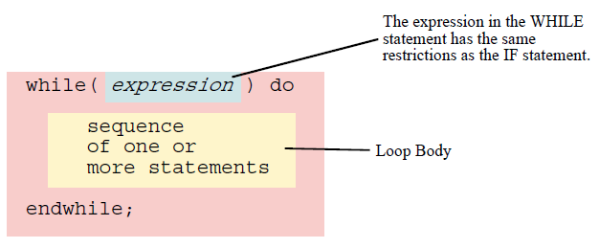
HLA Syntax – While Statement

Slide 23
HLA Syntax – For Statement
for( Initial_Stmt; Termination_Expression; Post_Body_Statement ) do
<< Loop Body >>
endfor;

Slide 24
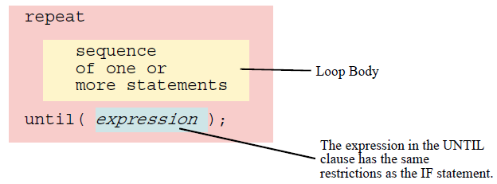
HLA Syntax – Repeat Statement

Slide 25
HLA Syntax – Break Statement

Slide 26
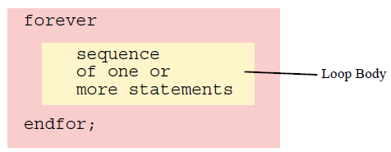
HLA Syntax – Forever Statement

Slide 27
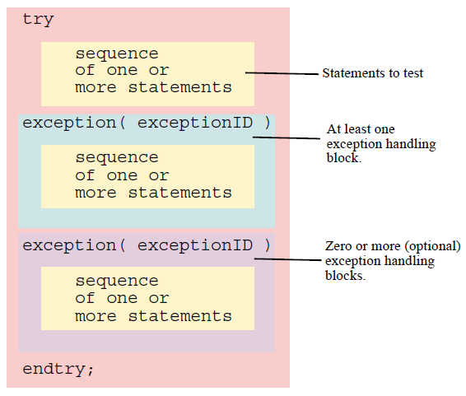
HLA Syntax – Try/Catch Statement

Slide 28
HLA Standard Library
Along with control structures HLA provides many commonly used modules as libraries
Technically these are not “assembly” language
The will allow you to concentrate in the most important aspect of assembly programming and ease the learning of “pure” assembly

Slide 29
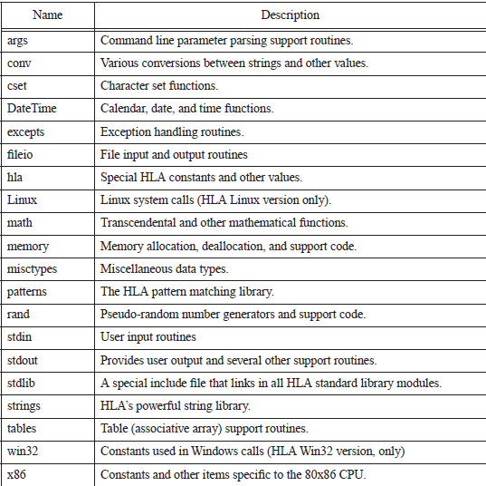
HLA Standard Library

Slide 30
HLA Standard Lib - stdio Module
Stdio.nl: The ASCII new line character
stdio.bell: The ASCII bell character. Beeps the speaker when printed
stdio.bs: The ASCII backspace character
stdio.tab: The ASCII tab character
stdio.eoln: A linefeed character (even under Windows)
stdio.lf: The ASCII linefeed character
stdio.cr: The ASCII carriage return character
< source : redirect input from stdin to source
> destination: redirect output from stdout to destination

Slide 31
HLA Standard Library
stdout.puti8, stdout.puti16, and stdout.puti32 prints a single parameter (1, 2, or 4 bytes) as a signed integer value
stdout.put( list_of_values_to_output ); very flexible command for output
stdin.getc reads the next available character from standard input
stdin.geti8, stdin.geti16, and stdin.geti32 read 8, 16, and 32-bit signed integer values from standard input

Slide 32
HLA Standard Library
stdin.readLn discards everything that is in the input buffer and requires the user to enter a new line of text
stdin.flushInput discards everything that is in the buffer
stdin.get very flexible input command
lea( reg32, Memory_operand ); (load effective address) loads the actual memory address of Memory_operand into reg32

