Slide 1
Chapter 8 Pointers
C++ How to Program, 8/e

Slide 2
8.2 Pointer Variable Declarations and Initialization
A pointer contains the memory address of a variable that, in turn, contains a specific value.
In this sense, a variable name directly references a value, and a pointer indirectly references a value.
Referencing a value through a pointer is called indirection.
Diagrams typically represent a pointer as an arrow from the variable that contains an address to the variable located at that address in memory.

Slide 3
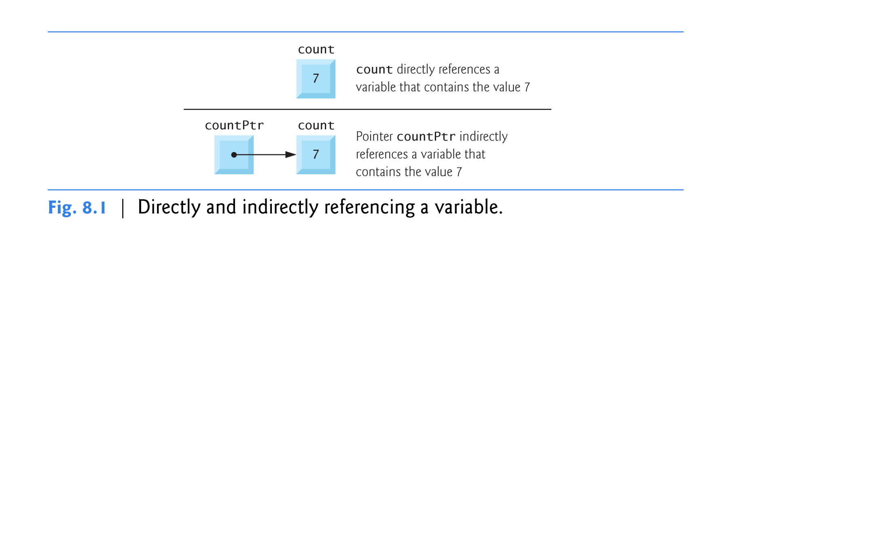

Slide 4
8.2 Pointer Variable Declarations and Initialization (cont.)
The declaration
int count;
int *countPtr
declares the variable countPtr to be of type int * (i.e. a pointer to an int value) and is read (right to left) “countPtr is a pointer to int.”
Variable count in the preceding declaration is declared to be an int, not a pointer to an int.
Each variable being declared as a pointer must be preceded by an asterisk (*).
When * appears in a declaration, is not multiplication; rather, it indicates that the variable being declared is a pointer.
Pointers can be declared to point to objects of any data type.

Slide 5
8.2 Pointer Variable Declarations and Initialization (cont.)
Pointers should be initialized either when they’re declared or in an assignment.
A pointer may be initialized to 0, NULL or an address of the corresponding type.
A pointer with the value 0 or NULL points to nothing and is known as a null pointer.
NULL is equivalent to 0, but in C++, 0 is used by convention.
The value 0 is the only in-teger value that can be assigned directly to a pointer variable without first casting the integer to a pointer type.
Similar concept as indirect addressing mode in HLA

Slide 6
8.3 Pointer Operators
The address operator (&) is a unary operator that obtains the memory address of its operand.
Same operator used in HLA
HLA also uses the command lea( )
Assuming the declarations
int y = 5; // declare variable y int *yPtr; // declare pointer variable yPtr
the statement
yPtr = &y; // assign address of y to yPtr
assigns the address of the variable y to pointer variable yPtr.
Figure 8.2 shows a representation of memory after this assignment.

Slide 8
8.3 Pointer Operators (cont.)
Figure 8.3 shows another pointer representation in memory with integer variable y stored at memory location 600000 and pointer variable yPtr stored at memory location 500000.
You have to be very careful when performing operations using pointer variables.
The * operator, commonly referred to as the indirection operator or dereferencing operator, returns a synonym for the object to which its pointer operand points.
Called dereferencing a pointer
A dereferenced pointer may also be used on the left side of an assignment.
The & and * operators are inverses of one another.

Slide 9
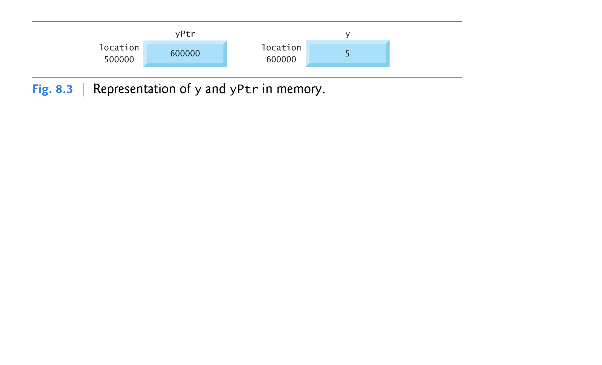

Slide 13
8.4 Pass-by-Reference with Pointers
There are three ways in C++ to pass arguments to a function—pass-by-value, pass-by-reference with reference arguments and pass-by-reference with pointer arguments.
In this section, we explain pass-by-reference with pointer arguments.
Pointers, like references, can be used to modify one or more variables in the caller or to pass pointers to large data objects to avoid the overhead of passing the objects by value.
In C++, you can use pointers and the indirection operator (*) to accomplish pass-by-reference.
This is how is done in C-language as it only supports pass-by-value, but this way you can accomplish similar results.

Slide 14
8.4 Pass-by-Reference with Pointers (cont.)
When calling a function with an argument that should be modified, the address of the argument is passed.
When the address of a variable is passed to a function, the indirection operator (*) can be used in the function to form a synonym for the name of the variable this in turn can be used to modify the variable’s value at that location in the caller’s memory.
Figure 8.6 and Fig. 8.7 present two versions of a function that cubes an integer—cubeByValue and cubeByReference.

Slide 17
8.4 Pass-by-Reference with Pointers (cont.)
Figure 8.7 passes the variable number to function cubeByReference using pass-by-reference with a pointer argument—the address of number is passed to the function.
The function dereferences the pointer and cubes the value to which nPtr points.
This directly changes the value of number in main.
Figures 8.8–8.9 analyze graphically the execution of the programs in Fig. 8.6 and Fig. 8.7, respectively.

Slide 19
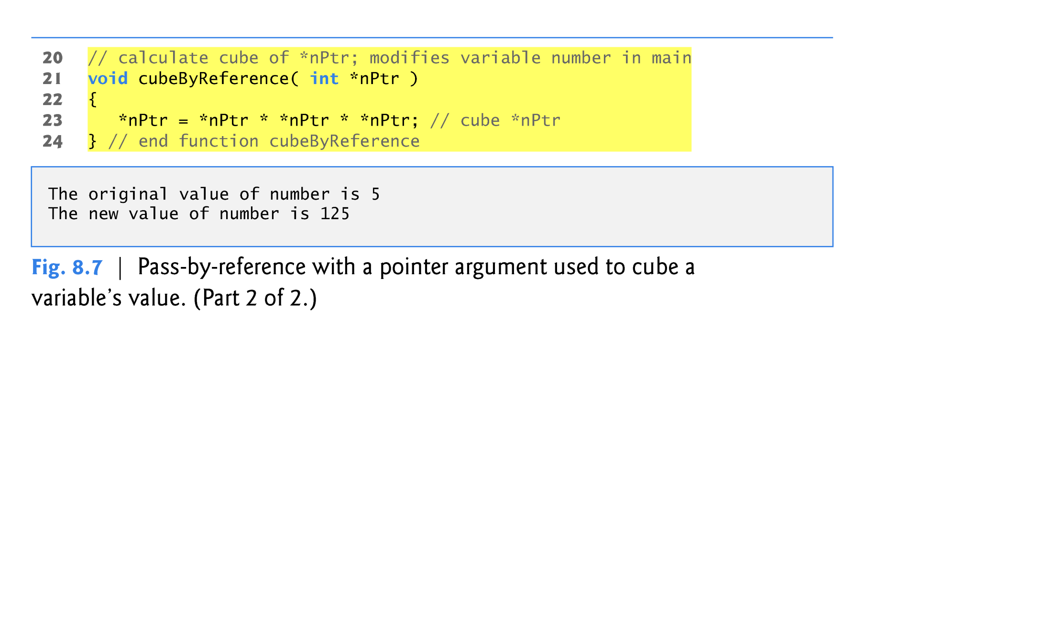

Slide 21
8.4 Pass-by-Reference with Pointers (cont.)
In the function header and in the prototype for a function that expects a one-dimensional array as an argument, pointer notation may be used.
The compiler does not differentiate between a function that receives a pointer and a function that receives a one-dimensional array.
The function must “know” when it’s receiving an array or simply a single variable which is being passed by reference.
When the compiler encounters a function parameter for a one-dimensional array of the form int b[], the compiler converts the parameter to the pointer notation int *b.
Both forms are interchangeable.

Slide 22
8.8 Pointer Expressions and Pointer Arithmetic
Pointers are valid operands in arithmetic expressions, assignment expressions and comparison expressions.
pointer arithmetic—certain arithmetic operations may be performed on pointers:
increment (++)
decremented (--)
an integer may be added to a pointer (+ or +=)
an integer may be subtracted from a pointer (- or -=)
one pointer may be subtracted from another of the same type

Slide 25
8.8 Pointer Expressions and Pointer Arithmetic (cont.)
Assume that array int v[5] has been declared and that its first element is at memory location 3000.
Remember int takes 32 bits or 4 bytes.
Assume that pointer vPtr has been initialized to point to v[0] (i.e., the value of vPtr is 3000).
Figure 8.16 diagrams this situation for a machine with four-byte integers.

Slide 26
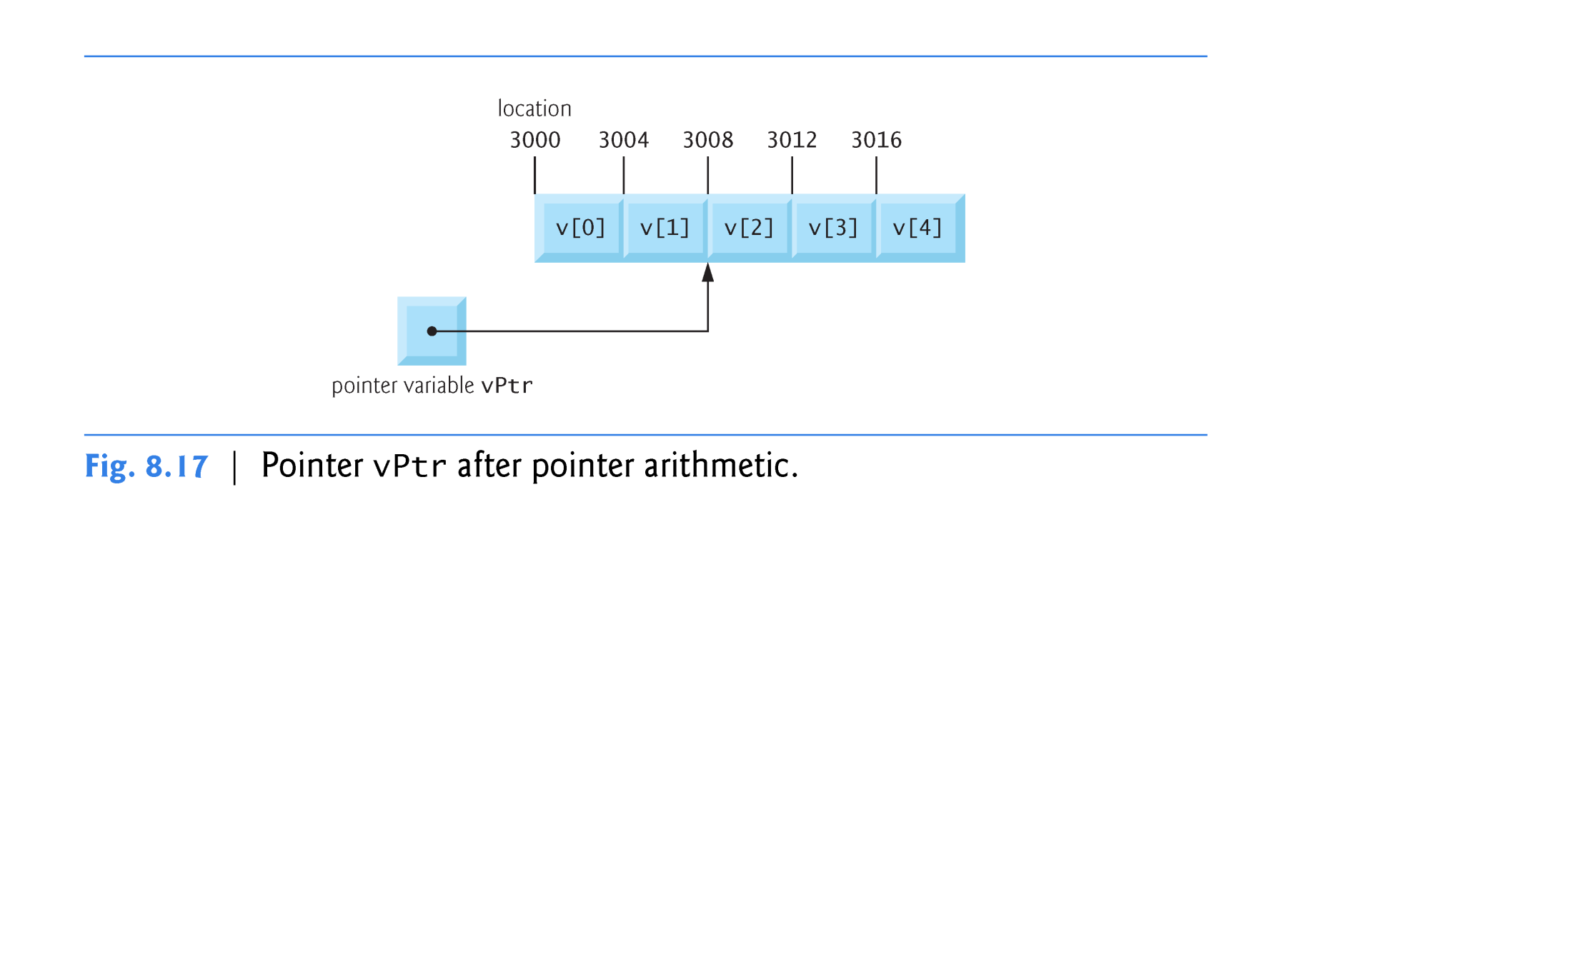

Slide 27
8.8 Pointer Expressions and Pointer Arithmetic (cont.)
In conventional arithmetic, the addition 3000 + 2 yields the value 3002.
This is normally not the case with pointer arithmetic.
When an integer is added to, or subtracted from, a pointer, the pointer is not simply incremented or decremented by that integer, but by that integer times the size of the object to which the pointer refers.
The number of bytes depends on the object’s data type.
In HLA, this corresponds to the Indexed Addressing Mode and Scaled Index Addressing Mode.
For cPtr the 3000 + 2 = 3008

Slide 28
Variations on the Indexed Addressing Mode

Slide 29
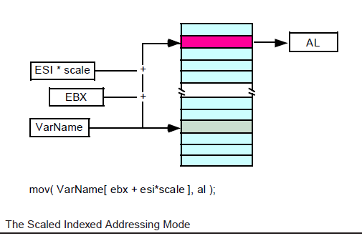
Scaled Indexed Addressing Modes

Slide 30
8.8 Pointer Expressions and Pointer Arithmetic (cont.)
Pointer variables pointing to the same array may be subtracted from one another.
For example, if vPtr contains the address 3000 and v2Ptr contains the address 3008, the statement
x = v2Ptr - vPtr;
Would assign to x the number of array elements from vPtr to v2Ptr—in this case, 2.
Pointer arithmetic is meaningless unless performed on a pointer that points to an array.

Slide 31
8.8 Pointer Expressions and Pointer Arithmetic (cont.)
A pointer can be assigned to another pointer if both pointers are of the same type.

Slide 32
8.8 Pointer Expressions and Pointer Arithmetic (cont.)
Pointers can be compared using equality and relational operators.
Comparisons using relational operators are meaningless unless the pointers point to members of the same array.
Pointer comparisons compare the addresses stored in the pointers.
A common use of pointer comparison is determining whether a pointer is 0 (i.e., the pointer is a null pointer—it does not point to anything).

Slide 33
8.9 Relationship Between Pointers and Arrays
An array name can be thought of as a constant pointer.
Pointers can be used to do any operation involving array subscripting.
Assume the following declarations:
int b[ 5 ]; // create 5-element int array b int *bPtr; // create int pointer bPtr
Because the array name (without a subscript) is a (constant) pointer to the first element of the array, we can set bPtr to the address of the first element in array b with the statement
bPtr = b; // assign address of array b to bPtr
equivalent to
bPtr = &b[ 0 ]; // also assigns address of array b to bPtr

Slide 34
8.9 Relationship Between Pointers and Arrays (cont.)
Array element b[ 3 ] can alternatively be referenced with the pointer expression
*( bPtr + 3 )
The 3 in the preceding expression is the offset to the pointer.
This notation is referred to as pointer/offset notation.
The parentheses are necessary, because the precedence of * is higher than that of +.

Slide 35
8.9 Relationship Between Pointers and Arrays (cont.)
Just as the array element can be referenced with a pointer expression, the address
&b[ 3 ]
can be written with the pointer expression
bPtr + 3
The array name can be treated as a pointer and used in pointer arithmetic.
For example, the expression
*( b + 3 )
also refers to the array element b[ 3 ].
In general, all subscripted array expressions can be written with a pointer and an offset.

Slide 37
8.9 Relationship Between Pointers and Arrays (cont.)
Pointers can be subscripted exactly as arrays can.
For example, the expression
bPtr[ 1 ]
refers to the array element b[ 1 ]; this expression uses pointer/subscript notation.

Slide 39
