Slide 1
CET 3510 - Microcomputer Systems Technology Lecture 1
Dr. José M. Reyes Álamo

Slide 2
Syllabus
Course website http://openlab.citytech.cuny.edu/cet3510f13
Syllabus posted there
Both OpenLab and Blackboard will be used to post material and submissions

Slide 3
Outline
Computer Architecture
Quick Review of Operating System Concepts
Introduction to High-Level Assembly

Slide 4
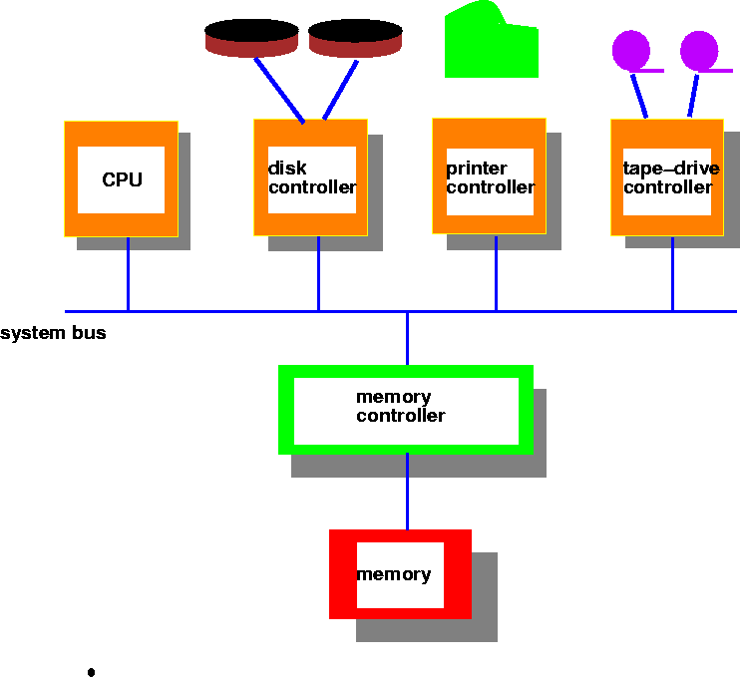
Computer System Architecture

Slide 5
What is an Operating System?
An Operating System (OS) is a program that acts as an intermediary between the user and the hardware
Software accounts for the major cost of general purpose computing
OS simplifies the complexity of running applications efficiently

Slide 6
What is an Operating System?
The OS manages resources and allocates them to programs and users.
Thanks to the management of the OS, a programmer does not have to deal with difficult hardware issues.
The OS provides services for:
Processor Management
Memory Management
File Management
Device Management
Concurrency Control

Slide 7
Computer System Components
Hardware
Provides the actual computing resources (CPU, memory, I/O devices).
Operating System
Controls and coordinates the use of hardware among applications and programs.
Applications and Programs
Solve computing problems of users (compilers, word processing, games, business applications).
Users
People, devices, and other computers

Slide 8
Goals of an Operating System
Simplify the execution of programs and problem solving
Efficient use of the computer hardware
Makes sharing hardware and software possible
Allows portability of software
Provides isolation, security, and protection for programs and hardware
Improves system reliability
Error detection, fault tolerance, reconfiguration.

Slide 9
What should I know about Operating Systems?
Understand interaction between the hardware and software
Understand basic principles in the design of computer systems
Resource management, security, portability, flexibility
Increasing need for specialized OS
Operating systems for embedded devices such as cell phones, sensors, and actuators
Real-time operating systems such as aircraft control and multimedia services

Slide 10
Major Operating Systems
Windows
Windows 8
Windows 7
Vista
UNIX and UNIX-like
Linux
Solaris
FreeBSD …
MAC OS
Snow Leopard
Lion
Mountain Lion

Slide 11
What is this course about ?
Learn key features of Intel Microprocessors (hardware)
Write programs in high-level language (C/C++) and assembly language (HLA, Real Assembly) to understand machine level operations (hardware and software)

Slide 12
High Level Assembly (HLA)
An assembly language that is easier to understand that regular assembly
Borrow some features from high-level languages without being a high-level programming language
Supported in multiple platforms

Slide 13
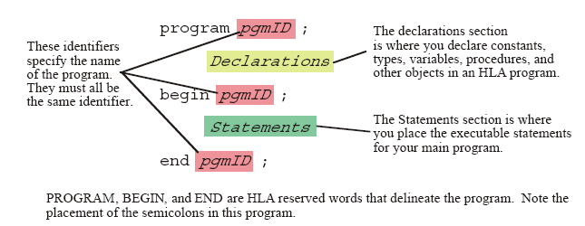
The Anatomy of an HLA Program

Slide 14
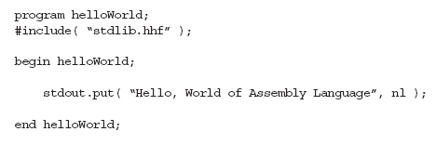
Hello World!!!

Slide 15
Declaring Integer Values

Slide 16
Declaring Boolean & Char Variables

Slide 17
References
Introduction to Operating Systems slides www.cs.pitt.edu/~mosse/cs1550/Slides/amer-intro.ppt
ICS-143 Introduction to Operating Systems www.ics.uci.edu/~ics143/lectures/oslecture1.ppt
Virtual Box Website www.virtualbox.com
HLA Assembly website http://homepage.mac.com/randyhyde/webster.cs.ucr.edu/index.html

