Slide 1
The Linux Command Line Chapter 7
Seeing The World As The Shell Sees It
Prepared by Dr. Reyes, New York City College of Technology

Slide 2
Expansion
echo – command that displays a line of text
echo can be combined with wildcards

Slide 3
Pathname Expansions

Slide 4
Tilde Expansion

Slide 5
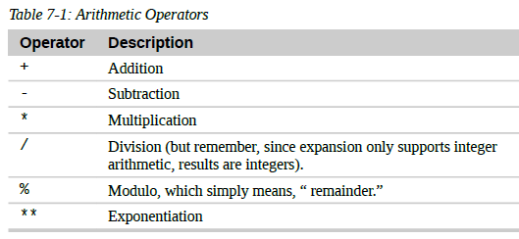
Arithmetic Expansion
Uses the form $((expression))
Operators supported:

Slide 6
Examples

Slide 7
Brace Expansion
Used to create multiple text strings from a pattern containing braces.
Examples:

Slide 8
Parameter Expansion
Given a variable, place a $ to retrieve its value
Example:

Slide 9
Double Quotes
Double quotes – when used, all the special characters used by the shell lose their special meaning and are treated as ordinary characters except for “$”, “\” (backslash), and “`” (backquote).
Examples:

Slide 10
Single Quotes
Single quotes – used to suppress all expansions
Example double vs. single quotes

Slide 11
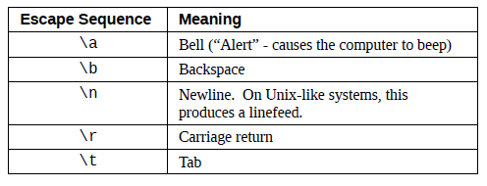
Escape Characters
Escape character – use the backslash “\” before “$”, “!”, “&”, “ ”, and other characters with special meaning.
Other escape sequences

