Slide 1
The Linux Command Line Chapter 17
Searching for Files
Prepared by Dr. Reyes, New York City College of Technology

Slide 2


locate Command
locate – command that performs a rapid database search of pathnames, and outputs every name that matches a given substring.
Example:
Example:

Slide 3
find Command
find – command used to search a given directory (and its subdirectories) for files based on a variety of attributes.
Example:

Slide 4
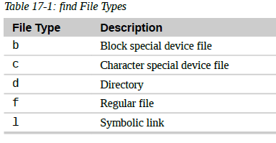
Using –type
-type – used to perform a test and return certain file types according to the following table:

Slide 5


Examples using -type
Example that only look at directories:
Example that only look at regular files

Slide 6
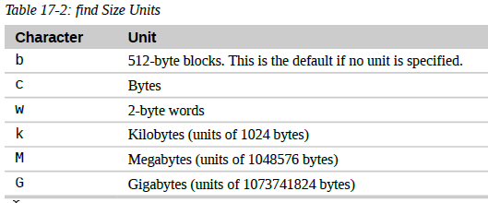
find -size
-size – an option that allows you to search for files based on their size according to the following table:
Example:

Slide 7
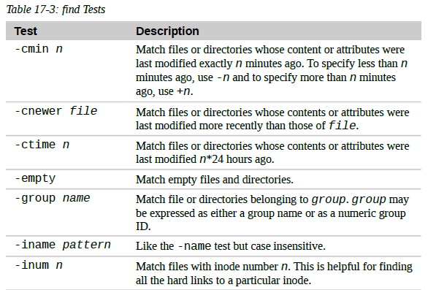
Other tests supported by find
…

Slide 8
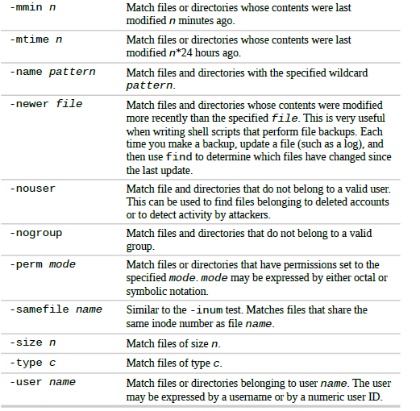

Slide 9
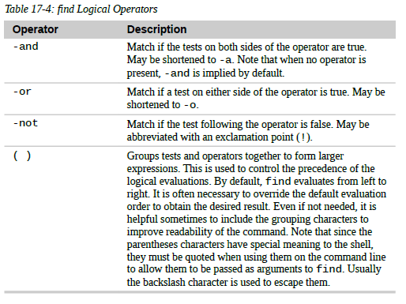
find Logical Operators

