Slide 1
Cypress Hill Dialysis Center
“Where your well-being is our focus.”
Chamirah Farley, RN
Tiffany McLeod, RN
Mingjie Gong, RN
Viktoriya Allakhverdov, RN
Chinweokwu Enekwechi, RN
Ivan Giannou, RN

Slide 2
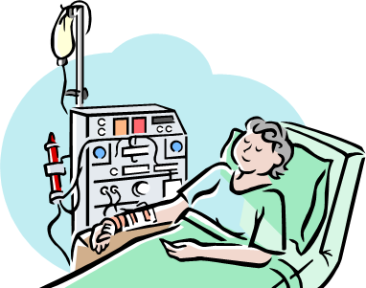
Mission
It is the mission of Cypress Hill Dialysis Center to provide and ensure the highest quality of care for all individuals from various walks of life who require the most advanced comprehensive and individualized dialysis treatment.

Slide 3
Mission Cont’d
This center offers an extremely safe, and culturally competent environment, as well as a welcoming atmosphere, that fosters the knowledge needed for the most positive improvements in well-being.

Slide 4
Mission Cont’d
The goal at our center is to equip our patients with the fundamental tools needed for them to play an active role in their care. Here, at Cypress Hill Dialysis, your well-being is our focus.

Slide 5
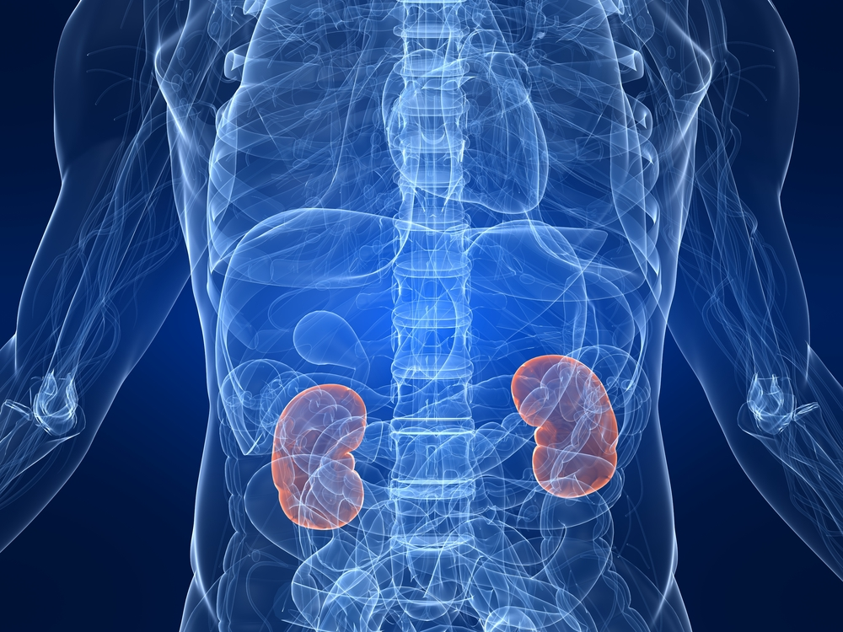
Vision
Cypress Hill Dialysis Center is committed to being a leader in advanced nephrology nursing practice.

Slide 6
Philosophy
Improving quality of life
Educate and support patients to have an active role
Collaborative approach
Safety and health
Compassion, concern, understanding
Dignity, respect
Cultural diversity
Effective communication

Slide 7
Objectives
Optimize patient care and outcome
Provide safe dialysis and minimize treatment related complications for all individuals
Improve access to information
Improve independence and quality of life through utilization of self-care

Slide 8
Structure of Staff Meetings
At staff meetings, we will:
Communicate
Plan
Connect

Slide 9
Agenda
The 3 D’s
Decision
Direction
Discussion

Slide 10
Organizational Structure
Chief Nursing Officer of Patient Care Services
Staff RN
Staff RN
Staff RN
Staff RN
Nurse’s Aide
Nurse’s Aide
Nurse’s Aide
Nurse Manager
Unit Clerk

Slide 11
Democratic Style of Management
Aka “participative” style
Competent team works
together for long periods
Input takes time but consensus improves compliance
Promotes AUTONOMY and personal growth
Leaders may still solve small problems alone

Slide 12
Orienting New Staff
Place RN within appropriate role in unit to maximize success
Begin employee indoctrination as soon as position is accepted
Familiarize with organization AND unit
Don’t assume somebody else will “fully” orient an employee

Slide 13
Developing Current Staff
Lowers employee turnover, maximizes skill usage, and keeps practices current
Provide ample access and info for development opportunities
Assess individual skills, strengths, and potentials
Give realistic support and encouragement
Develop policies which make development feasible

Slide 14
Employee Evaluation Tool
The nurse manager will gather data using:
Direct observation
Interviews
Surveys

Slide 15
Budget and Staffing Pattern Center opens: 7AM to 11PM, Monday to Friday
Based on 8 hours
RN’s
ADC = 20
Ratio = 1:5
4 RN’s X 7.5 hours=30/ADC (20)= NCH =1.5 X 2 (shifts: day and evening)= NCHPPD = 3
RN’s needed to staff unit= 4 X 2 (shifts) = 8 RN’s per day
Nursing assistants
ADC = 20
Ratio = 1:7
3 NA’s X 7.5 hours= 22.5/ADC (20)= NCH= 1.125 X 2 shifts= NCHPPD = 2.25
NA’s needed to staff unit = 3 x 2 (shifts) = 6 NA’s per day
Total NCHPPD = 5.25

Slide 16
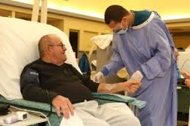
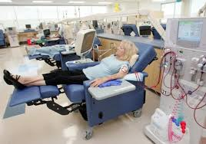
Budget and Staffing Pattern Cont’d
Unit Clerks
1 UC X 2 shifts = 2 UC per day
PTO = 1.6
RN = 1.6 X RN’s needed (8) = 12.8
NA = 1.6 X NA’s needed (6) = 9.6
UC = 1.6 X UC’s needed (2) = 3.2
RN salary = $80,000 X 12.8 = $1,024,000
NA salary = $38,000 X 9.6 = $364,800
UC salary = $32,000 X 3.2 = $102,400
Total staffing budget = $ 1, 491, 200

Slide 17
Location of Cypress Hill Dialysis
We considered:
Race
Age
SES
Availability of other dialysis centers in the area
Availability of train station nearby
Incidence of ESRD in the area

Slide 18
Area Without Dialysis Centers

Slide 19
Cypress Hill, Brooklyn, NY 11208

Slide 20
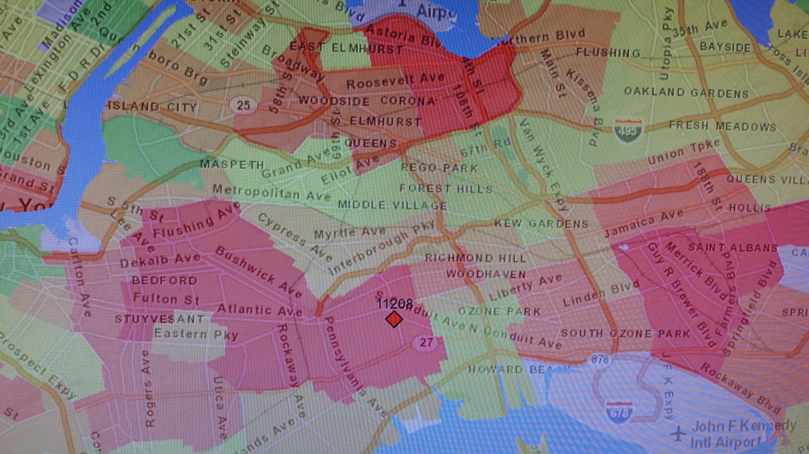
Incidence of ESRD in the area
Red color = high incidence of ESRD
Green color = lower incidence of ESRD

Slide 21
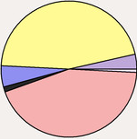
Demographics of Cypress Hill
White population: 1,973
Black population: 39,761
Asian population: 7,772
Hispanic or Latino population: 40,645
Black
White
Asian
Some other race
Hispanic

Slide 22
ESRD Incidence By Race
ESRD incident rates are more than three times higher for African Americans than for Caucasians.
African American rates rose more quickly than rates for all other races.
Hispanics are about one and a half times more likely to develop ESRD than non-Hispanics.

Slide 23
Socioeconomic Status
Estimated median household income in 2011:
$35,437 (New York $55,246)
Residents with income below the poverty level in 2011:
31.0% (New York 16%)

Slide 24
Income for Cypress Hill

Slide 25
How are SES and ESRD Related?
In all sex-race groups, the incidence of ESRD was greatest in those in the lowest SES score quartile.
The incidence of ESRD decreased progressively with higher SES.

Slide 26
How will we inform our target group?
Target group: Black and Hispanic middle aged to older adults of low SES in need of dialysis.
Website
Pamphlets in local medical offices
Ads in free medical magazines
Ads in the local newspaper
Bus and subway ads

Slide 27
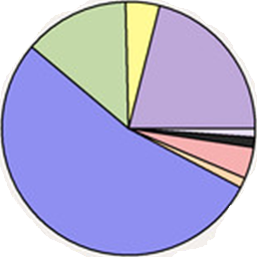
Means of Transportation
Carpooled
Bus
Drove a car alone
Other
Worked at home
Walked
Railroad
Subway or elevated

Slide 28
Problems ESRD Patients Face
Hematologic
Cardiovascular
Sensory
Motor
Metabolic
Fluid and Electrolyte
Vascular Access Care

Slide 29
Quality Indicators
Based on symptom management
Our aim is to ensure that all patients can live the highest quality of life possible

Slide 30
Computerized Clinic: Advantages
Secure
Reduces redundancy
Manages waste
Accessibility
Facilitates communication
Improved documentation

Slide 31
Computerizing Cypress Hill Dialysis
Comprehensive system
Connection from dialysis machine to clinical data system
Inventory and purchasing
Storing important contact info
Automatic lab order transmission
Internet access for patients

Slide 32
Considerations when computerizing the clinic
Cost
Computer skills of nurses
Software/system collaboration
Maintenance, replacement

Slide 33
References
Centers for disease control and Prevention, 2014 National Chronic Kidney Disease Fact Sheet (2014). http://www.cdc.gov/diabetes/pubs/factsheets/kidney.htm
Dadi, D. (2014). Changes in dialysis in the past 30 years -- The Experience of a Nephrology Nurse and Patient. Nephrology Nursing Journal, 41(2), 209-216.
Kammerer, J., Garry, G., Hartigan, M., Carter, B., Erlich, L. (2007). Adherence in Patients on Dialysis: Strategies for Success. Nephrology Nursing Journal, 34 (5), 479-486.
Marquis, B. L., Huston, C.J. (2012). How organizations work. Leadership and Management Tools for the New Nurse: A Case Study Approach. p. 165
Marquis, B. L., Huston, C.J. (2012). Making the most of interviews. Leadership and Management Tools for the New Nurse: A Case Study Approach. p. 240-243
NIDDK National Kidney and Urologic Diseases Information Clearinghouse (NKUDIC) (2012). http://kidney.niddk.nih.gov/kudiseases/pubs/kustats/#1
Peters, A. (2014). Safety issues in home dialysis. Nephrology Nursing Journal, 41(1), 89-92.
Yun, S., & Lee, Y. (2012). Factors Influencing Uncertainty in Dialysis Patient by Duration of Dialysis. Korean Journal Of Adult Nursing, 24(6), 597-606. doi:10.7475/kjan.2012.24.6.597

