Slide 1
-Chinatown A little history…
Chinatown is home to one of the city's most interesting museums, the Museum of Chinese in America, and a modern dance troupe, Chen Dance Center. You could say that both derive their creative energy from the same mixture of East and West that makes Chinatown so special.
With anti-Chinese violence mounting in the West, Chinese immigrants arrived in significant numbers in the New York area in the late 1870's. Discrimination forced immigrants into low-status service jobs in restaurants and hand laundries.

Slide 2
The Chinese Exclusion Act in 1882
It prohibited laborers and their families from entering America and immigrants already in the country from obtaining citizenships.
The absence of women and children turned the community into a ""bachelor society."" It was the first and only racially based legislation in U.S. history. The Exclusion Act was repealed 60 years later in 1943 when China and the U.S. became allies in World War II.
It was out of limited opportunities that some merchants began to encourage tourism in Chinatown. If they could not get jobs outside of Chinatown, why not bring outsiders into the community?

Slide 3
Hotels in Chinatown

Slide 4
Promoting Chinatown Rooftops

Slide 5
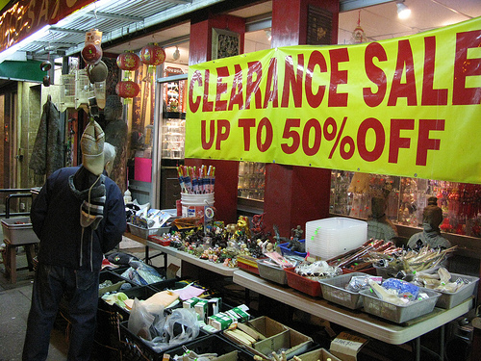
Chinatown Calendar of Events

Slide 6
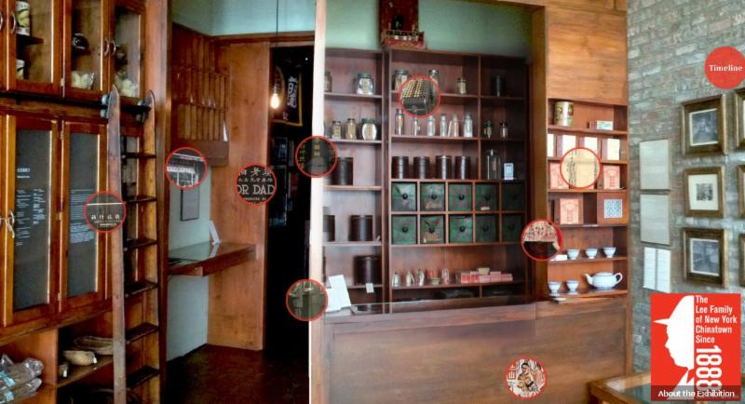
The First Chinese House

Slide 7
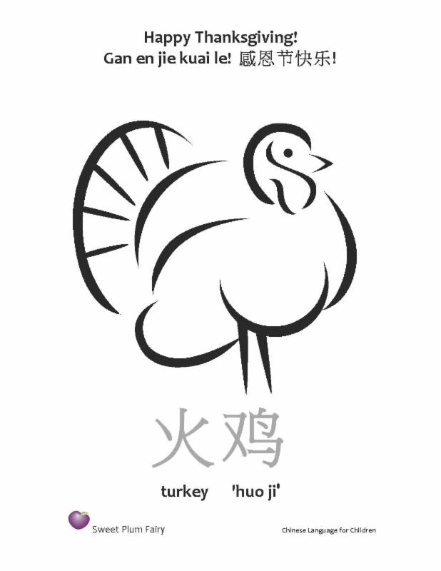
News & Events in Chinatown:

Slide 8
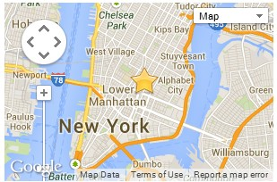
Lower Manhattan Public Engagement Event
The public is invited to come learn about the NY Rising Community Reconstruction Program and to share their ideas with the Planning Committee.
Come share your ideas for projects and strategies to make our community more resilient.
How can we increase the resiliency of small businesses?
How can we better protect vulnerable populations in future emergency events?
How can we better prepare our community for an emergency?

Slide 9
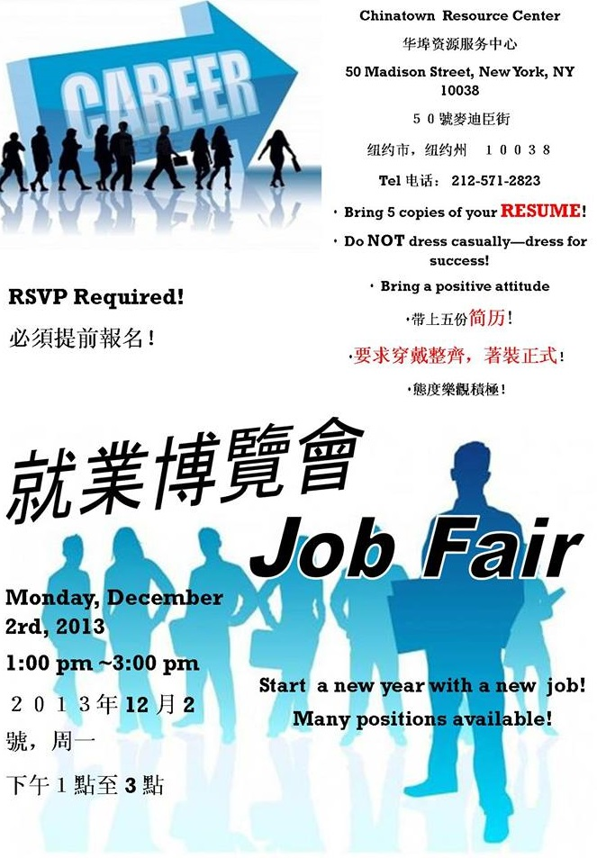

Slide 10
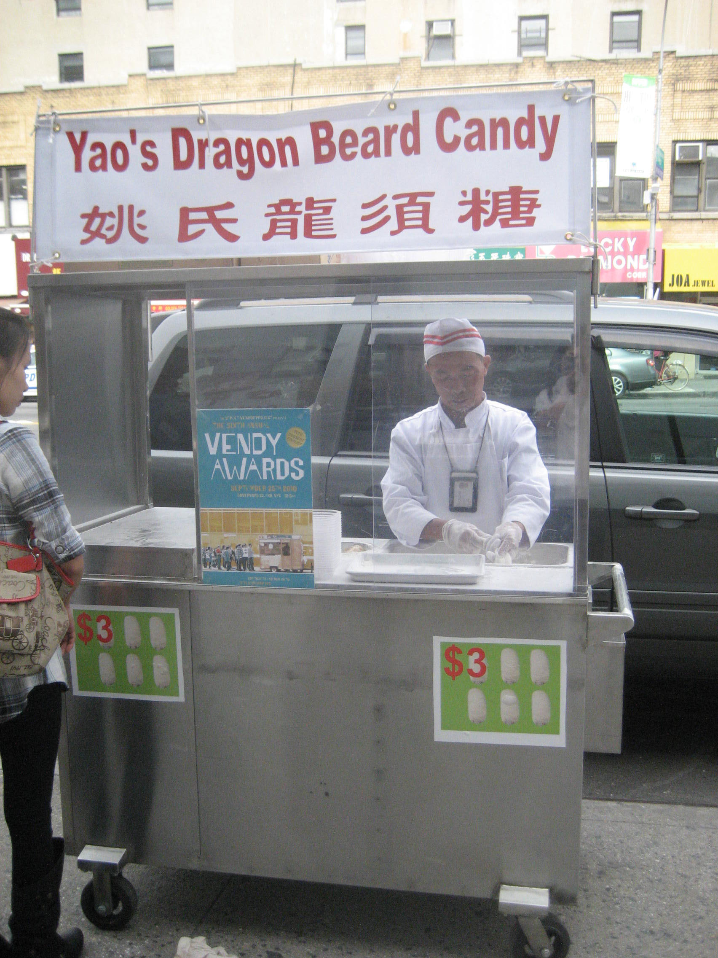
Yao's Dragon Beard Candy (long tzi tang)
You can catch Mr. Yao, a 2010. Award Winner 2010.

