Slide 1
Steve Jobs
Marco V escobar
New York City College of Technology
Professor Thelma Bauer
CDMG 1111, Section 313

Slide 2
Why did you select this person ?
I chose Steve Jobs because he deserves to be consider one of the most influential people in the technology arena. His vision has generated changes far beyond the phone industry and have put a remarkable mark in the general culture.
Steve is not the only tech businessperson who has created a big revolution in the technology field. However, I personally consider him one him one of the biggest influential people for CDMG.

Slide 3
How does Steve jobs success relate to cdmg?
Steve Jobs was a creative genius who revolutionized the music, movies and smartphones industries. He developed a platform for others to create and distribute applications that other people can use to innovate and change the world. This is his greatest contribution to CDMG.

Slide 4
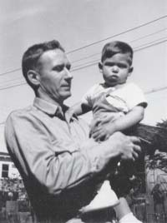
Briefly discuss his life. Who was Steve JObs
(Steve Jobs, San Francisco, 1955 - Palo Alto, California, 2011) Computer scientist and American businessman.
Father of the first personal computer and founder of Apple Computer, probably the most innovative company of the sector, this computer magician was one of the most influential of the high technological growth in which the world today still lives, contributing decisively to the popularization of the informatics.
His visionary ideas in the field of personal computers, digital music or smartphones technologies revolutionized the stock markets and habits of millions of people for more than three decades.

Slide 5
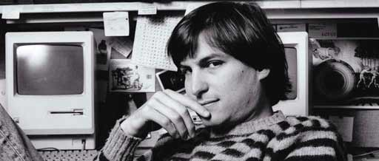
His parents, two university students without money to support him, gave little Steve in adoption to the marriage formed by Paul a railroad driver and Clara Jobs housewife. The Jobs Family lived since 1961 in the city of Mountain View in California which is an important center of the US electronics industry.
Many people assure that there is no doubt that the local environment in the city influenced Steve’s future professional inclinations.
When he was only twelve years old, joined the Hewlett-Packard Explorer Club, a youth association where Hewlett-Packard engineers taught children and young people the latest creations in the field of informatics.
Steve Jobs finished his high school and entered on the Reed College which was a liberal arts college based in Portland, Oregon, but dropped out of college a semester later.
Time later, after practices at the Hewlett-Packard company in Palo Alto, in 1974 Jobs was hired as a designer by Atari, a pioneer company of the video game industry.

Slide 6
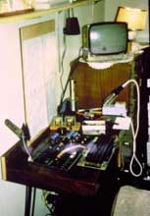
Steve Job’s accomplishments
Steve Jobs is famous to be the Co-founder of Apple. The company was born when he joined his first partner the engineer Stephen Wozniak.
Jobs and his new partner in business in 1976, with the money obtained for the sale of his Volkswagen van, they founded the company Apple Computer which based in the garage of the family Jobs.
There they created the first an imaginative motherboard and then a complete computer called the Apple I, considered the first personal computer in history.

Slide 7
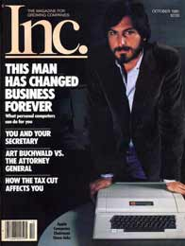
In 1977, Steve Jobs developed The Apple II which was an improvement of the previous model. This became the first computer of massive consumption. After an impressive number of orders, Apple happened to be the company of greater growth of the United States.
This is the reason why tree years later, Apple was launch in the stock market with a price of $ 22 per share, making Jobs and Wozniak millionaires.
After the Apple II, Jobs and Wozniak launched the Macintosh in 1984 which was a great innovation since it was a graphic interface with excellent and friendly design that simulated a desktop, and the introduction of the mouse to perform the functions doing Click on the icons, windows and option menus that were opened on the screen.
Jobs made a great contribution to the introduction of personal computers in education.
The personal conflicts between Jobs and Wozniak ended up with the resigned of Wozniak from Apple in 1985. At that time 1,200 employees were laid off as a result of an extensive restructuring in the company, Jobs resigned as well to undertake a new business venture alone.

Slide 8
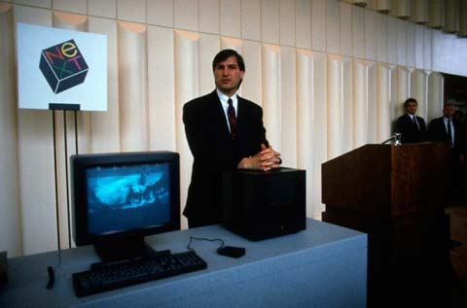
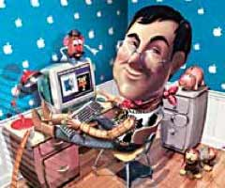
NeXT Computer y Pixar
Steve Jobs founded a new computer company named NeXT Computer in 1985, and in 1986 took another step in creating the Pixar Animation Studios, focusing on the computer production of cartoon films. They created movies like Toy Story, Monsters Inc. and Finding Nemo as part of the best-selling productions. On the other hand, his prior company had difficult times because IBM produced computers much more inexpensive.

Slide 9
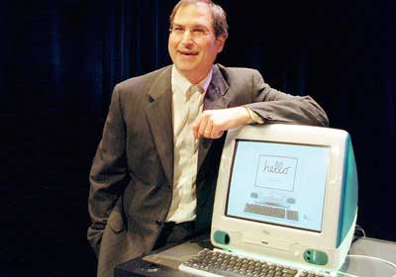
Jobs backs to Apple
Apple decided to buy NeXT Computer in December 1996, which meant the return of Steve Jobs to the company by him founded with a position of interim adviser. Nine months later after the resignation of the president of Apple, Steve was the head of the company again. During this second stage at Apple.
Steve Jobs continued on its revolution line, driving absolutely innovative products. When Jobs assumed the presidency of Apple again in September of 1997, the battle seemed lost against all its competitors. However, in 2012 a year after his death, Apple had become the most valuable company in the world: the global listing of its shares on the stock market was around 600 billion dollars.

Slide 10
In 1998, just a year after his return, Steve Jobs again revolutionized the computer market with the launch of the iMac, a compact computer integrated into the monitor, which in addition to its spectacular modern design was prepared to surf the Internet. As if the world of the personal computer had stayed too small for him, Jobs soon happened to unfold its infinite inventiveness in other areas.
Steve’s first innovation touched the digital music. He landed in 2001 in the music sector with a pocket audio player, the iPod, and two years later he created the iTunes Music Store, which immediately led the online music sales and continues to maintain his position dominant.
Unfortunately, his health problems forced him to temporarily withdraw from his work in 2004, when he was treated for pancreatic cancer.

Slide 11
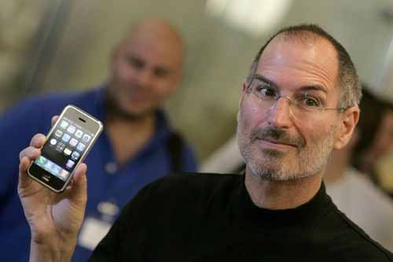
Steve Jobs at the iPhone presentation in 2007
Jobs introduced the iPhone in 2007. This was the first of the family of smartphones produced by Apple.
This smartphone was declared "invention of the year" by Time Magazine. Initially, it had a small number of applications, provided by Apple, but the demand for more programs by users led to the creation of the App Store in July 2008, an app store where all kinds of developers could sell software designed for The iPhone and other devices manufactured by the company.

Slide 12
The iPhone was soon imitated and Google that same year launched in the market Android which is a mobile operating system. Apple since then presents its dominant position in technology. It was also very well known by public that in the very near future, most Internet connections would be made from mobile devices.

Slide 13
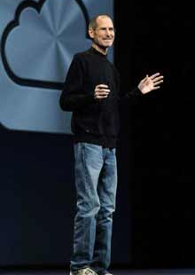
Steve Jobs in 2009 had to undergo a liver transplant which is why he delegated most of his responsibilities to Timothy Cook. Jobs despite his visible deterioration of his health never reduced his commitment to work and his innovative enthusiasm.

Slide 14
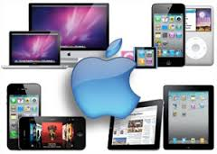
Steve’s creativity was intact still in 2010 and surprised the world with the iPad which is a tablet hybrid and mobile phone. Later, Steve Jobs introduced the second version, the iPad 2, in March 2011, in which it would be one of his last public appearances.

Slide 15
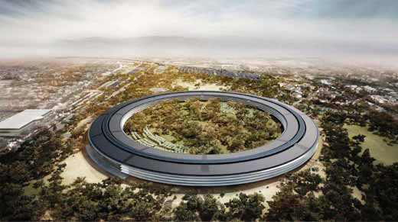
The future Apple spaceship campus
On October 5, 2011, at age 56, he died at his Palo Alto home, a victim of cancer progression that had been detected in 2003.

Slide 16
Bibliography
Biography.com Editors. “Steve Jobs Biography.” The Biography.com. Ed. A&E Television Networks. 24 Sep. 2015. 1 Dec. 2016 < http://www.biography.com/people/steve-jobs-9354805>
Entrepreneur Staff. “Steve Jobs: An Extraordinary Career.” Entrepreneur.com. Ed. n/a. n/a. 3 Dec. 2016 < https://www.entrepreneur.com/article/197538>
Gladwell, Malcolm. “THE TWEAKER The real Genius of Steve Jobs.” NewYorker.com. Ed. Malcolm Gladwell. 14 Nov. 2011. 3 Dec. 2016 < http://www.newyorker.com/magazine/2011/11/14/the-tweaker>
Isaacson, Walter. “The Real Leadership Lessons of Steve Jobs.” Hbr.org. Ed. Walter Isaacson. Apr. 2012. 3 Dec. 2016. < https://hbr.org/2012/04/the-real-leadership-lessons-of-steve-jobs>
Markoff, John. “Apple’s Visionary Redefined Digital Age.” nytimes.co. Ed. John Markoff 12 Oct. 2011. 3 Dec. 2016 < http://www.nytimes.com/2011/10/06/business/steve-jobs-of-apple-dies-at-56.html>
Moisescot, Romain. “Short Bio.” Allaboutstevejobs.com. Ed. Romain Moisescot. 7 Mar. 2012. 1 Dec. 2016 < http://allaboutstevejobs.com/bio/shortbio.php>
n/a. “Remembering Steve.” Apple.com. Ed. n/a. n/a. 2 Dec. 2016 <http://www.apple.com/stevejobs/>

