Slide 1
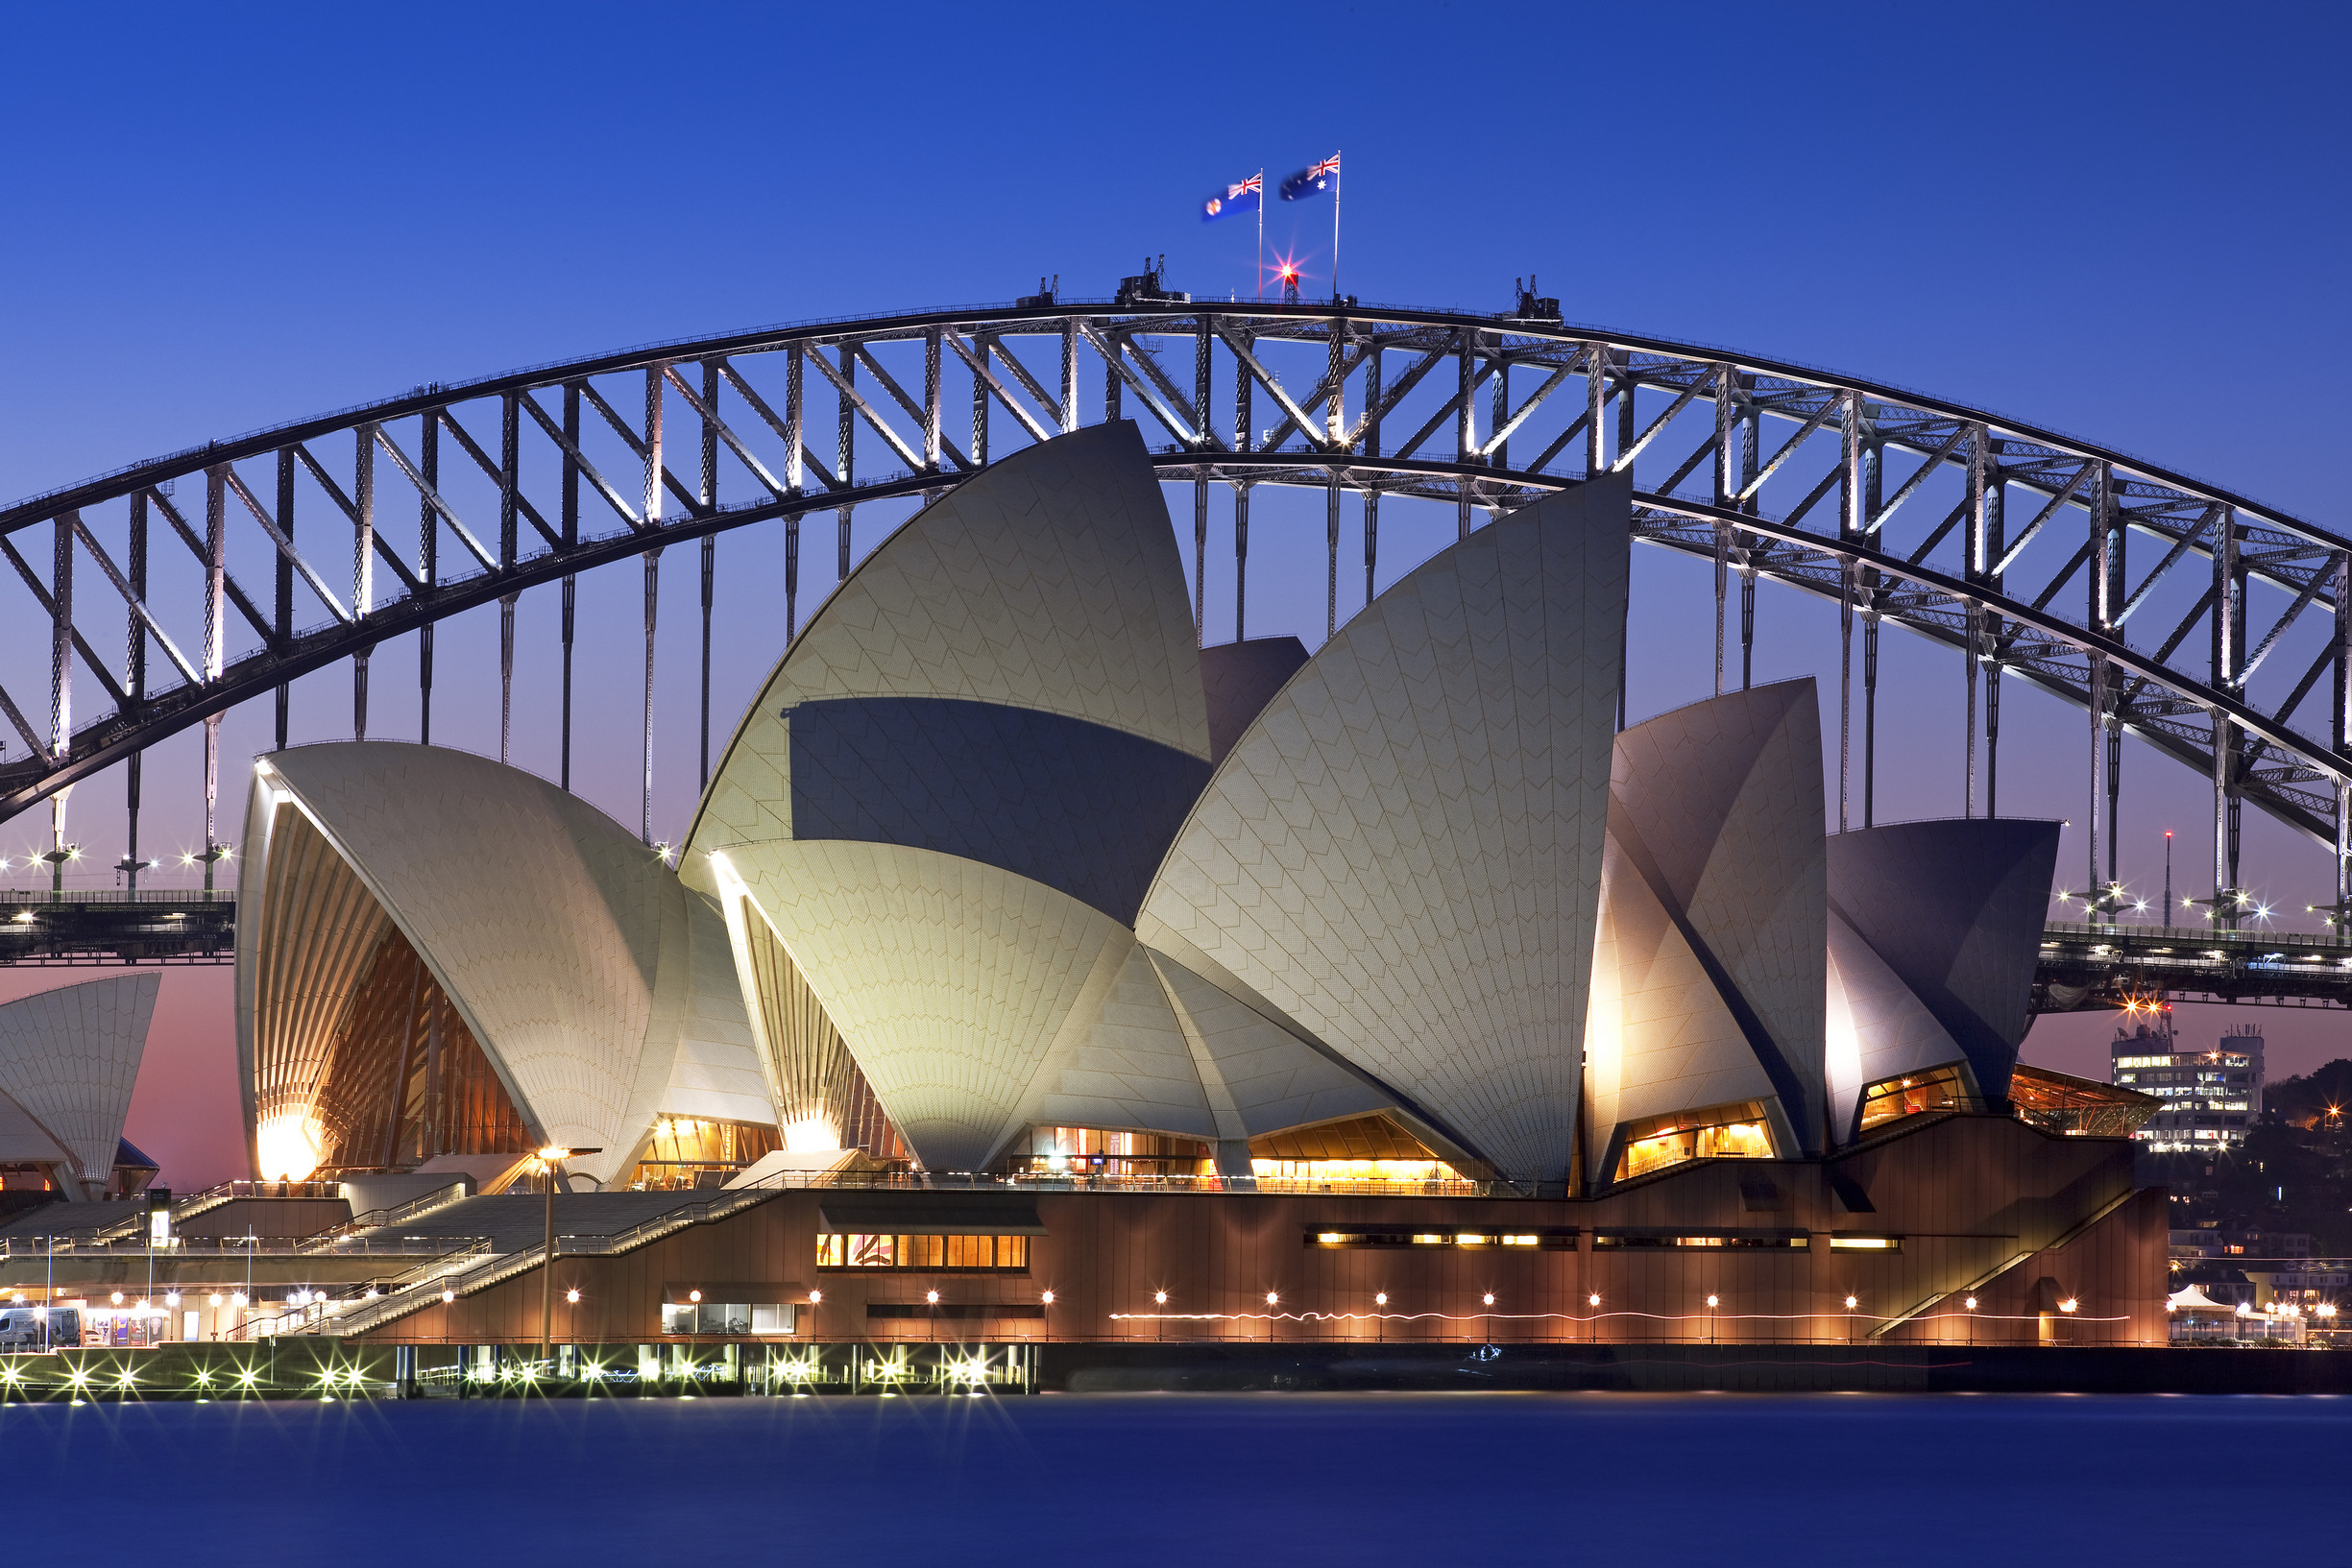
THIN SHELL STRUCTURES

Slide 2
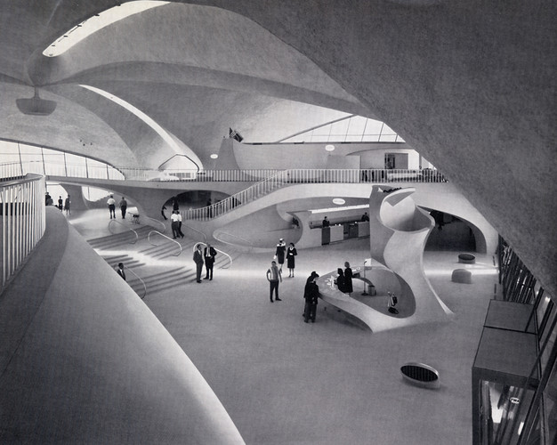
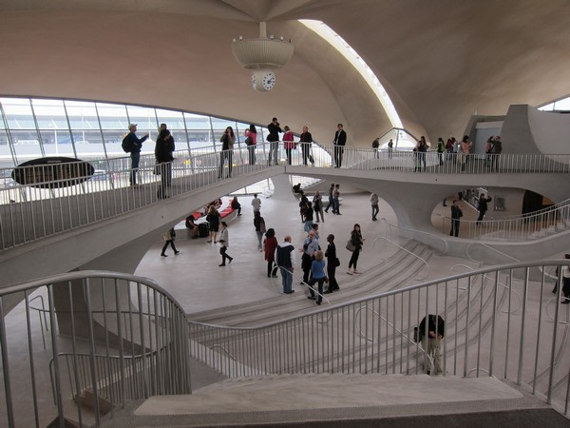
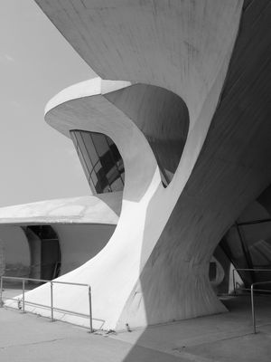
THIN SHELL STRUCTURES
SYSTEM SPANS AND EFFECTIVE SPANS

Slide 3
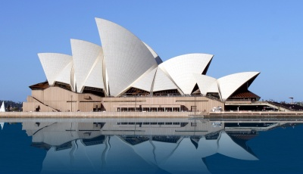
- The Sydney Opera House spans up to 164 feet.
- The arches are supported by over 350km of tensioned steel cable.
- The shell thickness goes from 3 to 4 inches.
- All Shells weight a total of 15 Tons.
THIN SHELL STRUCTURES
SYSTEM SPANS AND EFFECTIVE SPANS

Slide 4
- Consists mostly of # of labor.
- Concrete usually takes up to 28 days to cure if there is perfect temperature.
- Cost for a cubic yard is about $75.00
- Average construction workers, $16.73/Hr
- Average cost for Rebar including installation is $0.82/Sq foot
- The rest depends on the time to finish construction.
THIN SHELL STRUCTURES
CONSTRUCTION TIME AND COST

Slide 5
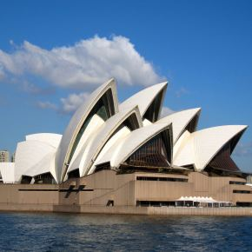
Finishes
Actual clay, brick, and stone veneer
Granite or Marble Cladding
Exposed aggregate finish
Sand Blasted Finish
Form Liner Patterns
- The Sydney Opera house uses white glazed granite tiles.
1,056,000 tiles were used to cover the massive structure.
THIN SHELL STRUCTURES
ARCHITECTURAL FINISHES AVAILABLE

Slide 6
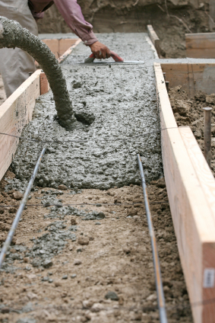
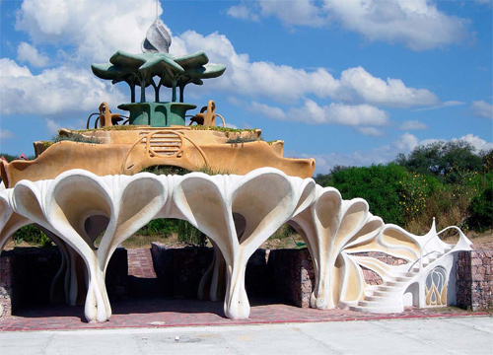
CONCRETE CONSTRUCTION IS VERSATILE, THERE’S NO LIMIT IN THE DIVERSITY OF FORMS YOU CAN CREATE. SINCE CONCRETE WHEN FIRST POURED INTO THE WOODEN FORMWORK IS SLURRY, IT GIVES YOU FLEXIBILTY WORK WITH IT SO IT CAN TAKE ANY SHAPE OR FORM
THE KIND OF STRUCTURES THAT CAN BE FORMED FROM THIN SHELL CONSTRUCTION ARE ROOF STRUCTURES. IT DOESN’T MEAN YOU’RE LIMITED TO DESIGN, ANY SHAPE CAN BE FORMED. THE MASSING IMPLICATIONS THESE CAN GIVE TO THE VIEWER IS THAT THEY’RE HEAVY WHEN IN REALITY IT’S LIGHT WEIGHT. THIN SHELL STRUCTURES CAN BE LESS THAN 2” THICK
THIN SHELL STRUCTURES
FLEXIBILTY OF THE SYSTEM DIVERSITY OF FORMS AVAILABLE

Slide 7
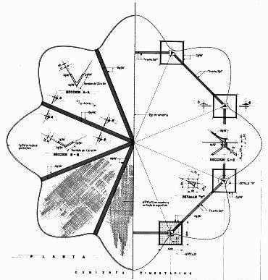
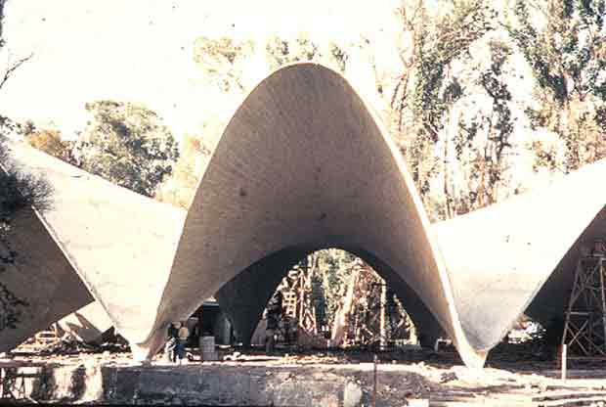
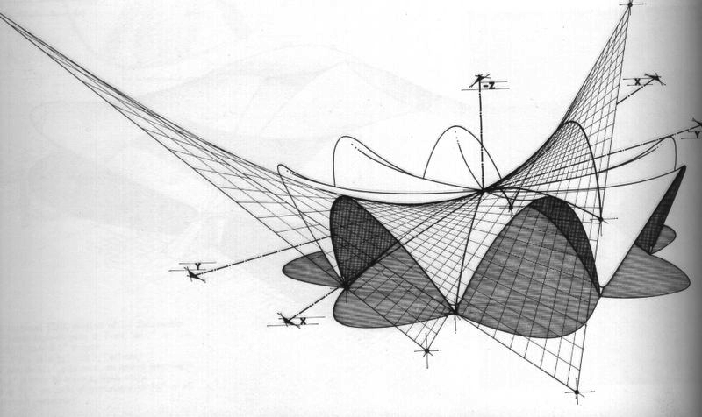
THIN SHELL STRUCTURES
CONNECTION DETAILS

Slide 8
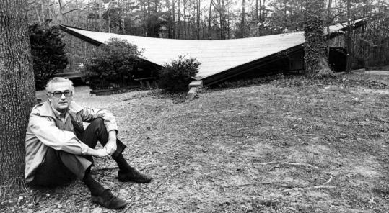
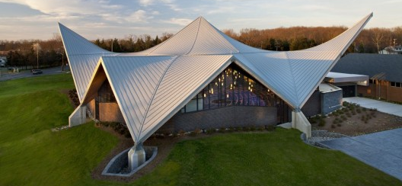
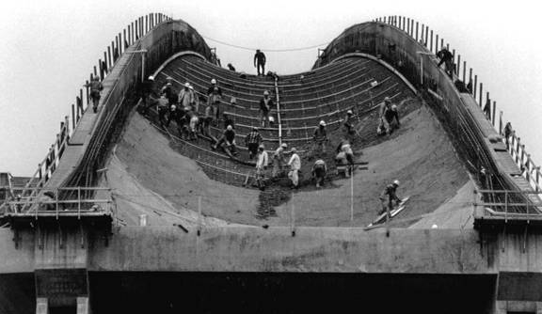
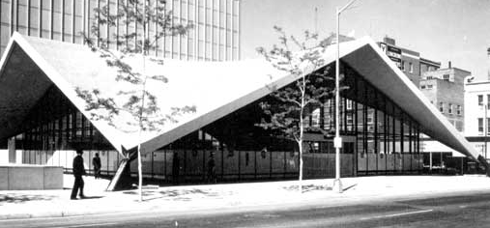
THE STRUCTURES USE AN UMBRELLA FOOTING TO SUPPORT THE LOADS BEING TRANSFERRED THROUGH THE HYPER BOLIC STRUCTURE
THIN SHELL STRUCTURES
CONNECTION DETAILS

Slide 9
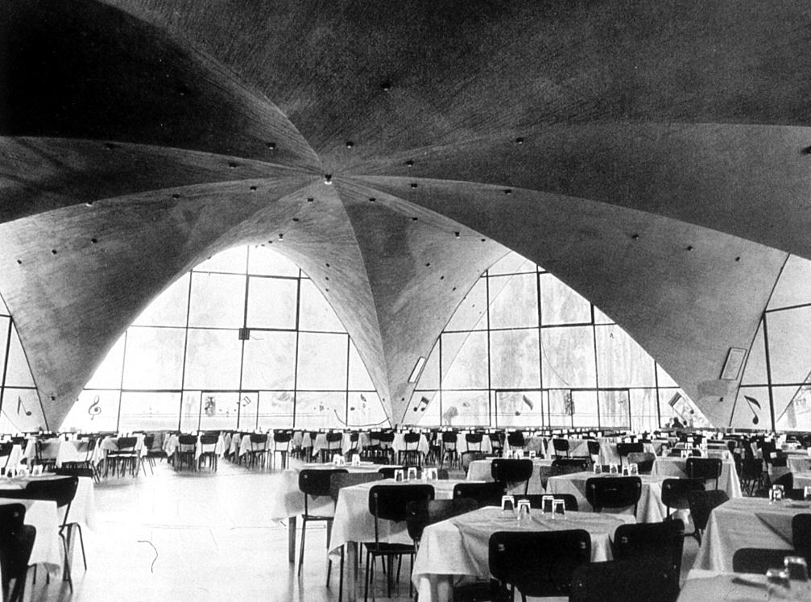
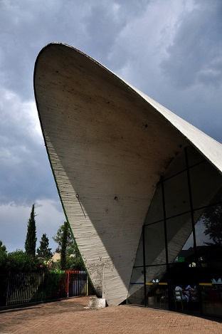
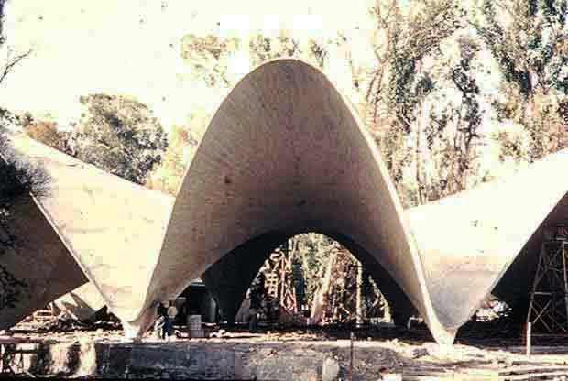
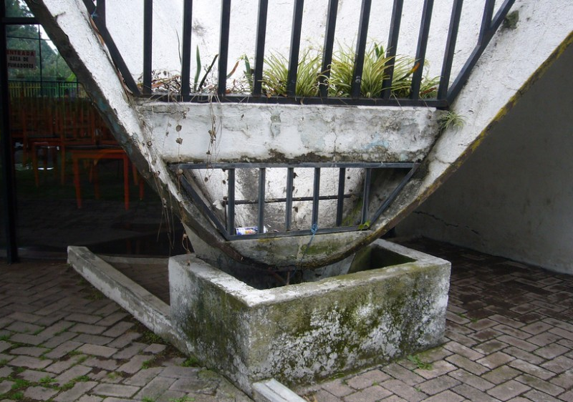
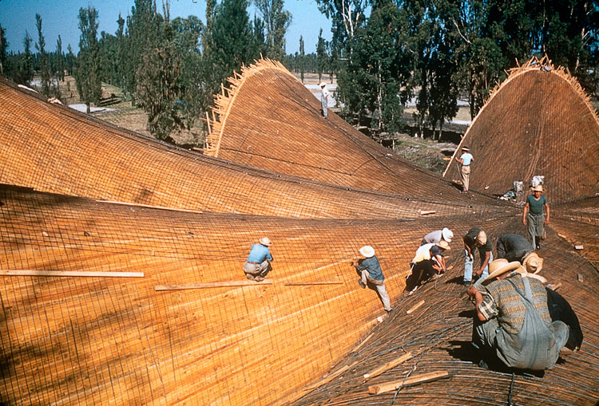
THIN SHELL STRUCTURES
CONNECTION DETAILS

Slide 10
STRENGTHS
WEAKNESSES
THE STRUCTURE STRENGTH COMES FROM THE HYPER BOLIC SHAPE WHICH DISTRIBUTES THE LOAD TO THE UMBRELLA FOOTING, NO NEED FOR COLUMNS
RESISTANT TO EARTHQUAKE
RESISTS LOADS THROUGH CURVATURE (ARCH)
CONCRETE IS STRONG IN COMPRESSION AND STEEL HAS TENSILE STRENGTH
FIRE RESISTANT
CONCRETE HAS GOOD WORK ABILITY TO FILL THE FORM/MOLD PROPERLY WITHOUT REDUCING THE CONCRETES QUALITY
CONCRETE HAS NO TENSILE STRENGTH
STEEL HAS NO COMPRESSION STRENGTH
IF NOT SEALED RIGHT WATER CAN GET THROUGH THE ROOF INTO THE INTERIOR
THIN SHELL STRUCTURES
SYSTEM STRENGTHS AND WEAKNESSES

Slide 11
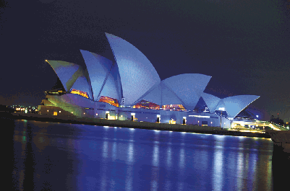
- Built by Jorn Utzon
- Covers an area of 606ft by 393ft
- Structure has 1000 rooms, 5 theaters, 5 Rehearsal Studios, 2 Main lobbies and 6 Bars.
- Total cost was first estimated at $8 million for a 4 year completion period.
- Final cost was $102 million at a 14 year completion period.
THIN SHELL STRUCTURES
THE SYDNEY OPERA HOUSE

Slide 12
CASE STUDY: FELIX CANDELA “LOS MANANTIALES”
Los Manantiales was built in Mexico City, the concrete system used was the thin shell system. This particular system was used because los Manantiales was supposed to be a restaurant and the program required for seating for 1,000 people. Thin shell structures allow wide areas to be spanned without the use of internal support such as columns. Which help maximize the floor space. In the area where los Manantiales was being built was prone to earthquakes. Thin shell construction is relatively resistant earthquakes, floods and other natural disasters that may occur.
THIN SHELL STRUCTURES
LOS MANANTIALES

