Slide 1
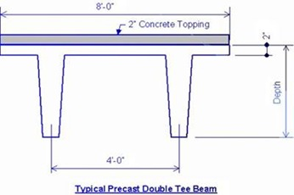

Slide 2
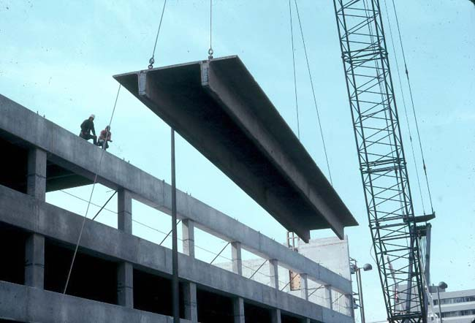
Benefits of Precast Double Tee System
Maximum durability and structural strength
Low maintenance
Excellent for fast-track construction
Can be manufactured and erected during inclement weather
Provides superior loading and clear spans
Cuts overall construction costs

Slide 3
Disadvantages of Precast Double Tee System
Cracking over time
Over sized pieces can be hard to transport, thus increasing construction cost
Connectors have to be sealed properly to avoid water damage over time
Shear walls/frames are located at the façade, which may cause a conflict with the looks.

Slide 4
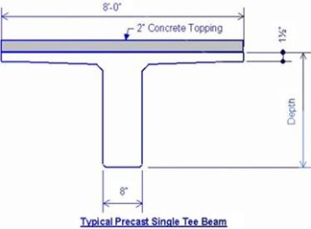

Slide 5
Advantages of Precast Single Tee System

Slide 6
Disadvantages of Precast Single Tee System

