Slide 1

Site Cast Concrete slab and beam
STERLING ADAMES
NOEMI ROVIROSA
SEAN MERCADO

Slide 2
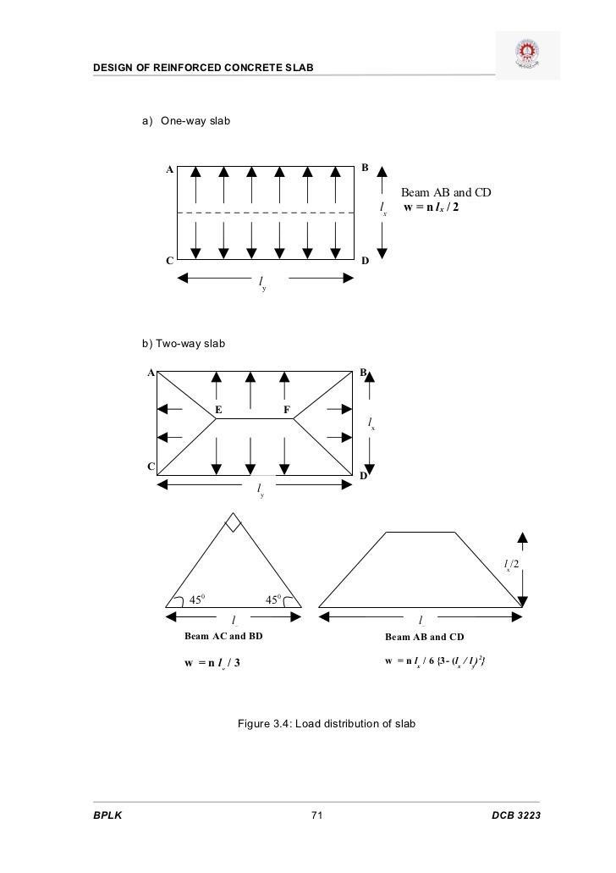
CONCRETE SLAB
REINFORCE CONCRETE SLAB ARE TYPICALLY USED IN NEW YORK CITY FOR FLOORS, ROOF AND WALLS OF BUILDING AS WELL AS DECK OF BRIDGES.
IT HAS MANY FORMS SUCH AS SOLID SLAB, RIBBED SLAB OR PRE-CAST UNITS.
IT CAN SPAN IN ONE DIRECTION OR TWO DIRECTIONS.
REINFORCE CONCRETE SLAB CAN BE DESIGNED IN ONE WAY OR TWO WAY

Slide 3
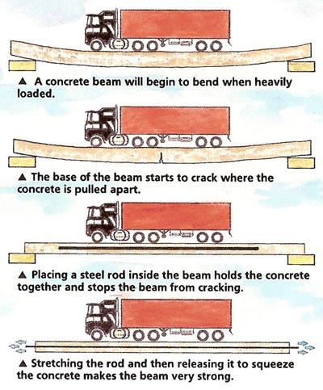
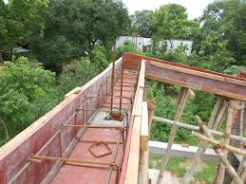
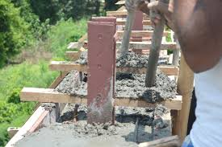
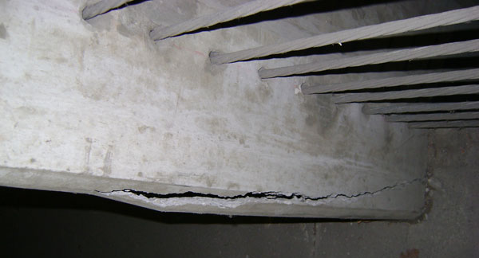
SITE CAST CONCRETE BEAM
Site cast concrete beam are commonly use for parking structures.
A concrete beam will begin to bend when heavily loaded. In addition, it would crack on the middle.
All this could be fix by placing steel rod inside the beam that holds the concrete together, preventing the beam from cracking.
The beams are most often affected by the flow of water that gets through expansion or constructions joints.
A crack beam on a parking structures.
The shuttering for the upper ring-beam, ready to be cast

Slide 4
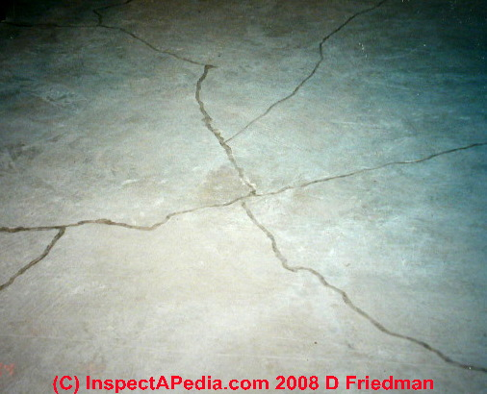
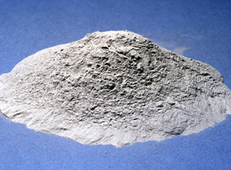
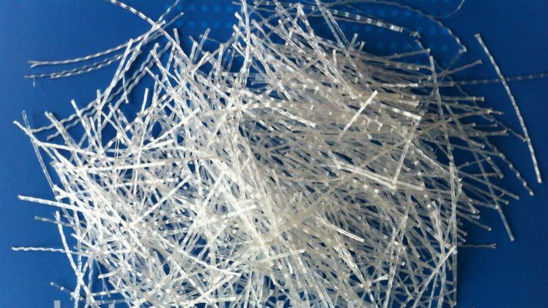
CONCRETE STRENGHTS AND WEAKNESSES
**CONCRETE IS WEAK IN TENSION AND EXCELLENT IN COMPRESSION.**
CONCRETE IS KNOWN TO CRACK,HOWEVER CONCRETE CAN BE MANIPULATED TO REDUCE
CRACKING BY ADDING ADMIXTURES SUCH AS FLY ASH, FIBER STRANDS AND MORE. ALSO IF WE LOWER THE WATER RATIO WE CAN REDUCE THE SHRINKAGE AND RESULT A STRONGER AND MORE CRACK RESISTANCE MIX
ALSO WATER CAN SIP THROUGH CONCRETES HOLE AND CRACK, FREEZE AND WILL DO DAMAGE TO THE CONCRETE BEAM OR SLAB
FLY ASH
FIBER STRANDS
CRACK SLAB

Slide 5
Advantage and disadvantage of site cast concrete
ADVANTAGES:
SITE CAST CONCRETE HAS A LOT OF RESISTANT TO STRUCTURAL DAMAGE SUCH AS EARTHQUAKE, FLOOD AND OTHER NATURAL DISASTER
PROVIDES HIGH DEGREE IF INSULATION
FIRE PROOF MATERIAL
HIGHLY VERSATILE - CAN BE SHAPED OR USED IN DIFFERENT CONSTRUCTION TYPES
DISADVANTAGES:
CAST CONCRETE IS HIGHLY MAINTENANCE (LABOR)
IT’S MESSY AND CAN SPLATTER WHEN POURED – ENDANGERING NEARBY SURFACES
TIME CONSUMING
QUALITY IS UNCERTAIN

Slide 6
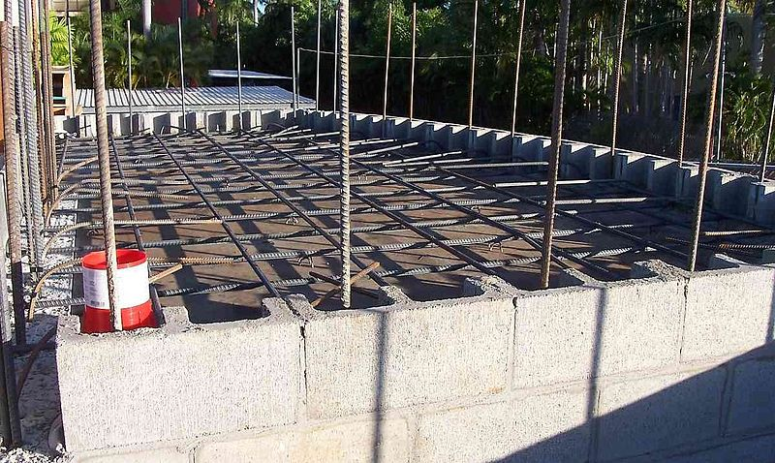
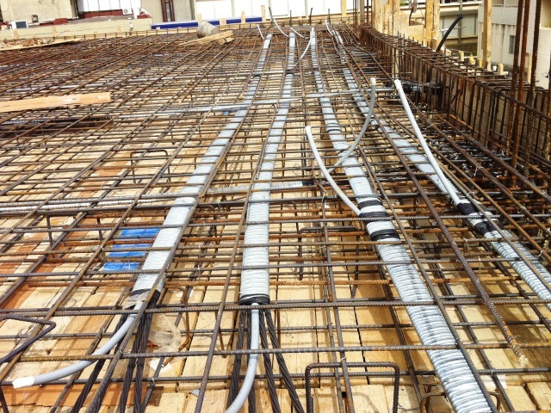
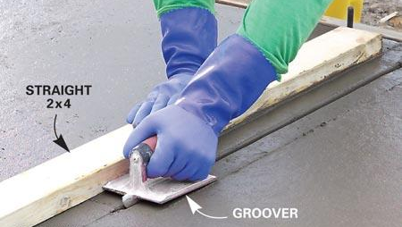
KEYS OF EFFECTIVE SPAN
MAKING SURE THE REINFORCEMENT/ WIRE MESH(RE-BAR) IS IN THE RIGHT PLACE AND NOT TOO DEEP
VERY THOUROUGH MIXTURE AND ACCURATE CURING OF THE CONCRETE MIXTURE TO GAIN
  THE DESIRABLE STRENGHT OF THE CONCRETE
DEPENDING ON HOW THICK THE SLAB WILL BE WILL DETERMINE HOW CLOSE THE CONTROL
  JOINTS WOULD BE (I.E. SLAB = 4-8 INCHES SPACING SHOULD BE 11’6” -17’6”
  THE PROPORTION SHOULD BE CLOSE TO A SQUARE TO BE MORE EFFECTIVE
MINIMUM
EFFECTIVE SPAN =
SPAN
BASIC RATIO X MODIFICATION
FACTORS

Slide 7
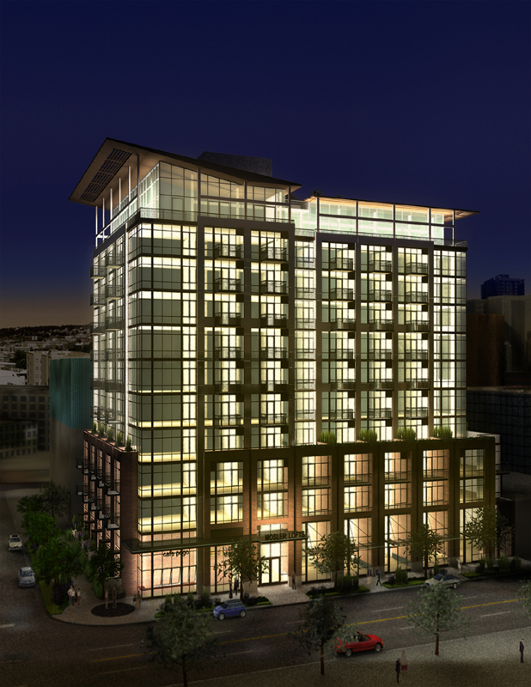
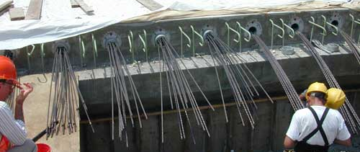
Mosler lofts – Seattle developed Schuster group
12 story mixed use building, 3 stories underground parking
150 unit condominium
Built in cast-in-place concrete frame (w 7-1/2in.)
Post tensioned flat-plate slab
Shear wall core incorporates 24in. Thick wall for seismic loads.
Cast concrete advantage on this building is it’s thermal
mass, durability and resilience to disaster

Slide 8
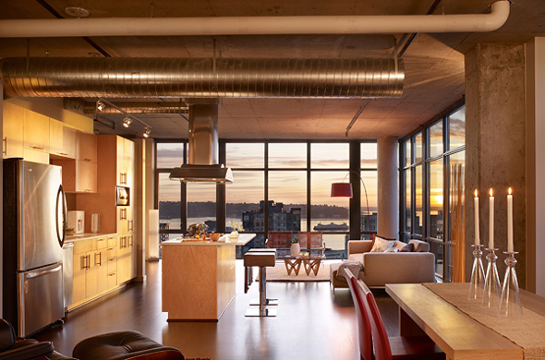
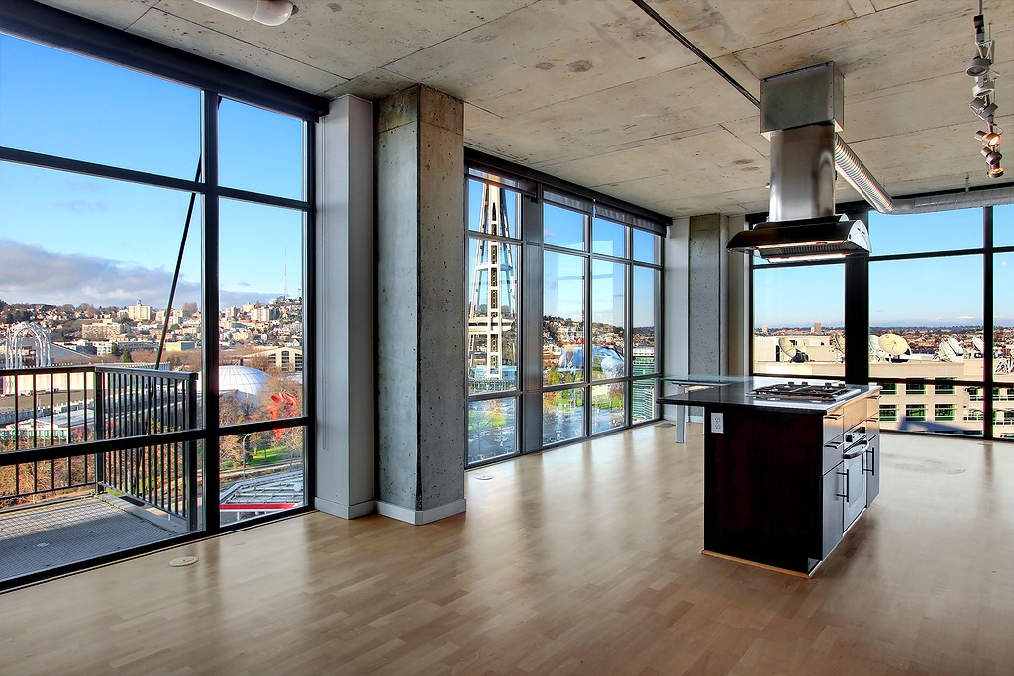
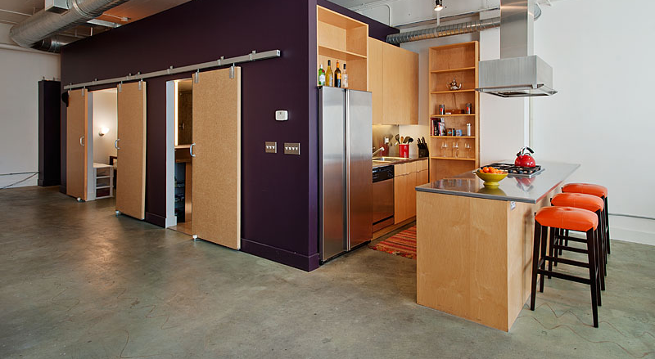
Mosler lofts – Seattle developed Schuster group
CONCRETE FLOORS
CONCRETE FRAME – COLUMN AND FLOOR ABOVE

Slide 9
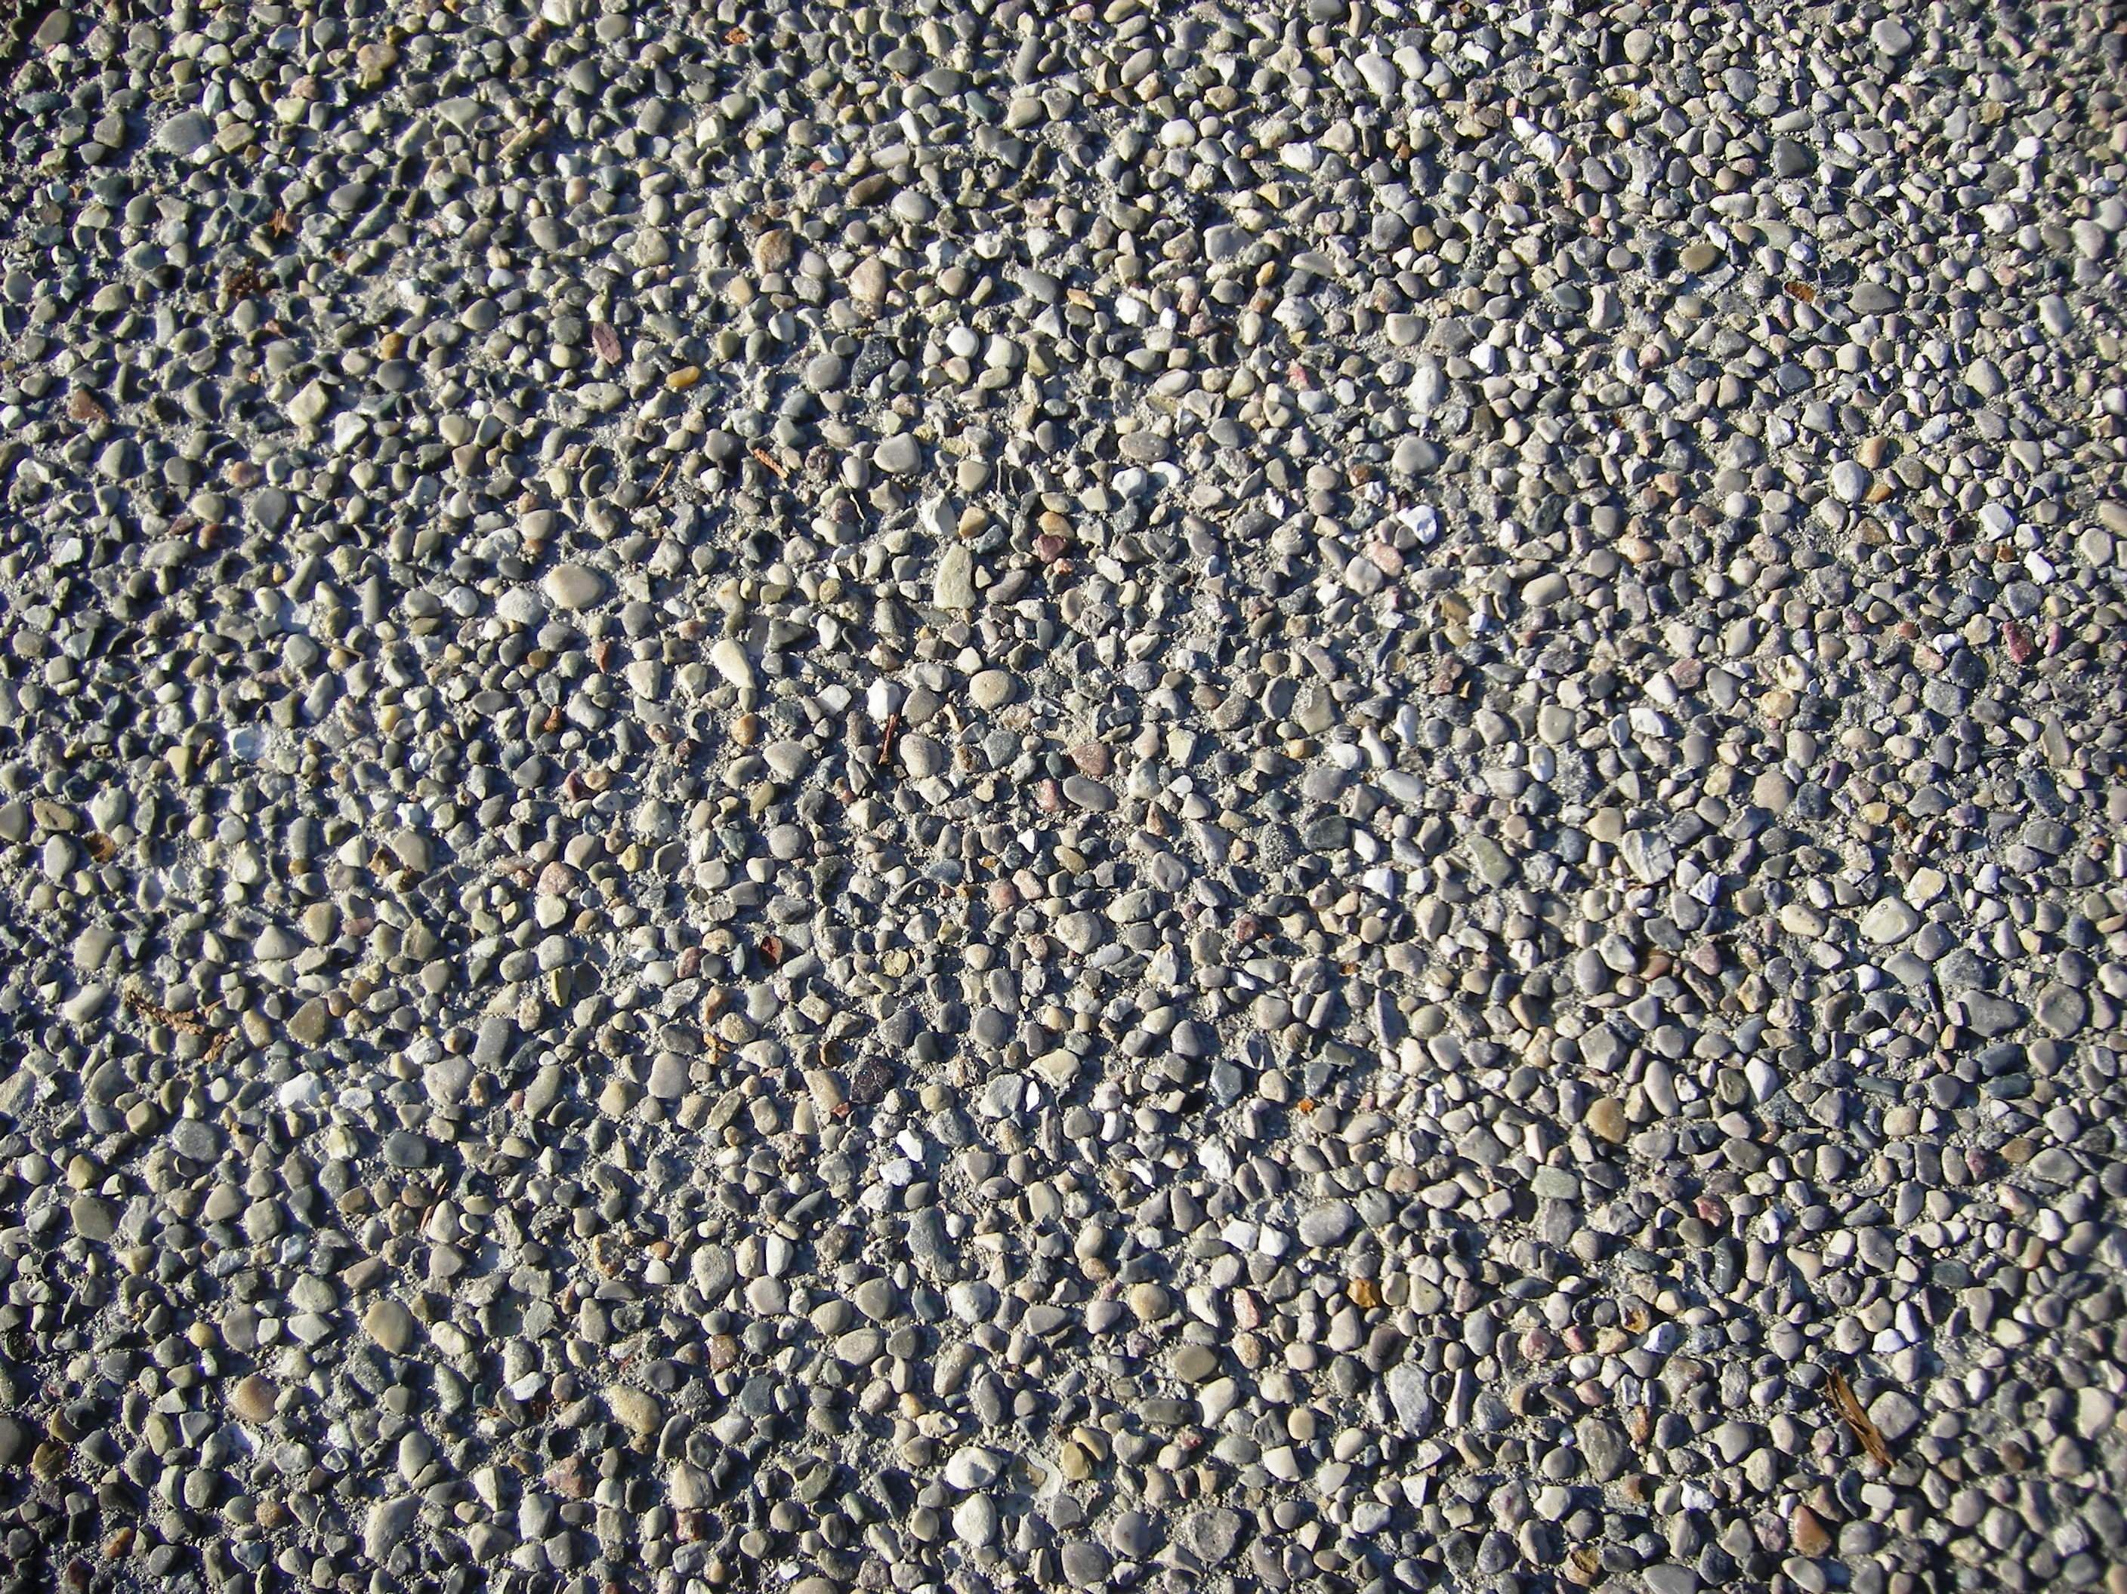
EXPOSED AGGREGATE
“An exposed-aggregate surface is obtained by placing concrete and then removing the outer 'skin' of cement paste to uncover decorative coarse aggregate (either batched into the concrete mix or seeded onto the surface).”
Exposed Aggregate is achieved by casting the concrete against a surface that has been painted with a retardant in order to slow the setting process. After the form is removed, the retardant is stripped away by sand blasting or high pressured water to reveal the texture and natural properties of the underlying aggregate.

Slide 10
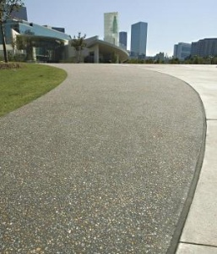
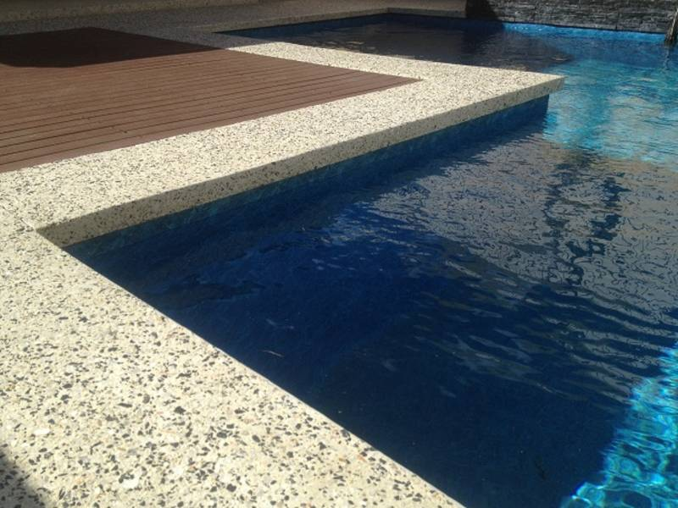
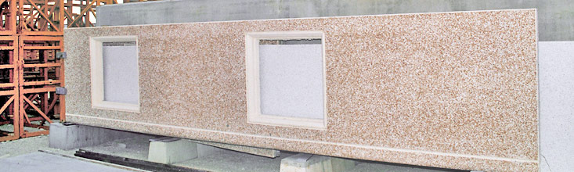
Exposed aggregate is durable and slip resistant ; properties that make it ideal for the following:
Sidewalks
Driveways
Patios
Pool decks
Plazas
An exposed-aggregate finish is also possible on concrete walls or tilt-up panels. Vertical applications include:
Decorative retaining walls
Architectural building facades
Sound barrier walls

Slide 11
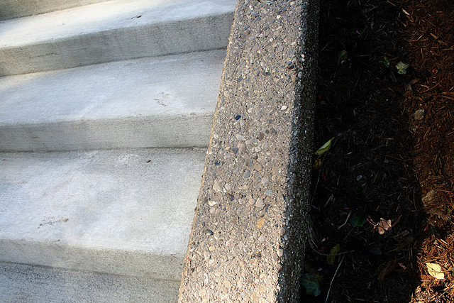
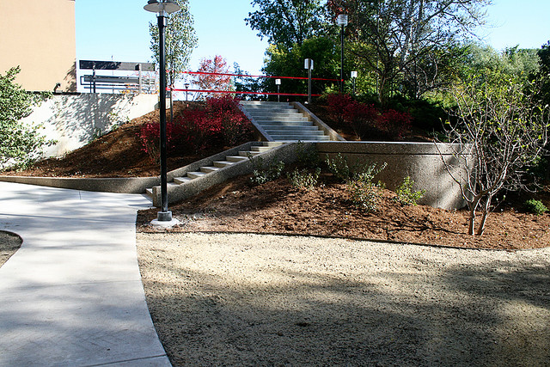
EXPOSED AGGREGATE

Slide 12
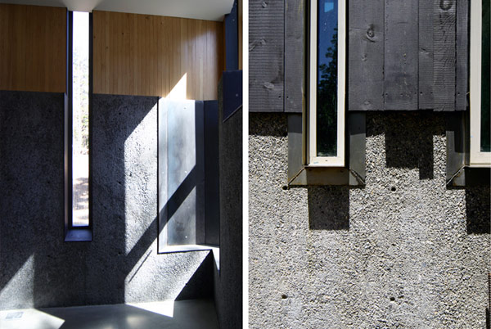
In design, adding a textured material such as concrete aggregate can be a way of adding contrast and warmth to a specific space and/or structure.

Slide 13
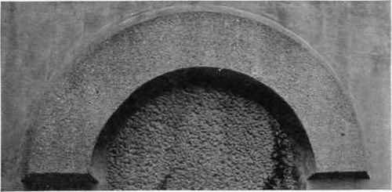
Tooled finish. This finish resembles the surface of a hand-tooled natural stone It is produced by casting the concrete against a smooth or specially textured or patterned form, and then "hammering" or "fracturing" the surface mechanically after the forms are removed.

Slide 14
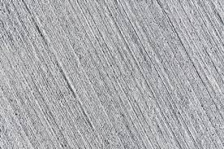
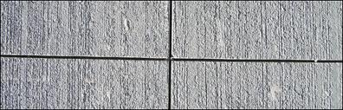
Tooled concrete finish can produce an interesting visual effect by producing a linear scratched look which can add horizontality and verticality when needed in a design. It is also a tangible element that can be added to any space interior or exterior
It also provides a method of disguising minor surface defects when needed.

Slide 15
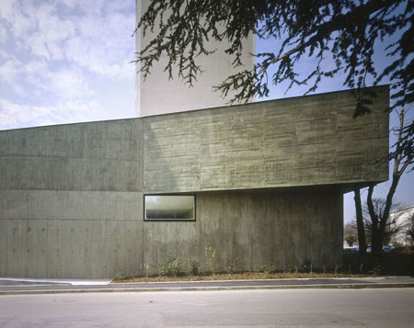
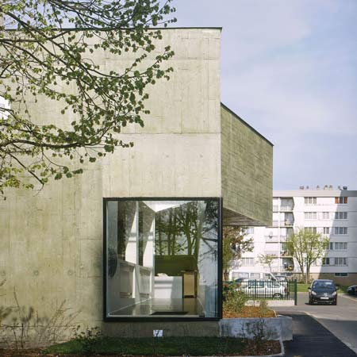
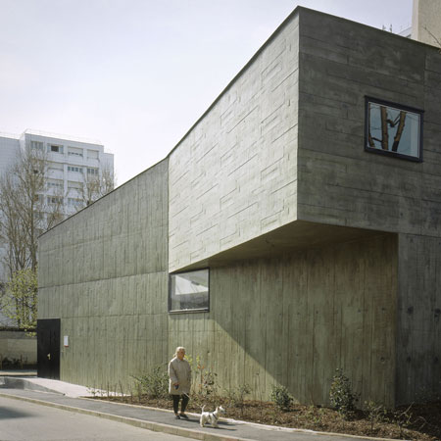
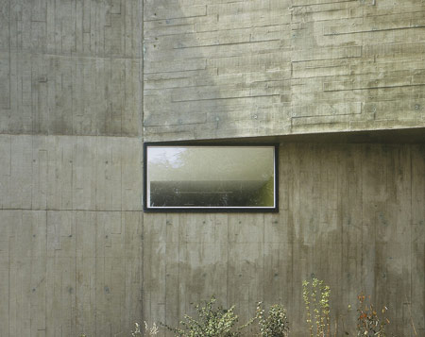
Toy Library in bonneuil-sur-marne by lan architecture
As Cast Concrete
This is a simple, unadulterated finish that displays the natural beauty of concrete without trying to simulate any other building material. The concrete is placed against a smooth form and is left in its natural state after form removal.

Slide 16
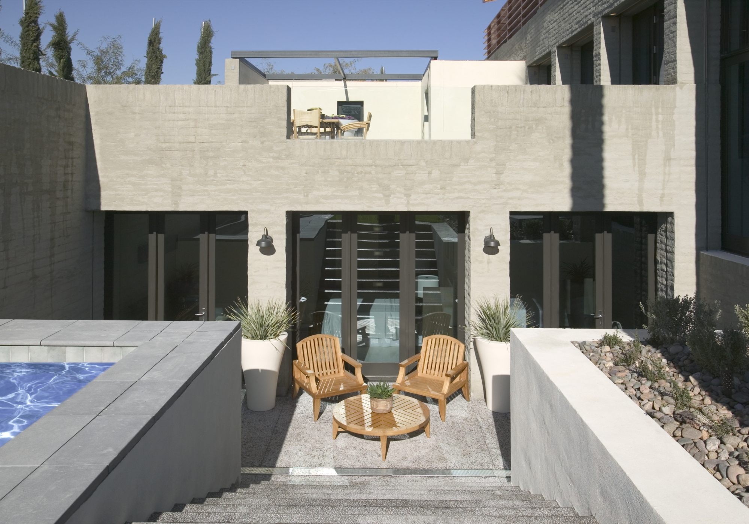
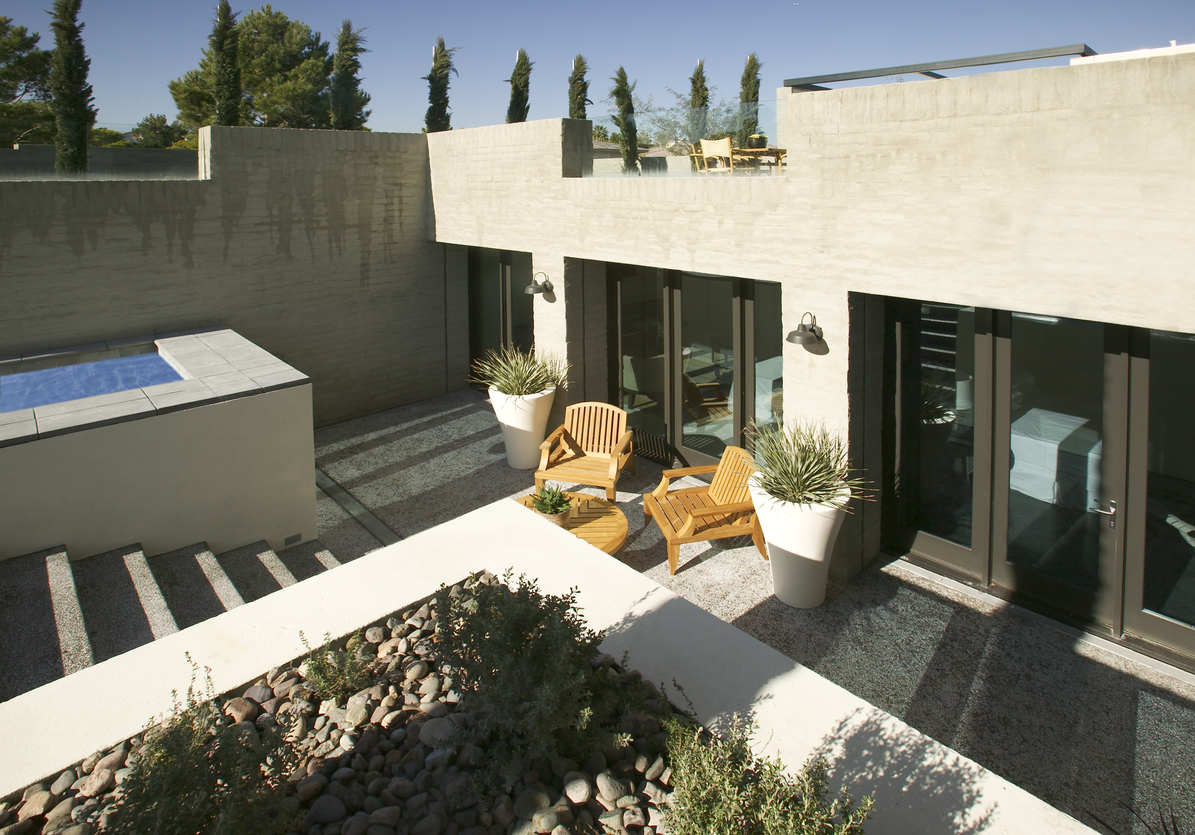
Toy Library in bonneuil-sur-marne

Slide 17
Work cited
Builtgreen.net
Dezeen.com
Fundamentals of building/E.Allen&J.Iano)
Google.com/image
Jkargon-architect.com
Megarprefab.com

