Slide 1
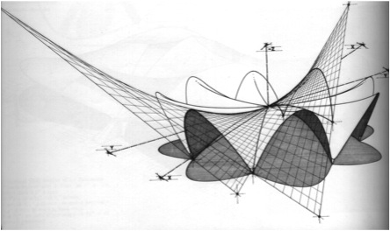
Thin Shell Structures
Group Member:
Desiree Andrade
Larry Molina
Fernando Tejeda

Slide 2
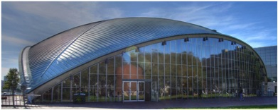
System spans and effective spans
“Thin shells are characterized by their three-dimensional load- carrying behavior, which is determined by the geometry of their forms, by the manner in which they are supported, and by the nature of the applied load.” Concrete shell structures are able to span large distances with a minimal amount of material. An arch, spanning tens of feet, can be mere inches thick.”
Thin Shell Structures
A roof structure could be made very thin, ending in achievements such as the Kresge Auditorium’s (113-foot span) 3-inch shell thickness,6 or the Kingdome (660-foot span) with its 5.5 inch to 15-inch variable shell thickness.
Kresge Auditorium
Estimate thickness for hyperbolic paraboloid ,umbrella shells per square foot of projected area is about 3.5 inches and for a gabled HP shells or saddle shells, 4.5 inches including the edge members. The weight of steel for an inverted umbrella is about 3 pounds per square foot of horizontal area. For square gabled hypars or saddle shell it is about 17 pounds per square foot of horizontal area. These quantities vary little with the span.

Slide 3
Construction cost
Components of a Concrete Price Analysis:
 | Concrete Concrete makes up the majority of the cost of a concrete project. To get a more accurate estimate contact your local Ready-Mix supplier. | $75 per cubic yard *National Average in 2008
 | Grading Cost will vary depending on the amount of dirt you need to move. Hourly rates apply for a tractor and operator. | $50 per hour
 | Sub-base Cost for gravel or sand delivered to the job site. | $12 per cubic yard
 | Concrete Forms and Finishing Labor is the biggest cost for concrete forms. Setting up concrete forms and finishing concrete is backbreaking work. | $1 - $1.50 per square foot
 | Reinforcement is required because all concrete cracks, so if you want your cracks to remain small, you'll need reinforcement. Wire mesh, re-bar, plastic mesh, and fiber in the mix are all commonly used materials. | .10 cents per square foot
The factor to consider the cost are the formwork, the time to erect forms,
set reinforcing, place and cure concrete, dismantle forms and labor.

Slide 4
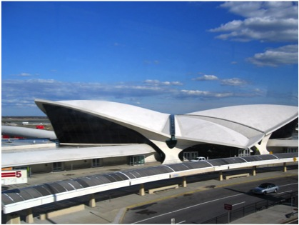
TWA - Trans World Airlines
Flexibility of the System
When talking about flexibility and which structures can be built, thin shell structures are ideal, because of the infinite possibilities.
As shown in this image the TWA (or Trans World Airlines), located in Queens, New York at JFK airport , this is a perfect example of the many possibilities one can do while practicing with thin shell structures.
Concerning what kinds of shapes can be constructed, the answer to that is complex geometry.

Slide 5
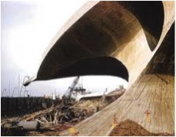
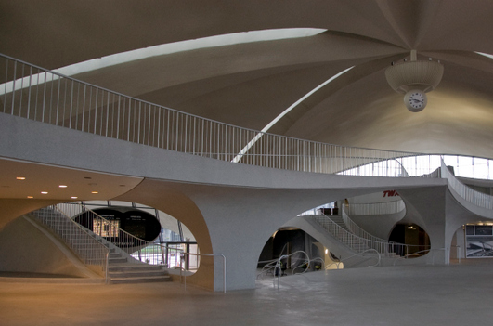
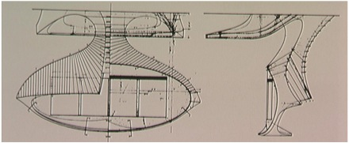
Connection Details
They are many ways that architects go about connecting the supporting floors and their vertical floors. When look at the TWA we can see what holds this thin shell structure is theses complex geometry that acts as pillars to distribute the load onto the ground.
Most of the interior structures have the same characteristic as the exterior structure. This structures that acts as a pathways funnels into a columns holding itself.

Slide 6
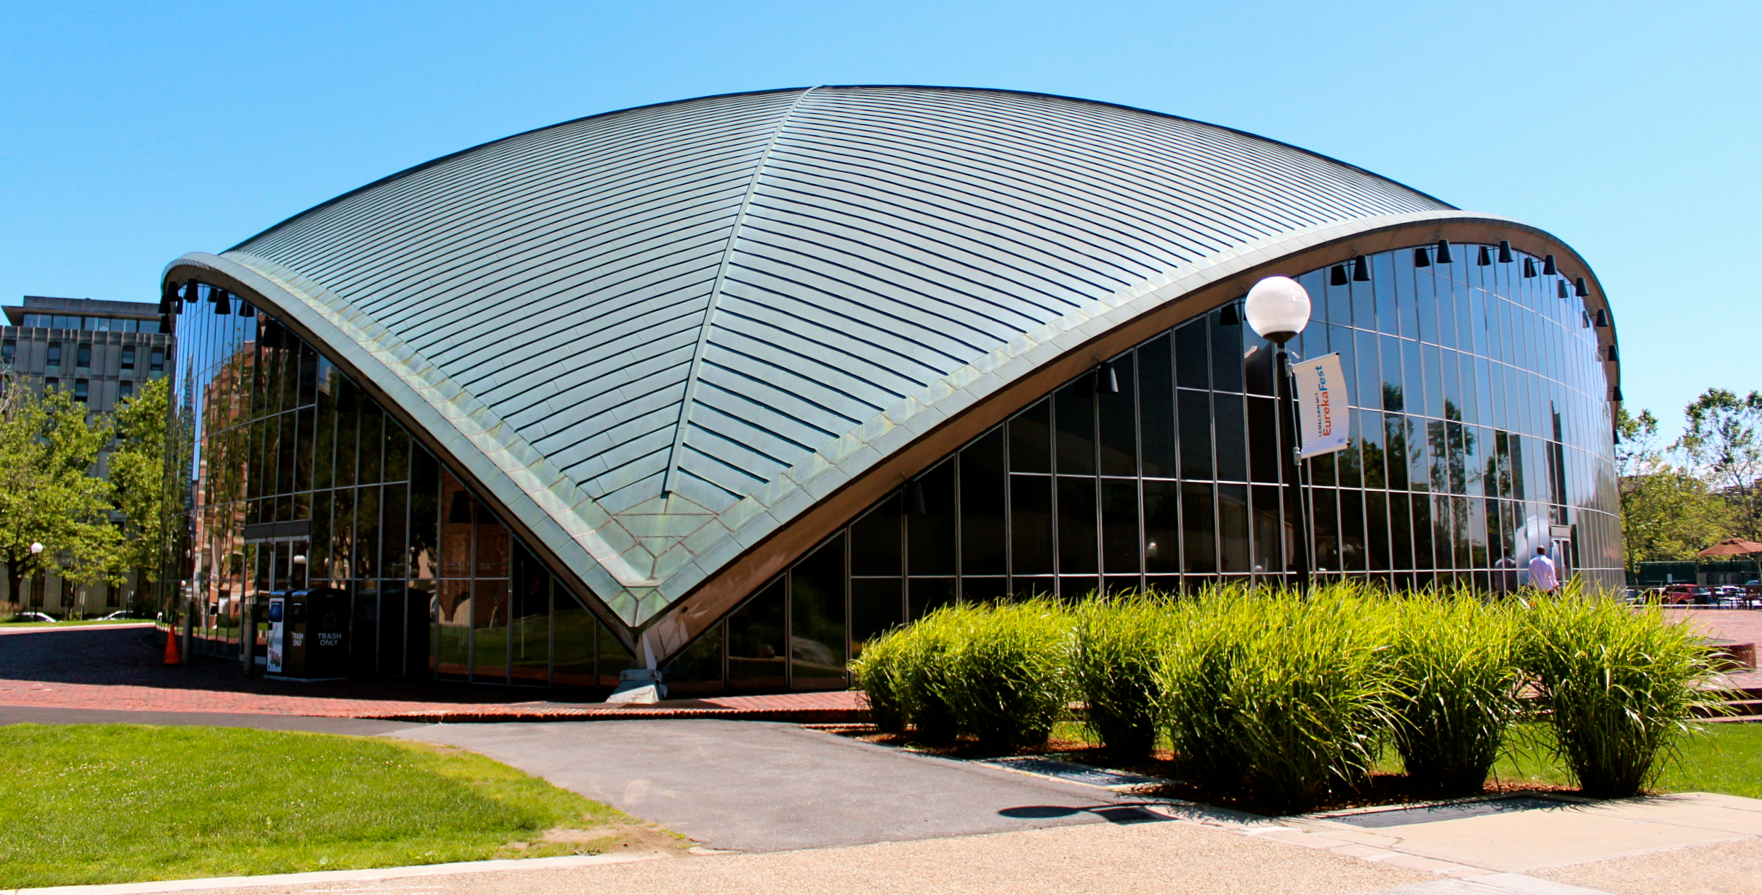
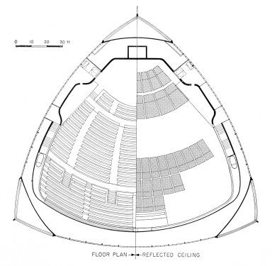
Massing Implications
Usually when architects construct thin shell structures, they usually span very wide and for the most part the thin-shell structures when properly and thought out fully can hold its on weight. Thin shell structures give the appearance as though they are defying gravity because of its appearance of it lightness.
Another example of a thin shell structure is Kresge Auditorium is an auditorium building for the Massachusetts Institute of Technology, located at 48 Massachusetts Avenue, Cambridge, Massachusetts.
Kresge Auditorium

Slide 7
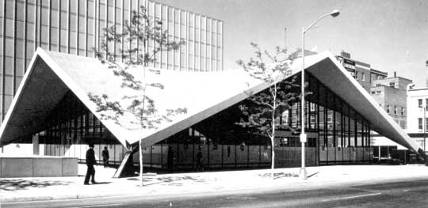
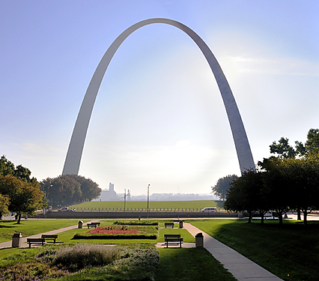
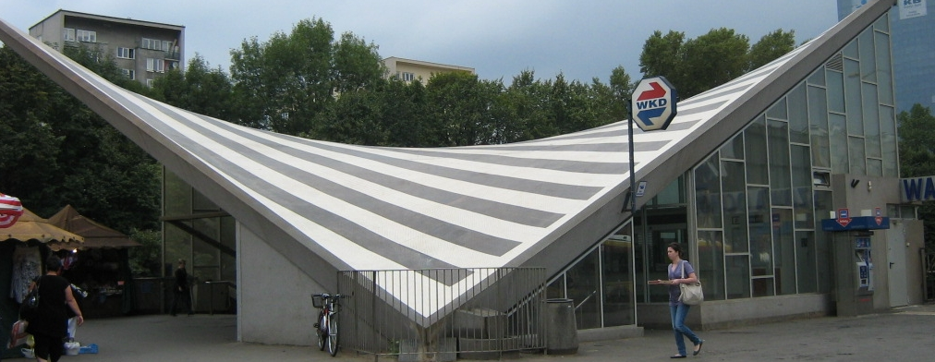
Diversity of forms available
hyperbolic paraboloid
Parabolic Arches
Hyperbolic saddle

Slide 8
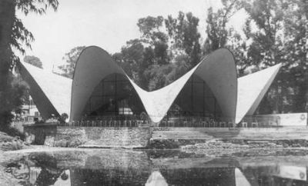
Case study building
Plan
Los Manantiales Restaurant
Construction- 1958,
Location: Mexico DF, Mexico
Architect: Felix Candela
Elevation
Section

