Slide 1
Cladding Systems: Metal Panels
Sheathing over walls

Slide 2
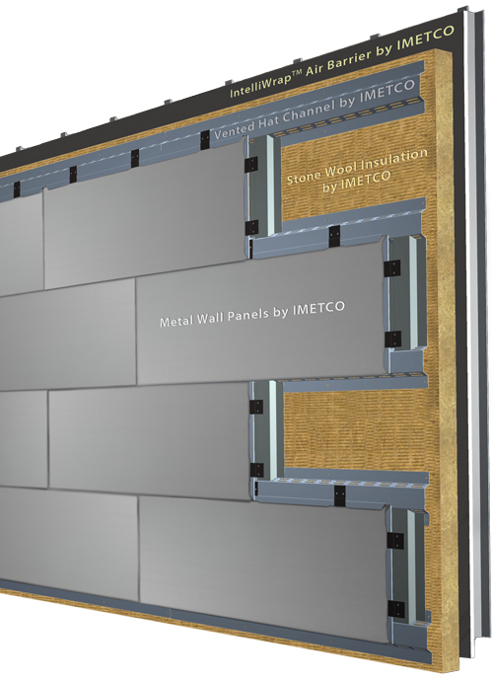
Metal and aluminum wall panels offer flexibility and tremendous design potential. Some companies offer Dry Reveal Rainscreen Systems, Wet Joint Systems, Extrusion – Captured Edge Systems. You'll choose from a variety of durable materials: Composite Aluminum, Stainless Steel, Rheinzink, Copper, and many others. These high-quality, exterior wall system extend your design and architecture options. Metal Panels also give the building maximum flexibility and the ability to withstand the most severe environmental conditions.
Advantages
-low maintenance
-material that is fashionable
-flexibility in the design process.
-New metal panels can be installed over any type of cladding – including brick, block, pre case concrete, stucco, or even existing metal systems.
Metal panel

Slide 3
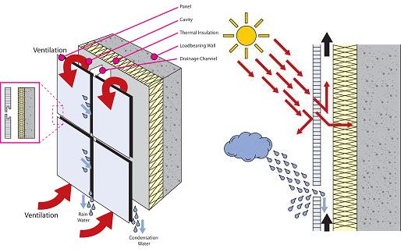
How the ventilation system works
Red arrows channels for ventilation and allows rain water and condensation to be drained off behind the cladding surface.

Slide 4
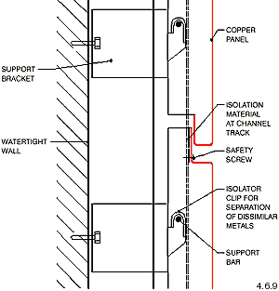
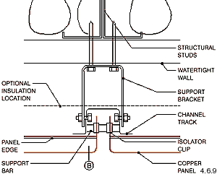
Section
Plan
Between bracket and panel (channel track &isolator cup)
Connection from the bracket to panel

Slide 5
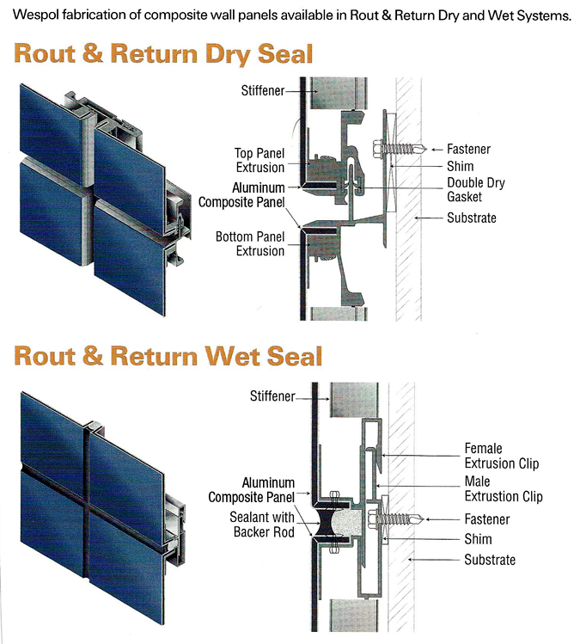
Rain Penetration & Moisture Control
What is Rainscreen Cladding?
The term “Rainscreen” refers to an approach to moisture control for building exterior wall assemblies that is based on two distinct layers – an outer cladding layer and an interior layer which performs multiple functions, including acting as the building structural wall, insulation, air and weather barrier. These two layers are separated by a ventilated air cavity which allows any moisture that passes through the cladding layer to be drained to the exterior. Materials commonly used as the outer layer include metals like aluminum, steel, zinc and copper, as well as terra cotta, stone & wood. There are two primary approaches to rainscreen design, defined as Drained & Back-Ventilated (DB/V) and Pressure-Equalized/ Compartmentalized (PER). To learn more about rainscreen design principles, please visit our Continuing Education page to schedule an AIA CES presentation for your office.
Manufacturers of panels used in rainscreen applications include Centria, VMZINC and Dri-Design. Dry-joint detailing makes these systems virtually maintenance-free and a more sophisticated approach to moisture control than wet-joint systems that rely on sealants and gaskets at joints for moisture control

Slide 6
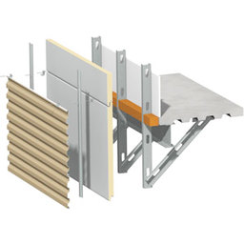
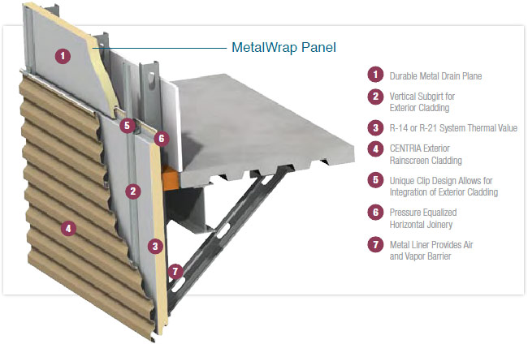
CENTRIA METAL PANELS
MetalWrap Series achieves energy efficiency goals with a single component that eliminates the need for conventional batt or board insulation, exterior gypsum, air barriers, vapor retarders and building wraps. Featuring an air and vapor barrier, along with insulation and a metal drain plane, MetalWrap Series controls moisture and air infiltration without sacrificing thermal efficiency. As a single panel, MetalWrap delivers thermal performance with U-values that exceed ASHRAE requirements, while also meeting the requirements for the NFPA 285 multi-story fire test.
The MetalWrap Series 100 is designed specifically for CENTRIA non-insulated metal wall systems. The simplicity of the MetalWrap Series is in its integrated single-panel design. MetalWrap Series includes an air and vapor barrier, insulation and metal drain plane all on one panel. This technology eliminates the need for conventional batt or board installation, exterior gypsum board, air barriers, vapor retarders and building wraps, while providing better thermal efficiency and moisture control to build better walls.

Slide 7
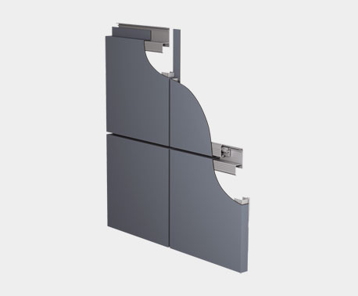
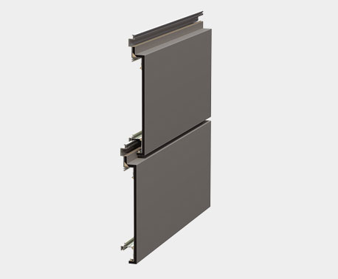
FormaBond Composite Panels
From a performance standpoint, FormaBond’s patented dry joinery means wet seals are eliminated, providing the optimum venting that keeps moisture out and allows wall cavities to dry effectively. This reduces the chance of mold, material degradation and mildew. The panels also provide excellent bond strength and superior impact resistance.

Slide 8
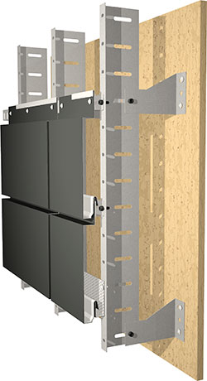
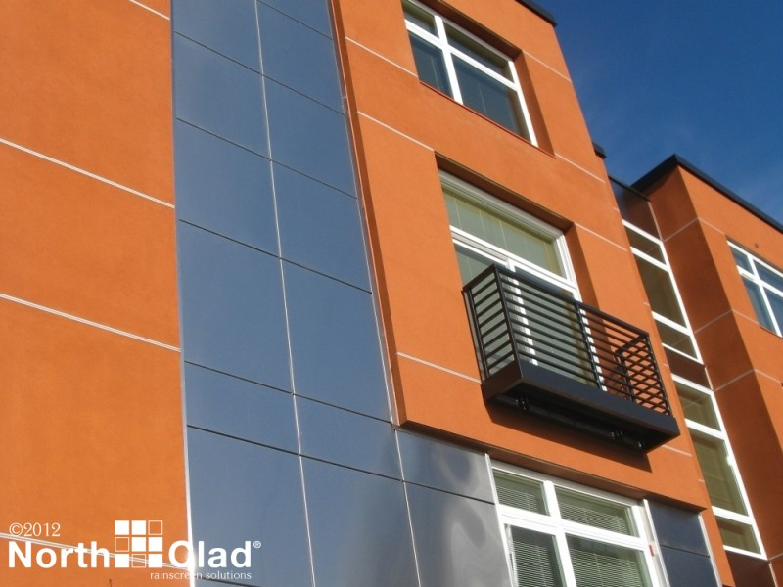
NorthClad® Dual Interlocking Rainscreen System
Panels hook on the leveling system
Self leveling mounting systems allow for easy use of insulation outboard of the sheathing
Panels can be installed "running bond" or as a "grid"
Vented rainscreen design for the health of your building

Slide 9
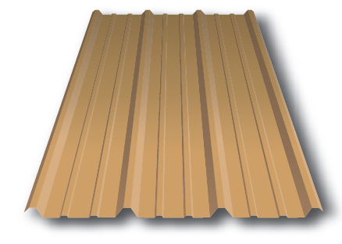
R panel

Slide 10
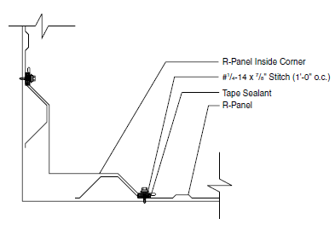
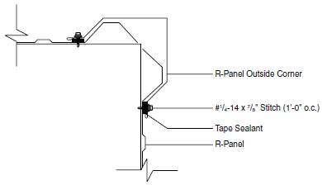
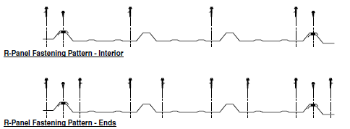
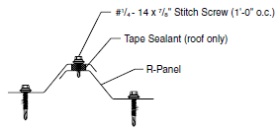
R panel connections
Inside corner detail
Outside corner detail

Slide 11
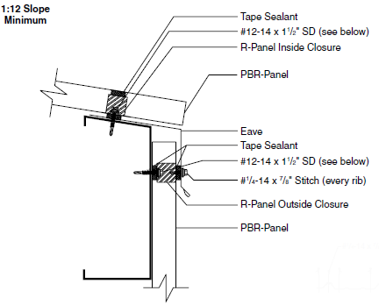
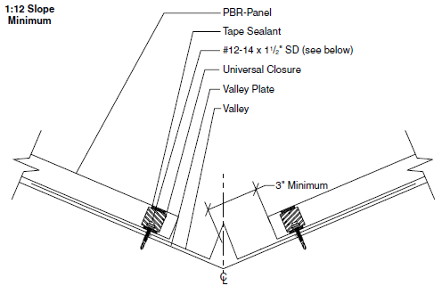
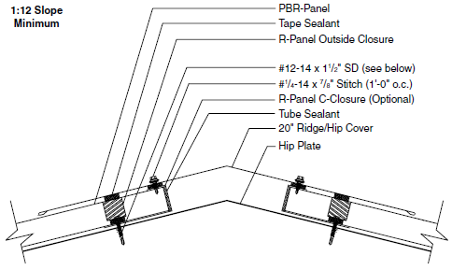
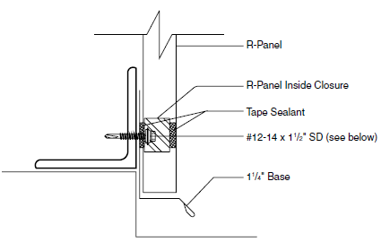
R panel connections
Eve detail
Valley detail
Ridge detail
Base detail

Slide 12
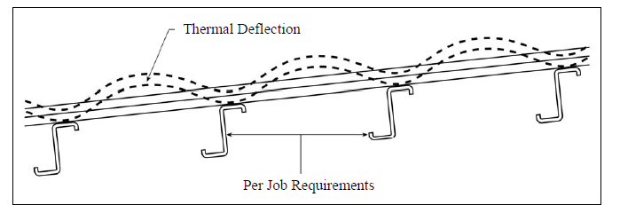
Metal panel
Thermal Effects
All insulated metal panels must demonstrate the ability to withstand exposure to temperature extremes on both the exterior and interior skins. Panel temperatures on the outer skin can reach service temperatures of 180 degrees F with dark colors. The surface temperature can be reduced by using lighter colors and paint systems containing cool infrared reflective pigments. The inner skin is usually limited to a lower in-service temperature. Depending on the manufacturer the maximum allowable liner temperature will range from 120 degrees F to 160 degrees F. It should be noted that panels manufactured in a pinch roll/contact adhesive process usually will not perform well in high temperatures. The minimum interior temperature for cold storage applications can be as low as .–40 degrees F.
R value
Aluminum: .61
Aluminum w/ .5” insulation: 1.80
Gauge steel: .34 per inch thick

Slide 13
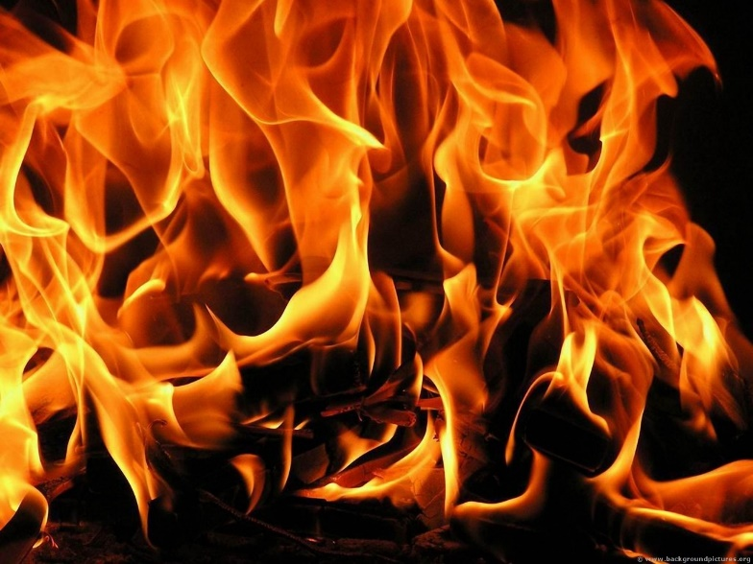
Metal panel Fire Resistance
To conform to the requirements of the major building codes, insulated metal panels
should be tested by Underwriters Laboratories, FM Approvals or similar testing and
listing agencies for conformance with the requirements of the model building codes. The
foam core should have a maximum flame spread of 25* and a maximum smoke
developed rating of 450

Slide 14
Rain Screen
Terracotta and Fiber Panel

Slide 15
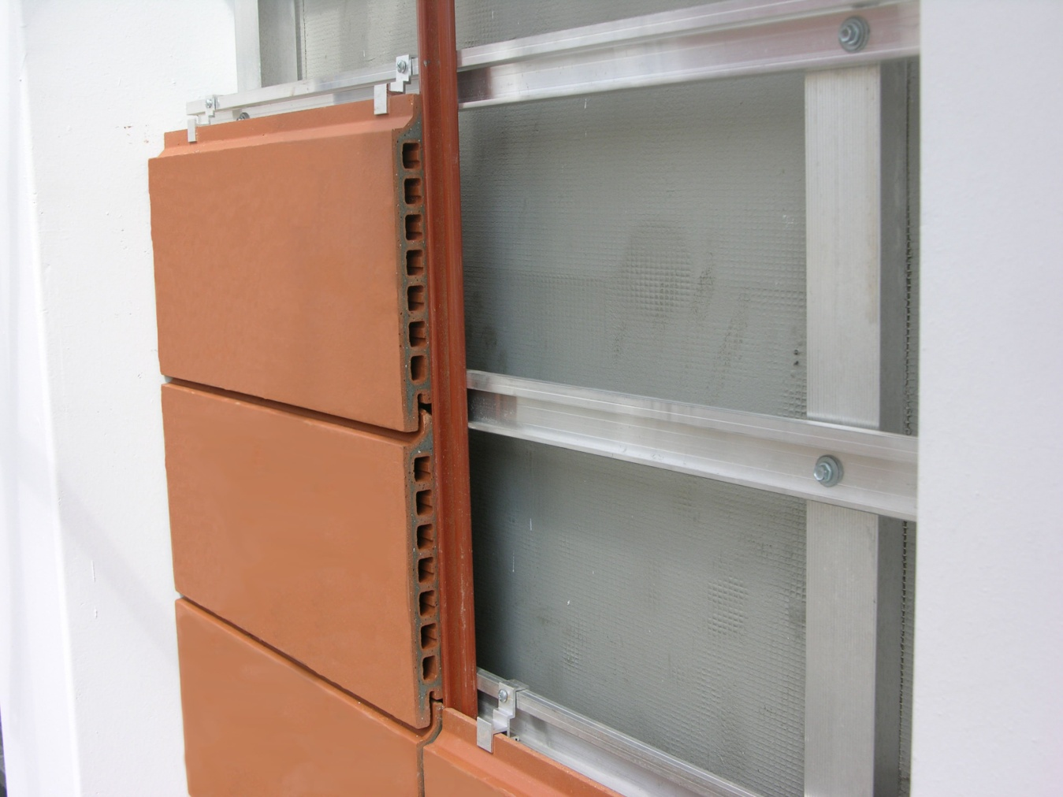
The system contains:
a back ventilated ceramic shell to keep the construction dry
-protective membrane to keep moister from entering the structure
heat insulation
natural beauty of clay

Slide 16
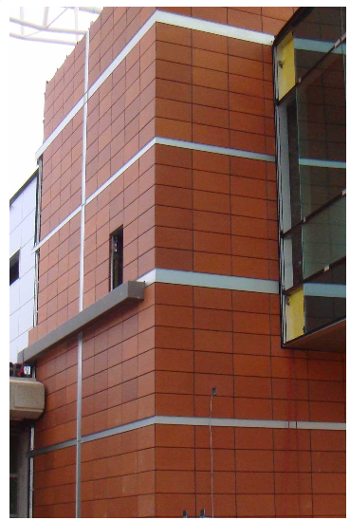
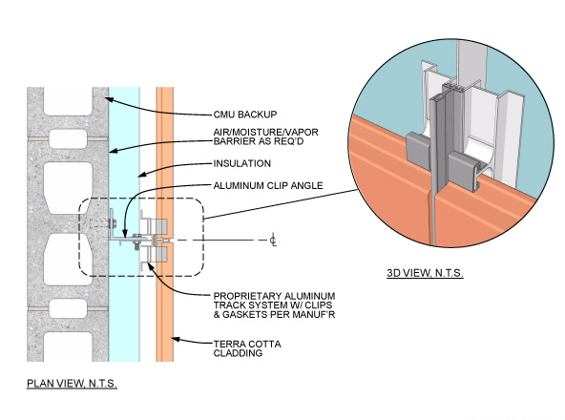

Slide 17
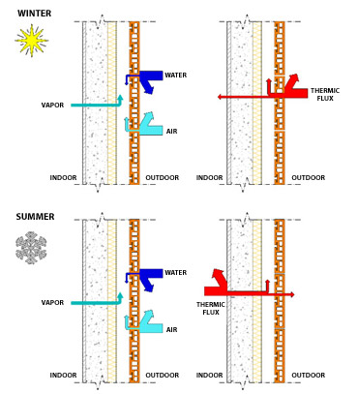
water vapor passes through the
walls releasing water
While the air flows up ward
creating a chimney effect
winter-heat from the inside gets
transferred outside
Summer-heat from the outside gets
transferred inside

Slide 18
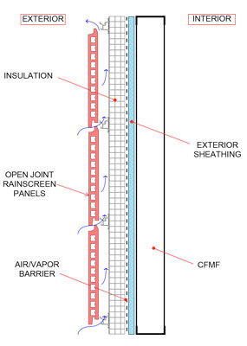
Rain Penetration & Moisture Control
The rainscreen principle is not new, nor is the idea of rainscreen applied to wall design. For centuries in Norway, the rainscreen idea was intuitively used, without any scientific or systematic foundation. They utilized drained and back-ventilated claddings with both closed and open joints.
For centuries terra cotta has been used in building construction, mostly as roof and floor tiles. Terra cotta today now provides a premier architectural option used in Rainscreen and ventilated exterior wall construction. Terra cotta is available in a wide range of profile shapes and earth tone colors to provide an architecturally appealing, energy-efficient building. Terra Cotta is a 100% natural material that is non-combustible that provides LEED certification value as a sustainable material.
The Terracotta Rainscreen system allows air to circulate behind the panels to provide pressure equalization, preventing water from being drawn into the building. Additionally, a vapor barrier on the outside face of the back-up wall acts as a final air and water barrier.
Sustainable Design 80 year-plus life expectancy, with a naturally ventilated wall cavity, helps to eliminate the potential for “sick building syndrome” common to closed cavity walls. All materials fully recyclable.

Slide 19
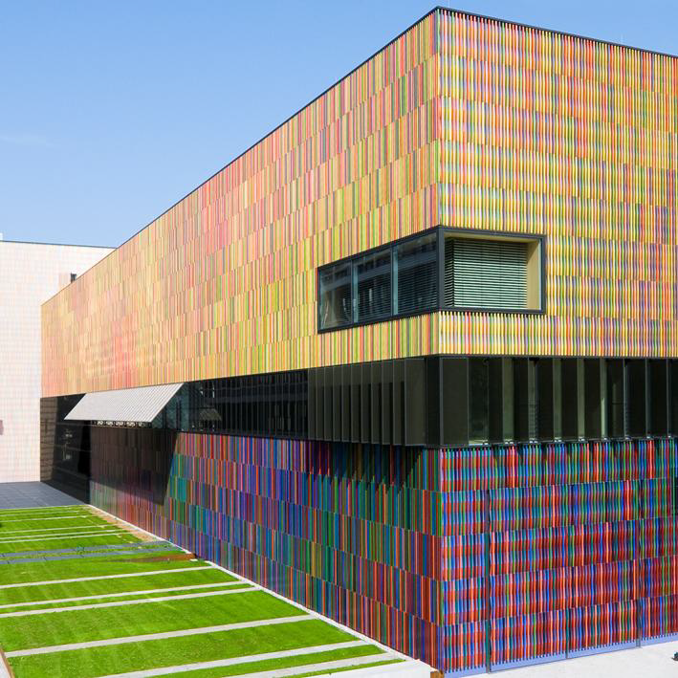
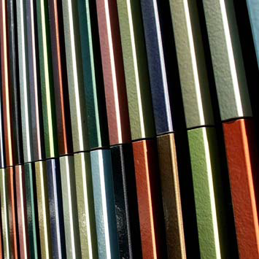
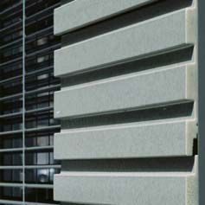
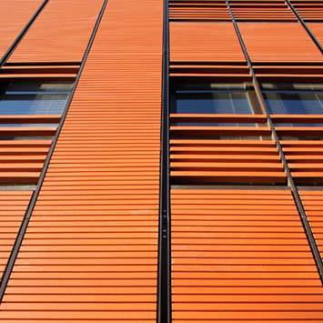
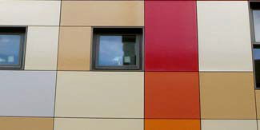
External Architectural Finishes
Surface finishes:
Natural, polished, textured, peeled, profiled, engobe, glazed. Curved surfaces can not be polished. Other surfaces are available on request.

Slide 20
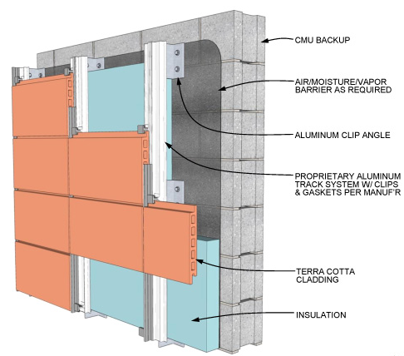
Costs
Price: US $26 - 40 / Square Meter
Minimum Order Quantity:100 Square Meter
Supply Ability: 10000 Square Meter/Square Meters per Day
Thickness: 18mm
size: 300x900mm
weight: 8.37kg/pc

Slide 21
ENVIRONMENTAL IMPLICATIONS
Terracade is a rear ventilated façade,which creates an airspace outside the load-bearing wall.
improving comfort levels and providing energy savings. The airspace provides natural ventilation with a chimney effect, which facilitates the removal of heat, humidity and condensation away from the
building structure. Terracade tiles are classified exposure grade so they can be used in all environments including severe marine environments and areas subject to heavy industrial pollution. Terracotta tiles are robust and extremely durable and have an extremely long service life. Terracade XP provides the natural beauty, low maintenance and longevity of real terracotta. Terracade also offers design edibility as individual tiles can be replaced at any stage for ease of maintenance or to
facilitate changes to update the buildings appearance. The tiles can also be secured by mechanical means to prevent vandalism.

