Slide 1
TEAM
ZONING
RESEARCH
Notes:
cover page or nah?

Slide 2
TEAM MEMBERS
GROUP 4
DEMETRI, PARKER
MARCO
DWYER
HUYING
TAN
DIANA
SECLEN
MIMU
SAKUMA
MS

Slide 3
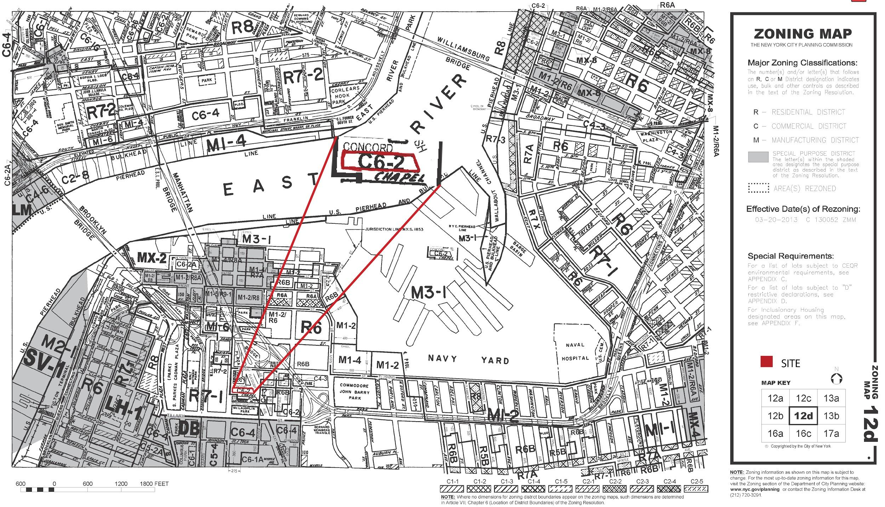
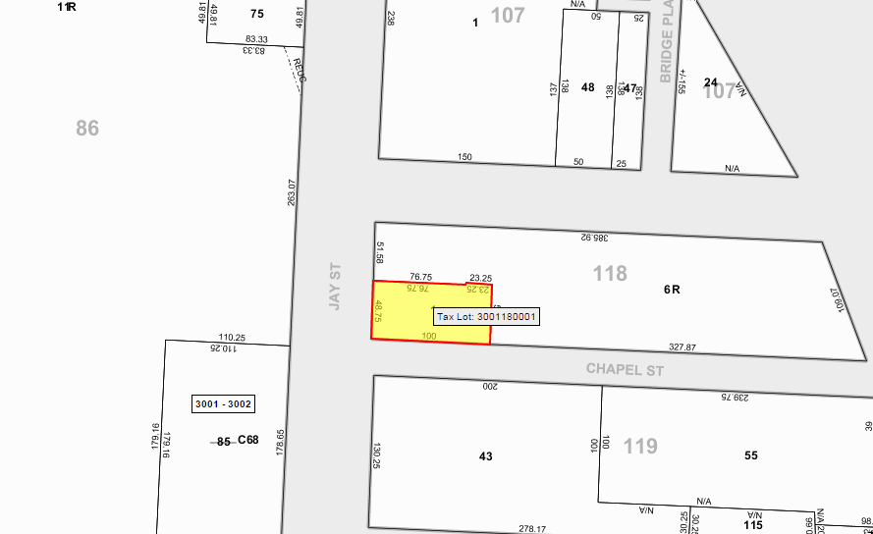
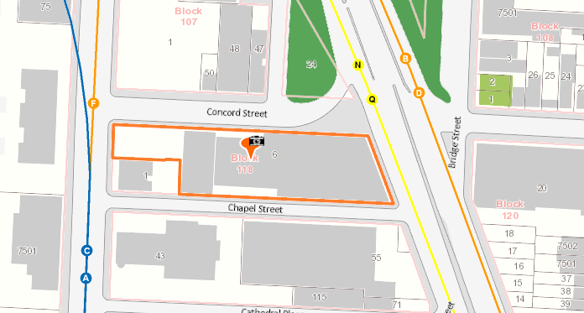
locating and understanding the site content
District type: C6-2
Block: 118
Lot(s): 1&6
Area of the site
~41,937 sq feet
MD, DP

Slide 4
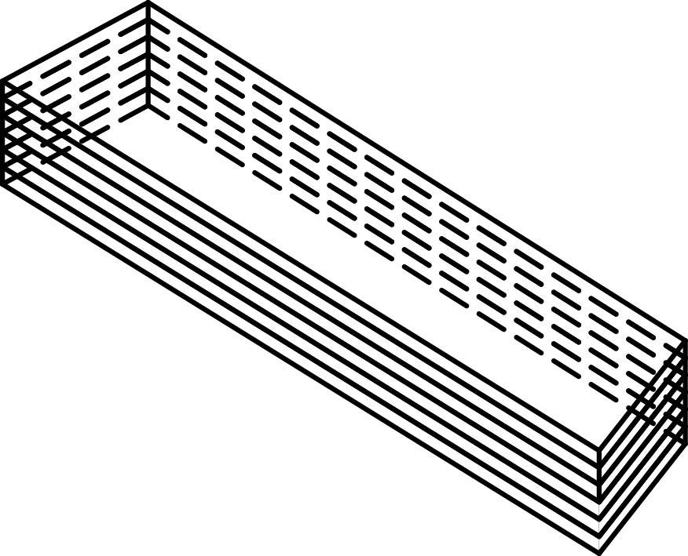
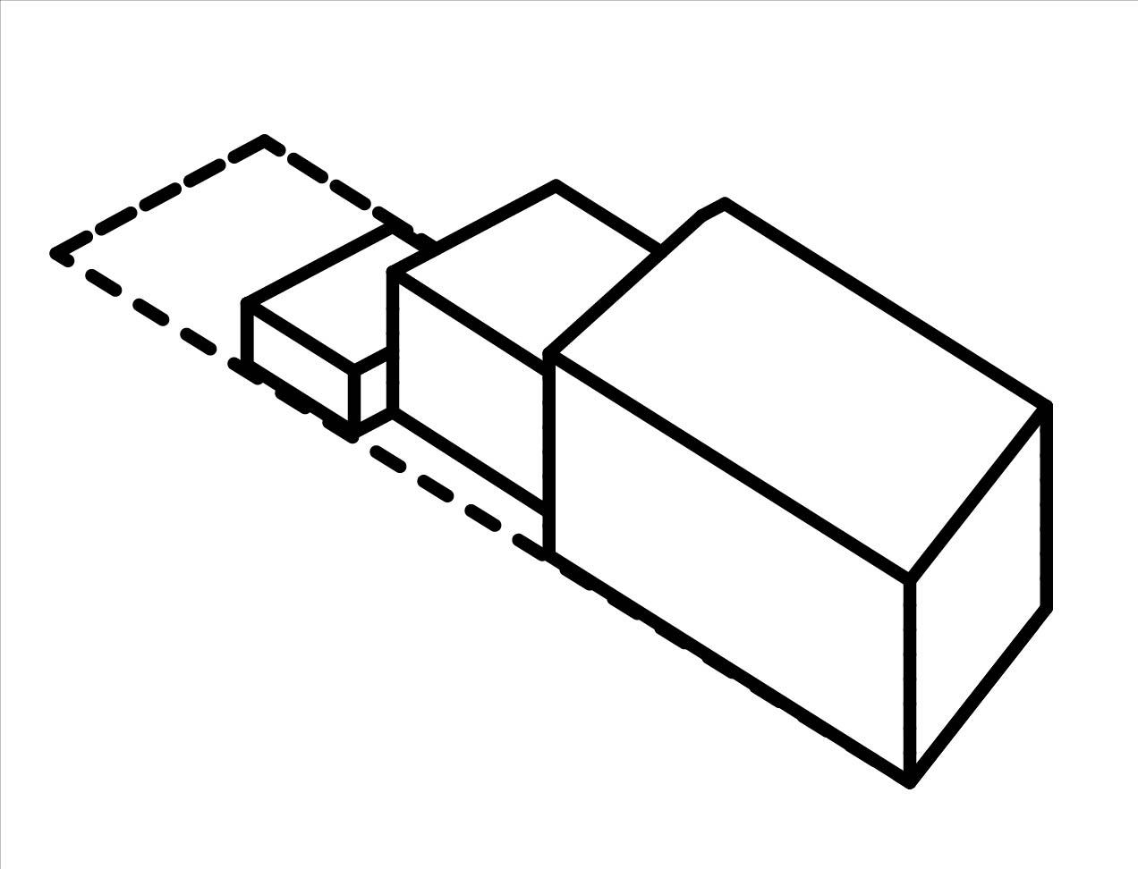
EXISTING BUILDINGS
total area of the lot
X FAR(6.0)
=41,937×6.0=251,622….(S)
area building A x 2
=3,747×2=7,494…………(Av)
area building B/2×7+B/2×10
=B/2×17
=7,215×17=122,655…….(Bv)
total buildable sq footage available
=S-(Av+Bv)=121,473
A
B
DS,MD,MS

Slide 5
Setback
Initial Setback Distance
-Narrow Street of 20’
-Wide Street of 15’
MD,DS

Slide 6
My calculations- Diana
area of the lot=40823 sq ft
total buildable sq ft=40823*6=244938 sq ft
10 floor building sq ft used= 161490 sq ft---> area 16149 ft
7 floor building sq ft used=37170 sq ft-> area 5321
2 floor building sq ft used=8444 sq ft → area 4222
THE REMAINING IS:
244938-161490-37170-8444=37834

