Slide 1
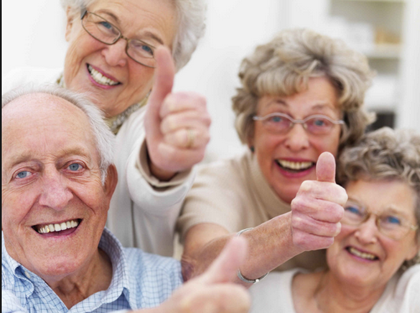
Promoting activity and socialization in Seniors Zongfang Yang Tianna Cover

Slide 2
Introduction
Staffs in the community play a major role in improving physical activity and socialization for community dwelling elderly
Due to aging, seniors are vulnerable both physically and mentally
Activity and socialization can delay aging process, improve life quality and overall life-expectancy

Slide 3
How aging impacts elderly
Cardiovascular Changes
1.Under physiological stress and exercise: Decreased maximal heart rate and cardiac output, resulting in fatigue, shortness of breath, slow recovery from tachycardia.
2.Risk of hypertension
3. Risk of arrhythmias, postural and diuretic-induced hypotension-may cause syncope.
Reduced pulmonary function
1. Decreased respiratory muscle strength
2. Dyspnea, decreased exercise tolerance with exertion
Changes in the Gastrointestinal Systems
1. Decreases in strength of muscles of mastication, taste, and thirst perception.
2. Decreased gastric motility with delayed emptying

Slide 4
How aging impacts elderly
Changes in the Musculoskeletal System
1. decline inmuscle with increased weakness and poor exercise tolerance. 2. Lean body mass replaced by fat with redistribution of fat. 3. Bone loss in women and men after peak mass at 30 to 35 years.
4. Increased risk of disability, falls, unstable gait caused limited ROM, joint instability, risk of osteopenia , osteoporosis and osteoarthritis.
Changes in the Nervous System and Cognition
1. Impairments in general muscle strength; deep-tendon reflexes;
2. Slowed motor skills and potential deficits in balance and coordination.
3 .Slowed speed of cognitive processing.
Changes in the Immune System

Slide 5
Benefits of activity for seniors
Helps maintain the ability to live independently and reduces the risk of falling and fracturing bones.
Reduces the risk of dying from coronary heart disease and of developing high blood pressure, colon cancer, and diabetes.
Can help reduce blood pressure in some people with hypertension.
Helps people with chronic, disabling conditions improve their stamina and muscle strength.
Reduces symptoms of anxiety and depression and fosters improvements in mood and feelings of well-being.
Helps maintain healthy bones, muscles, and joints.
Helps control joint swelling and pain associated with arthritis.

Slide 6
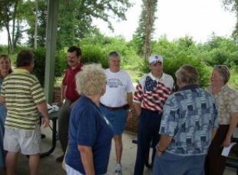
Importance of socialization for seniors in community
Sense of purpose and belonging
Increased self-confidence
and self-esteem
Improved physical
and mental health
Improve memory
and mental performance

Slide 7
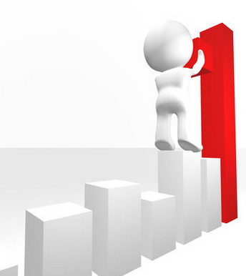
Seniors’ Barriers to physical activity
Major concern : fear of fall
Lack confidence in their ability to be physically active (low self-efficacy)
Fear being injured or
have been injured recently
Lack encouragement, support,
or companionship from family
and friends
Lack self-motivation

Slide 8
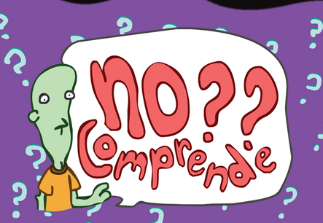
Barriers to socialization in seniors
Cultural difference
Language barriers
Lack of resources

Slide 9
What community can do to promote physical activity
Provide community-based physical activity programs that offer aerobic, strengthening, and flexibility components specifically designed for older adults.
Encourage malls and other indoor or protected locations to provide safe places for walking in any weather.
Ensure that facilities for physical activity accommodate and encourage participation by older adults.
Provide transportation for older adults to parks or facilities that provide physical activity programs.
Encourage health care providers to talk routinely to their older adult patients about incorporating physical activity into their lives.
Plan community activities that include opportunities for older adults to be physically active. (e.g. Tai Chi, Dancing class, walking. )

Slide 10
Promote socialization in community
Engage the seniors, promote interaction between staffs and seniors
Involve Family Members and Friends
Promote Organized Activities
Take Advantage of Community Programs
( e.g. volunteers, social workers)

Slide 11
REFERENCE
http://www.umh.org/assisted-independent-living-blog/bid/271766/The-Importance-of-Socialization-at-Senior-Living-Communities
http://www.cdc.gov/nccdphp/sgr/olderad.htm
http://consultgerirn.org/topics/age_related_changes/want_to_know_more/#item_
http://www.cdc.gov/physicalactivity/everyone/getactive/barriers.html

Slide 12
Referremce
http://ageing.oxfordjournals.org.citytech.ezproxy.cuny.edu:2048/content/33/3/273
http://advantahomecare.net/tips-for-caregivers-to-promote-healthy-social-interaction
http://www.cdc.gov/physicalactivity/everyone/guidelines/olderadults.html

