Slide 1
Type II Diabetes
How can it affect you?

Slide 2
What is Type II Diabetes?
Diabetes is a problem with your body that causes blood glucose (sugar) levels to rise higher than normal.
Type 2 diabetes is the most common form of diabetes.
If you have type 2 diabetes your body does not use insulin properly.
At first, your pancreas makes extra insulin to make up for it. But, over time it isn't able to keep up and can't make enough insulin to keep your blood glucose at normal levels.

Slide 3
Risk Factors for Type II Diabetes
Weight: The more fatty tissue you have, the more resistant your cells become to insulin.
Lack of Exercise : Physical activity helps you control your weight, uses up glucose as energy and makes your cells more sensitive to insulin.
Body Fat Distribution: If your body stores fat primarily in your abdomen, your risk of type 2 diabetes is greater than if your body stores fat elsewhere, such as your hips and thighs
Family History: The risk of type 2 diabetes increases if your parent or sibling has type 2 diabetes.
Race: Although it's unclear why, people of certain races — including blacks, Hispanics, American Indians and Asian-Americans — are more likely to develop type 2 diabetes than whites are.
Age: The risk of type 2 diabetes increases as you get older, especially after age 45. That's probably because people tend to exercise less, lose muscle mass and gain weight as they age.

Slide 4
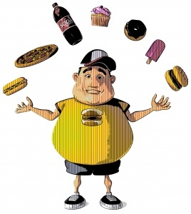

Possible Risk Factors for Type II Diabetes
Obesity
Inactivity

Slide 5
Type II Diabetes Treatment
Healthy Eating: Fruits, Vegetables and Whole Grains
Physical Activity: 30 minutes of aerobic exercise most days of the week.
Diabetes Medication
Insulin Therapy
Bariatric Surgery

Slide 6
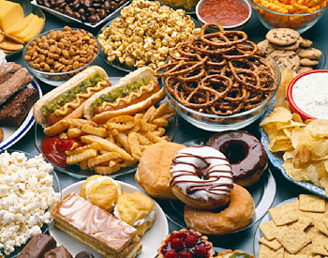
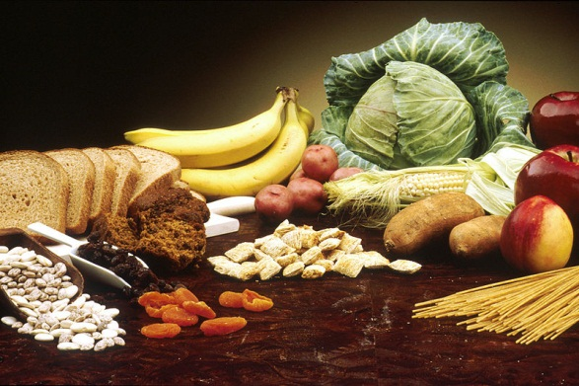
What Kind of Foods Should You Eat?
Nutritious Foods
Non-Nutritious Foods

Slide 7


Good VS. Bad
Natural Peach
Peaches in Syrup

Slide 8
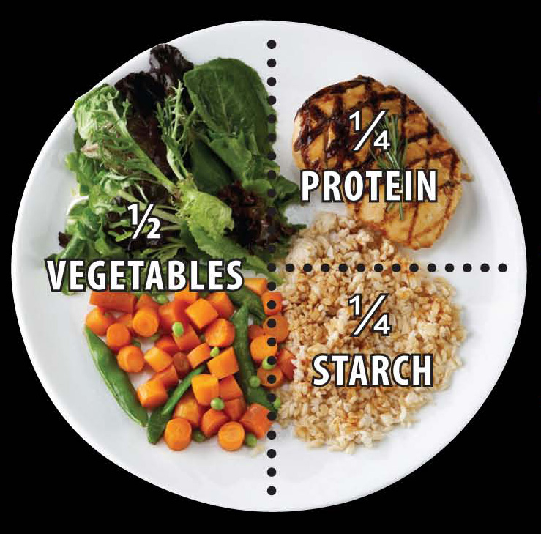
Portion Control Plate

Slide 9
Type II Diabetes Prevention
Get more physically active
Eat plenty of fiber
Lose excess weight
Change to a healthier life style

Slide 10
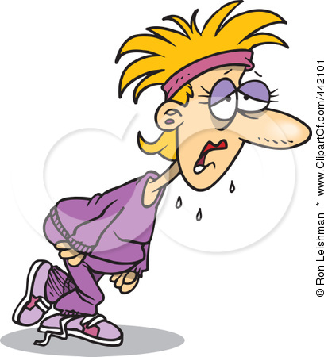

Steps Towards Prevention
Exercise
Lose Excess Weight

Slide 11
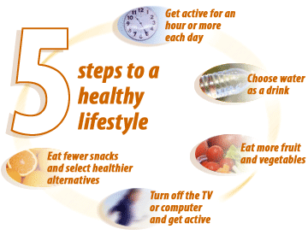
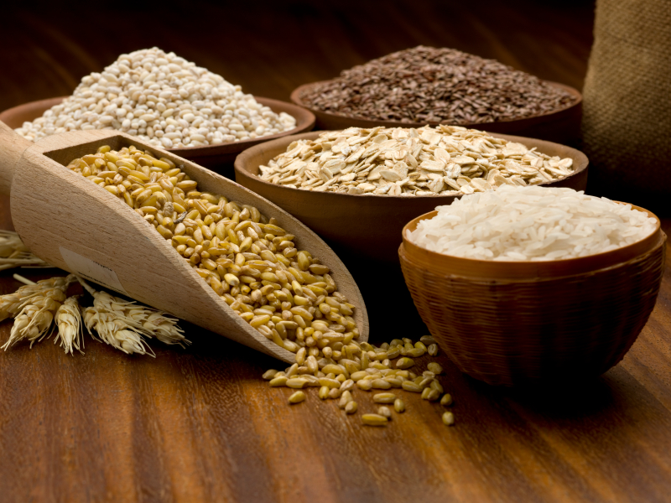
More Steps Towards Prevention
Fiber
Healthy Life Style

Slide 12
Reference(s)
Rubin, A. (2012). Diabetes for Dummies. Hoboken, NJ: John Wiley & Sons

