Slide 1
New York City College
of Technology
Spring, 2014
Created by Nursing Students:
Gujina, Anastasiya
Kulikova, Elizabeth

Slide 2
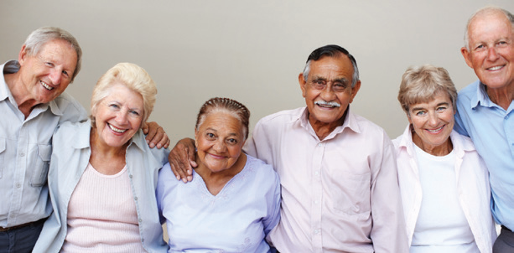
The Aging Process

Slide 3
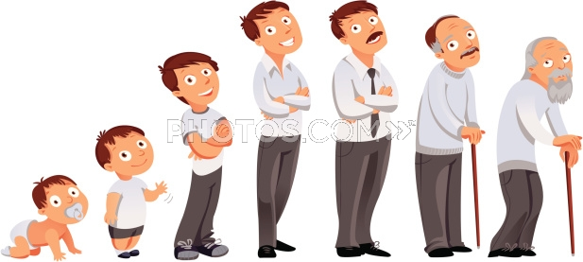
What is the aging process?
Aging begins at the time human is born
Living Is a process of continual change
Infants become toddlers, children blossom into young men and women, and dependent adolescents develop into responsible adults
Continuation of change into later life is natural and expected

Slide 4
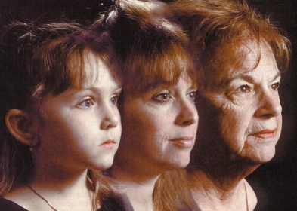
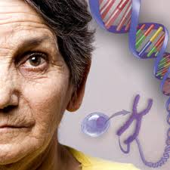
Why do people age?
There are many theories
Genetic and hereditary factors
Loss of cellular mass and ability of cells to divide and replicate
Accumulation of waste materials that clog cells and leads to cell death
Changes in structure of connective tissue (blood)

Slide 5
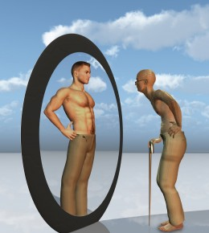
When does the aging begins?
The type, rate, and degree of physical, emotional, psychological, social changes experienced during life are highly individualized
Although some similarities exist aging is a
unique process in each person
Aging changes influenced by genetic factors,
environment, diet, health, stress, lifestyle choices,
and numerous other elements

Slide 6
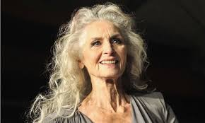
Changes to the body: Physical appearance
After 4th decade of life adults start to experience hair loss
Both sexes develop gray hair and wrinkles
Fat atrophy cause body contours gain bony appearance
Tissue elasticity cause elongated ears, double chin, baggy eyelids
Loss of subcutaneous fats cause older adults to be more sensitive to cold temperature
High decreases for about 2inches by 80 years old
Body shrinks due to reduced hydration, loss of cartilage, thinning of vertebra

Slide 7
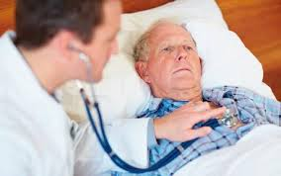
Changes to the body: Respiratory/Cardiovascular
Since older people can not breathe as fast, there is less oxygen entering the blood per minute. Less oxygen in the system cuts down the amount of work that can be done
Due to decreased mobility respiratory activity reduces gas exchange leading to high risk for developing respiratory infection
Heart losses its efficiency and contractile strength resulting in reduced cardiac output
Blood vessels lose elasticity with age making heart have to pump harder to circulate blood
Less blood pumped results in lowered blood oxygen levels

Slide 8
Changes to the body: Gastrointestinal system
Bone that support the teeth decrease in density and height, contributing to tooth loss
Tooth loss lead to dentures wear, which may not be worn regularly because of poor fit and discomfort
Taste sensation become less acute with age affecting taste buds
Excessive seasoning of foods lead to health problems
Slow motility of large intestine causes constipation

Slide 9
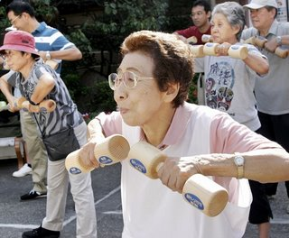
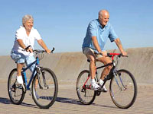
Changes to the body: Musculoskeletal system
Loss of elasticity of connective tissue can cause pain and impair mobility
No way to prevent these changes
Maintain bone health through diet,
exercise and getting adequate rest
Always consider medication side
effects when assessing mobility concerns

Slide 10
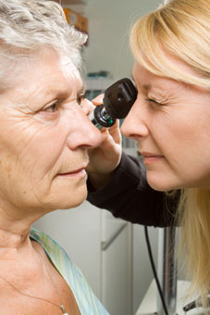
Changes to the body: Vision
Not all older people have impaired vision
Loss of ability to see items that are close
up begins in the 40’s
Size of pupil grows smaller with age:
focusing becomes less accurate
Lens of eye yellows making it more
difficult to see red and green colors
Sensitivity to glare increases
Night vision not as acute

Slide 11
Changes to the body: Hearing/Touch
Presbicusis is a progressive hearing loss that occurs as a result of aging
Have trouble hearing over the telephone/ Need to turn up the TV volume
Find it hard to follow conversations when two or more people are talking
Have a problem hearing because of background noise
Sense that others seem to mumble
Equilibrium cab be altered because of degeneration of the vestibular structures
Reduction in tactile sensation
Decreased sensation in pressure, pain, and different temperatures

Slide 12
Conclusion
We all change physically, as we grow older
Some systems slow down, while others lose their "fine tuning."
People who live an active lifestyle lose less muscle mass and flexibility as they age
As a general rule, slight, gradual changes are common, and most of these are not problems to the person who experiences them
Steps can be taken to help prevent illness and injury, and which help maximize the older person's independence, if problems do occur
There is no need for most people to fear getting older

Slide 13
The End

