Slide 1
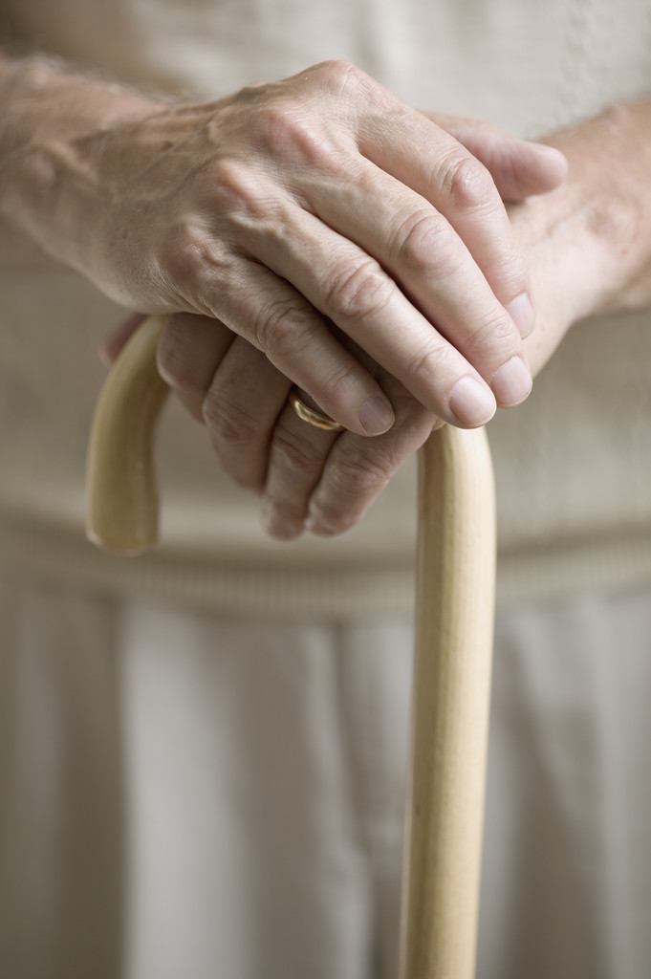
Fall Prevention in Elderly Population
New York City College
of Technology
Spring, 2014
Created by Nursing Students:
Gujina, Anastasiya
Kulikova, Elizabeth

Slide 2
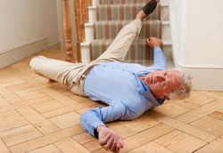
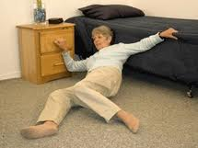
What is a fall?
An unintentional event that results in a person coming to rest on the ground, or another low level

Slide 3
Rate of Incidents of Injuries Among Elderly
An Estimated one in three people aged 65+ suffer a fall at least once a year, about half of those suffer multiple falls
Those who have fallen once have a greater chance of falling later
Approximately 1-2% result in a fractured femur or hip

Slide 4
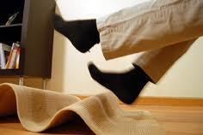
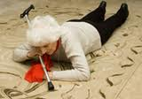
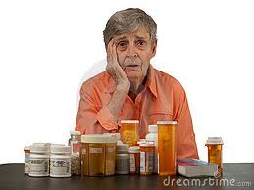
Why Do Seniors Fall More Than Others?
Advanced age
Poor balance and gait
Those living alone
Those with 1 or more diseases
People on multiple medications (4 or more)
Cognitively impaired
Decreased vision
Foot disorders/ Unsafe footwear
Unsafe clothing
Improper use of mobility devices
Environmental Hazards

Slide 5
What you need to do to prevent falls?
Do exercise (yoga, walking for 30min or more, get physical therapist evaluation)
Have Assistive devices (cane, walker, high seat and chair)
If noticed unusual or new symptoms notify your primary physician
Wear eye sight glasses at all times
Wear enclosed shoes at the front and back
Avoid scuffs, high hills, and sling backs (flat sole)
Avoid poor fitting clothing or tight clothing
Do not use assistive devices without being prescribed
Know proper and safe use of assistive devices
Watch out for the wet floor, poor lighting, clutter rooms, objects on the floor

Slide 6
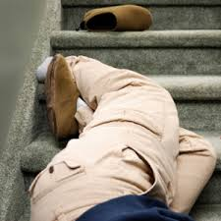
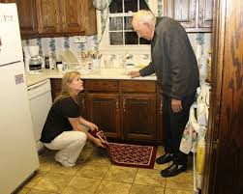
Hazards in home
Rugs and mats
Slippery and damaged floors
Electrical cords
Poor lighting
Unsafe bathrooms
Steps and stairs
Hazardous gardens and paths
Furniture
Ladders

Slide 7
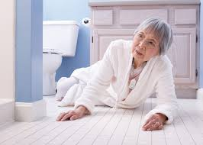
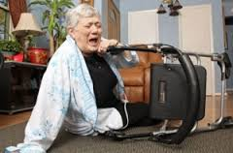
What to do if you fall?
Stay calm
Decide if you will try to get up
If you cannot get up try keep warm
Make a loud noise to get help
Always tell someone if you have had a fall even you don’t hurt yourself

Slide 8
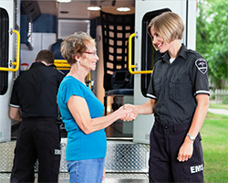
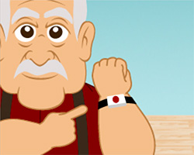
21st Century Saving life services
Get Medical alert alarm system: CALL 1-866-488-3012
People who live alone
Fast medical and professional help
Saving your life
Available 24/7
24/7 live operator
If necessary, we’ll contact friends, family, neighbors,
and your local 911 emergency services
Need help? Simply push your emergency medical alert button. Remain calm. Help is on the way!

