Slide 1
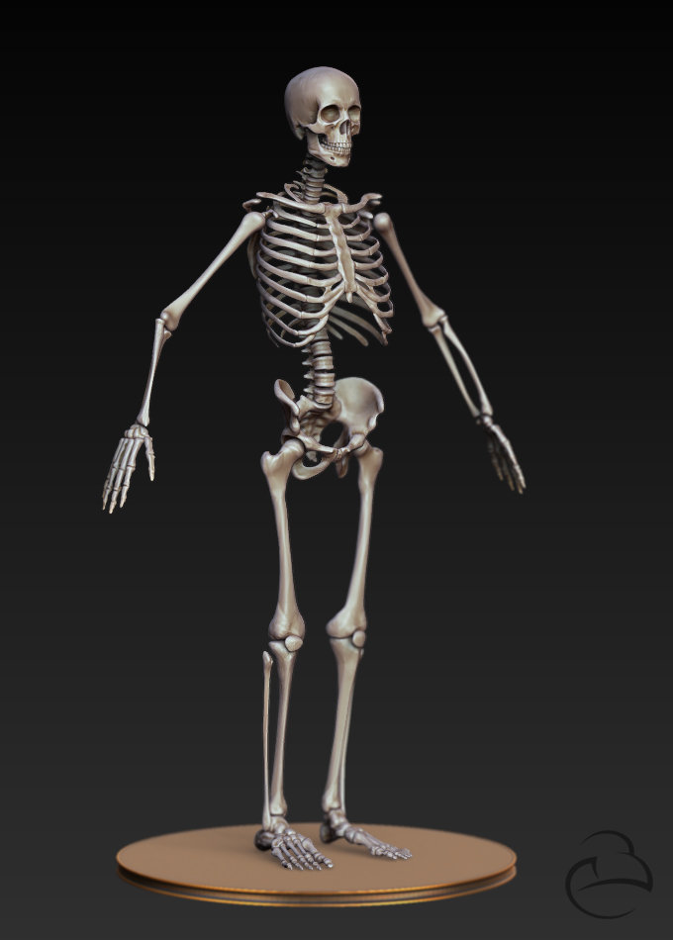
Bone Health
By: Tianna Cover
Zongfang Yang

Slide 2
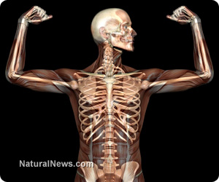
Bone health
Our bones support our body, helps us move, and protects our organs; which is why it is important to keep them strong and healthy.
The food that we eat and our daily activities can affect our bone health

Slide 3
What can I do to keep my bones healthy?
There are many things we can do to keep our bones healthy and strong.
Eating foods rich in calcium and vitamin D
Getting plenty of exercise
Having good health habits
But if we don’t eat right and don’t exercise enough, our bones can become weak and even break. Broken bones can be painful and problematic.

Slide 4
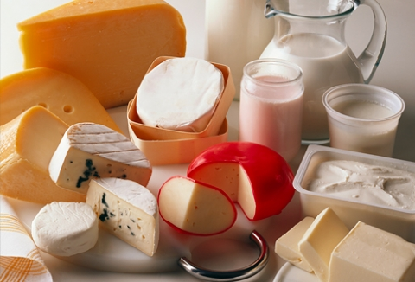
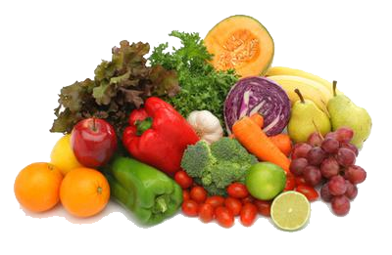
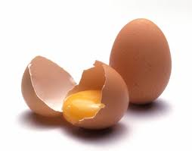
What kind of foods are rich in calcium and vitamin d
Milk
Yogurt
Cheese
Sardines
Eggs
Salmon
Spinach
Tuna
Soybeans

Slide 5
What kind of exercises keep my bones healthy?
Weight-bearing exercises help keep our bones strong.
For example:
Walking
Dancing
Jogging
Tai Chi
Yoga

Slide 6
what else can I do to keep my bones healthy?
Eat a well balanced diet
Get active ( exercise at least 30 minutes a day)
Decrease the amount of salt and caffeine in your diet
Stop smoking because it causes bones to weaken
Decrease your alcohol consumption

Slide 7
What may happen if I do not get enough calcium, vitamin d, and exercise?
Your bones may weaken
Your bones may break or fracture easily
You risk developing Osteoporosis

Slide 8
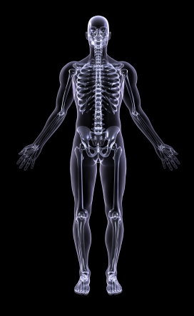
What is Osteoporosis?
Osteoporosis is the most common bone disease.
It causes our bones to become weak and they are more likely to break.
People with osteoporosis most often break bones in the wrist, spine, and hip.

Slide 9
What can I do to decrease my chances of developing osteoporosis?
Eat foods that are rich in Calcium and Vitamin D
Milk
Cheese
Tofu
Nuts
Fruits, and Vegetables
Exercises daily (at least 30 minutes)
Walk
Dance
Yoga
Tai Chi

Slide 10
Bone health
Our bones support our body, helps us move, and protects our organs. If we eat right and exercise daily we can keep them strong and healthy.

Slide 11
references
Bone Health for Life: Easy-to-Read Information for Patients and Families. (2011). Retrieved from http://www.niams.nih.gov/Health_Info/Bone/Bone_Health/bone_health_for_life.asp#2
Calcium and Bone Health. (2011). Retrieved from http://www.cdc.gov/nutrition/everyone/basics/vitamins/calcium.html
Top 10 Calcium-Rich Foods. (n.d.). Retrieved from http://www.webmd.com/food-recipes/features/10-calcium-rich-foods

