Slide 1
Personal care skills ADLs body mechanics
By Julia zanchenko, Sergey makov, and Vitaly semenov
NYCCT
2014

Slide 2
What are body mechanics?
Body mechanics refers to the way we move during every day activities.
Good body mechanics may be able to prevent or problems with posture

Slide 3
How do I practice good body mechanics?
When standing:
Wear shoes. They protect your feet from injury, give you a firm foundation, and keep you from slipping.
Keep your feet flat on the floor separated about 12 inches (30 cm).
Keep your back straight.

Slide 4
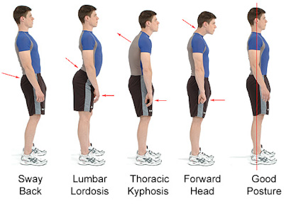
How do I practice good body mechanics?

Slide 5
How do I practice good body mechanics?
When walking:
Keep your back straight as you walk.
If helping a person to walk you may need one arm around the back of the person. Put the other arm at the side or ready to help the person if needed.

Slide 6
How do I practice good body mechanics?
When lifting an object:
Your feet should be apart, in a standing position.
Keep your back straight.
Lower your body to get close to the object.
Bend from your hips and knees. DO NOT bend at the waist.

Slide 7
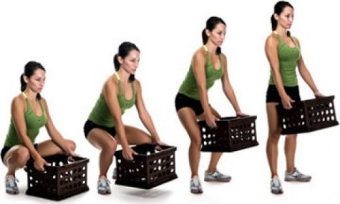
How do I practice good body mechanics?

Slide 8
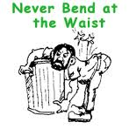
How do I practice good body mechanics?

Slide 9
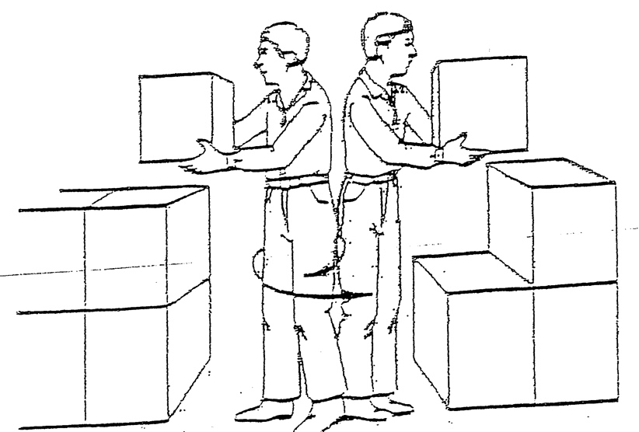
How do I practice good body mechanics?
When turning, rotate your whole body, not just your back.

Slide 10
How do I practice good body mechanics?
Hold the object by putting your hands around it. Keeping your knees bent and your back straight, lift the object using your arm and leg muscles. Do not use your back muscles.
If the object is too heavy ask another person to help you.
Many devices are available to help move or lift heavy objects. If you need help from a device.

Slide 11
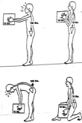
How do I practice good body mechanics?
When carrying an object:
Hold the object
close to your body.

Slide 12
How do I practice good body mechanics?
DO NOT carry things that are too heavy for you. Always ask for help to move heavy objects.
There are many devices available to help carry heavy objects

Slide 13
How do I practice good body mechanics?
Pushing or pulling:
Use the weight of your body to help push or pull an object.
Your feet should be apart as in the standing position.
Keep your back straight.
Lower your body to get close to the object. Bend from your hips and knees. DO NOT bend at the waist.
If the object or person you are pulling or pushing is too heavy ask someone to help you.

Slide 14
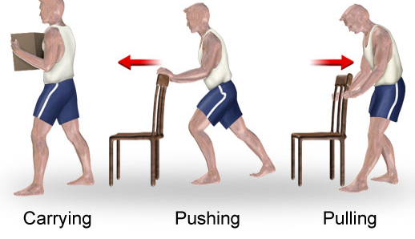
How do I practice good body mechanics?

Slide 15
How do I practice good body mechanics?
To position a person on his side in bed:
Ask or help the person to bend their knees.
Put a soft pillow between the knees.

Slide 16
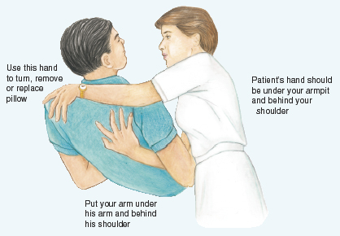
How do I practice good body mechanics?

Slide 17
References
1.Using good body mechanics. Retrieved from: http://www.drugs.com/cg/using-good-body-mechanics.html
2. The slow path to a healthy back. Retrieved from: http://theslowpath.com/blog/node/10
3. AllinaHealth.org. Retrieved from http://www.allinahealth.org/mdex/ND2555G.HTM

