Slide 1
Behavioral management in elder adults
Short survey
By
Lyubov Levina-Brooks

Slide 2
Summary
Once a person gets older he/she goes through many changes; most of those are irreversible.
Body and mind start declining, many skills get lost
Learning new skills gets harder and even impossible
Behavior Management: Acknowledges the limitations of the individual and works around those limitations

Slide 3
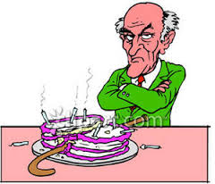
Main concerns in behavioral changes
Dementia describes a group of symptoms affecting thinking and social abilities severely enough to interfere with daily functioning
Alzheimer progressive disease that destroys memory and other important mental functions.
Examples of disturbing behavior:
Anger, screaming
Wandering
Memory loss, confusion
Impaired judgment, movement or language
Changes in eating patterns: forget to chew, refuses to eat, risk for choking, dehydration and malnutrition

Slide 4
Theories to explain aggression
•Cognitive Impairment noticeable and measurable decline in skills such as memory and thinking
•Functional status –unable to complete or initiate a task such as dressing, showering
•Environmental stimuli such as noises, –or social isolation, such as being lonely
•Emotional states such as anxiety, inability to express needs.

Slide 5
Anger/ Screaming
It is not ok to scream if you do not like something, if you just want attention, if you are upset at someone or many more situations.
Examples when screaming is ok: emergency situation, you fell and need help, to avoid danger, warn someone of danger.
Fighting is never ok!
Do not refuse help.
Stay peaceful!

Slide 6
Interventions for undesired behavior
•Regular routine/keep it simple/avoid changes
•Opportunity to participate/make choices
•Focus on assets(skills which are still available by patient) -use remaining abilities –
•Be flexible/alter situations
•Do not reason with those who can no longer think logically
•Approach slowly from the front in a friendly manner
•Rest between stimulating activities
•Sensory stimulation: Aroma therapy, Massage, Pet/Music therapy, video tapes of family
• Recreational interventions: Exercise movement program, Walking program, Games, Music/singing

Slide 7
Interventions for Wandering
•Daily exercise
•Attempt to pinpoint cause
•Is wandering a problem? For whom?
•Safety for wandering person
•Locks/bells on doors, nightlights
•Fence/hedge
•Photo/ID
•Reassurance

Slide 8
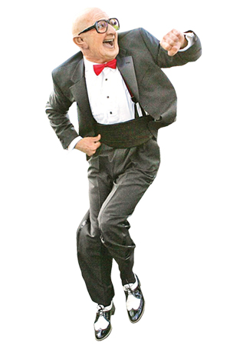
Interventions for poor eating behavior
•Good lighting/diffuse lighting
•Avoid clutter/distractions
•Music
•Colorful dishes/glasses –red/blue
Small frequent meals/1 course at a time
•Finger foods
•Sit up/feet on floor/chin tuck position
•Remain upright for 30-60 min after meal
•Sit and feed at patients eye level/make eye contact
•Larger meal breakfast/lunch
Frequent verbal cueing of desired behavior
•Vitamin/mineral supplement
•Observe rituals –hand washing/blessing
•Keep food as close to original form
Relearn eating behavior –hand over hand guide
•Dentures in place, mouth care
•Dental soft diet
•Wear glasses/hearing aids
•Exercise

Slide 9
Thank you for attention
Take good care of yourself and family!
Stay fit and healthy!

