Slide 1
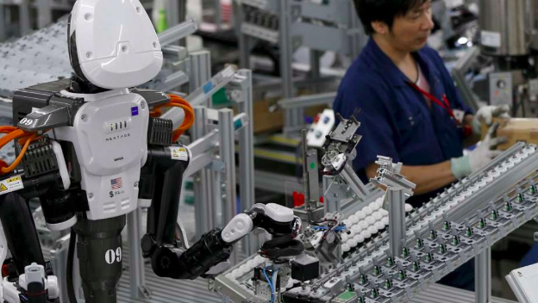
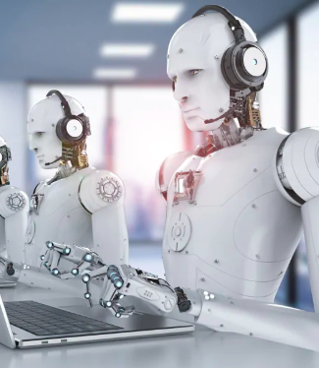
Robots In The Fashion Industry
Brenda Mendez
BUF 4700
Prof. Appelstein

Slide 2
“You’re either the one that creates the automation or you’re getting automated” (Tom Preston Werner)
Thesis Statement: Robots and technology are almost done in taking over the fashion industry and jobs available, but they have come along with both pros and cons that led to a divided opinion about their significance in the industry.

Slide 3
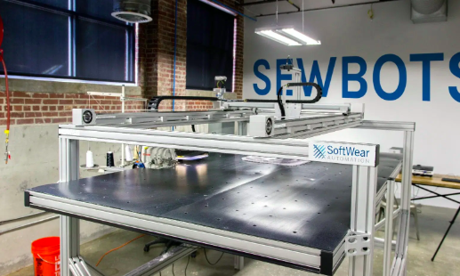
Cons of robots & technology
Job losses remain the biggest negative impact that technology and the use of robots in the fashion industry have attracted. Designers, analysts and common laborers in textile companies are all at risk of losing their jobs to robots
Sewbots: To replace humans for machines.
9 million people working in the textile, garments and footwear companies within the Association of Southeast Asian Nations (ASEAN) inclusive of Vietnam, Cambodia, Malaysia, and Thailand to lose their jobs

Slide 4
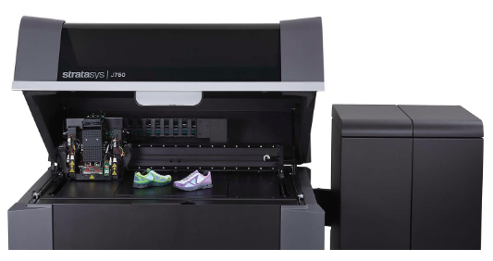
Cons of robots & technology
“Stratasys J750 / J735 Pantone Colour 3D Printer with Texture Mapping.” Javelin 3D Solutions, 11 Jan. 2019, www.javelin-tech.com/3d/stratasys-3d-printer/stratasys-j750/.
Besides the already available jobs getting lost, the use of technology and robots in the fashion industry is also stopping youthful individuals from having jobs in the industry
3D Technology/J750 polyjet Printers can produce 5 million combinations of colors.
Youthful designers have found it difficult to find jobs.

Slide 5
Cons of robots & technology
The loss of human interaction in the fashion industry is also another negative development that has emerged as a result of companies in the industry developing using technology and robots in human resource departments
Nike Maker’s Experience system that makes use of Augmented Reality (AR) which relies on customers' graphics and colors to design shoes with no human employees
Absence of humans denies customers the affection and consistency they require.

Slide 6
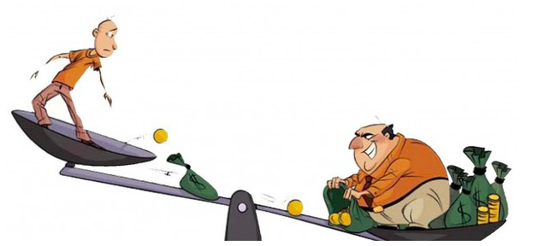
Cons of robots & technology
The use of technology and robots in the fashion industry has also magnified the disparity between the highest earners in the industry and the lowest earners.
“The poor are becoming poorer while the rich continue growing rich.”

Slide 7
Pros of Robots and Technology
Robots and technology have also come with their benefits.
It is not only benefitting the owners of the companies but also the world economy at large.

Slide 8
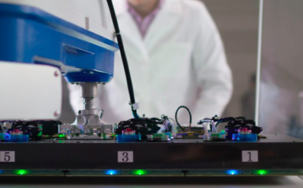
Pros of Robots and Technology
robots have reduced the time used in manufacturing products in the industry and this has also resulted in reducing the cost of production.
Hence, companies that have embraced use of the technology in the fashion industry have reduced the number of workers needed and the time required which is a competitive edge in the industry.
Staff, T. R. R., & Staff, T. R. R. (2019, February 12). Grabit Robots Use Static Electricity to Make Nikes Faster than Human. Retrieved from https://www.therobotreport.com/grabit-robots-make-nikes-faster-humans/.

Slide 9
Pros of Robots and Technology
The use of robots in the fashion industry has reduced the cost of products from the industry which has increased affordability of many customers and therefore, growth of the industry.

Slide 10
Pros of Robots and Technology
Reducing the cost of production and the price of products, use of technology in the fashion industry has also led to improved levels of protecting the environment.

Slide 11
Conclusion
The use of robots and technology in the fashion industry has resulted in both advantages and disadvantages leading to a divided opinion over their contributions to the economy.

