Slide 1
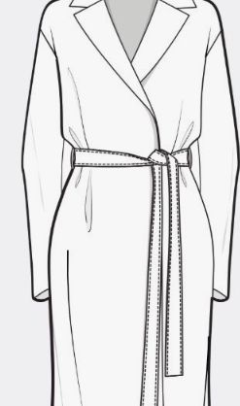
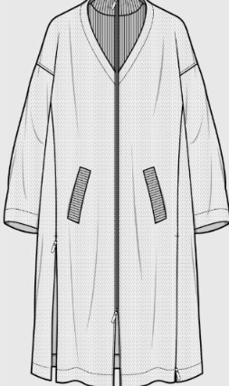
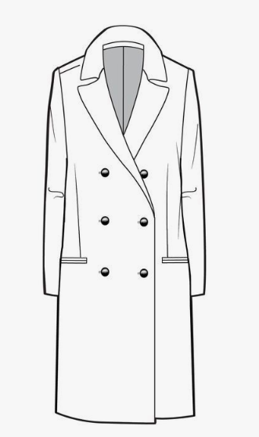
PEACMELUXURY♥ Brenda Mendez Fall/winter 2019/2020 collection

Slide 2
About PeacMe
The women’s 2020 Fall/Winter Collection will follow its historical traditions with pea coats. Pea Coats continue to evolve through history as it has made its way to being a “classic piece” that everyone has in their closet.
The reason why these products are such classic pieces is because they help women not only to conclude their outfit, but to walk in the streets with style -- to feel confident. The new collection would bring you different kinds of pea coats, which are belted, button down, and wrapped.

Slide 3
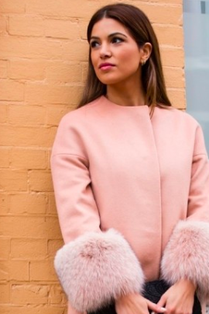
Target Market
Jessica Shwartz is our preferred consumer.
Jessica is a perfect example of our target market because she is a beautiful 30 year old women who has her PhD in fashion design, She makes 150,000 a year doing what she loves, she loves to cruise in her BMW I8 and goes to Paris twice a year.
Jessica’s life consist of traveling, having important events, playing tennis, hang out with her girlfriends and go on dates.
Jessica is still single and ready to mingle. She has no kids therefore, she can afford all of these products and everything else she desires.

Slide 4
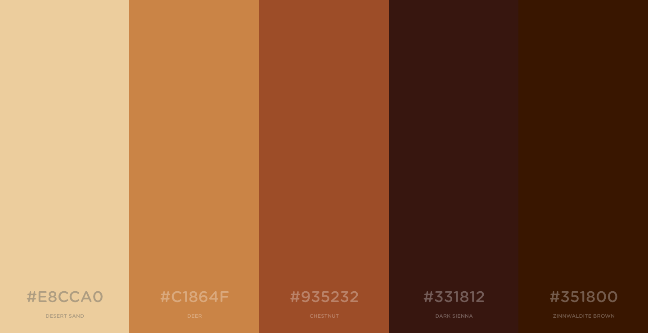
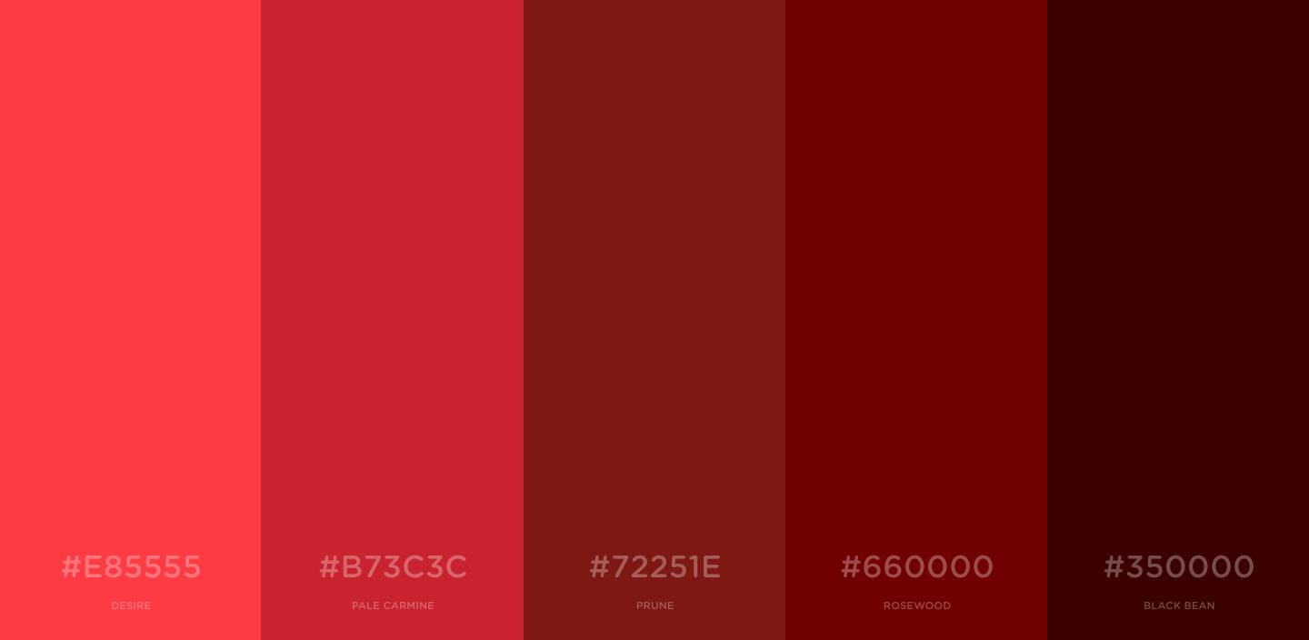
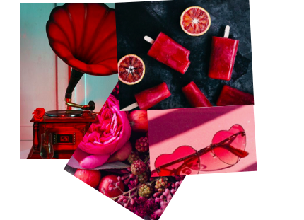
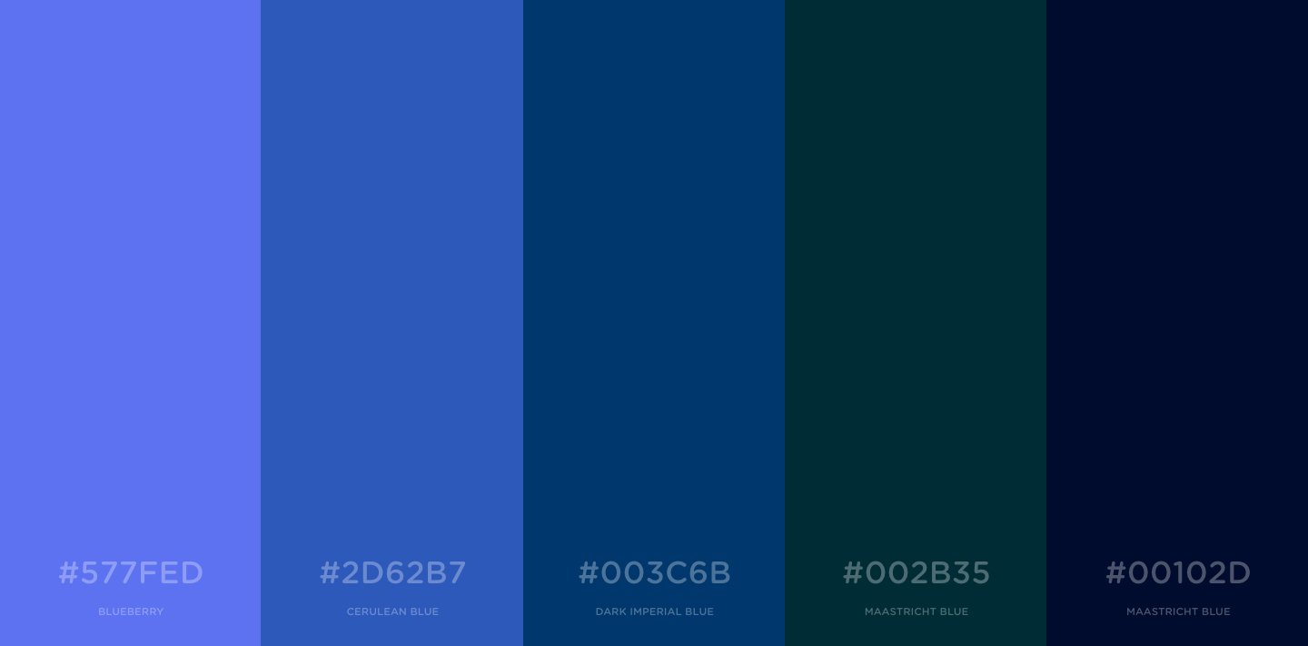
Button Down Pea Coats
Wrapped Pea Coats
Zipped Down Pea Coats

Slide 5
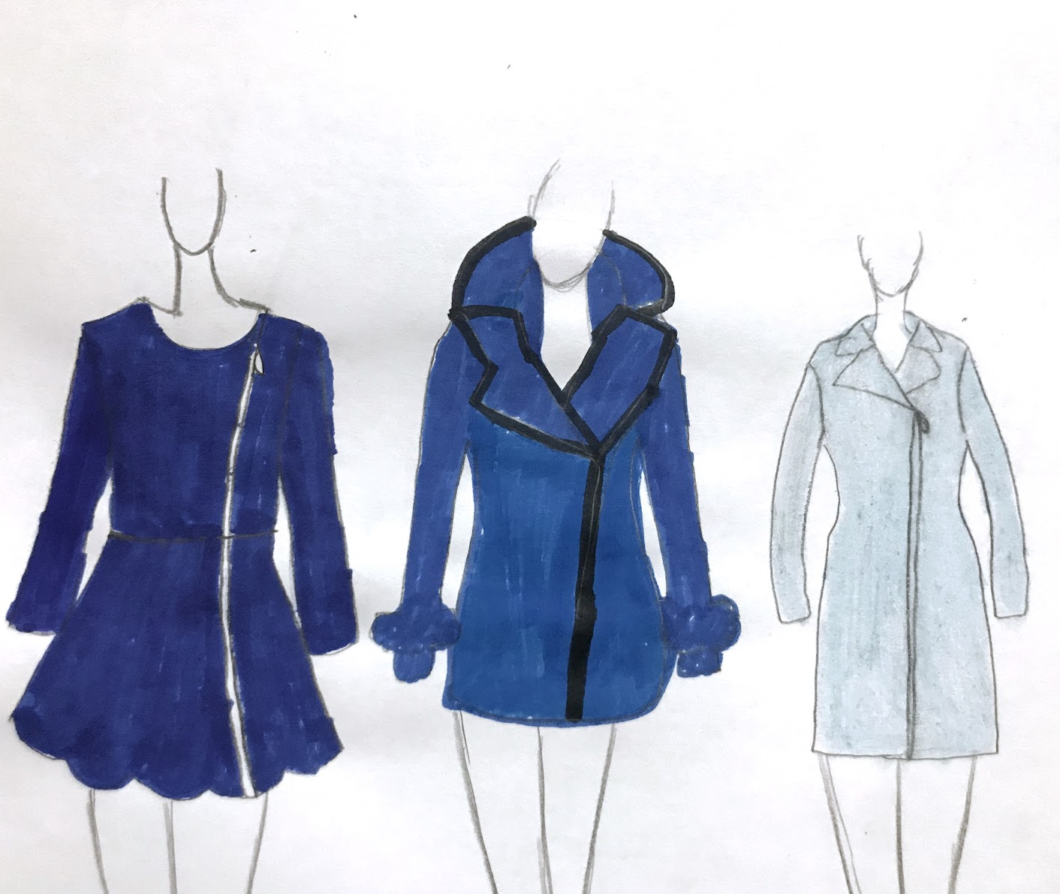
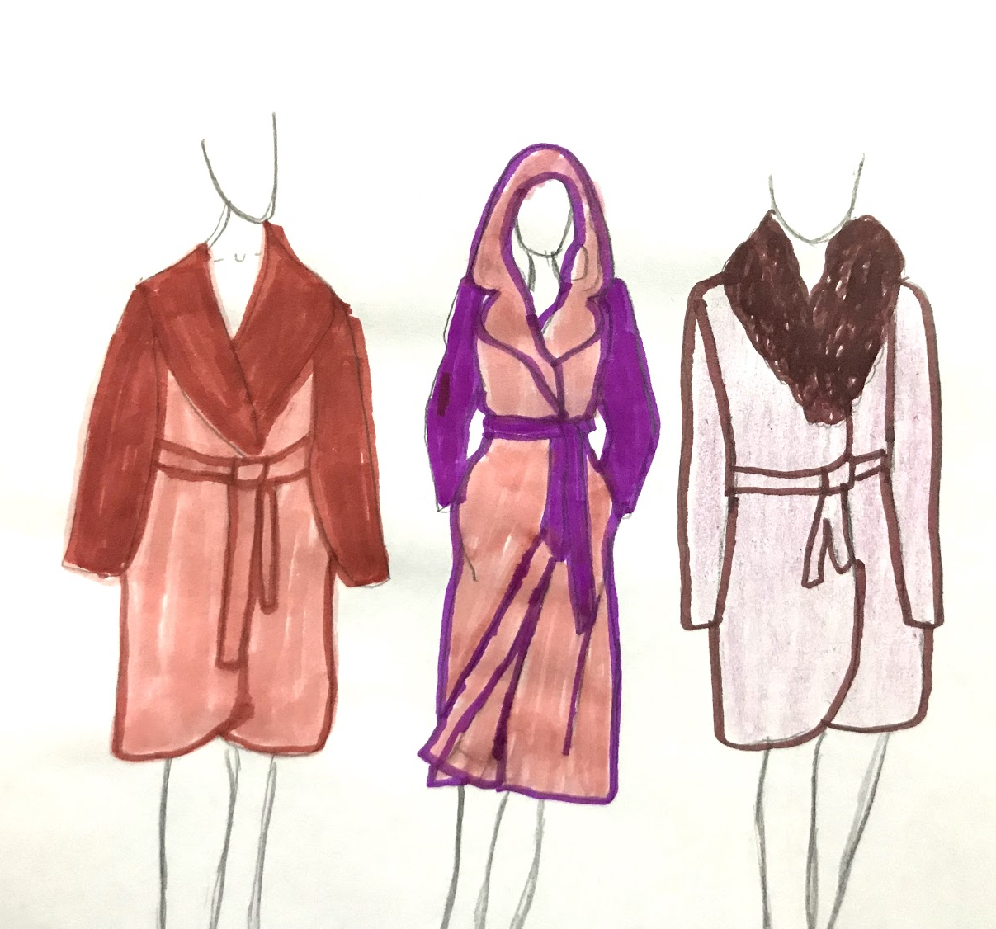
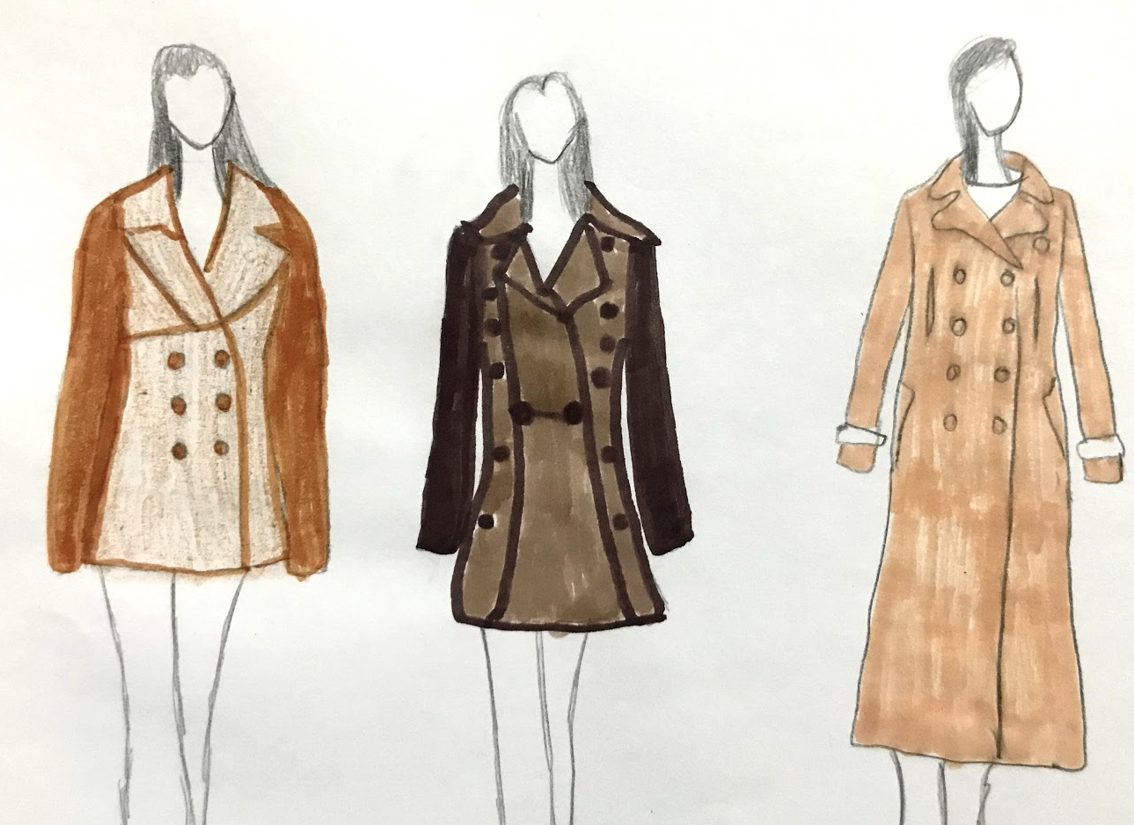
The reason why we are a “luxury” brand of pea coats is because we use different varieties of special fabrics like the finest wool which is merino wool, we use silk, and we also would be using chinchilla fur on our collard pea coats.
I loved the idea to put my three different trends and styles in different color scheme categories.

Slide 6
Thank You! You can visit us PeacMeluxury.com

