Slide 1
ENG 1121
UNIT 2
FEATURE ARTICLE
Understanding where we are as a brand and how our competitors work.

Slide 2
TODAY'S AGENDA
1
What is a feature article and why is it a good composition assignment
2
Scaffolding the assignment
3
Student examples
4
Q&A: 1121 and Model Courses

Slide 3
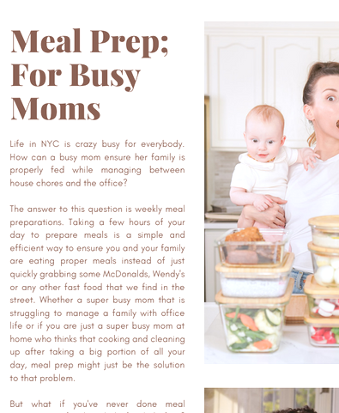
INTRODUCTION
What is a feature article?
A feature article is a news story that goes beyond the facts to weave in a narrative and tell a compelling story. A feature article differs from a hard news story as it offers an in-depth look at a particular subject, current event, or location to audiences. A good feature story will keep the reader’s attention until the end, delivering a fleshed-out narrative and creating a lasting impression. Master Class
Between hard news and opinion lies information hiding inside a narrative

Slide 4
MY PEDAGOGICAL CHECK BOXES
Genre analysis and awareness
Rhetorical analysis - audience and credibility
Research tools for general audience

Slide 5
Overview/Roadmap
The Assignment

Slide 6
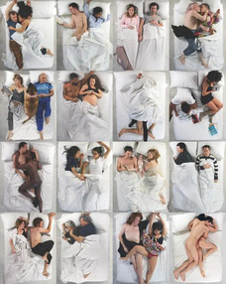
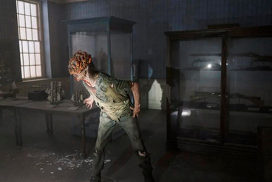
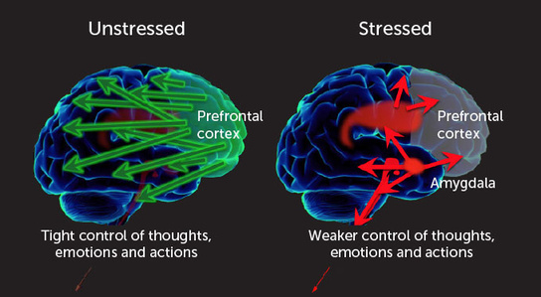
Cory Booker (opinion)
MENTOR
TEXTS
LaTasha Barnes (culture/biography
End of Privacy. (call to action)
Marriage (cultural analysis)
Vaccines for fungus (science)
Covid made us stupid (science)
Perusall

Slide 7
from the Model Course Hub

Slide 8
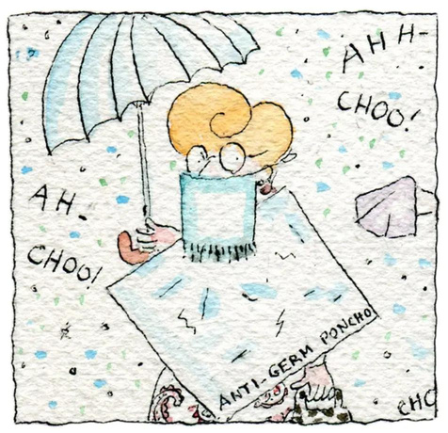
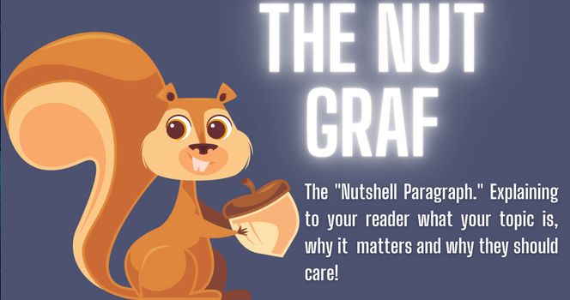
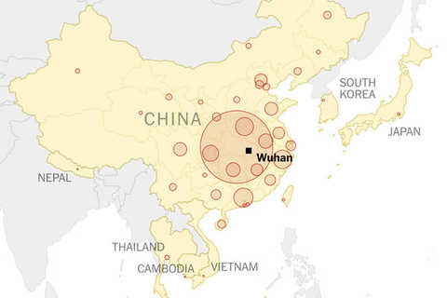
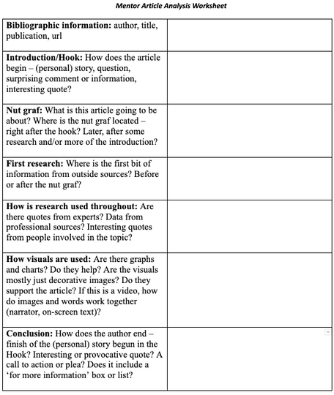
THE ELEMENTS OF A FEATURE
INTROS & CONCLUSIONS
THE NUT GRAF
ANALYZING A FEATURE
GROUP ANALYSIS OF MENTOR TEXT
from NY Times on intros
from the Model Course Hub
Coronavirus article from 2020
The worksheet

Slide 9
Don't forget about interviews!!!
Overview/Roadmap
how to do interviews
Picking a topic
questions
Padlet
KWL+
Short rhetorical analysis
Pitch
More Illumination than persuasion

Slide 10
MAKE IT LOOK LIKE AN ARTICLE
Student examples
Meal prep for busy moms
Looking good is feeling good
Canva, Word, Google Docs
Ft. Hood cooking
Journey to Mars
World around introverts
Sleep

Slide 11
Q & A
ENG 1121 Unit 2
Model Courses
Donna.Blain18@citytechy.cuny.edu

