Slide 1
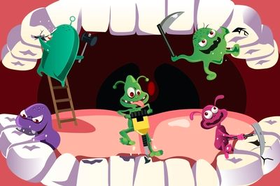
Brittany Gallo
Nutrition in relation to Dental caries

Slide 2
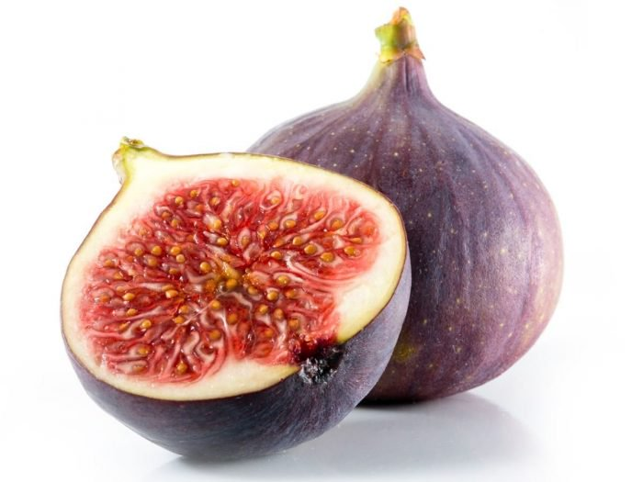
FUN FACT:
Dental decay was discovered in the 1800’s due to sweet fig consumption. They discovered the sticky fruit stuck to the teeth causing much more plaque build up and leading to dental decay

Slide 3
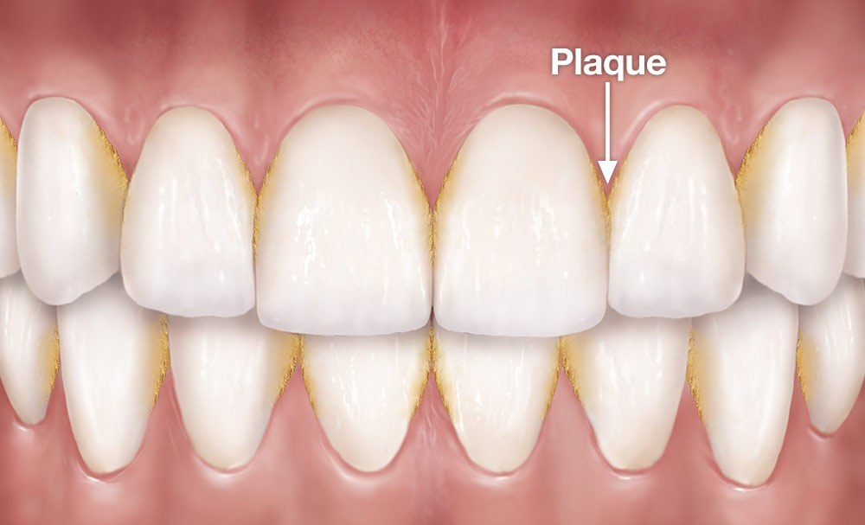
WHAT YOU EAT ISNT ALWAYS JUST ABOUT CALORIE COUNTING.. WHAT YOU EAT CAN EFFECT YOUR TEETH.. how?
Eating sugary foods or sipping sugary drinks can cause plaque to sit on your teeth
Have you ever had a fuzzy
feeling on your teeth ?
Plaque is a sticky layer of bacteria
on your teeth
Eating foods high in sugar like
Sweets, fruits, and soda
can accelerate plaque
growth

Slide 4
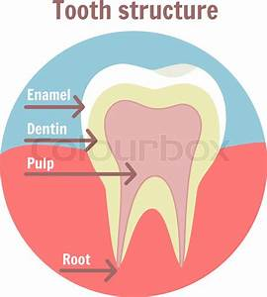
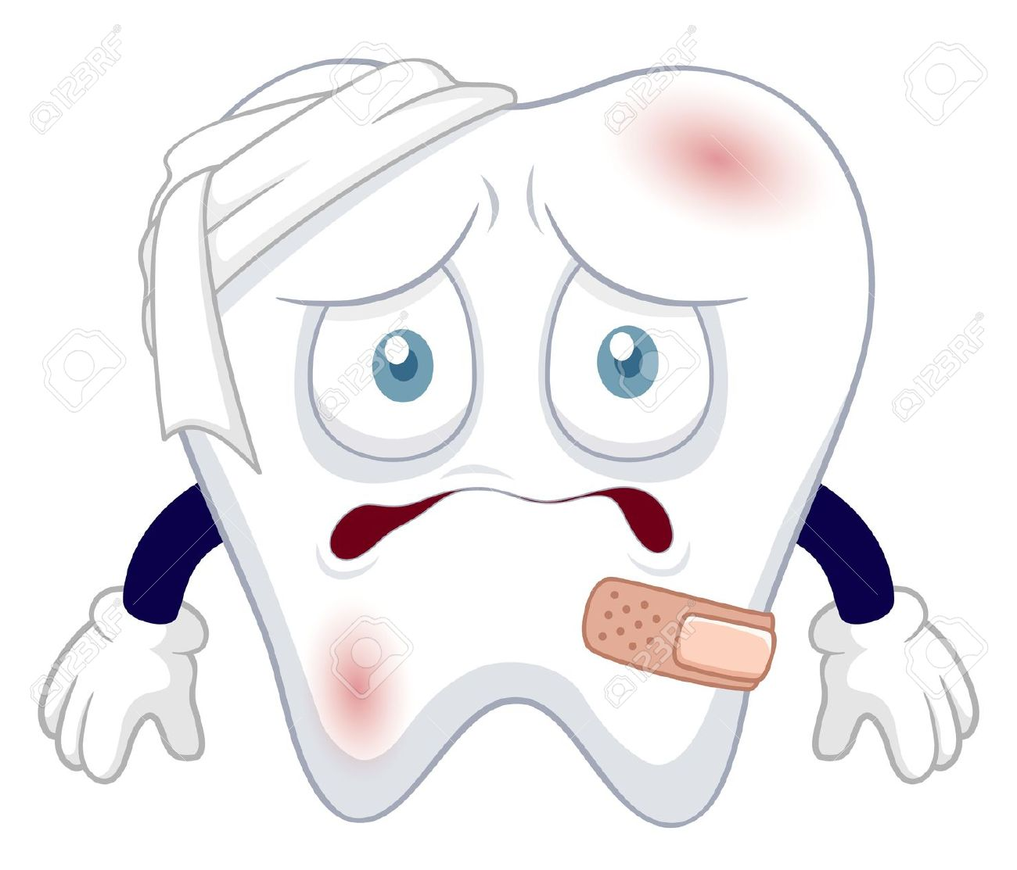
Plaque (bacteria) + sugar = ACID
After long periods of time with plaque and
often consumption of sugar on your teeth..
an acid is produced
This acid than begins to eat away at
your outer tooth layer known as enamel

Slide 5
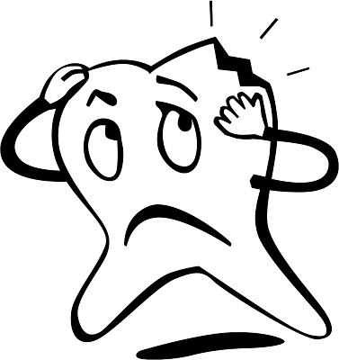
Dental caries
Once the acid has eaten away at your tooth layer it is known as dental caries also known as cavity!
If left untreated, the disease can lead to pain, tooth loss, infection, and, in severe cases, death.

Slide 6
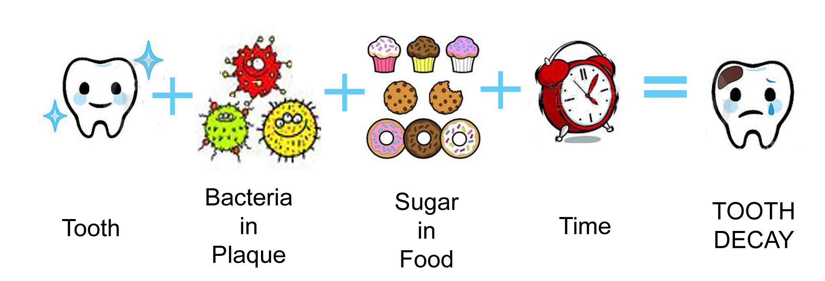
Time line to dental caries

Slide 7
Foods with sugar
As you can see what you eat has a major effect on your teeth.
Sugars will cause dental decay to occur.
Some common foods to avoid or have in small moderations:
Candy
Soda, Sports drinks
Desserts (Cake, cookies, pastries)
Gum (* try sugar free)
Coffee ( *with added sugar)
Fruits
Alcohol
& many more you can research!

Slide 8
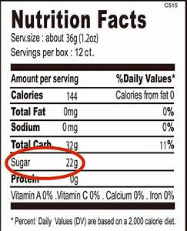
How to manage your sugar intake to help prevent tooth decay/ caries
Watch the sugar intake on the nutrition
Label. You want to consume foods and
Drinks with LOWER sugar level.
The less sugar intake you have, in small
moderations, the less chance for caries

Slide 9
Rinse with water
If you cant stay away from the sweets as much as you should ….
Rinse your mouth with water after consuming the sugar
This can help rinse away the sugar and not have it sitting on your teeth

Slide 10
BRUSH, FLOSS, RINSE
Oral hygiene is very important after consuming all the sugar filled foods and drinks
Morning and night should consist of brushing, flossing and rinsing to keep away the bad bacteria

Slide 11
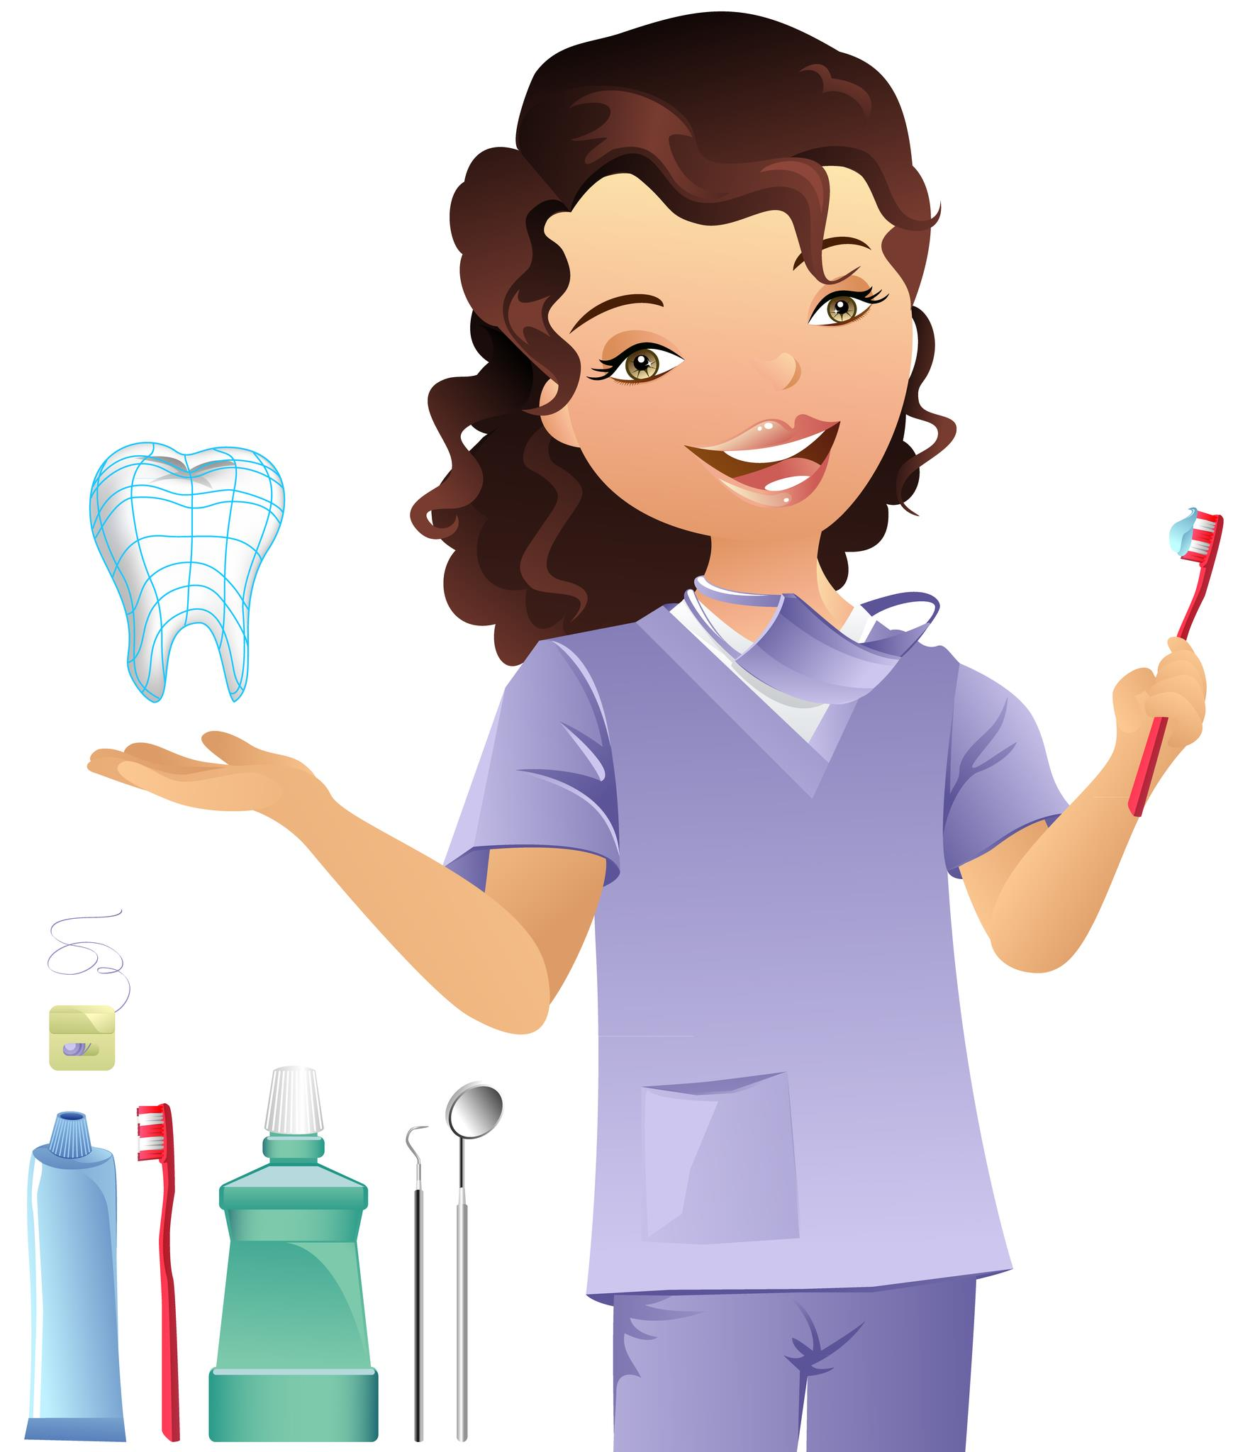
See your Dental professionals
You want to see your Dental health care professionals on 6 month recalls for professional cleanings and check ups to keep away the plaque and early caries if found

Slide 12
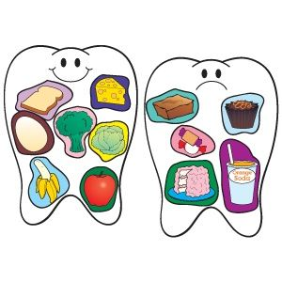
YOU ARE WHAT YOU EAT
Stay alert of your nutritional habits.
Nutrition is a major part of your health not only for your body but also your oral cavity, that’s where good nutritional habits start.

Slide 13
ANY QUESTIONS?

