Slide 1
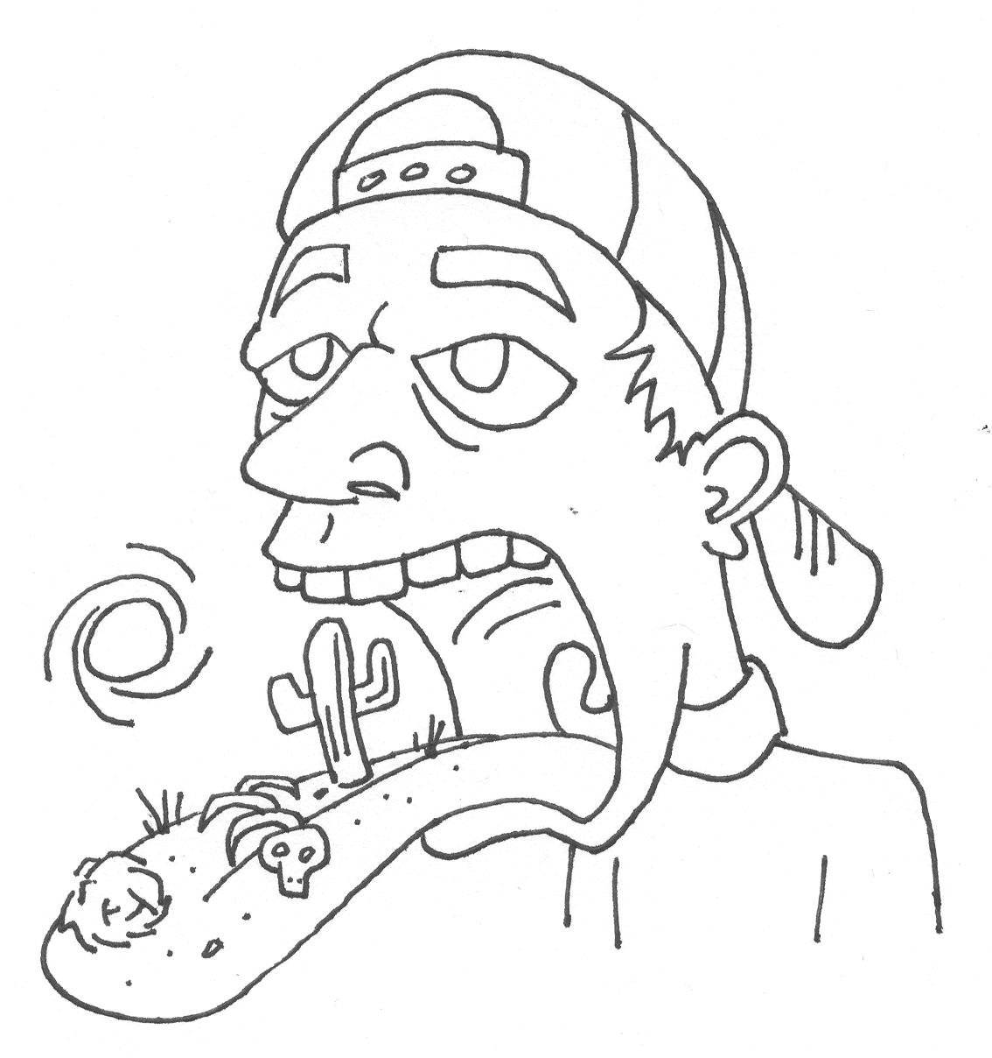
Xerostomia
Brittany Gallo
D200

Slide 2
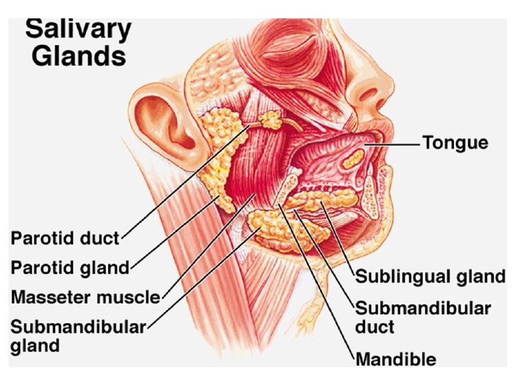
What is Xerostomia?
Xerostomia (ZEER-oh-STOH-mee-ah) is another word for dry mouth. Dry mouth occurs when the salivary glands don't work properly. Your salivary glands produce saliva, which keeps your mouth moist, helps protect your teeth from decay, and helps you digest food. The salivary glands are small and are located around the inner linings of your mouth, lips, and cheeks.

Slide 3
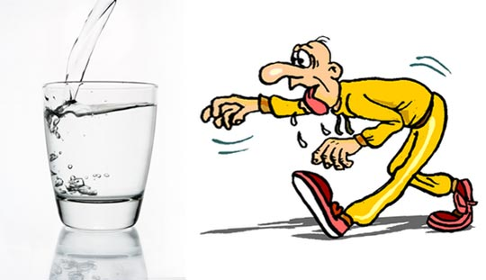
What causes Xerostomia?
Everyone has a dry mouth once in a while if they are nervous, upset or under stress. But if you have a dry mouth all or most of the time, it can be uncomfortable and can lead to serious health problems. Dry mouth affects all people but is more prevalent in women than men. Some causes of Xerostomia is due to aging, diseases, medications, anxiety, being pregnant, radiation, nerve damage, smoking, and bacteria or infections in the oral cavity.

Slide 4
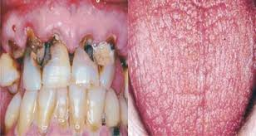
Developmental Disturbances
Xerostomia can lead to a greater risk of gingivits (gum disease), tooth decay, cervical carries, speech problems, and mouth infections.

Slide 5
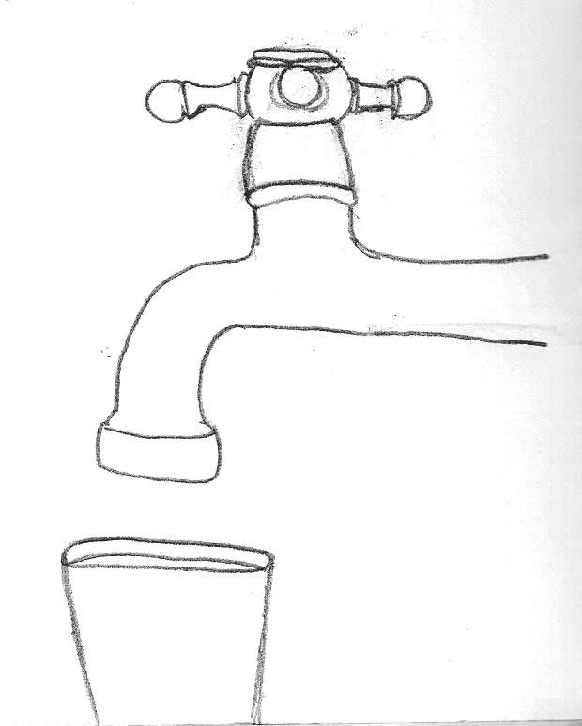
Abnormality Occurrences
-Chemotherapy treatments cause dry mouth by damaging the salivary glands.
-Radiation therapy to the head, face,
or neck may also cause dry mouth.
-Antidepressants, medications called
diuretics that increase urination, and
some painkillers can cause dry mouth.

Slide 6
Recommendations for Xerostomia
Xerostomia is a symptom, not a disease. Tell your dentist and hygienist about your dry mouth. They will try to determine the cause. Your dentist will ask you about your medical history and your symptoms. He or she will ask about any drugs you are taking. This includes prescription, nonprescription and herbal remedies. The dentist also will examine your mouth. He or she will assess the flow of saliva and look for cracks, sores, and signs of cavities and gum disease. Your doctor will recommend that you practice good dental hygiene. This means that you should brush and floss properly. You should have regular dentist visits as well.

Slide 7
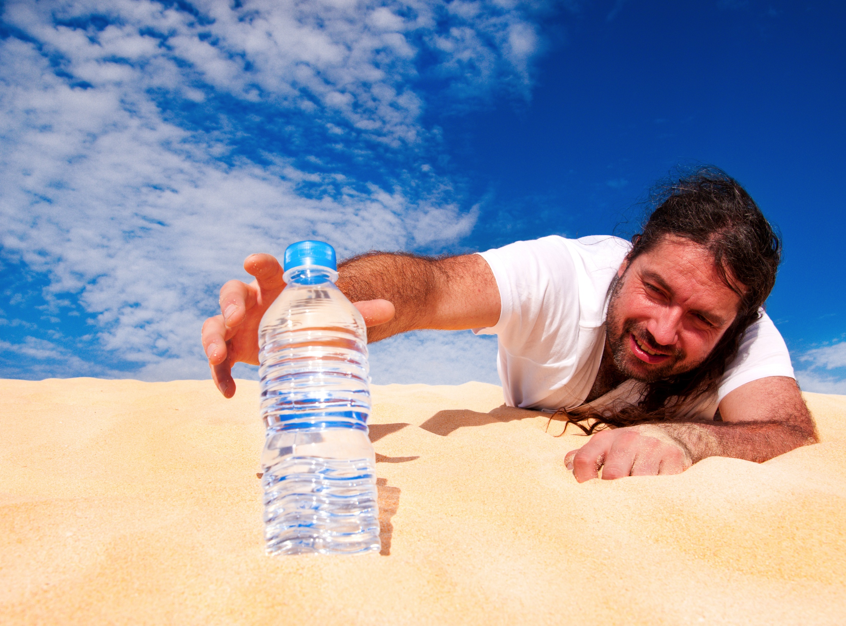
Treatment for Xerostomia
-Drink water often to keep your mouth moist. Carry water with you. Sip it throughout the day. Keep water by your bed at night.
-Suck on sugar-free hard candies, ice chips or sugar-free ice pops.
-Use an over-the-counter oral moisturizer or saliva substitute.
-Use mouth rinses or mouthwashes that do not contain alcohol.
-Avoid salty foods, dry foods (crackers, cookies, toast) and foods and beverages with high sugar contents.

Slide 8
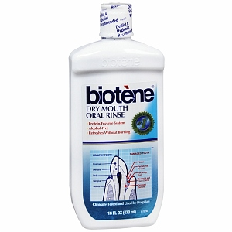
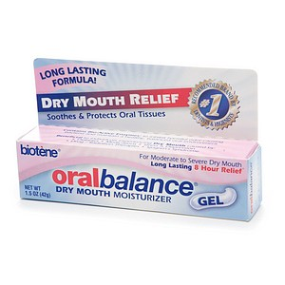
Care Recommendations

Slide 9
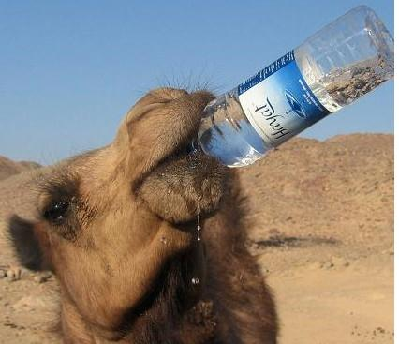
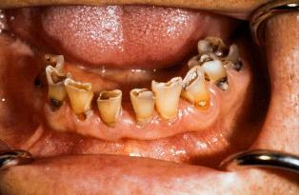
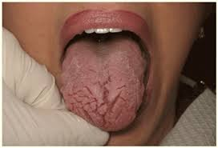
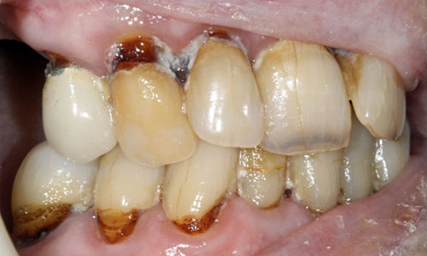
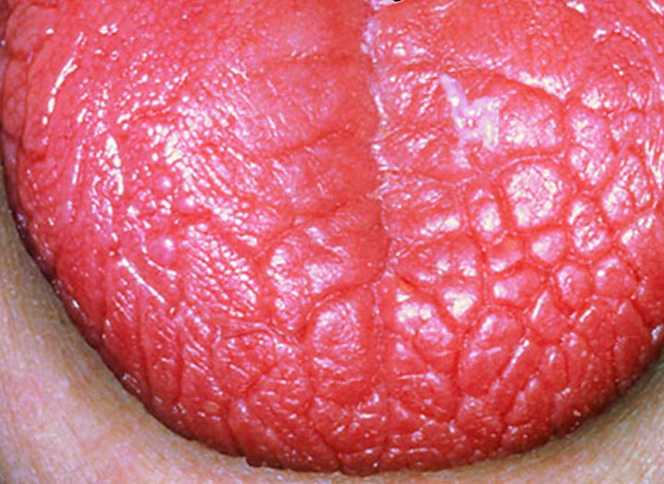
Hope to never see you in the desert of Xerostomia!!!

