Slide 1
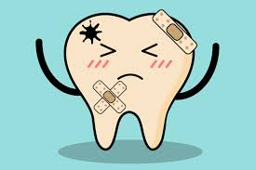
New York City College of Technology Department of Dental Hygiene DEN 2300 Case Presentation
Brittany Gallo
December 10, 2018

Slide 2
Patient Profile
Mr. M is a 35 years old male.
Single, middle- class, lives in suburbs.
Has a master’s degree in Biology,
and is a professor at city tech college.
He currently has dental insurance, but heard about the program through students.
Patient’s last dental appointment was in June 2018 for annual checkup, X-rays (Bitewings), and cleaning.
Patient states brushing 2-3x times per day, using manual toothbrush with medium bristles, Colgate total toothpaste, Listerine cool mint mouth wash, and occasional flossing.

Slide 3
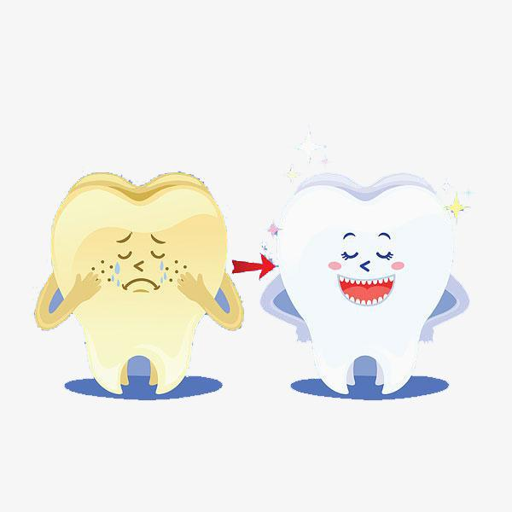
Chief Complaint
Patient states that his
“teeth are very yellow”.
He presented with
severe erosion, on buccal,
lingual, and occlusal surfaces.
Mr. M made a dental appointment to “make his teeh, “white and more clean”

Slide 4
Health History Overview
Blood Pressure: 130/90
Pulse: 85
ASA II
Patient states he has been treated for Hodgkin’s lymphoma in 2003 with chemotherapy and radiation. In September of 2004 Mr. M, relapsed and was treated with a bone marrow transplant.
Patient also presents with diagnosed GERD in 2005. He states it is untreated.
No current medications are being taken.

Slide 5
Hodgkin’s lymphoma (HD) Hodgkin’s lymphoma (HD) is a type lymphoma, which originates in white blood cells that help protect you from infections. These white blood cells are called lymphocytes. In people with Hodgkin’s lymphoma their cells grow abnormally and spread beyond the lymphatic system. As the disease progresses, it makes it more difficult for your body to fight infections. The disease has been linked to DNA mutations or changes, as well as Epstein- barr virus, which causes mononucleosis.
Hodgkin’s Lymphoma (HD)
Notes:
https://www.cancercenter.com/hodgkin-lymphoma/symptoms/

Slide 6
Hodgkin’s Lymphoma (HD) continued..
The most common signs and symptoms of Hodgkin’s lymphoma is swelling of the lymph nodes, which causes a lump to form under the skin. The lump is usually not painful. The lumps can normally be palpated on the neck, armpit, and groin area. Other signs and symptoms associated with HD are night sweats, itchy skin, fever, fatigue, unintended weight loss, persistent cough, trouble breathing, chest pain, enlarged spleen, and pain in lymph nodes after alcohol consumption
Hodgkin’s lymphoma can occur at any age, but mostly affects people between ages 15 to 40.

Slide 7
Hodgkin’s lymphoma management
Chemotherapy and radiation are the main treatments for Hodgkin’s lymphoma. Depending on the severity of the disease one or both treatments might be used.
Relapse patients are treated with stem cell transplant also known as bone marrow transplants. This is a way of giving a very high dose of chemotherapy.

Slide 8
Dental Hygiene management/ contraindications of Hodgkin’s lymphoma
Patients can be more likely to get an abscess or infection while under radiation, or chemotherapy because they are immunocompromised. Dental emergencies can often be treated on an as needed basis during chemotherapy carefully timing the dental work around the low point of patients blood count.
Consultation with oncologist should preformed for dental visits during radiation, chemo therapy and bone marrow transplants.

Slide 9
Dental Hygiene management/contraindications of Hodgkin’s lymphoma continued..
Blood should be drawn 24 hours prior to dental treatment to see platelet count.
Patients being treated for Hodgkin’s lymphoma with radiation and chemo therapy or more susceptible to being nauseous and vomiting which can lead to erosion in the oral cavity.
Our goal has hygienist is to prevent oral disease and manage oral health of patient safely during the treatment of HD.

Slide 10
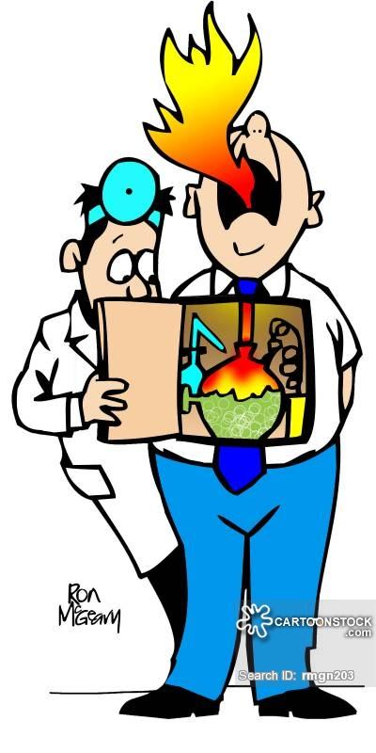
GERD
GERD is a condition called Gastroesophgeal reflux disease. This occurs when stomach acid frequently flows back into the tube connecting your mouth and stomach, this can irritate the lining of your esophagus.
Several factors can cause GERD to occur such as hiatal hernia, smoking, obesity, pregnancy, certain food and drinks such as alcohol, carbonated beverages, spicy foods, fried foods and citrus fruits.
Signs and symptoms of GERD would include a burning sensation in your chest (heart burn), chest pain, difficulty swallowing, regurgitation of food, sensation of lump in your throat.

Slide 11
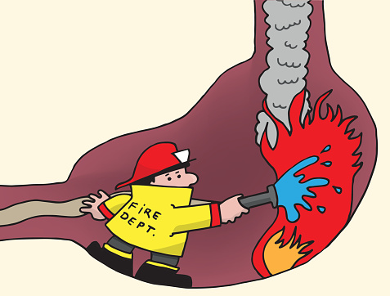
GERD management
Most people can manage GERD with lifestyle changes and over the counter medications. If the patient does not experience relief within a few weeks, the doctor might recommend prescription medication or surgery.

Slide 12
Dental hygiene management/ contraindications of GERD
Remineralization therapy is important part of protecting the long term health of the dentition. Remineralization treatments can be administered professionally and recommended as apart of a patients self care routine. Not only will these treatments help patients with erosion due to acid reflux, but they will help control damage to the enamel from futher demineralization. Topical fluoride in office treatments can be given every 3 months to help keep the dentition in stable. Topical fluoride through varnish application, rinses, tooth paste can also be recommended by oral health are providers.

Slide 13
Radiographs
There were no radiographs present during treatment.

Slide 14
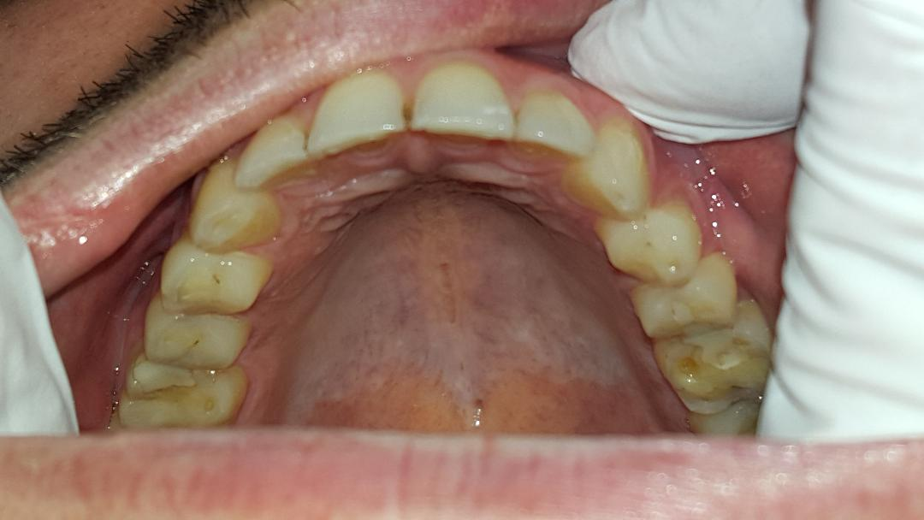
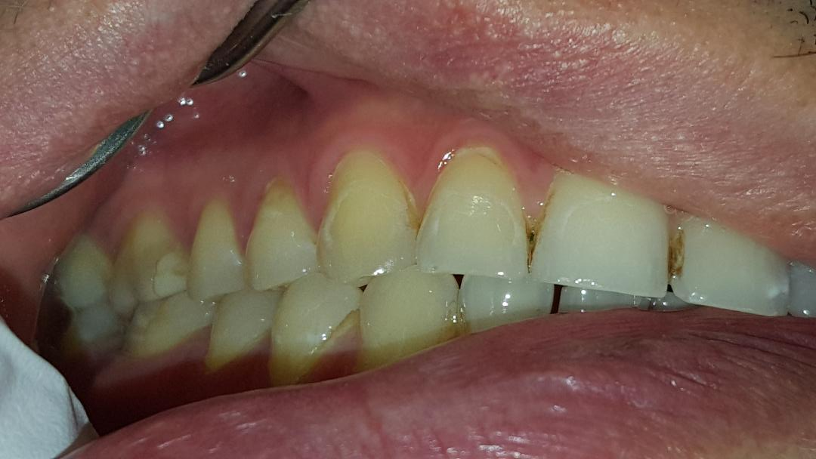
Intra Oral Photos

Slide 15
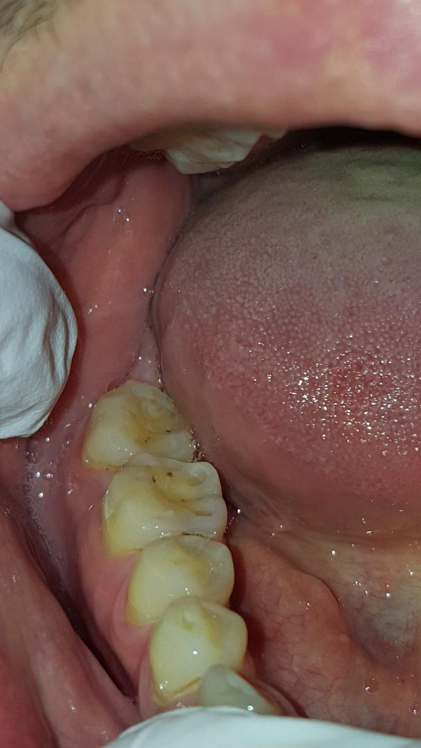
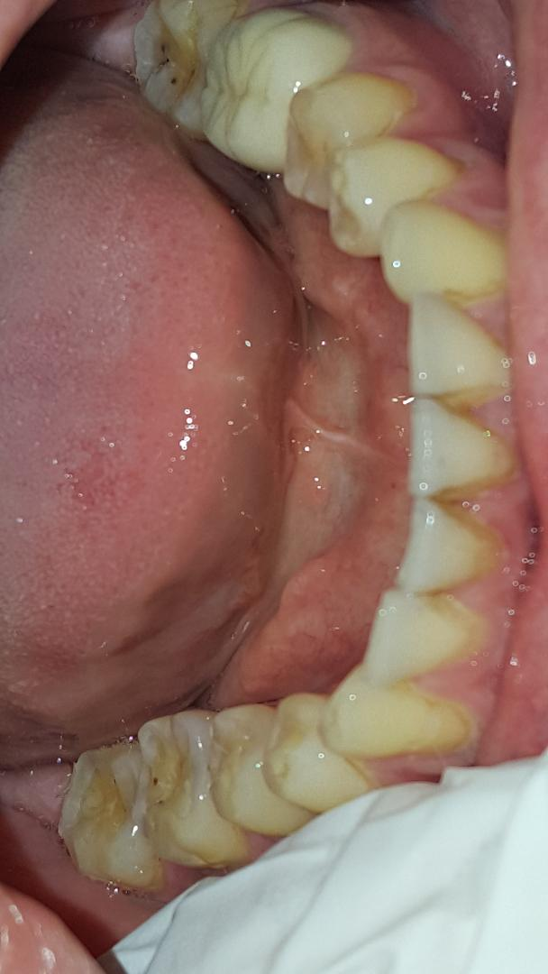

Slide 16
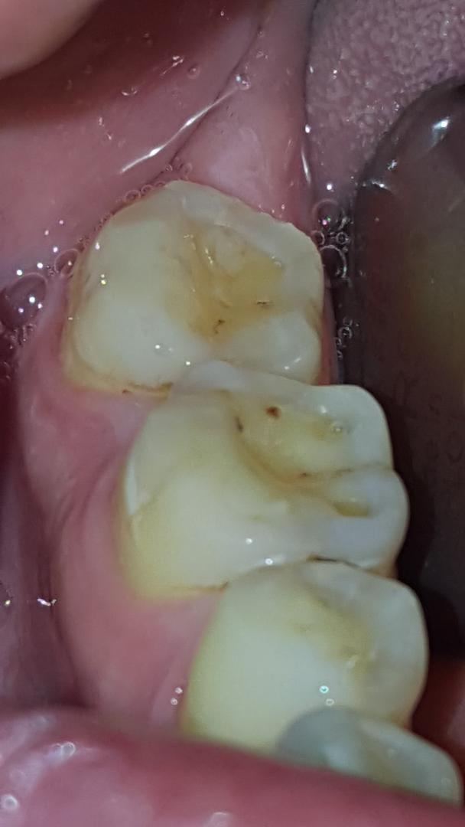

Slide 17
Summary Of Clinical Findings
Extra oral findings: TMJ bilaterally, asymptomatic.
Intra oral findings:
-Patechia 2mm wide on buccal mucosa adjacent to tooth #15.
2. Occlusion: Class I, over bite 30%, over jet 2mm.
3. Dental charting:
Amalgam filling found on occlusal of tooth #1.
Composite fillings found on #3 MO, #13 DO, #14 MO.
Porcelain fused to metal crown #19
Tooth #16,17,32 missing, patient stated he had extractions over 15 years ago.
4. Deposits:
-Localized brown staining on facial mandibular anterior teeth
- Generalized supra gingival plaque with generalized subgingival calculus.

Slide 18
Dental Charting

Slide 19
Caries Risk Assessment

Slide 20
Gingival Description and Periodontal status
Gingival description: Pink, generalized bulbous on maxillary and mandibular, non stippled, moderate BOP.
Generalized type I periodontitis (Possible type II, will confirm with radiographic evidence).
Generalized moderate bleeding upon probing
Generalized recession present
No bone loss evident clinically
Generalized 3-4mm pocket depth
No furcation present
No mobility

Slide 21
Periodontal charting

Slide 22
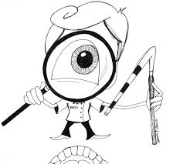
Dental Hygiene Diagnosis
Mr. M is a type generalized type I (potential type II, will evaluate with radiographs), due to generalized 3-4mm probing depths, Moderate BUP, with localized areas on recession on maxillary and mandible regions.
Patient was at moderate risk for caries due to visible plaque, unusual tooth morphology, and interproximal restorations being present.

Slide 23
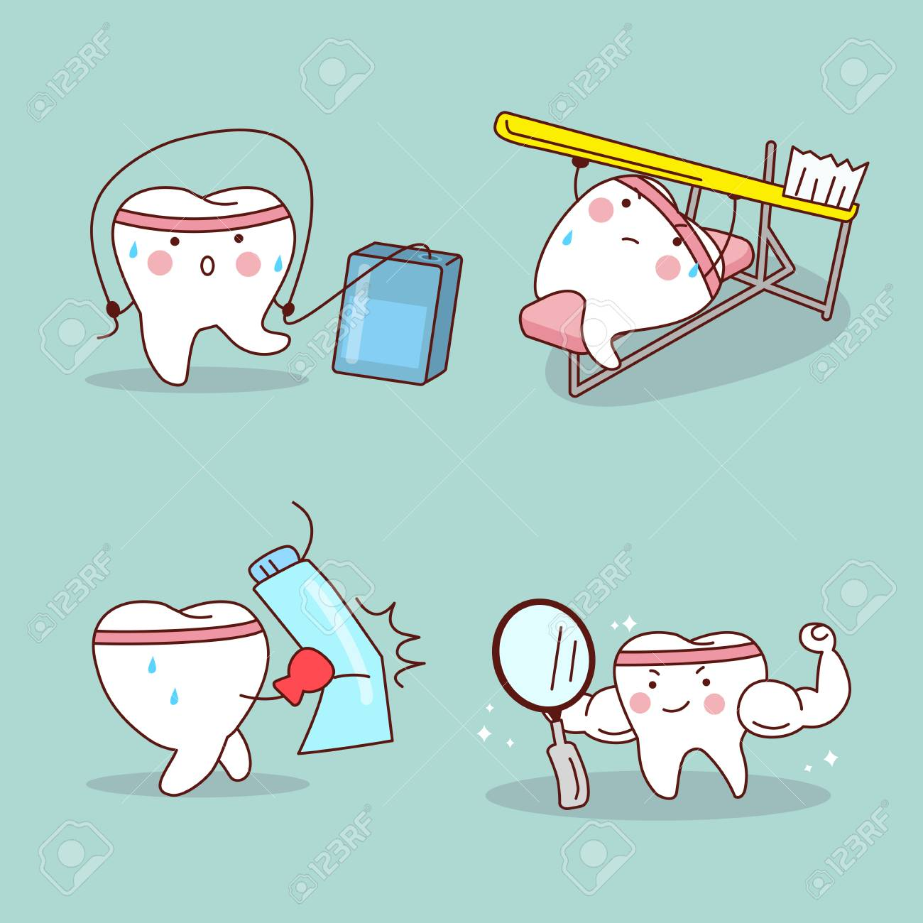
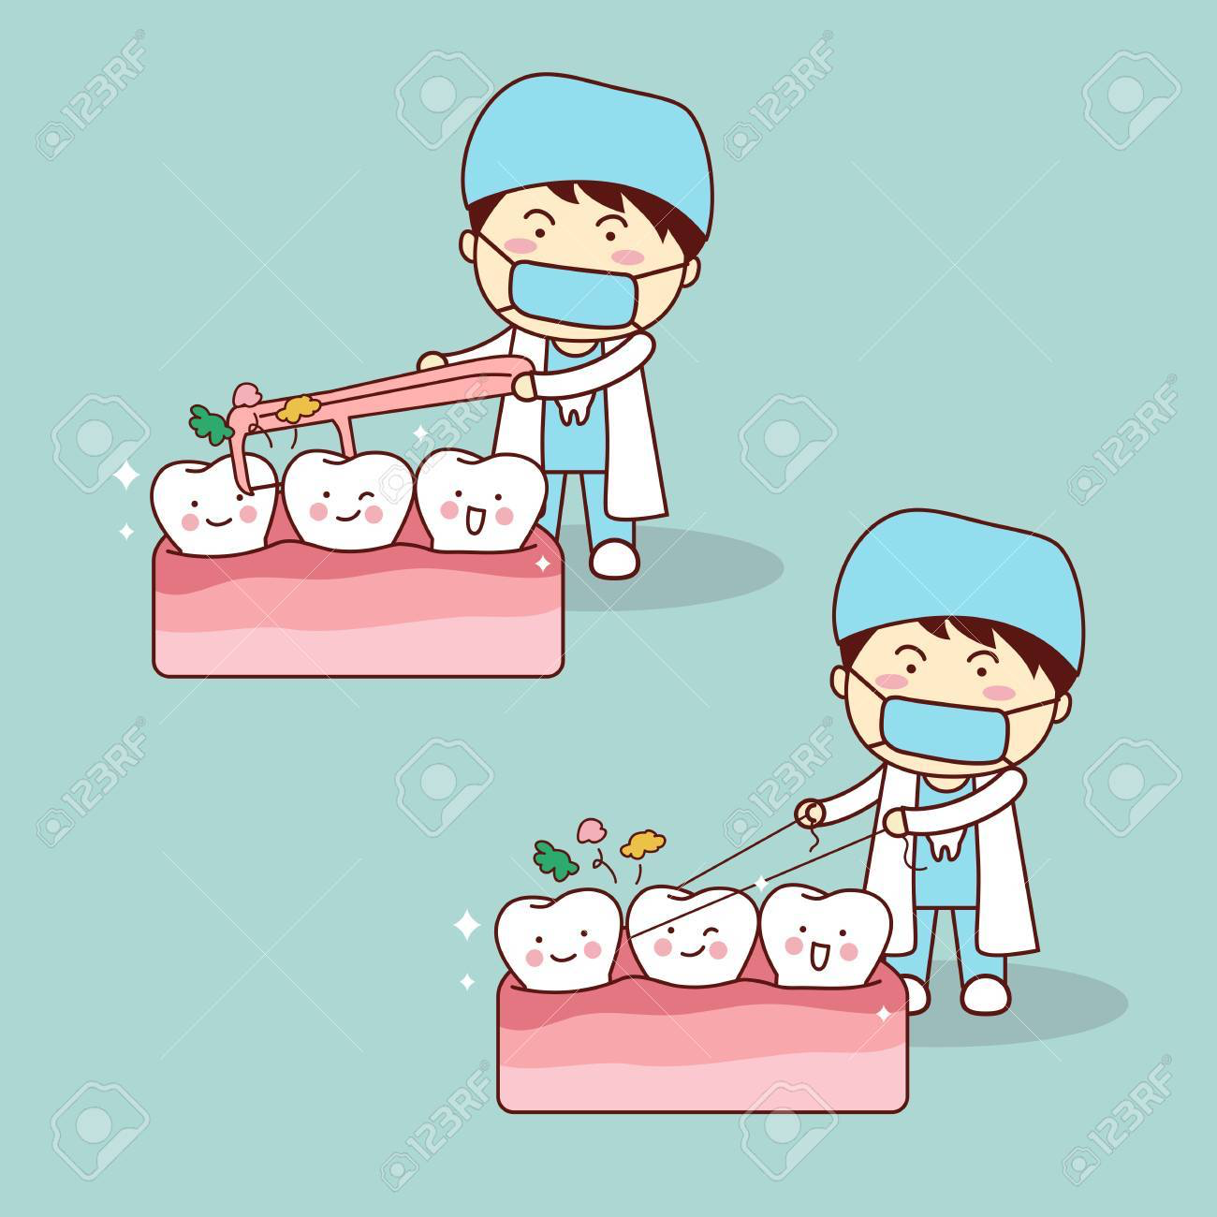
Dental hygiene care plan
Patient will report reduced bleeding upon probing by next recare visit.
patient will report using proxy brush daily by next revisit appointment.
Patient will report brushing twice a day with soft bristle tooth brush for 2 minutes by next revisit appointment,

Slide 24
Consent for treatment

Slide 25
IMPLEMENTATION- TREATMENT

Slide 26
Implementation- treatment
Oral self care instructions: Patient was informed to brush twice a day (once in the morning and before bed) for two minutes, with a soft bristle tooth brush. The modified bass method was taught to disrupt the presence of biofilm. Proxy brush was introduced for type I embrasure spaces.
Fluoride: Patient was advised to have fluoride varnish every re-care appointment.
Sealants: Patient was no a candidate for sealants.
Antimicrobial: Patient was advised to use Listerine Zero. Zero- alcohol formula that kills millions of bad breath germs for a healthier mouth. Advised patient to use twice daily after brushing. Swish 2 teaspoons (10 mL) for 1 minute.

Slide 27
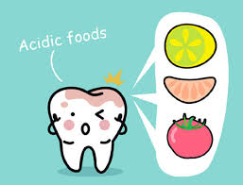
Implementation- treatment continued..
Dietary Guidance: Patient was recommended on foods to help with his uncontrolled condition of GERD.
Patient was advised to avoid foods such as citrus fruits/ juices.
Foods in high fat such as, cheese, fries etc.
Garlic and onions
Spicy foods
Coffee
Alcohol
These foods along with many others, contain high acid and should be avoided to help with GERD.

Slide 28
Implementation- treatment continued..
Debridement Preformed: Debrided all four quadrants using the FSI 100, thinsert, and hand scaling. Handscale instruments used were sickle scalers and graceys to remove calculus, supragingival and subgingival. I was able to use extra oral and intra oral fulcrum techniques when using the cavitron and hand scaling. Engine polish with fine fast was used to remove any plaque. I than proceeded with treatment to a 5% fluoride varnish to reduce the risk of carries and sensitivity.
During treatment Mr. M was well managed he did not need any local anesthesia. He was very friendly and knowledgeable about some aspects of oral hygiene due to his biology background.
One difficulty I had during debridement was extending to the third molar area on the maxillary. My professor did help me and show me some helpful tips to work better in the distal area of the third molar.

Slide 29
eVALUATION OF CARE- OUTCOME OF CARE PROGNOSIS
1. Goal statement: Patient will report using proxy brush by next re-care appointment.
Prognosis: Patient stated he did buy proxy brushes on second revisit appointment. Goal was sucessfully met.
2. Goal statement: Patient will report using Listerine zero by re-care appointment.
Prognosis: Patient stated he will buy Listerine zero but has not changed his Listerine yet. Goal was potentially met.
3. Goal statement: Patient will report brushing twice a day with a soft bristled brush for 2 minutes by 3 month re-care.
Prognosis: Goal to brush twice a day has potential to be met because patient states he likes the soft bristled brush better than the medium.

Slide 30
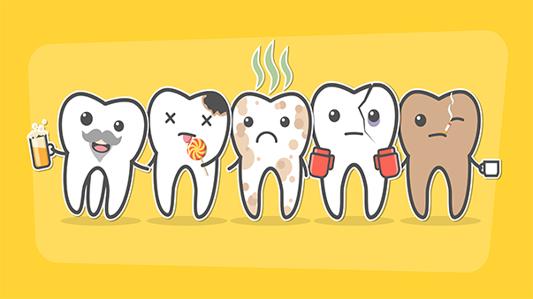
Referrals
A referral was given to see a doctor for his untreated GERD. The patient and I discussed how important it was to take care of this condition not only for his health but for his oral health as well.
Mr. M and I discussed that GERD can be a leading cause to his erosion.

Slide 31
Continued care recommendations
Patient was recommended for a 4 month re-care, due to his uncontrolled GERD and severe erosion. Patient was also at a moderate risk for caries and should be evaluated ever 4-6 months.

Slide 32
Positive final reflections
During treatment with my patient I felt my time management was a positive reflection. From assessments to debridement my patient and I was compliant with treatment. The treatment plan was followed and did not need any modifications.

Slide 33
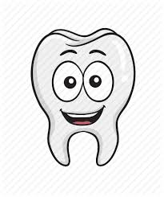
Positive final reflection
I also feel I educated my patient to the best of my ability on what erosion is and how it is caused.
When assessing my patient I asked many questions about him having Hodgkyn’s lymphoma. He did state from what he remembers during treatment he did vomit a lot due to medications and chemo therapy.
When assessing my patient on having GERD, I explained why having untreated GERD can effect the oral cavity and went over a diet plan to help him modify the issue as he finds his way to see his doctor.

Slide 34
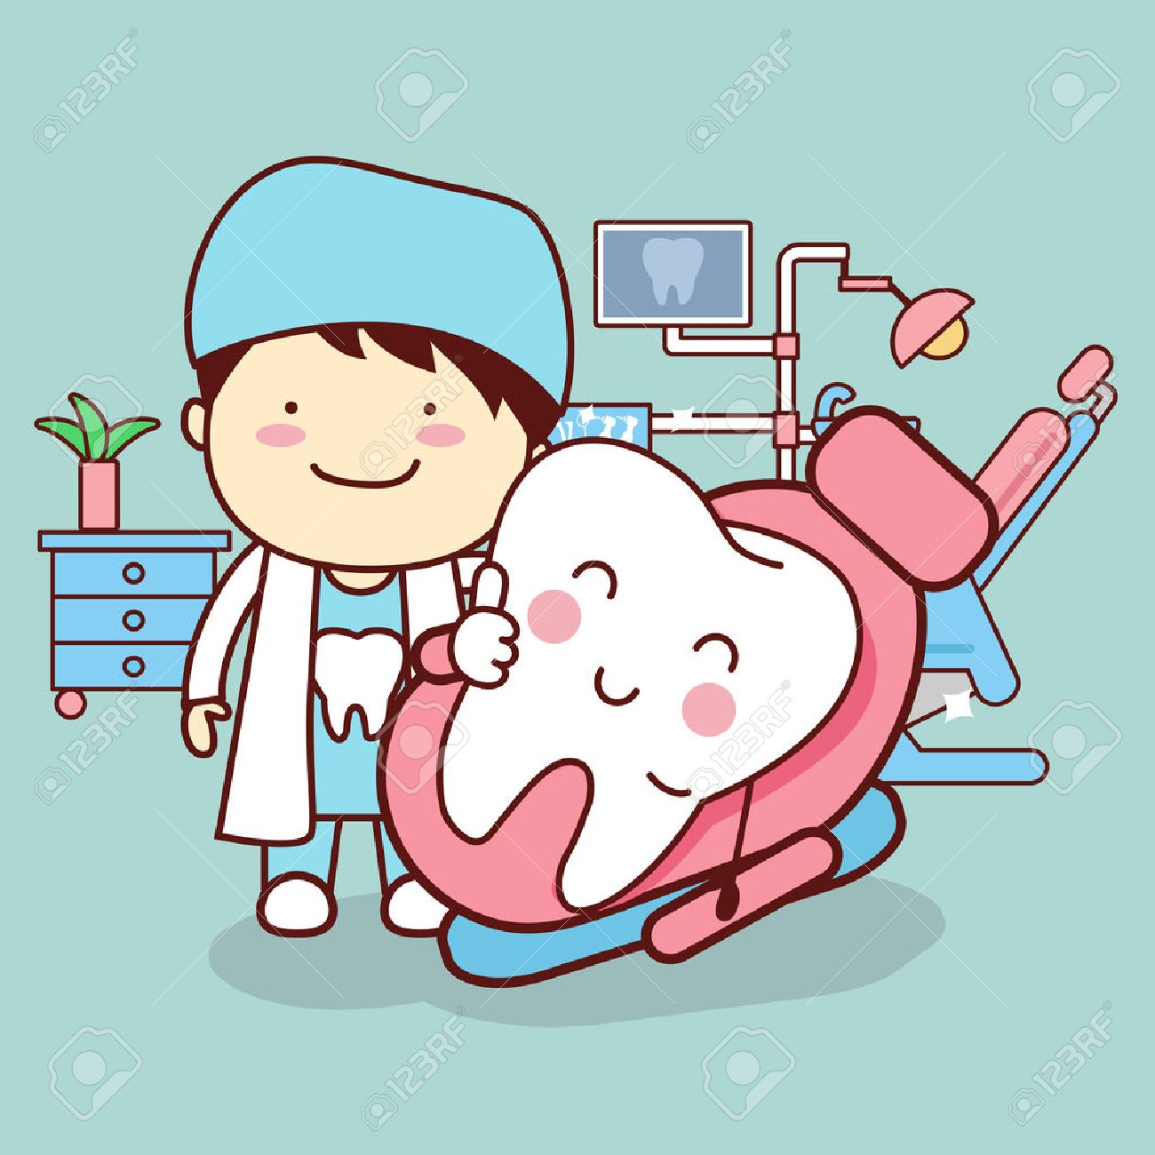
Critical final reflection
Throughout treatment phase, I had trouble identifying CEJ and calculus due to his recession. My professor and I worked on distinguishing how to identify if there is calculus present. Air was a major help In seeing the chalky white calculus.

Slide 35
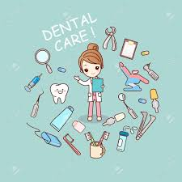
overall
Overall I had a great experience and learning process while treating Mr. M. He seemed very excited to come back and see me next semester and I cant wait to continue to make his smile a healthy and happy one.

