Slide 1
Steampunk
Vs
Cyberpunk
Karl Jagdipsingh
English 2420 Project #2

Slide 2
Which one is Cyberpunk?

Slide 3
Both!?

Slide 4
What is Cyberpunk?
Cyberpunk is a science fiction genre in which the future world is portrayed as one in which society is largely controlled by computers, at the expense of daily life and social order.

Slide 5
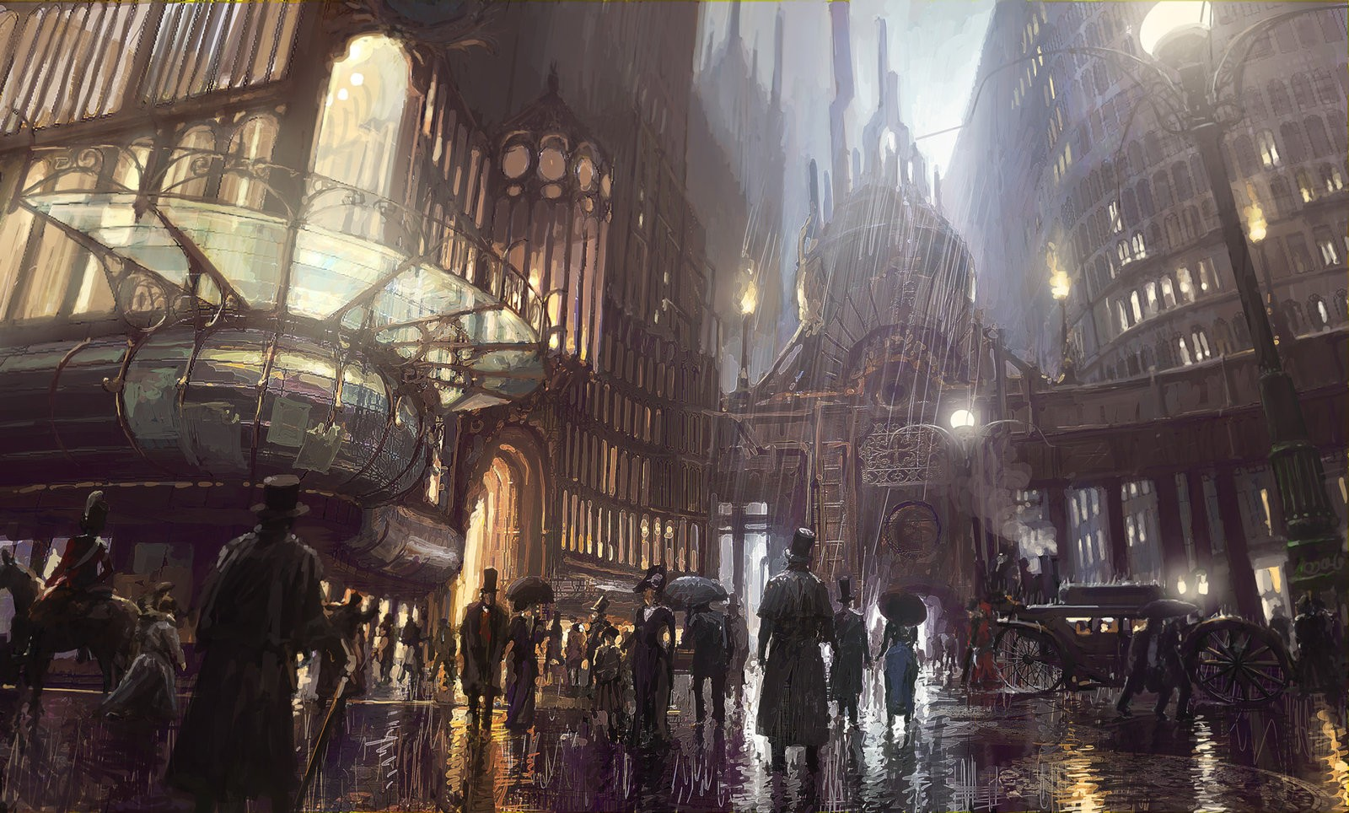
What is Steampunk?
A genre of science fiction that typically features steam-powered machinery rather than advanced technology.

Slide 6
Steam Chair

Slide 7
Harry Potter if Cyberpunk

