Slide 1
Sound of Cyborg Organs
Leonel Mendoza

Slide 2
What is a cyborg?
Cybernetic Organism: A hybrid of Human/Machine
Cybernetic: the study of human control functions and of mechanical and electronic systems designed to replace them

Slide 3
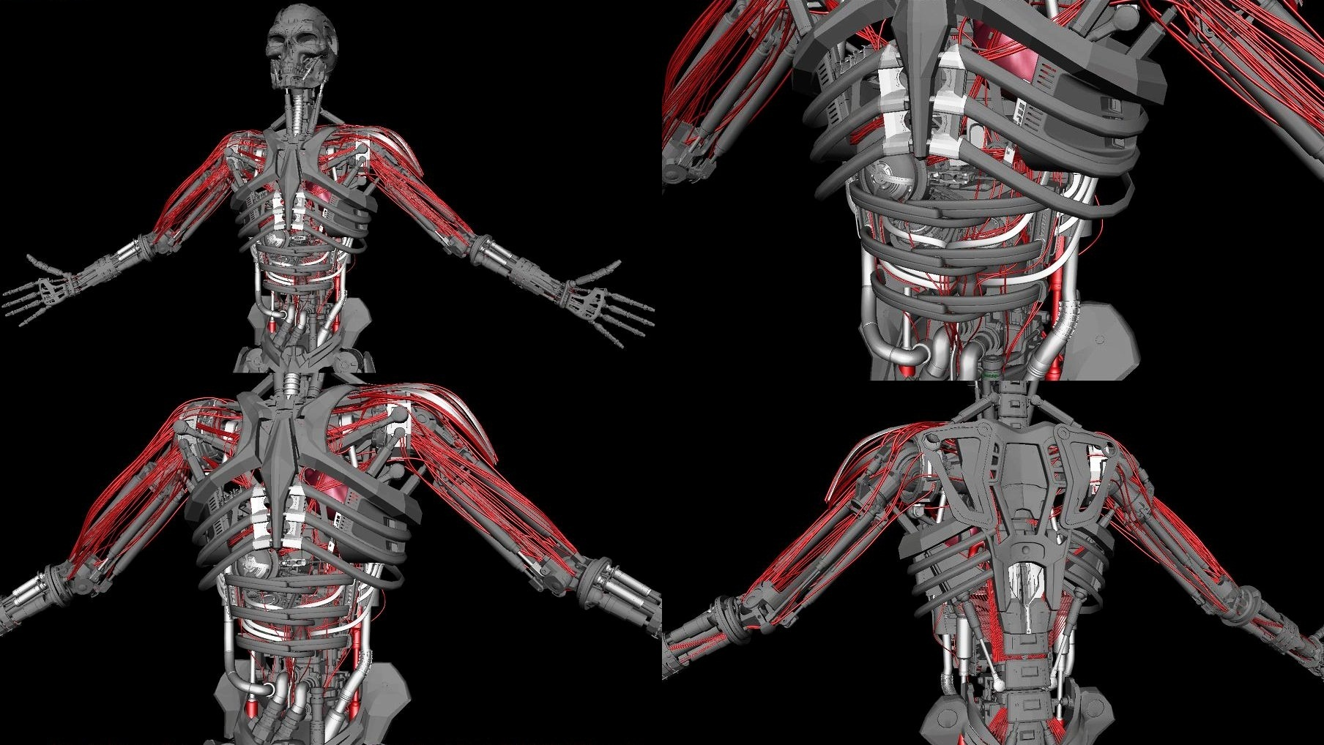

Slide 4
Pacemaker
In some patients on artificial pacemakers we have also noticed an extra sound, always earlier, and sometimes louder, than the usual heart sounds

Slide 5
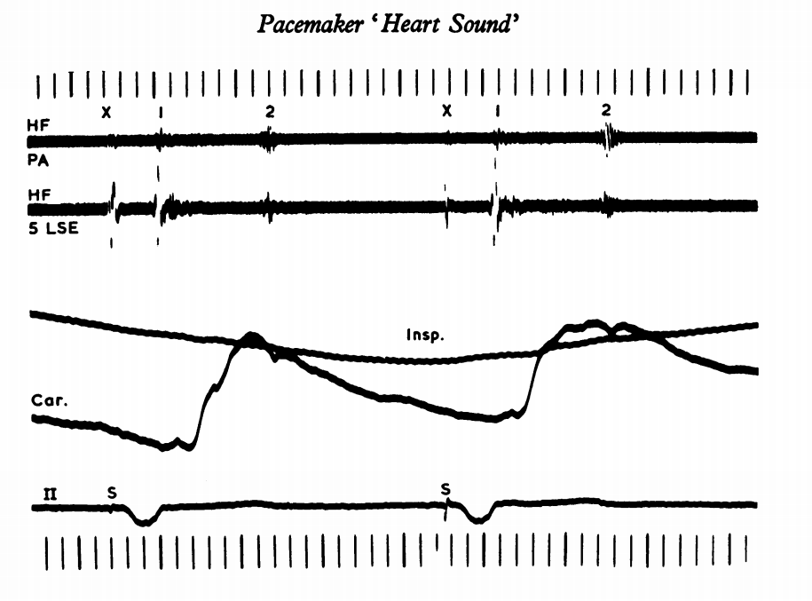

Slide 6
Circulatory System

Slide 7


Slide 8
Xth Sense
Biophysical musical instrument
Picks up subcutaneous mechanical vibrations
  Continuous and dense stream of low frequencies modulated by sudden muscle bursts

Slide 9
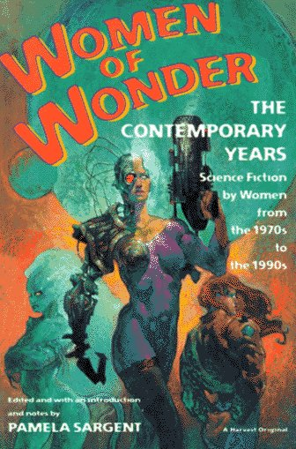

Slide 10
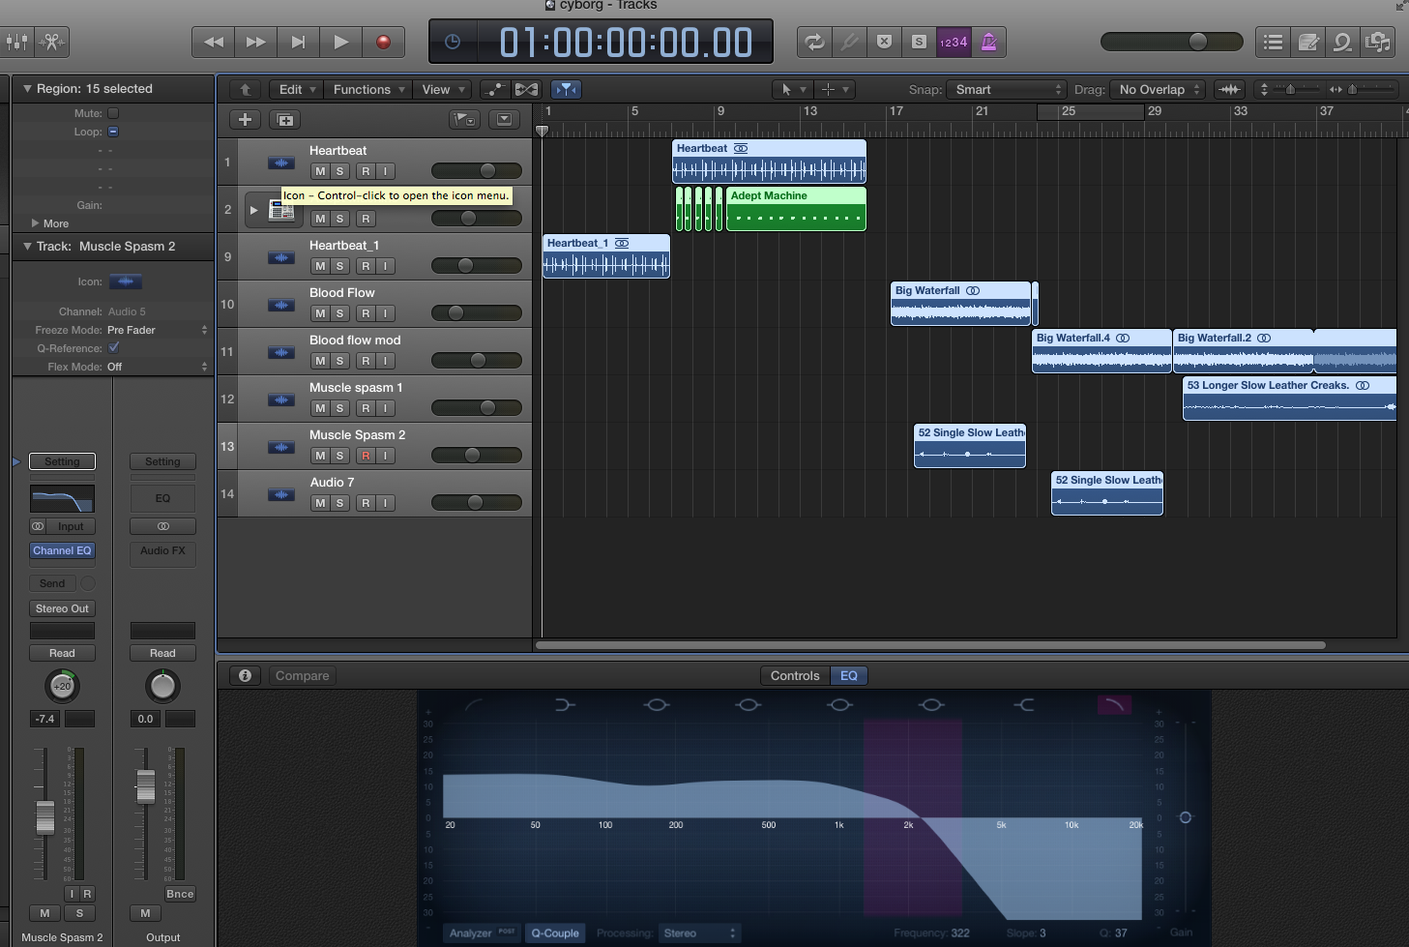
What does it sound like?

Slide 11
Works Cited
"cybernetic." Dictionary.com Unabridged. Random House, Inc. 13 May. 2015. <Dictionary.com http://dictionary.reference.com/browse/cybernetic>.
"Cyborgs." Themes : Cyborgs : SFE : Science Fiction Encyclopedia. SFE: The Science Fiction Encyclopedia, 10 Apr. 2015. Web. 14 May 2015.
<http://www.sf-encyclopedia.com/entry/cyborgs >.
Foster, F.S.; Obara, H.; Bloomfield, T.; Ryan, L.K.; Lockwood, G.R., "Ultrasound backscatter from blood in the 30 to 70 MHz frequency range," Ultrasonics Symposium, 1994. Proceedings., 1994 IEEE , vol.3, no., pp.1599,1602 vol.3, Oct. 31 1994-Nov. 3 1994
Harris, A. "Pacemaker 'heart Sound'." Heart 29.4 (1967): 608-15. Group.bmj.com. Web. 13 May 2015. < http://heart.bmj.com/content/29/4/608.full.pdf >.
(Pacemaker)
“hybridization” GHR.NLM.NIH.gov. Genetics House Reference. 11 May, 2015
<Ghr.NLM.NIH.gov http://ghr.nlm.nih.gov/glossary=dnahybridization>
"Hypo Chrysos: Action Art for Vexed Body, Xth Sense, and Biophysical Media." Hypo Chrysos (2013): n. pag. ACM. Web. 13 May 2015.
Sargent, Pamela. Women of Wonder: The Contemporary Years: Science Fiction by Women from the 1970s to the 1990s. Vol. 2. San Diego: Harcourt Brace, 1995. Print. Revised.
Terminator Salvation. Dir. McG. Perf. Christian Bale and Sam Worthington. Sony, 2009. DVD.

