Slide 1
TOP 5 CUTTING EDGE/ Handy Inventions Inspired by Science Fiction
Plus it’s affect on society.
Aaron Villalobos

Slide 2
What inspires you?
Inspiration is the key to motivation.
It can come from anywhere.

Slide 3
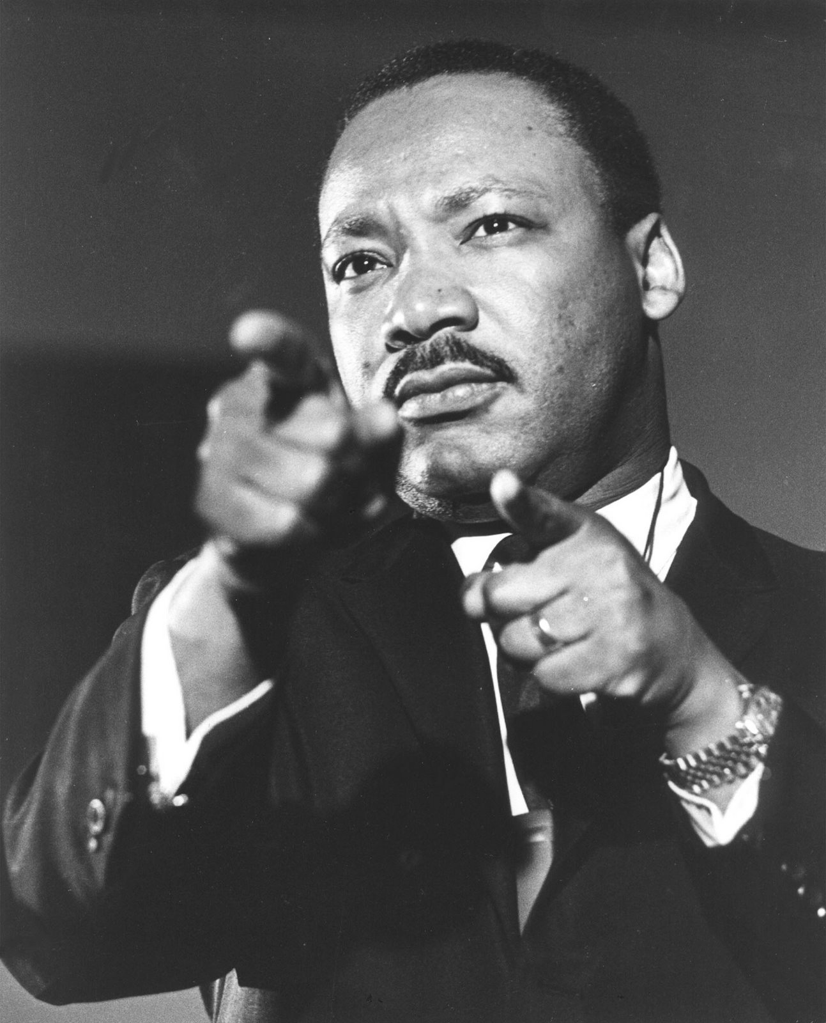

Slide 4
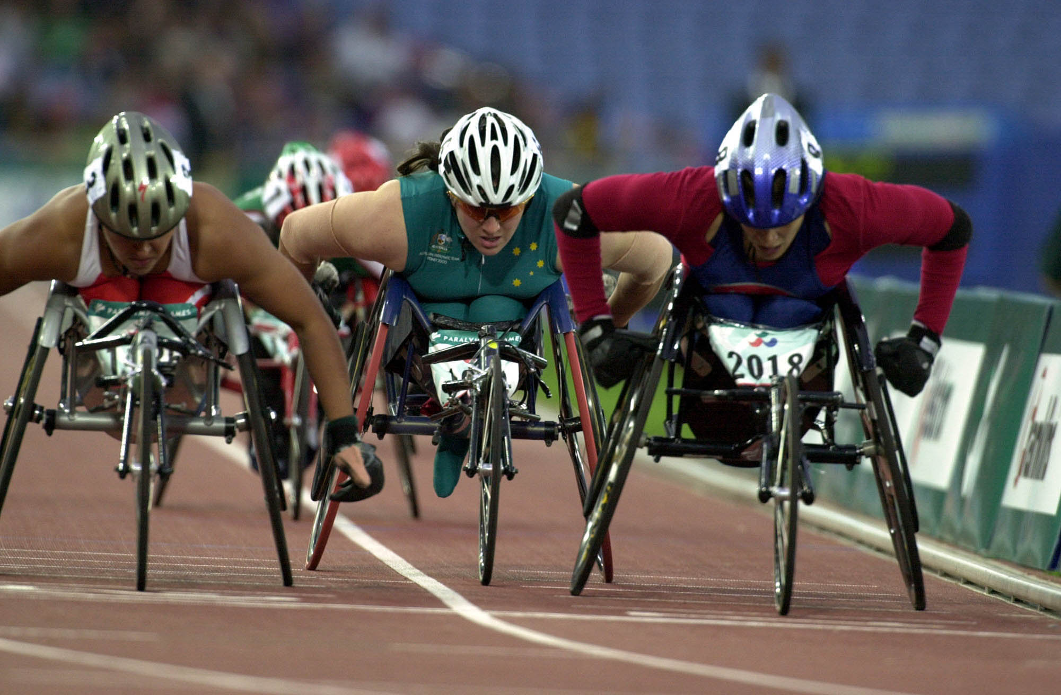

Slide 5
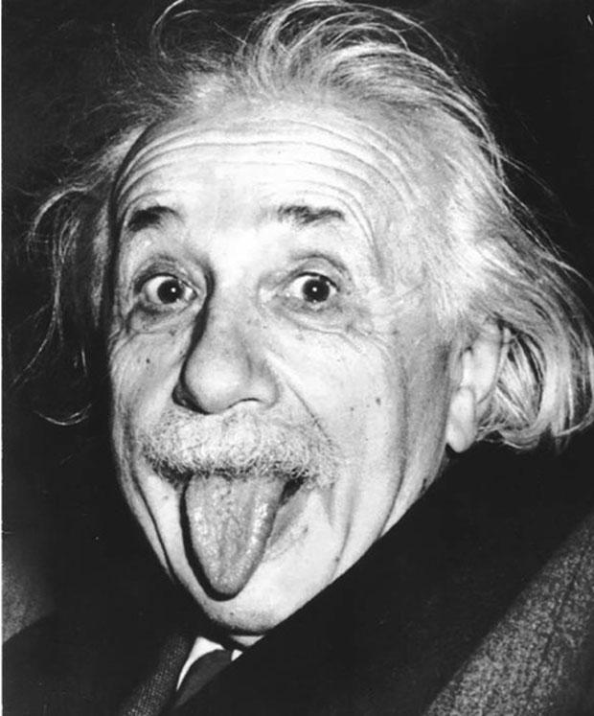

Slide 7
Some people plagiarize,
Some people simply mimic,
The genius’s observe and INNOVATE.

Slide 8
#5
In no particular order

Slide 9
The taser

Slide 10
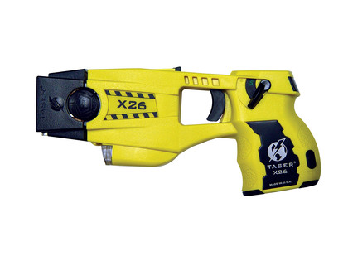

Slide 11
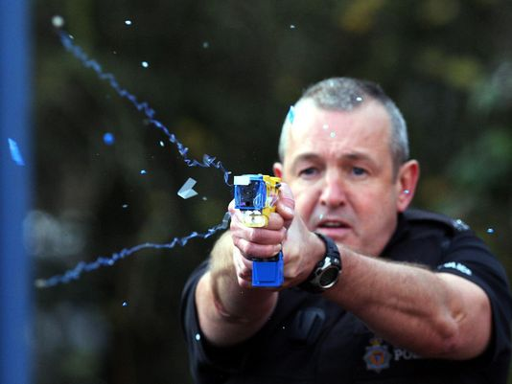

Slide 12
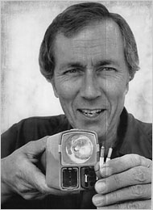
Jack Cover

Slide 13
Jack Cover, who was a NASA researcher got the idea to create the Taser after he read the 1911 novel “Tom Swift and His Electric Rifle” by Victor Appleton. He started developing this device in 1969 and by the year 1974, it was complete.
Jack Cover was inspired by this and not only created the Taser but the word “Taser” became an acronym for Swift’s fictional invention, “Thomas A. Swift’s Electric Rifle”.

Slide 14
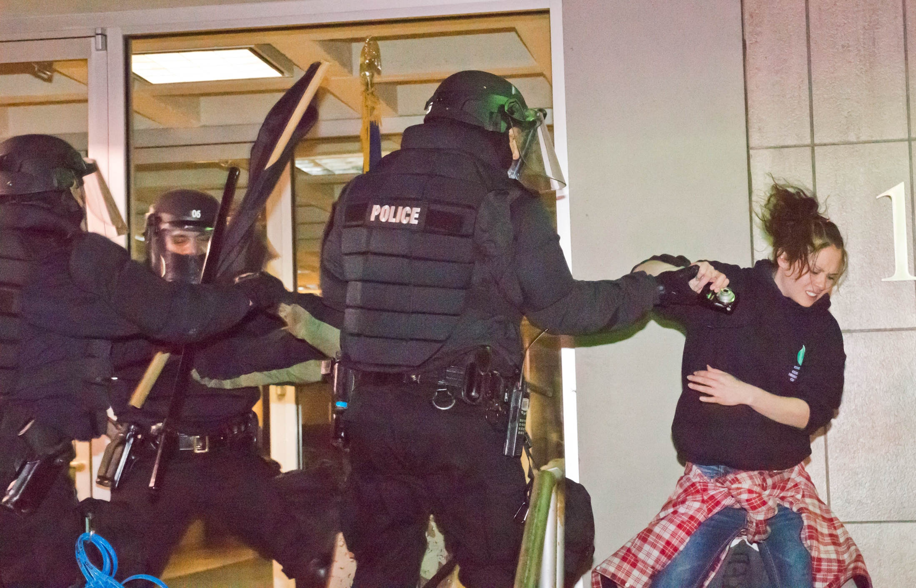

Slide 15
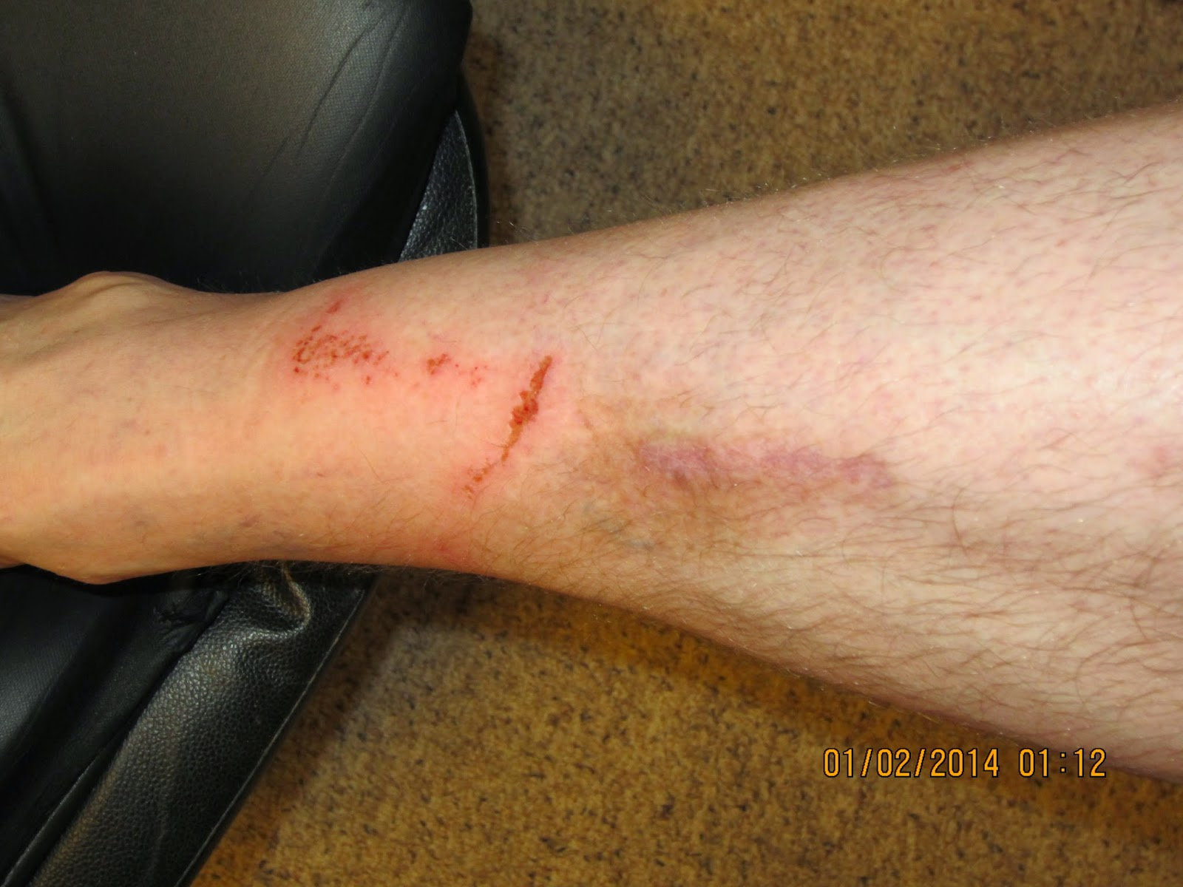

Slide 16
#4

Slide 17
The internet

Slide 18
Someone predicted it, over 100 years ago, and his name was:

Slide 19
Mark twain
Mark Twain who is famous for his books such as “The Adventures of Tom Sawyer” (1875) and its sequel “Adventures of Huckleberry Finn” (1885) actually predicted the internet as early as 1898.
The short story “From The London Times” 1898, takes place 5 years in the future and actually describes an extreme resemblance of the internet. It depicts a phone system generated to contribute information over a worldwide network. He named it the “Telectroscope”, and his prediction saw the light of day in the early 1980’s.

Slide 20
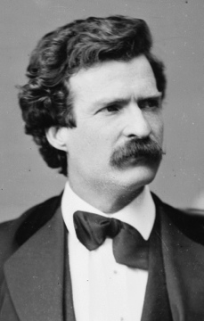

Slide 21
So who really made the internet?

Slide 22
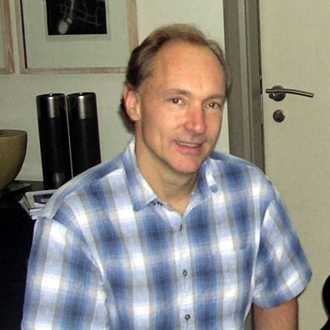
Tim-Berners LEE a.k.a timbl

Slide 23
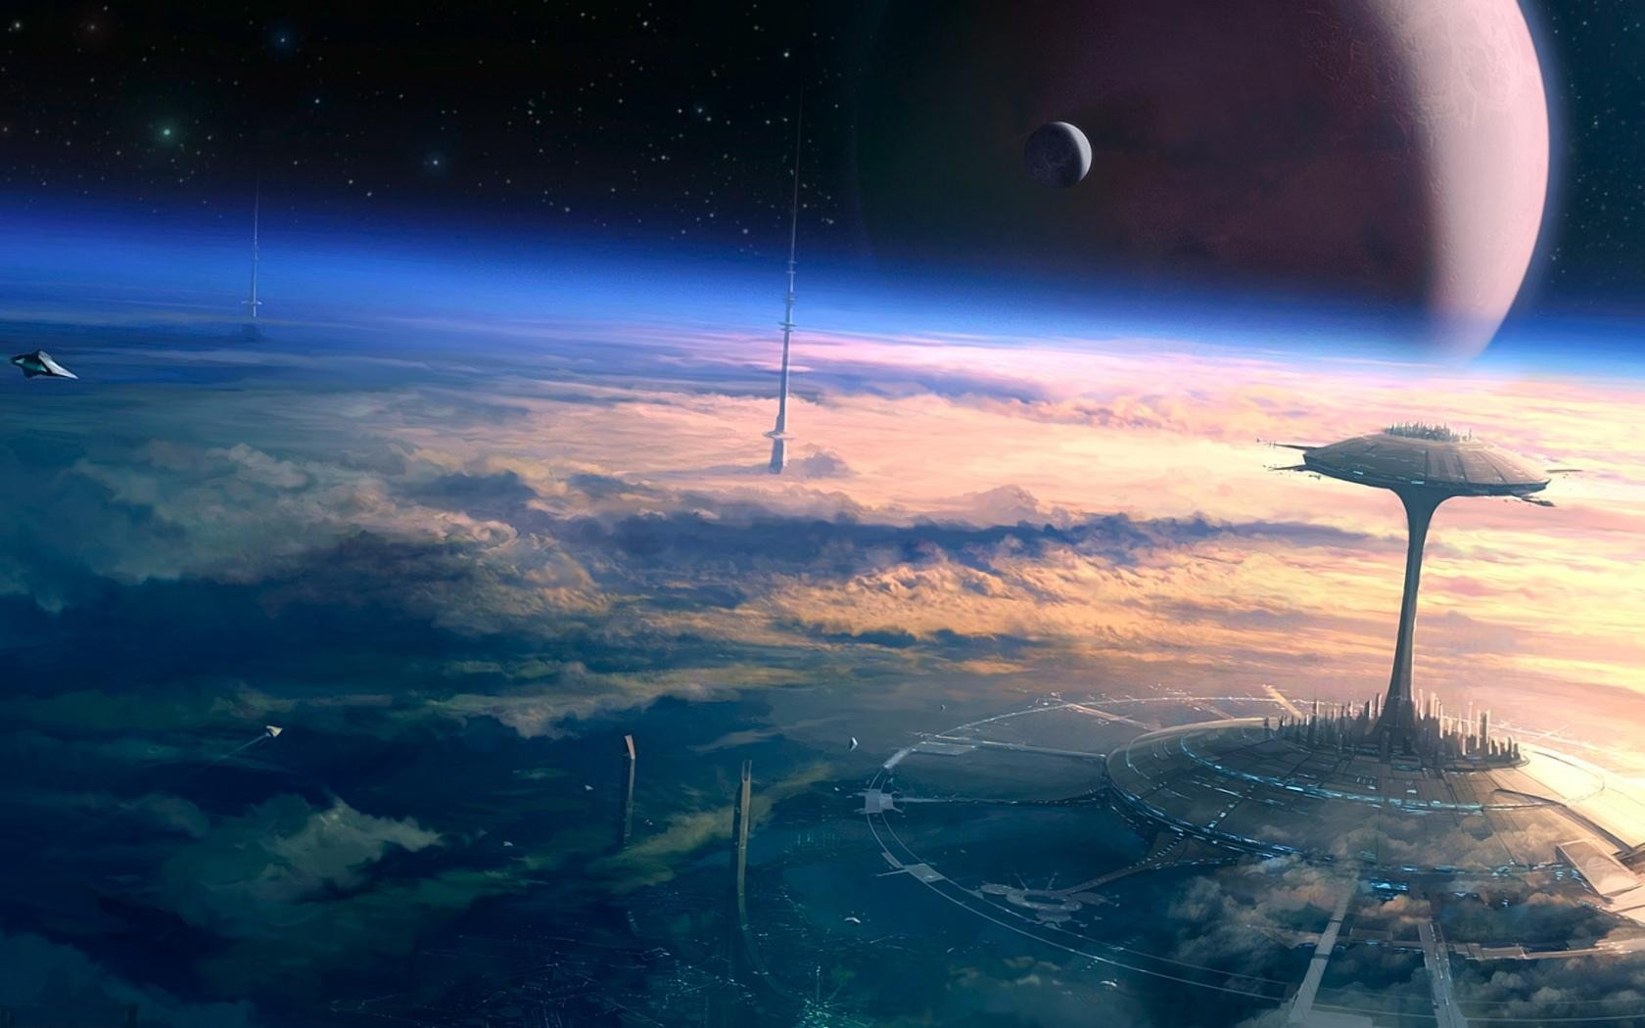
An English computer scientist who is best known as the inventor of the World Wide Web. He was inspired by a science fiction book.

Slide 24
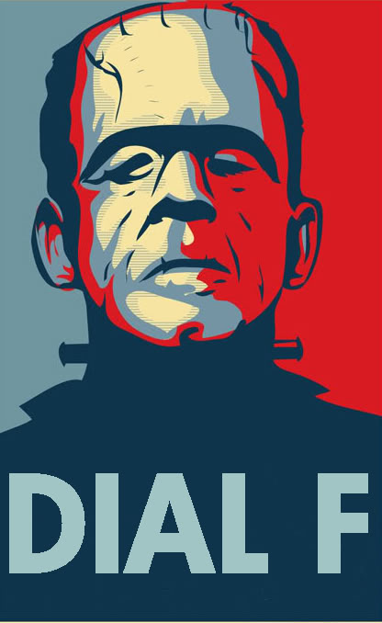
Author C. Clarke’s story
Dial F For Frankenstein (1964)
Describing a platform that allowed computers to communicate with one another.
Not the original cover.

Slide 25
I need to create something like that.

Slide 26
That’s exactly what he did.
Without him, who knows how the world would be without the beauty of the internet.
Thanks TimBL!

Slide 27
#3

Slide 28
Voice control

Slide 29
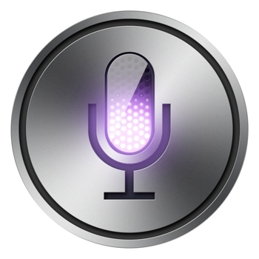

Slide 30
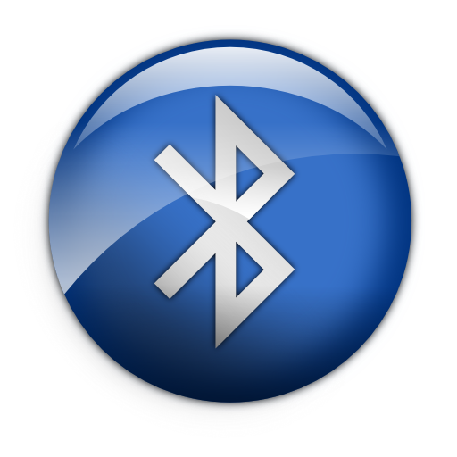
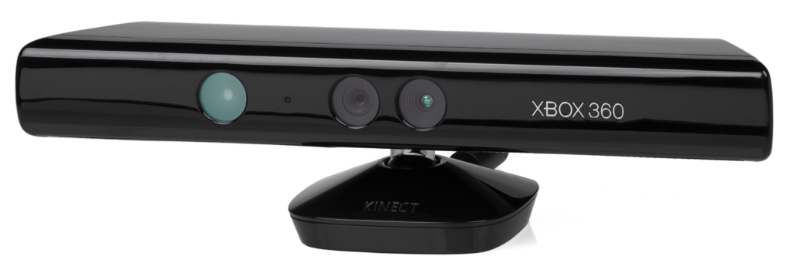
Siri, xbox, bluetooth and more!

Slide 31
Shortcuts.
Save time.
Responsive Robot in your phone! (Siri is technically not a robot because the voice is from an actual human who’s name is, Susan Bennett)

Slide 32
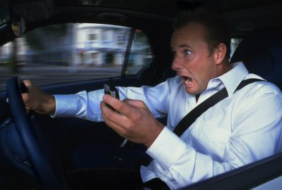

Slide 34
“Bell laboratories”
Made it’s “Audrey” system in the 50’s/60’s which could observe digits spoken by someone’s voice.
But it didn’t become a huge astonishment and possibility until...

Slide 35
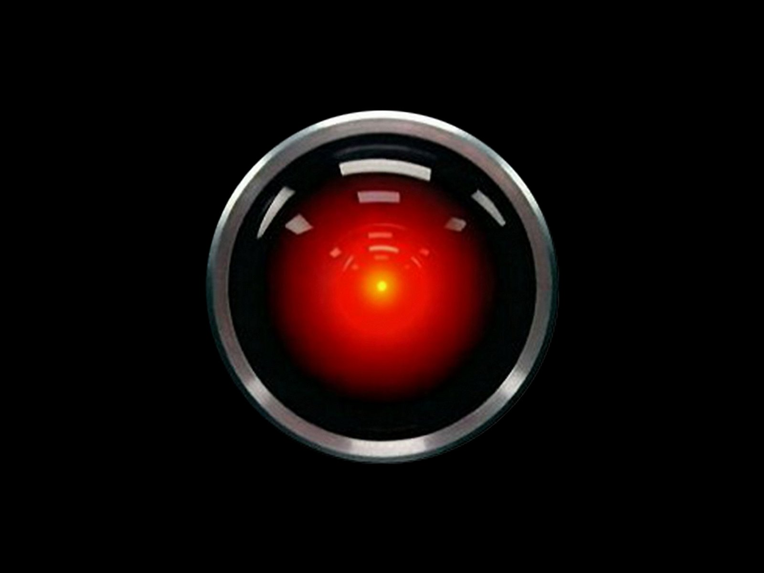

Slide 36
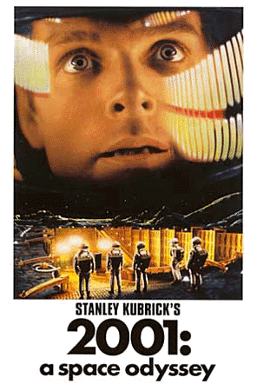

Slide 37
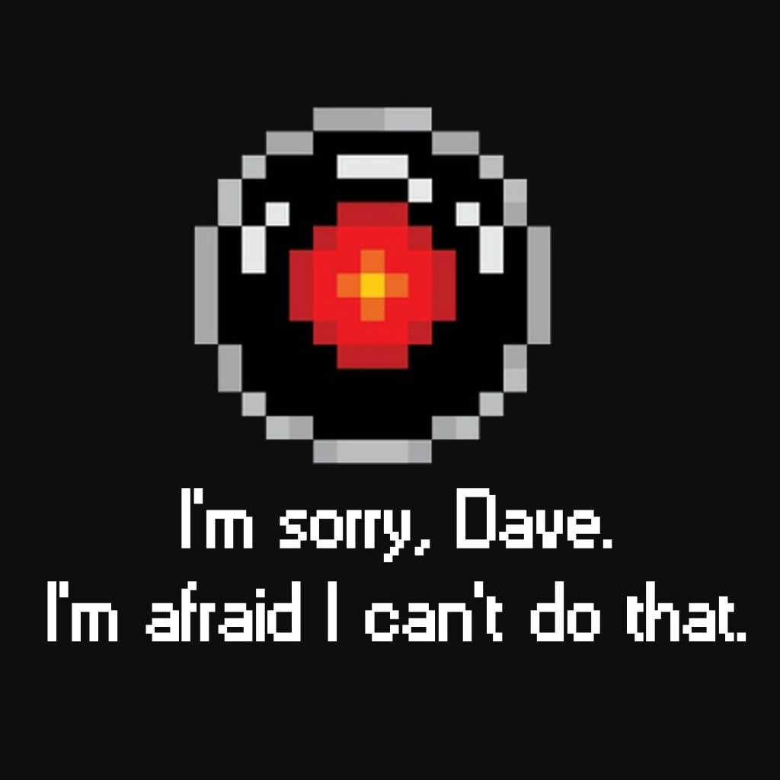
HAL, the robot in the movie was responsive with voice control and was just the spark that paved the way for all the imaginations and possibilities.

Slide 38
#2

Slide 39
Video Chat

Slide 40
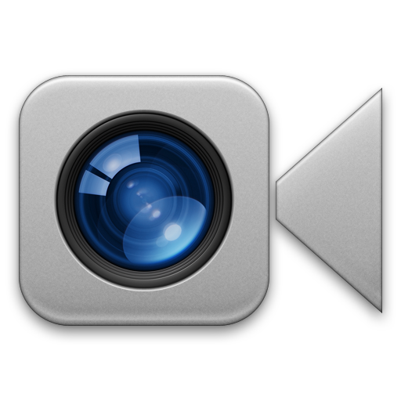

Slide 41
Videoconferences were created in the 70’s as part of AT& T’s development of Picturephone technology.
Who predicted it?

Slide 42
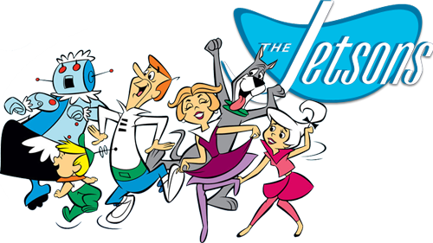
An American cartoon show produced by Hannah Barbera, formerly airing in primetime from 1962 to 1963, then later with new episodes in 1985 to 1987.

Slide 43
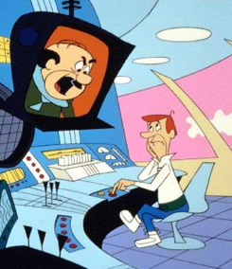
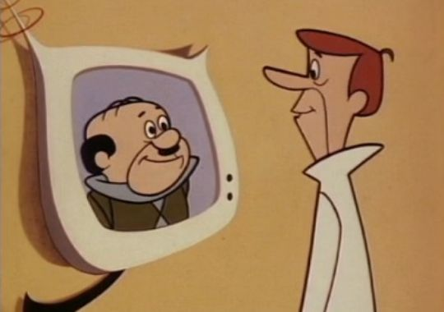
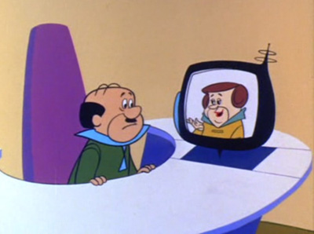

Slide 44
#1

Slide 45
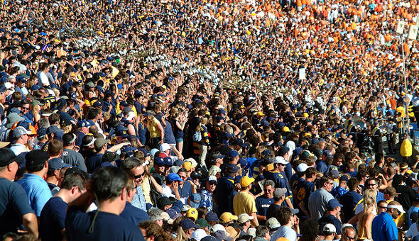

Slide 46
The cell phone

Slide 47
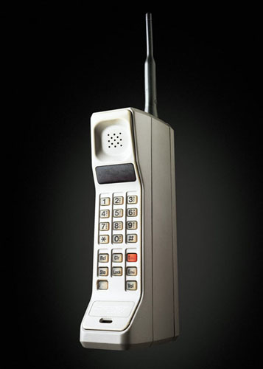
“The Motorola DynaTAC 8000X”
The first commercially available cell phone in 1984.

Slide 48
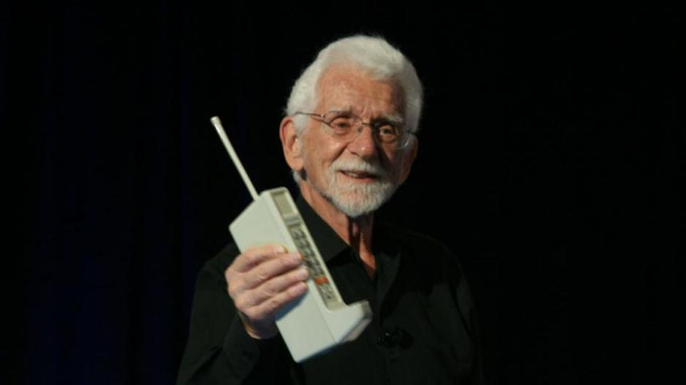
Martin Cooper
He is the director of research and development at Motorola. He got his brilliant invention inspiration from Sci-Fi series called…

Slide 49
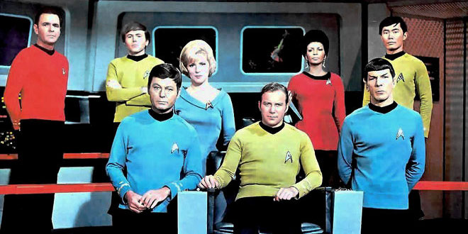

Slide 50
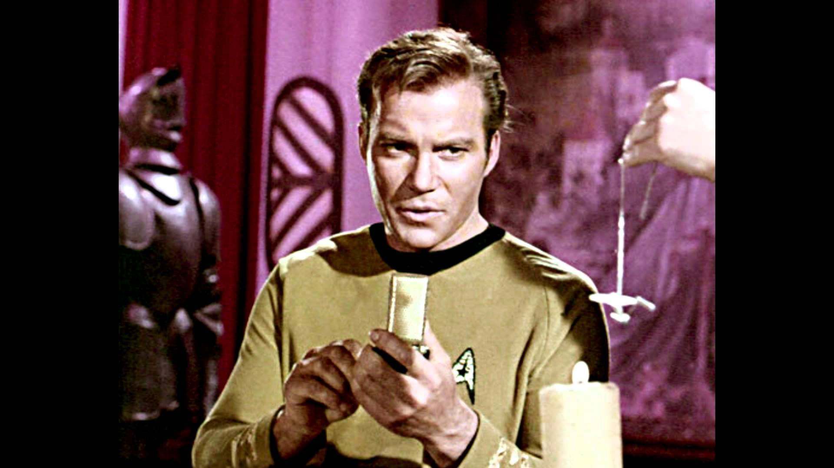
Star trek communicator

Slide 51
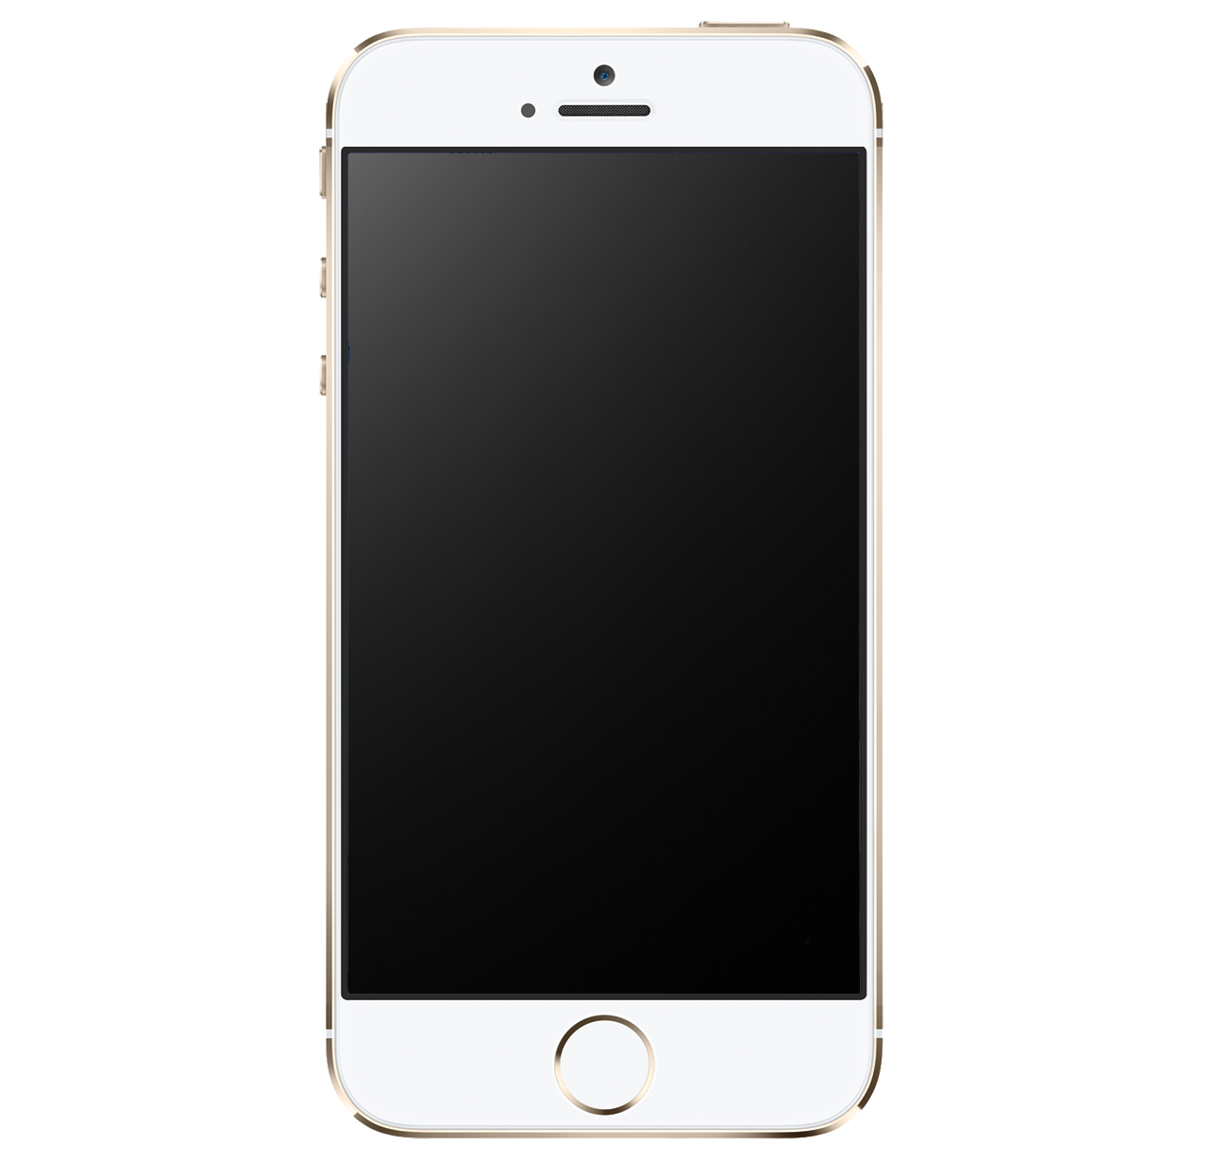
1984
2015

Slide 52
Where would we be without our phones?
Phone’s allow us to talk to any one anywhere at any time. So, who knows.

Slide 53
Thank you for watching!

Slide 54
Here were all my sources!
"History, Travel, Arts, Science, People, Places | Smithsonian." History, Travel, Arts, Science, People, Places | Smithsonian. N.p., n.d. Web. 13 May 2015.
"10 Inventions That Began Life as Science Fiction." The New Economy. N.p., n.d. Web. 13 May 2015.
"6 Eerily Specific Inventions Predicted in Science Fiction." Cracked.com. N.p., n.d. Web. 13 May 2015.
"Top 10 'Star Trek' Technologies That Actually Came True - HowStuffWorks." HowStuffWorks. N.p., n.d. Web. 13 May 2015.
"Top Ten Science Fiction Technologies That Walked to Reality." Technology 4 U B4 U, Before You! N.p., 05 Feb. 2015. Web. 13 May 2015.
“11 Astounding Sci-Fi Predictions That Came True”
Mashable. N.p., n.d. Web. 13 May 2015
"How The Jetsons Predicted the Future." ZME Science. N.p., 01 Aug. 2014. Web. 13 May 2015.
"“Dial F For Frankenstein”: The Birth of The World Wide Web." David Paul Kirkpatricks Living In The Metaverse. N.p., n.d. Web. 13 May 2015.
Gahran, Amy. "How Cell Phones Have Changed Our Lives." CNN. Cable News Network, 22 Oct. 2010. Web. 13 May 2015.
Google.com (For all images)

