Slide 1
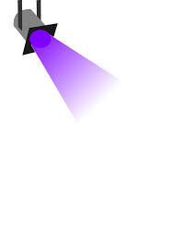
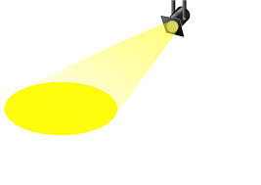
Lighting In Science Fiction Films
By Jonathan Stampfl

Slide 2
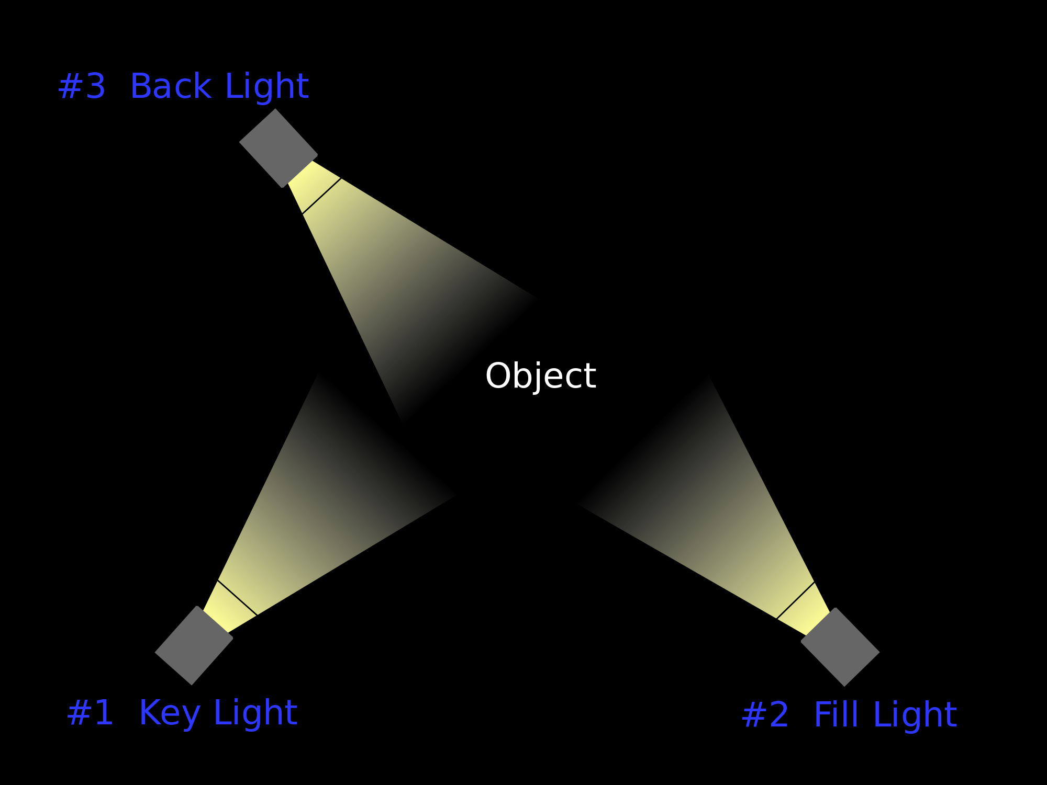
Lighting in film and its importance
Lighting creates special effects
Lighting sets the tone
Three point lighting

Slide 3
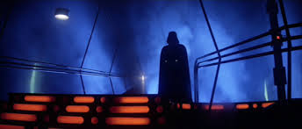
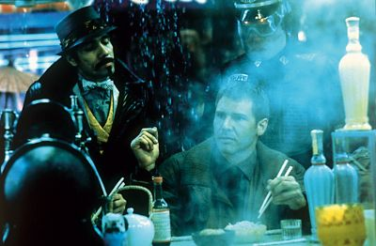
Lighting in Science Fiction Films
“A sub trope of Mood Lighting common in Science Fiction and Forensics shows. Shots are suffused with vaguely blue lighting.”(TV tropes)
Blue Lighting effect

Slide 4
Darth Vader Introduction as the Villain
Darker lighting
Smoke creates a dramatic effect
Shows us the villain

Slide 5
Luke Skywalker Introduction as the Hero
Brighter, bolder and stronger lighting
This is the hero of the story

Slide 6
The Use of Blue lighting while on Hoth
Blue lighting effect
Adds a science fiction tone
Also adds a dramatic effect

Slide 7
The use of blue lighting in the iconic fight scene
“Then I decided to light the whole thing from underneath, as the floors had been made translucent.” (Peter Suchitzky)
Blue lighting, smoke, no light on actors
Bolder and more serious tone

Slide 8
Fight Scene again
More light on actors
Still has a hint of the blue lighting effect
However still has a serious tone

Slide 9
Again Using light to show the hero
Spotlight effect
Shows us the hero

Slide 10
Darth Vader returning to the light
Three point lighting
Dramatic effect
Vader is now a hero

Slide 11
Works Cited
Anders, Charlie J. "10 Cinematographers Who Turned Science Fiction Movies into Great Art." Io9. Kinja, 2 July 2013. Web. 12 May 2015.
"Unnaturally Blue Lighting - TV Tropes." Unnaturally Blue Lighting - TV Tropes. TV Tropes, n.d. Web. 12 May 2015.
Kaminski, Janusz. "Film Lighting Techniques and Tips: With Pretty Pictures!" Free Online Film School: Learn Filmmaking. LAvideo Filmmaker, 30 Apr. 2010. Web. 12 May 2015.
Sharnela. "Star Wars IV: A New Hope Lighting Techniques." Film. WordPress, 02 Oct. 2014. Web. 12 May 2015.
Wranglerv33. "The Importance of Film Lighting for Star Wars Trilogies." American Patriotism. WordPress, 16 Feb. 2015. Web. 12 May 2015.

