Slide 1
Has Steampunk run out of Steam?
A Steampunk Retrospect.

Slide 2
Quick Presentation.
I’ll Keep this quick.

Slide 3
What is Steampunk? - Quick Presentation.
Steampunk is about Steam and Punks….
Thank you and good night.

Slide 4


Slide 5
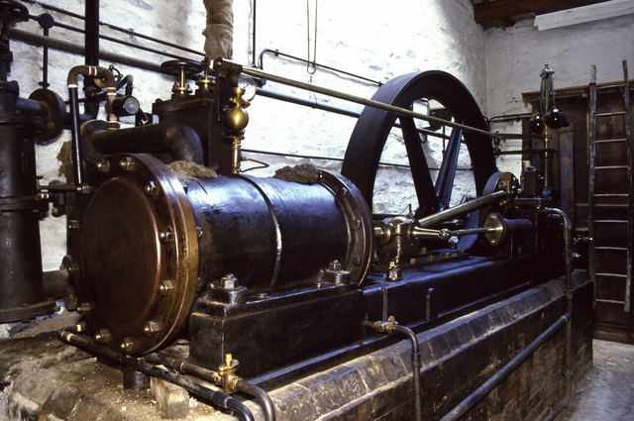
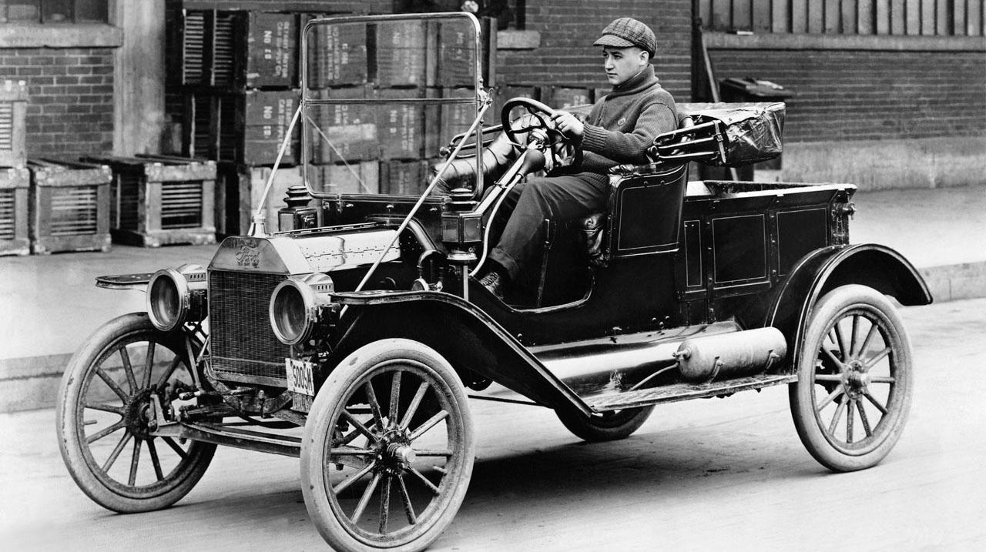
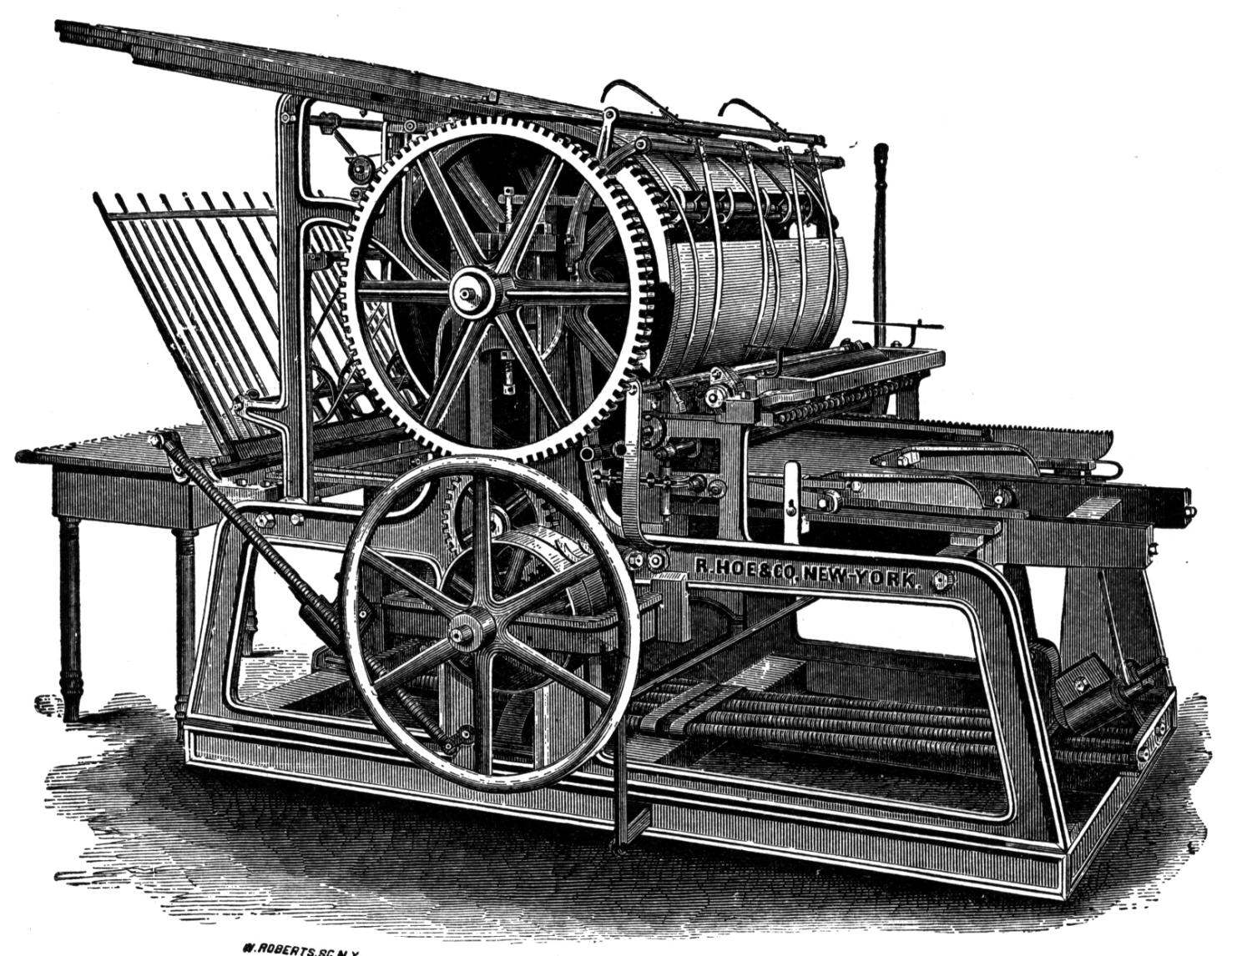
What is Steampunk? - In All Seriousness.
Steampunk is a “What If??” senario.
We question what would have happened if modern advancement in technology still followed the same principles of the industrial revolution.

Slide 6
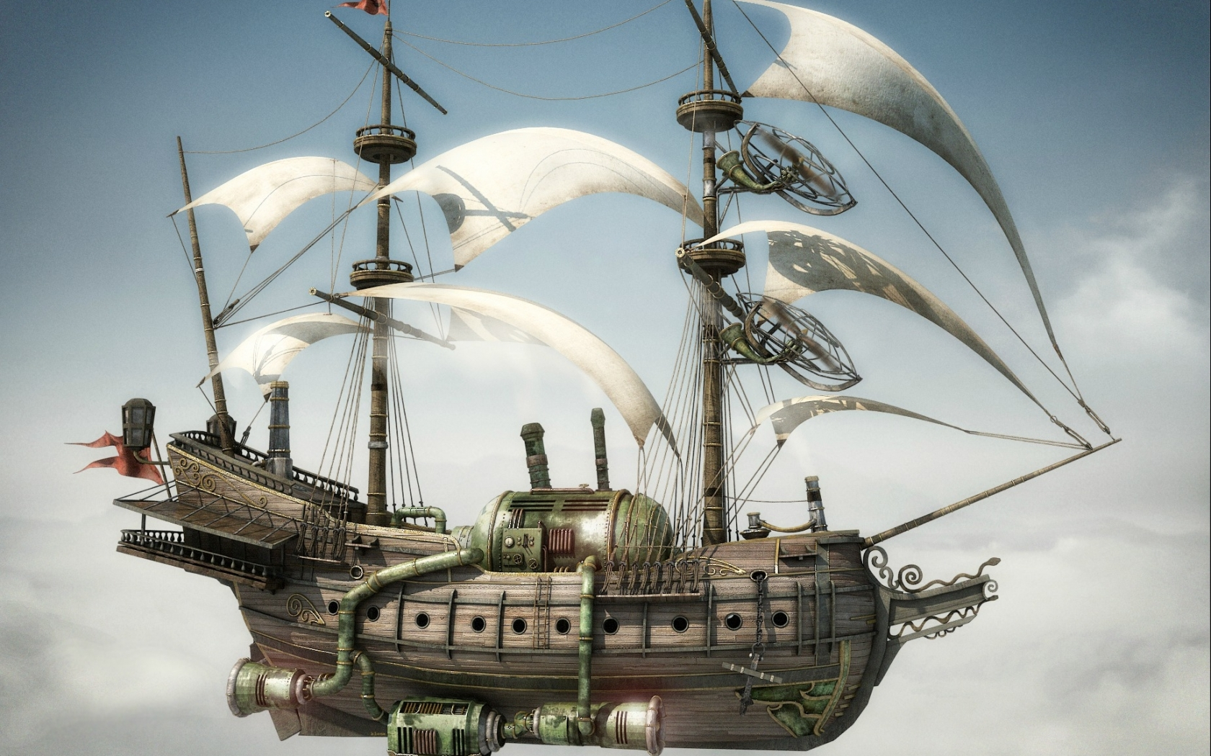
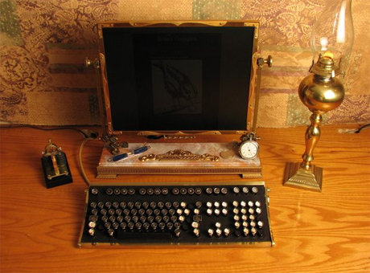
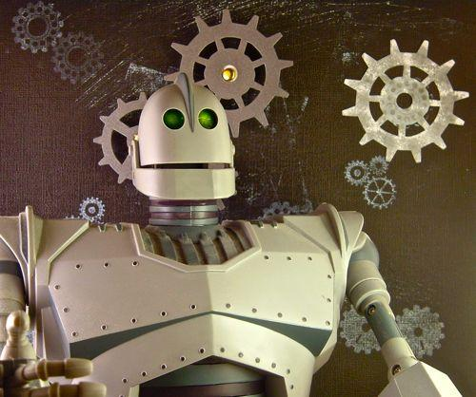
What is Steampunk?
We would take modern problems and solve them using this tech.
Flying/transportation.
Computing.
Robotics.

Slide 7
Research
What exactly did I waste my time in trying to figure out?

Slide 8
Research - Down the Rabbit Hole.
Question: Why isn’t Steampunk in the limelight?
What is makes Steampunk so interesting?
Main Components:
Technology.
Time Era.
Story and Antics.

Slide 9
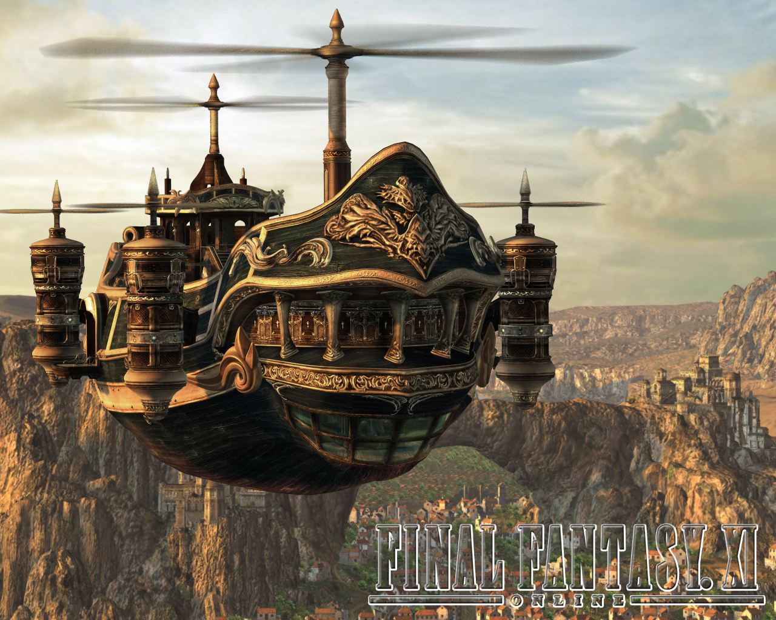
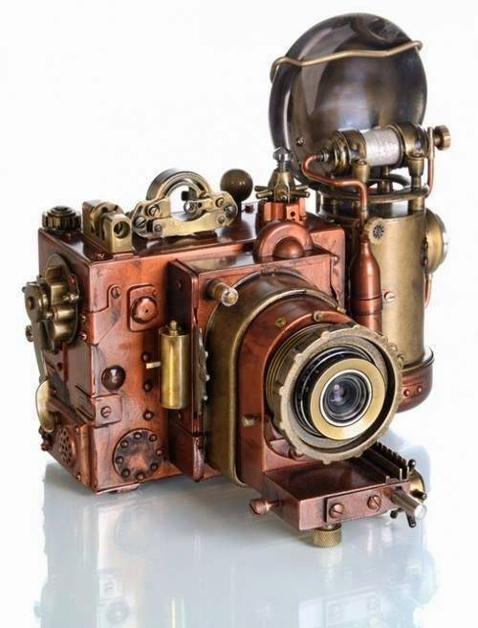
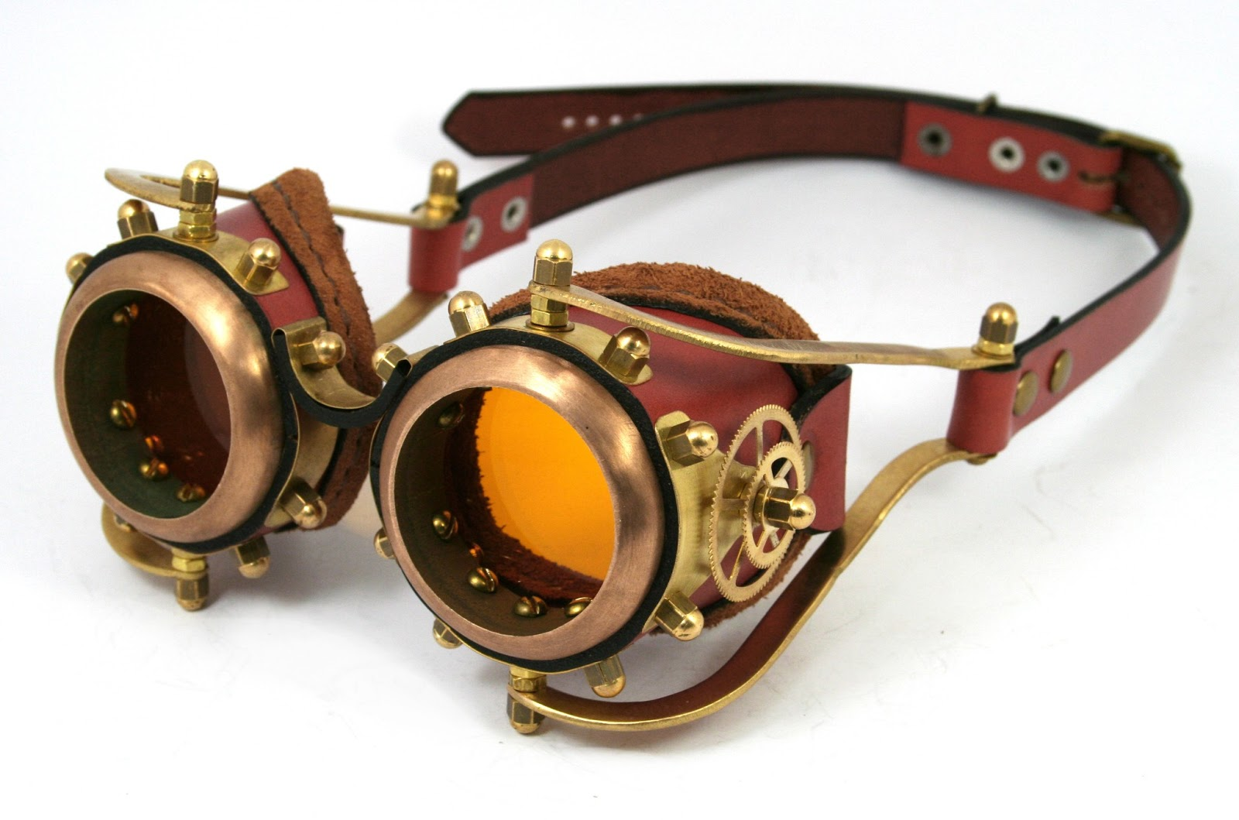
Research - Technology
Big boom of the Industrial Revolution
Futuristic yet rusty.
Practical

Slide 10
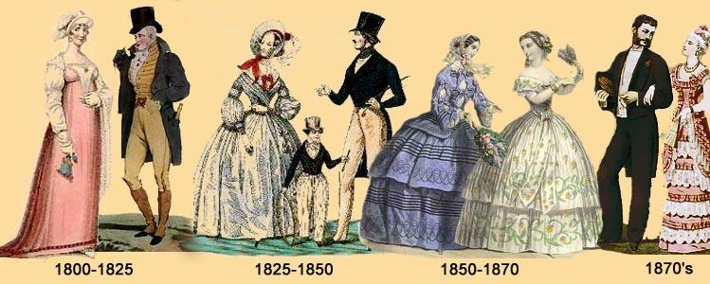
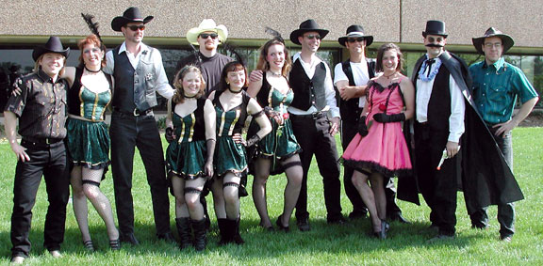
Research - Time Era
Industrial Revolution
Victorian Era
Classy Gentlemen in suits
Madams in Frilly dresses.
Balls and Galas
Wild West
Cowboys
Cowgals
Rootin tootin time.

Slide 11
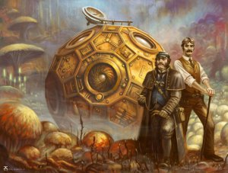
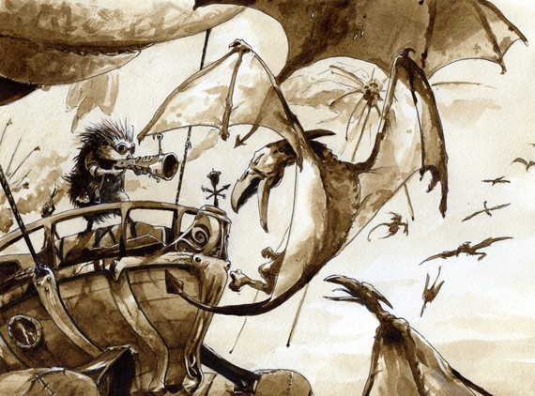
Research - Story and Antics
Most creative portion.
Characters
Plots
Hijinks ensue.

Slide 12
Conclusion.
Are you bored yet ?

Slide 13
Conclusion.
Did we solve our question?.
No… But it gave us an understanding of how broad the genre can get.
Will take time to make its return to the big screen (thanks to Wild Wild West), but its okay.

Slide 14
Awesome Examples.
In my opinion.

Slide 15
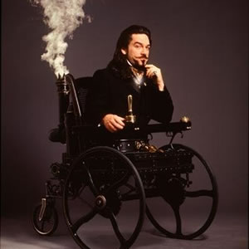
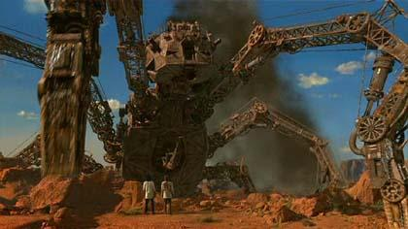
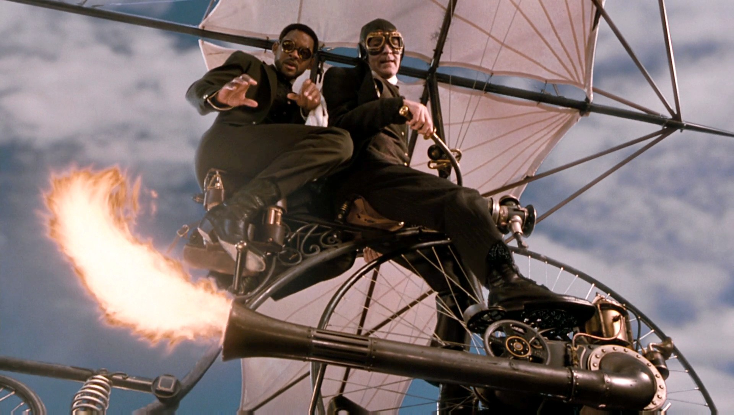
Wild Wild West
While considered a low in not just Will Smiths acting career, but it also stopped the sub-genres rise in popularity.

Slide 16
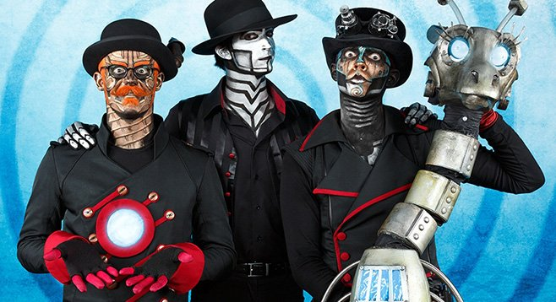
Steam Powered Giraffe
A good example of the fans that live and breath steampunk. Music group where their shtick is they are automatons. Like Chuck E Cheese's.

Slide 17
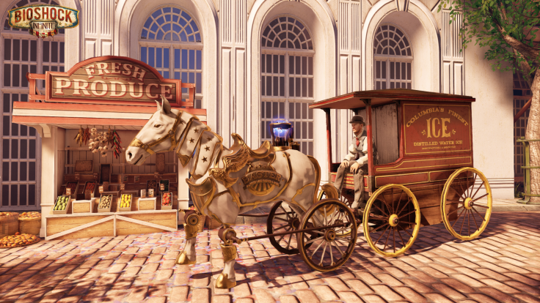
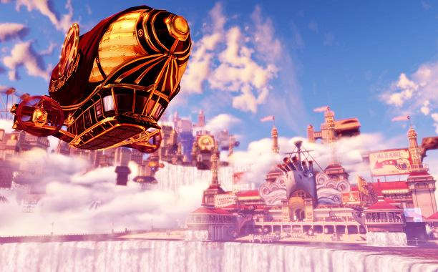
Bioshock Infinite.
Blends story along with its amazing environments and interesting characters.

Slide 18
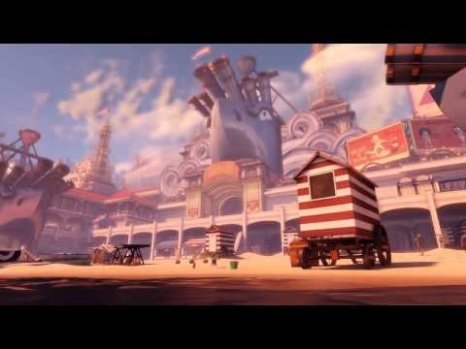
Tour of the World inside Bioshock Infinite.

