Slide 1
Big Dumb Objects?
2440: Science Fiction Project Final
Eugene R. Espinueva

Slide 2
Ok, What is that?
Argued to be coined by Roz Kaveney, in 1981
Describes “alien enigmatic artefacts”^{[1]}
Focus is on “alien” and “enigmatic”. Being unable to determine the origin of the object in question
Can also be known as, but not limited to, macrostructures and megalotropic constructs.
In the case of macro and megalo, scale is a factor as well as the object being “enigmatic”.

Slide 3
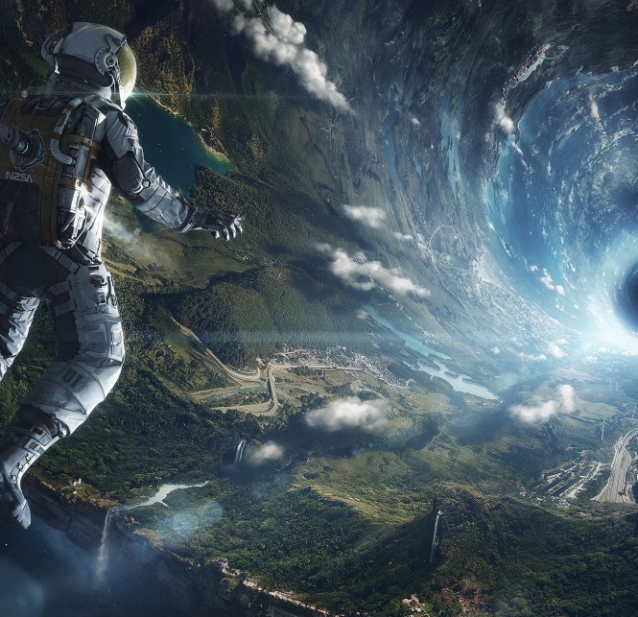
Early Notabable Objects
Ringworld (1970)
Larry Niven
Rendezvous with Rama (1973)(right image)
Arthur C. Clark
Orbitsville (1975)
Bob Shaw
Starwars (not exactly)
George Lucas

Slide 4
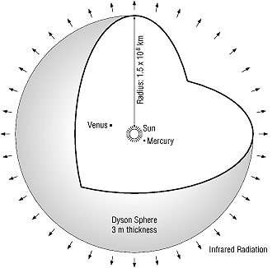
Conceptually
Example of a Dyson Sphere or Shell
BDOs are not limited to very large objects. But today that is how they are commonly conceptualized as.

Slide 5
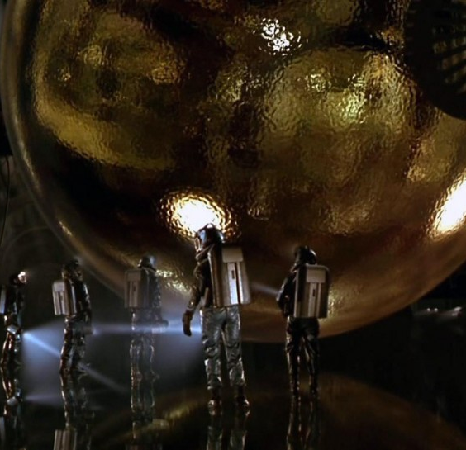
Conceptually
“Smaller” example of a BDO would be the Monolith in Space Odyssey
The Spherical object in Sphere (1998), based on the book of the same name (right image)

Slide 6
In Recent Times
Video Games and CGI effects in films have pushed the boundaries of depictions of BDO objects.
Core literary concepts of BDOs still apply
Alien origin
Unknown purpose, function, origin, or capabilities

Slide 7
Impact on Human Psyche
The scale and enormity of these concepts, fills consumers with a sense of awe and insignificance.
This feeling is compounded by the fact that the BDO’s origins and capabilities are unknown.

Slide 8
The Paradox
Sequels to works that involve BDOs tend to receive less recognition with each iteration.
This is due to the nature of BDOs. The less we know about them, the more we are interested and filled with a sense of wonder.
This interest drives us to “fill in the blanks” of BDO mysteries, and ultimately in many cases interest is lost.
“Moths to a flame” situation

Slide 9
Lasting Influences
BDO and Macrostructure physics have roots in proven scientific fields. Constructs proposed today, may be possible for humans in the future.
Freeman Dyson, postulates that a highly advanced civilizations would require the use of all output of stars, which is the foundation of his Dyson Sphere concept.
As new mediums to convey BDOs emerge (virtual and augmented technologies), depictions of BDOs will continue to be relevant in the future.

Slide 10
Works & Images
http://io9.com/how-rendezvous-with-rama-might-look-as-a-cg-film-1579846748
http://www.daviddarling.info/encyclopedia/D/Dysonsp.html
http://spindlemagazine.com/2015/05/retrospective-film-review-barry-levinsons-sphere/
http://halo.wikia.com/wiki/Halo_Array

