Slide 1
Tweeting or Chirping? A look at user engagement
BY: Samantha Pezzolanti

Slide 2
Purpose and objectives
The purpose of the Twitter user engagement experiment was to determine if an individual could increase their engagement on Twitter by applying popular strategies.
Prove or disprove the strategies by applying them to my own Twitter
Increase my Twitter engagement and following by 25% all around

Slide 3
DEFINING SUCCESS
For this experiment success will be determined by two components, one being an increase of followers and the other and larger aspect will be increasing my percentage of engagement per tweet.
At the start of this experiment my statistics were,
21 Followers
12 views (engagement) per tweet

Slide 4
Strategy
My strategy was composed based off of strategies created by Forbes, Business Insider, Hootsuite and the NY Times.
Implementing the use of Hashtags and engaging with popular content
Sharing Content
Cross Posting
Third Party Apps

Slide 5
THE CLAIMS
Though not completely the same many of the sources recommend similar approaches to online engagement building, of all the strategies read the strongest claims used to build my open strategy as well as the ones I aimed to prove or disprove were;
Forbes 11th strategy for building online presence was “Use Hashtags often… it will bring more users to your page”
Business Insider suggests that sharing content across multiple platforms optimizes its ability to be seen
Hootsuite also auggests using hashtags and engaging with the more active tags to be apart of the conversation, don’t overwhlem the tweet with hashtags stay on topic

Slide 6
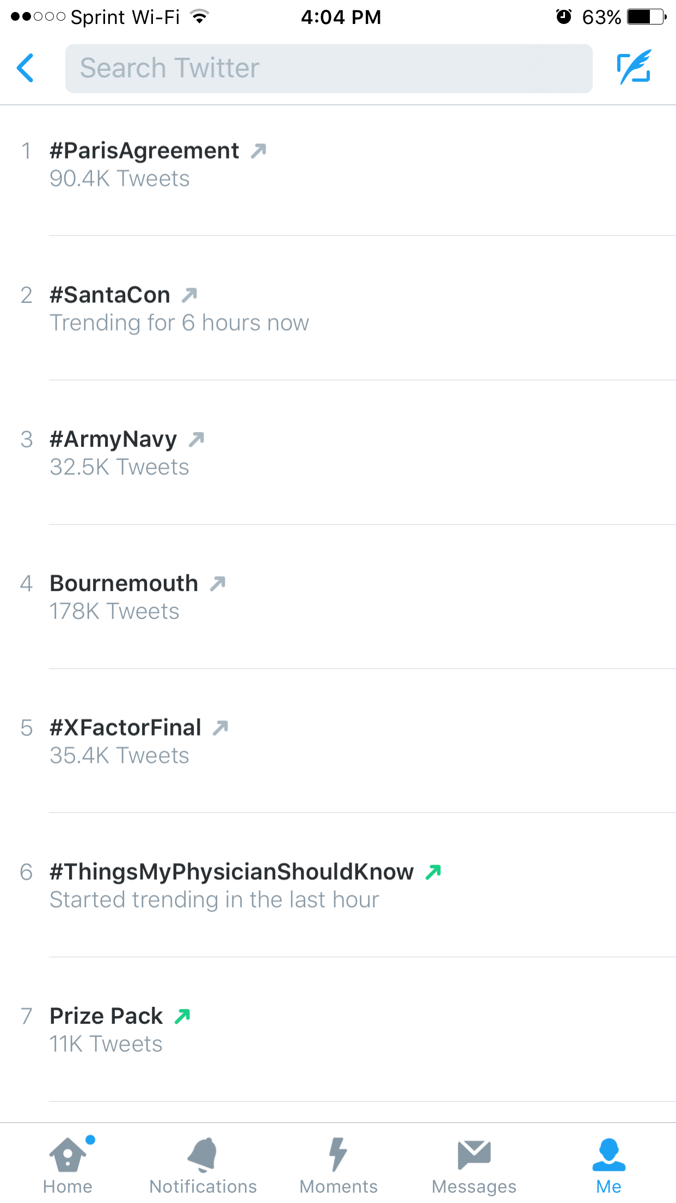
Why #hashtags?
A hashtag (#) is a word, phrase or acronym that raises awareness, gathers support or starts a conversation about a specific topic. In a sense it is the gateway to a sub community on Twitter and is used by businesses, marketers or TV/ MOVIE producers to advertise, get feedback or gain popularity.

Slide 7
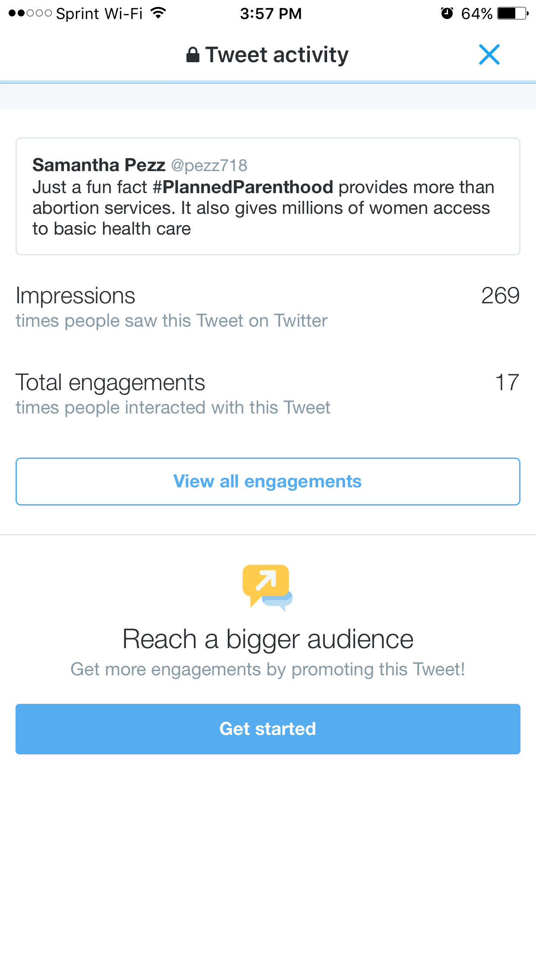
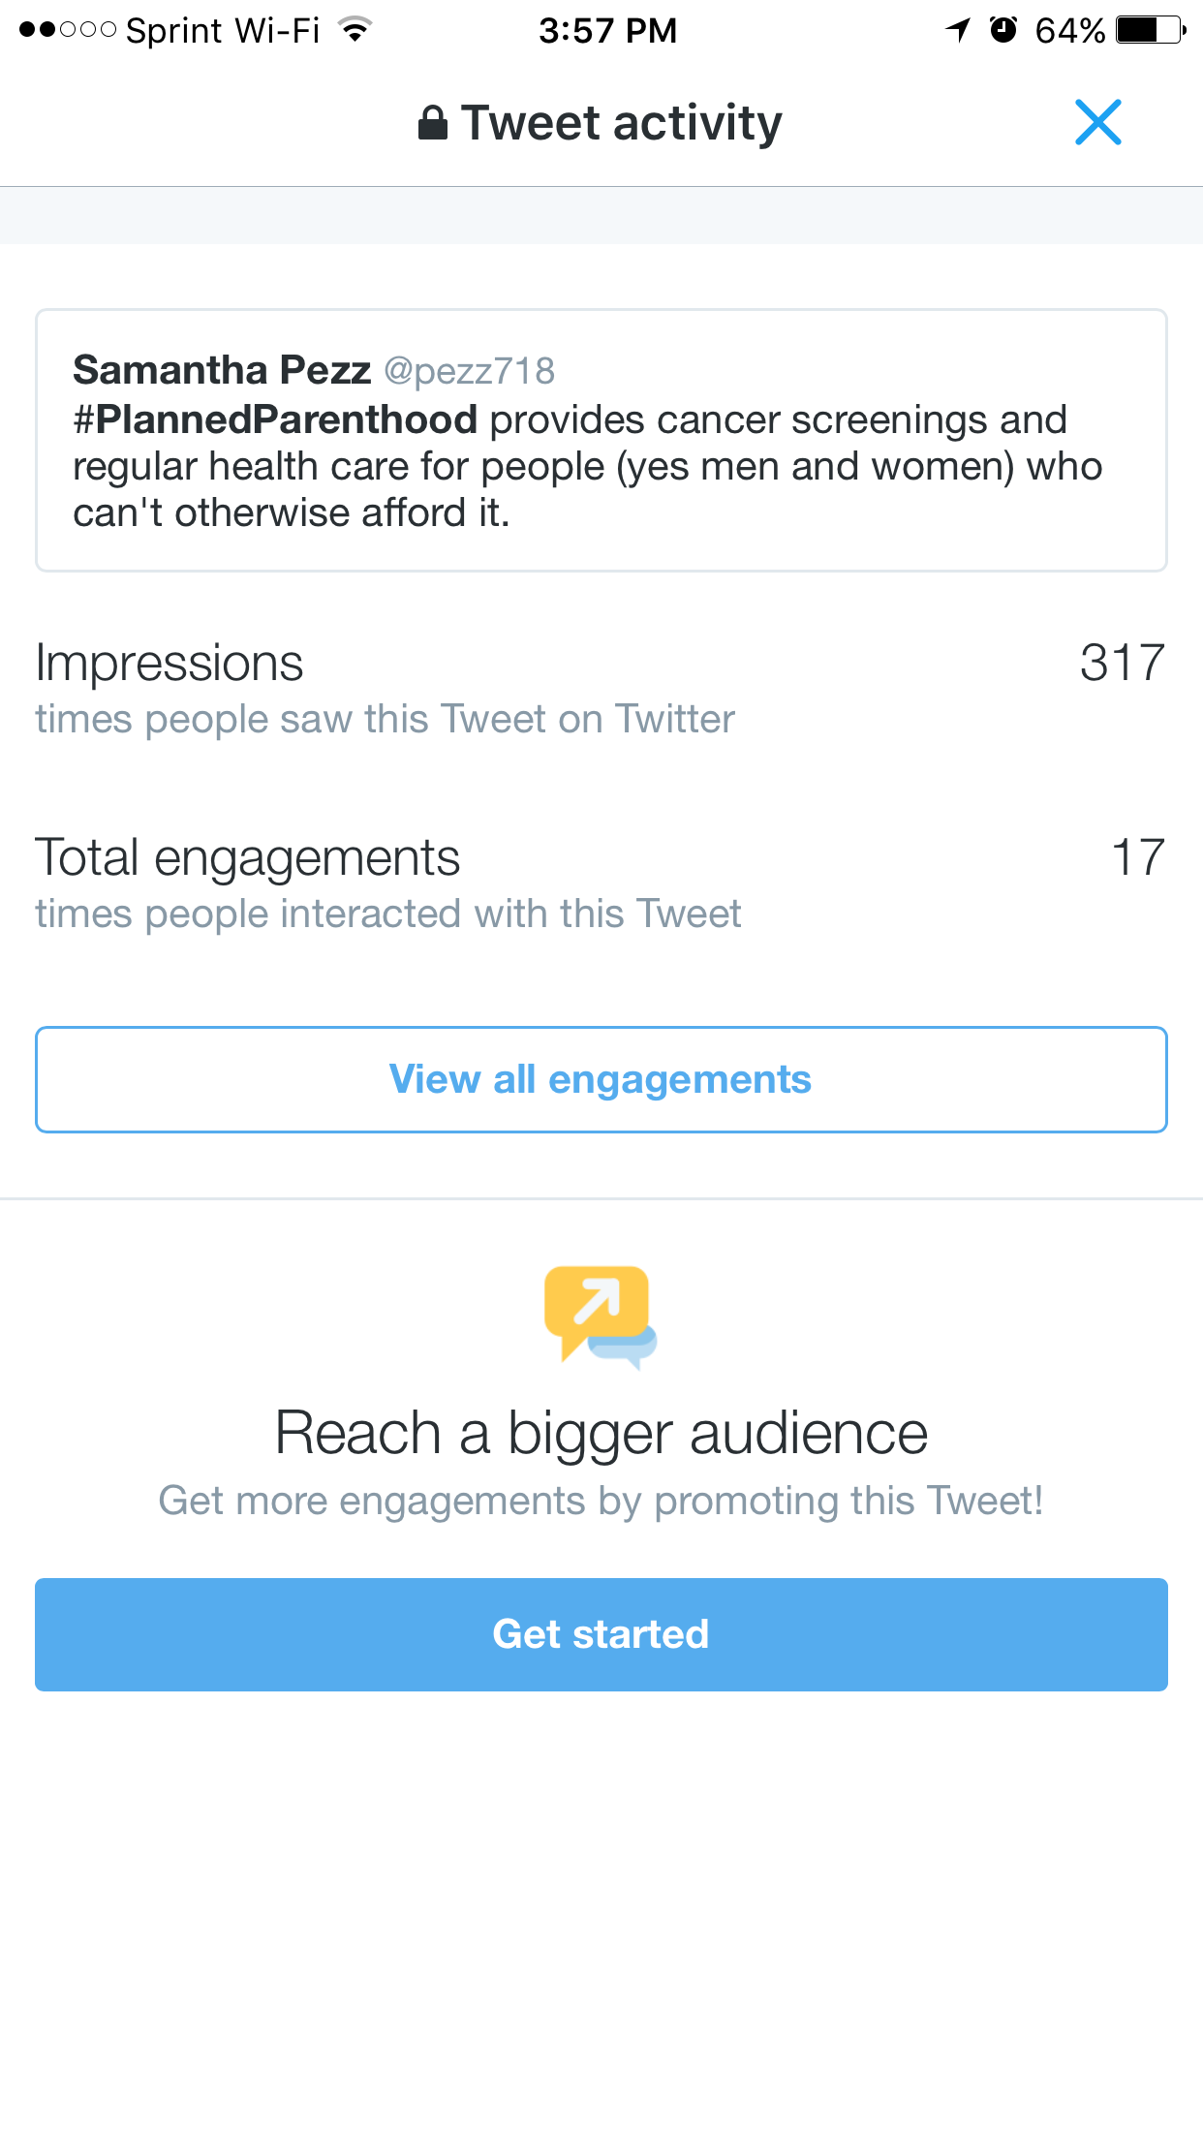
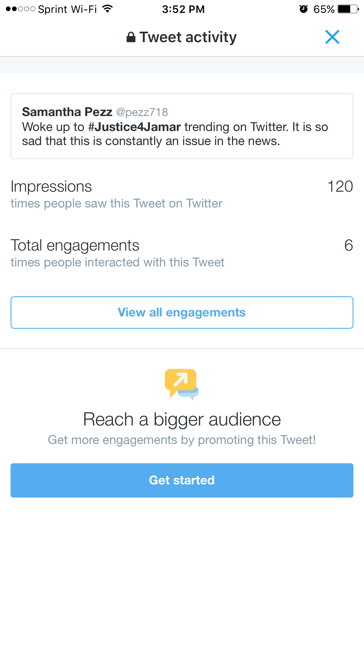
#HASHTAGS

Slide 8
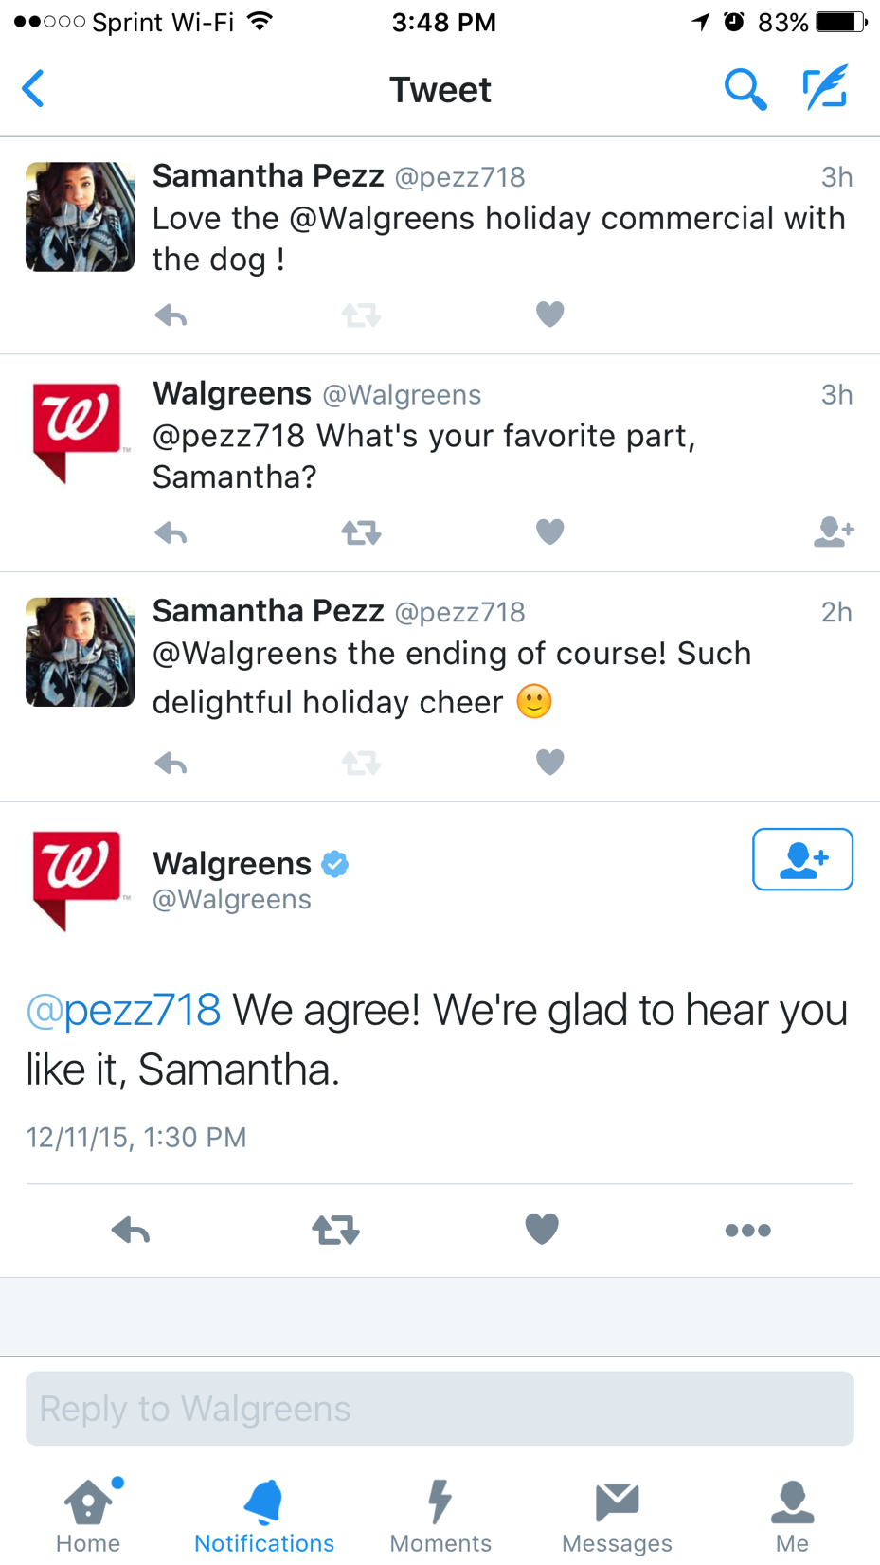
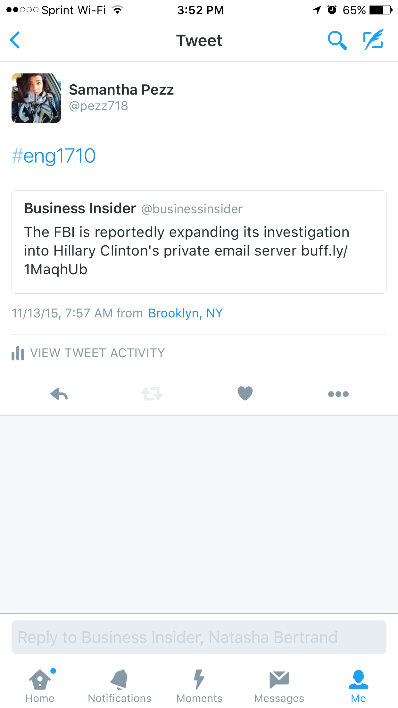
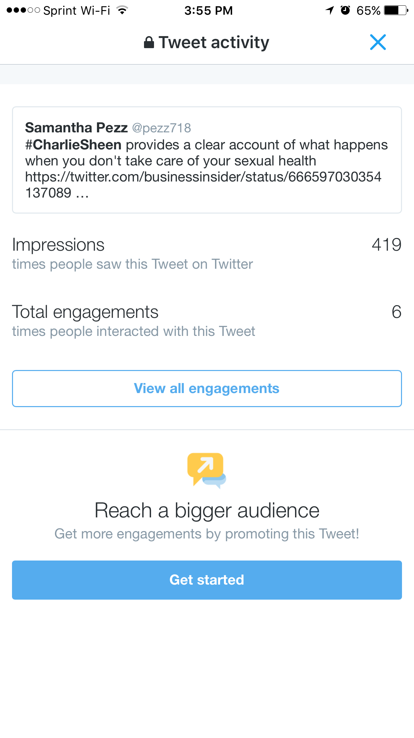
#HASHTAGS

Slide 9
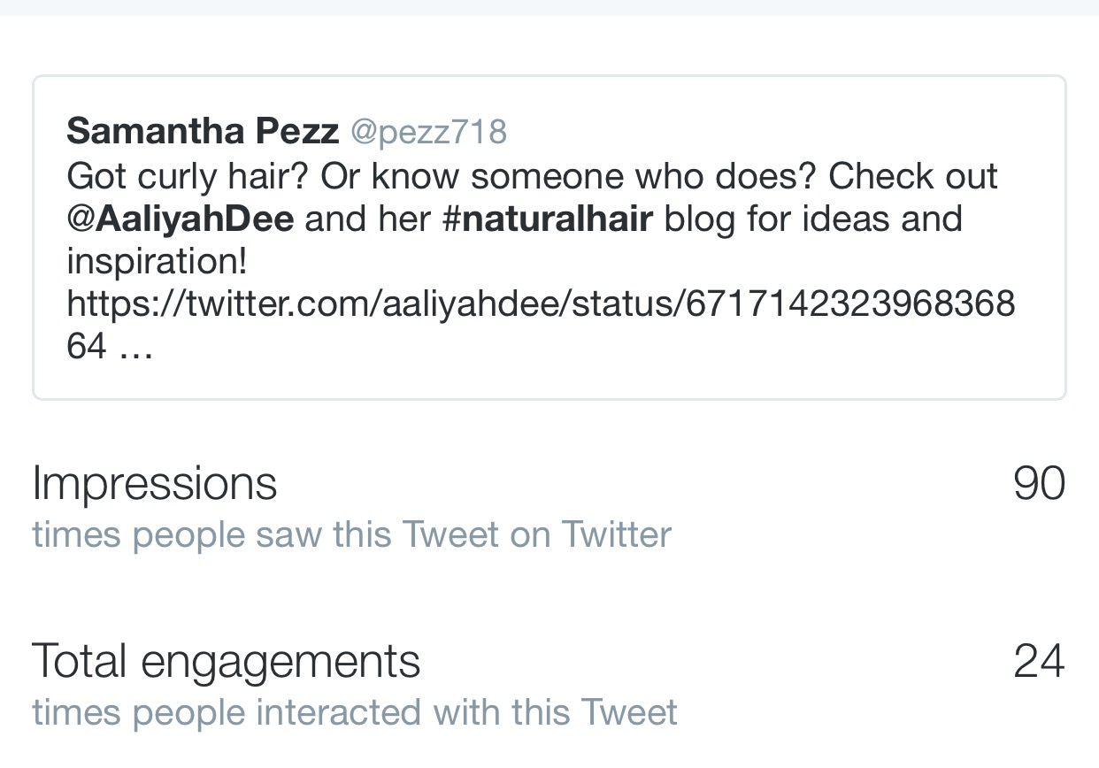
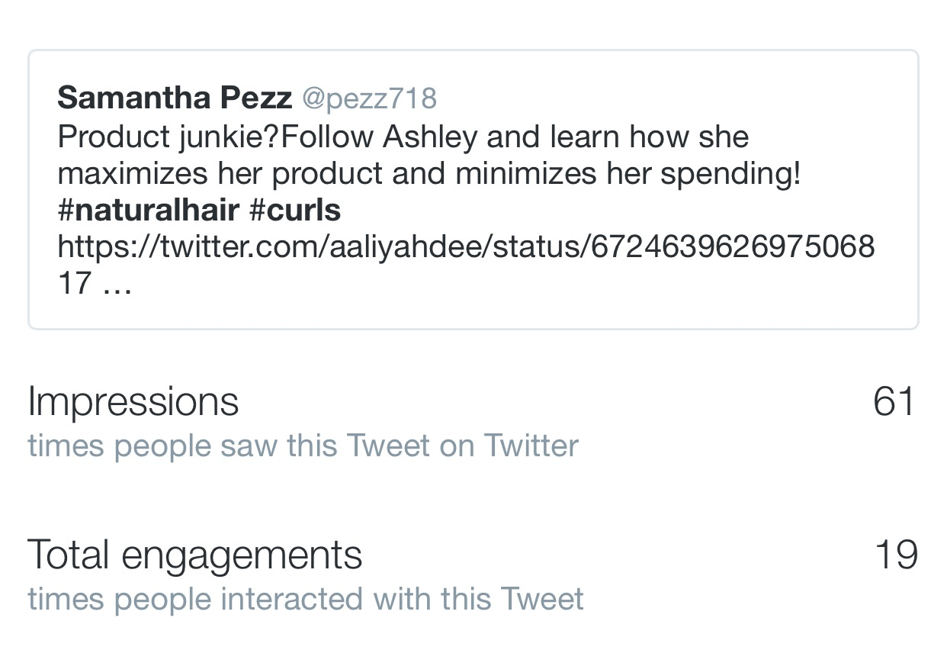
Sharing content
Sharing content from other users or from media outlets is also another avenue to consider in getting your engagement numbers up. Nearly doubling your audience potential you also open yourself up to joining smaller twitter communities.

Slide 10
Cross posting
Cross posting is posting content from other sites onto Twitter, essentially an extension of sharing content using multiple platforms gives your content a larger audience to be noticed by and also appeals to users who may not be on your select platform, in this case twitter.
For this experiment my cross posting came from, my open lab e-portfolio, my personal blog and my instagram account.

Slide 11
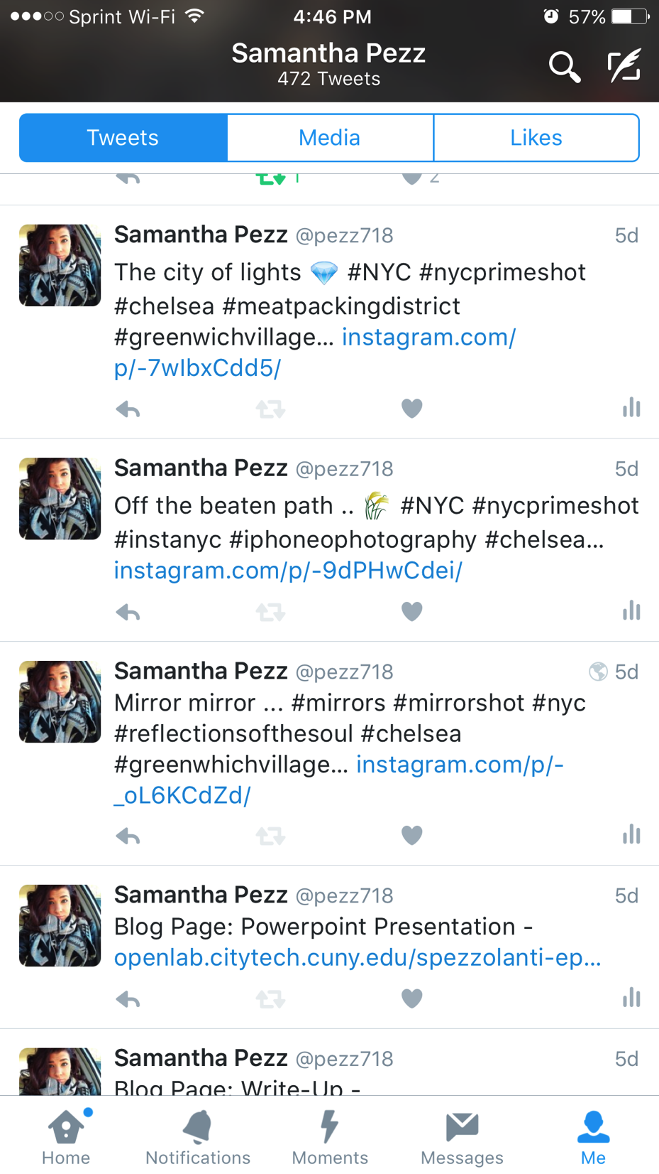
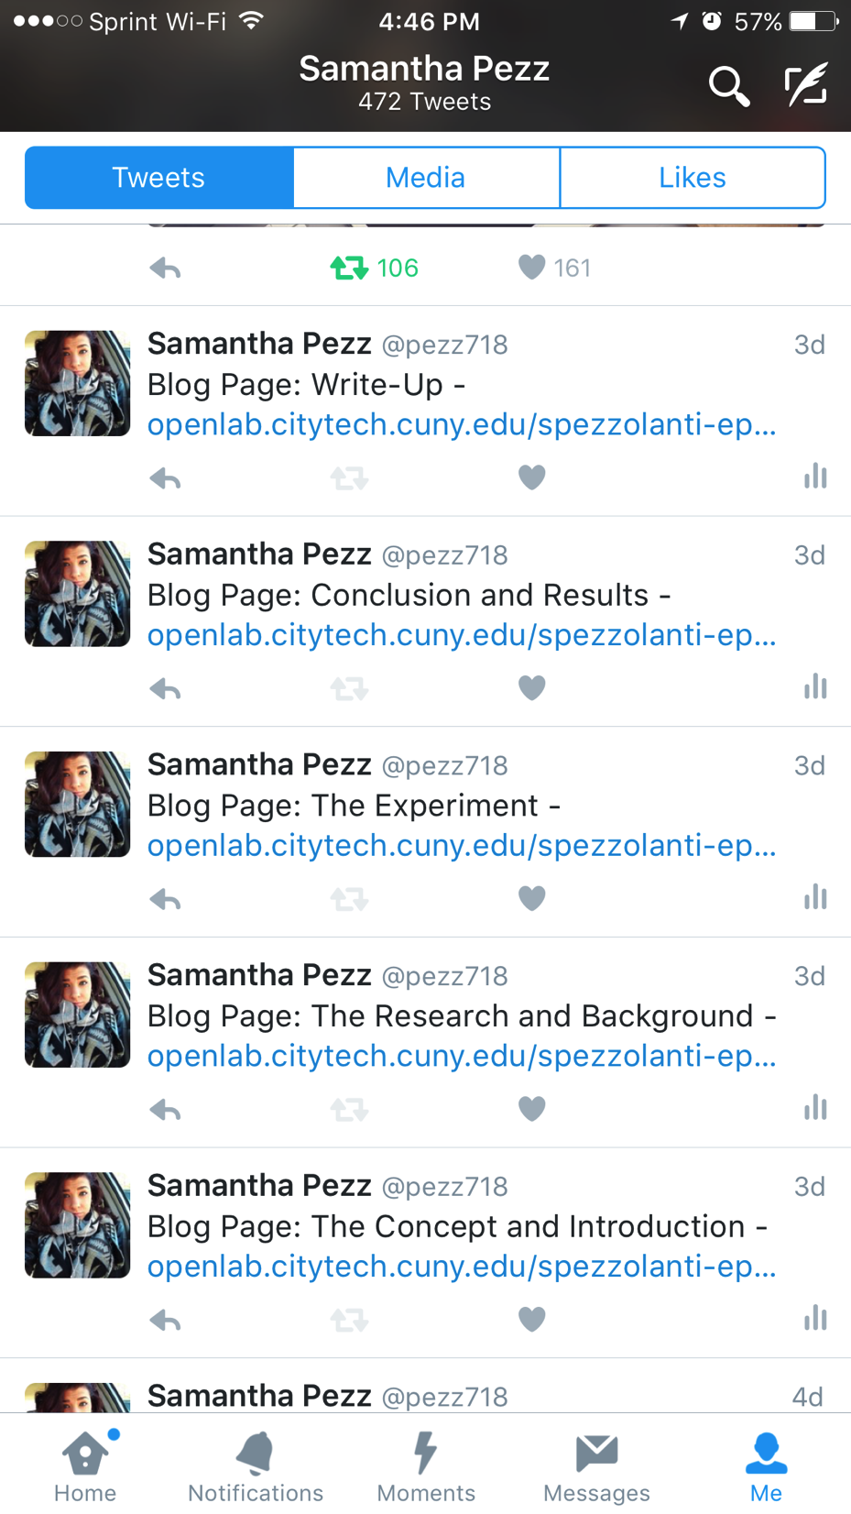
Cross posting

Slide 12
Third party apps
There are several third party Apps that can be used with Twitter to organize and increase your activity, the main ones though are Hootsuite and Tweetdeck. For this experiment I attempted to use Hootsuite to schedule my tweets at various points in the day.

Slide 13
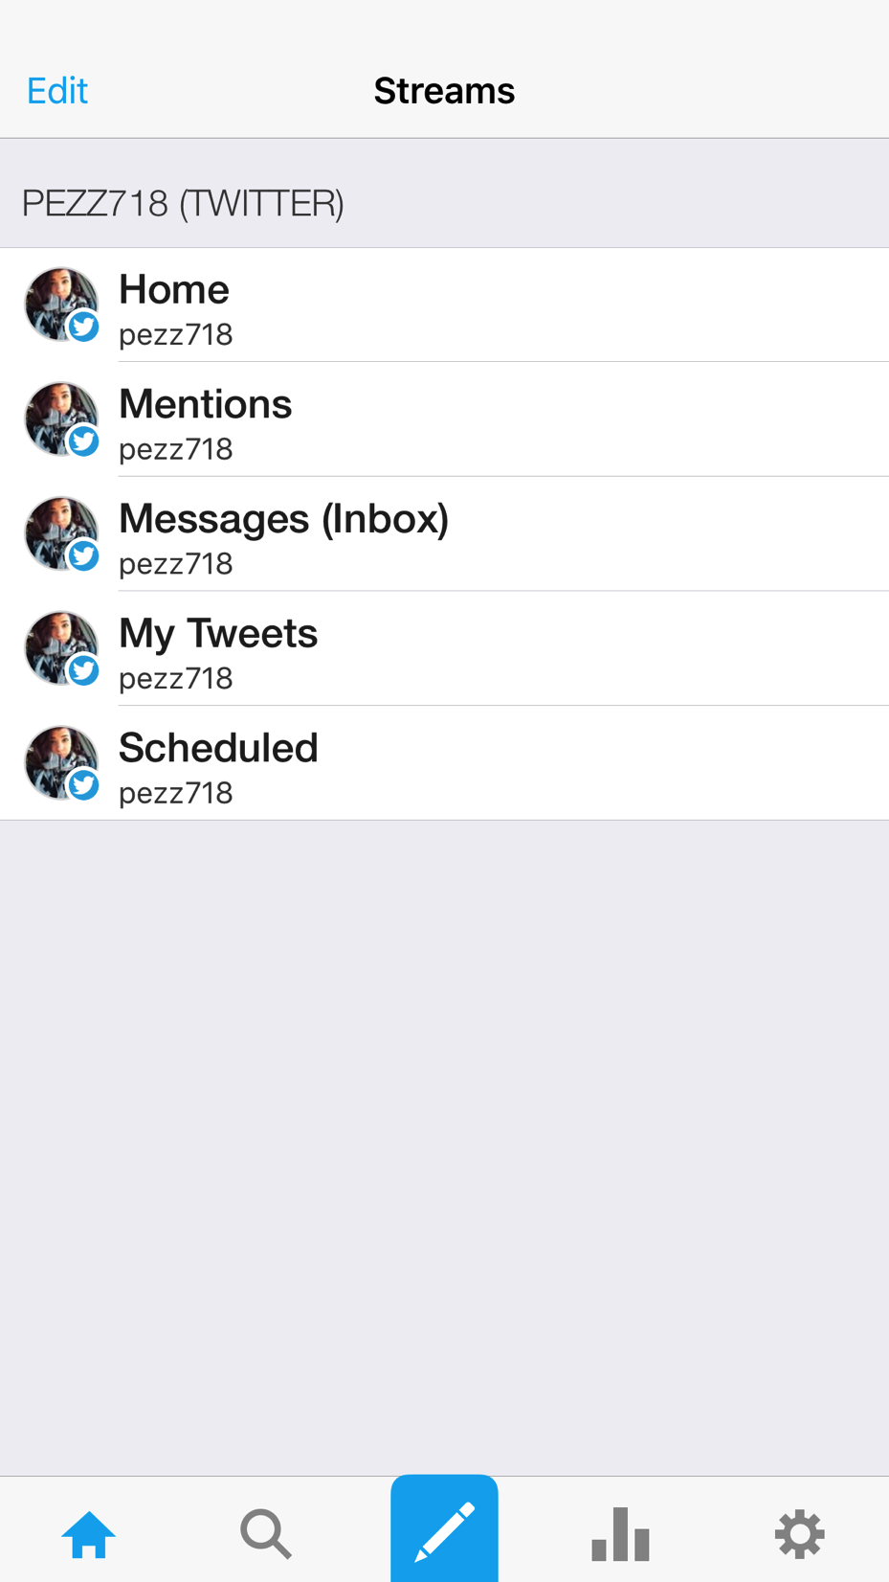
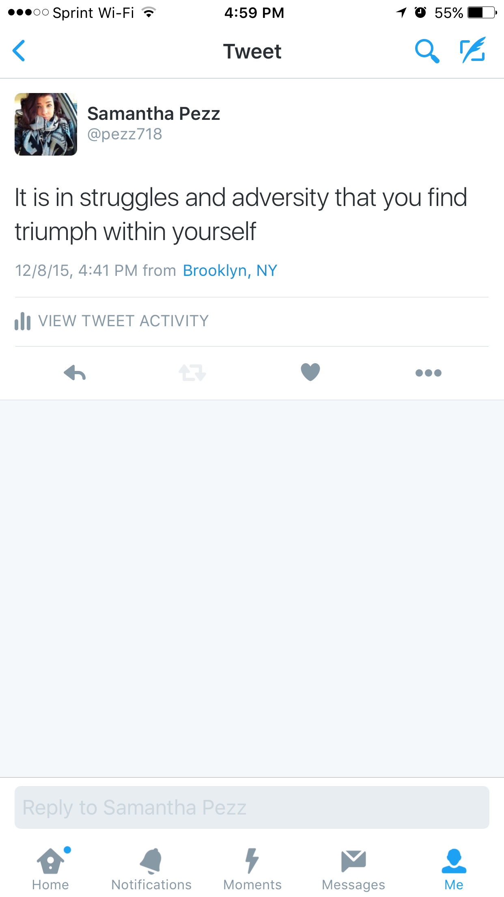
Hootsuite
Of all my strategies third party apps, namely hootsuite was the least successful. With a combination of being inexperienced with the interface and not being fond of the inner workings I was unable to get the most potential out of it.

Slide 14
Results and conclusion
Overall this experiment had its successes but it also had its failures. The area in which I saw the most success was user engagement, my views per tweet improved substantially.

Slide 15
UNDERSTANDING THE NUMBERS
Values are based per 100 followers
My following increased by 11%
My views per tweet increased by 100%
My engagement (retweets, mentions etc.) increased by 17%
The most successful strategy was Hashtags or topic engagement
The least successful was third party apps and or cross posting

Slide 16
Understanding success
This experiment has taught me several things about the strategies, myself as a writer and about new media.
Building an online presence takes an extended period of time probably a year or more to solidify and take off
It takes extreme time and dedication
The strategies are geared more towards businesses or people with a team of writers not one individual
They’re not all as useful as they seem because not everyone has the man power to accomplish them
We’re really only a small blip in the twitterverse radar, it’s a highly fluid site and content gets lost quickly

Slide 17
The key takeaways
Though I did not hit my target 25% overall increase my engagement/ views per tweet has increased dramatically
This project is relevant in becoming a reference for other users who want to use popular strategies by Forbes or Hootsuite
To continue the experiment I would certainly learn how to properly use Hootsuite
A more complex strategy guideline would be developed and a more targeted audience or community would be the target

Slide 18
SOURCES
Armstrong, Russel. "Marketing Pros and Cons of Twitter." Linkedin. LinkedIn, 1 Feb. 2015. Web. 17 Nov. 2015. <https://www.linkedin.com/pulse/twitter-marketing-pros-cons-russell-armstrong>.
Olanoff, Drew. "Twitter Debuts Moments." TechCrunch. 6 Oct. 2015. Web. 17 Nov. 2015. <http://techcrunch.com/2015/10/06/project-glacier/#.cxicwgi:TMDC>.
Cave, Andrew. "Will Twitter Be Dead in Three Years." Forbes. Forbes Magazine, 2015. Web. 17 Nov. 2015. <http://www.forbes.com/sites/andrewcave/2015/01/31/will-twitter-still-be-around-for-super-bowl-lii-in-2018/>.

Slide 19
SOURCES
Cohen, James, and Thomas Kenny. "CHAPTERS 2 AND 7." Producing New and Digital Media Your Guide to Savvy Use of the Web. Independence: Taylor and Francis, 2015. Print.
Kricfalusi, Elizabeth. "Twitter vs. TweetDeck vs. Hootsuite: Which Is the Best Twitter Client?" Tech for Luddites. Tech or Luddites, 3 Apr. 2015. Web. 17 Nov. 2015. <http://techforluddites.com/twitter-vs-tweetdeck-vs-hootsuite-which-is-the-best-twitter-client/>.
Prattler, Adam. "How to Use Twitter Hashtags to Get Noticed." Social Media Today. 22 Oct. 2013. Web. 17 Nov. 2015. <http://www.socialmediatoday.com/content/how-use-twitter-hashtags-get-noticed>.

Slide 20
SOURCES
Patel, Neil, and Retia Pure. "The Complete Guide to Understand Customer Psychology – Chapter 3." Quick Sprout. Quick Sprout, 2014. Web. 6 Dec. 2015. <https://www.quicksprout.com/the-complete-guide-to-understand-customer-psychology-chapter-3/>.
Rampton, John. "25 Ways to Grow Your Social Media Presence." Forbes. Forbes Magazine, 29 Sept. 2014. Web. 12 Nov. 2015.
Works, Bernadeen. "HootSuite: Maximize Your Social Media Efforts." Business Insider. Business Insider, Inc, 26 Dec. 2012. Web. 17 Nov. 2015. <http://www.businessinsider.com/hootsuite-maximize-your-social-media-efforts-2012-12>.

Slide 21
THINGS TO THINK ABOUT
What makes you engage with or ignore content you see online?
If you do engage with something what are the primary reasons?
What do you think is the best way to build a following on social media and if you already have an established following how did you achieve it?

