Slide 1
Branding 101
Ashley A Dunlap
December 3, 2015
Writing in New Media

Slide 2
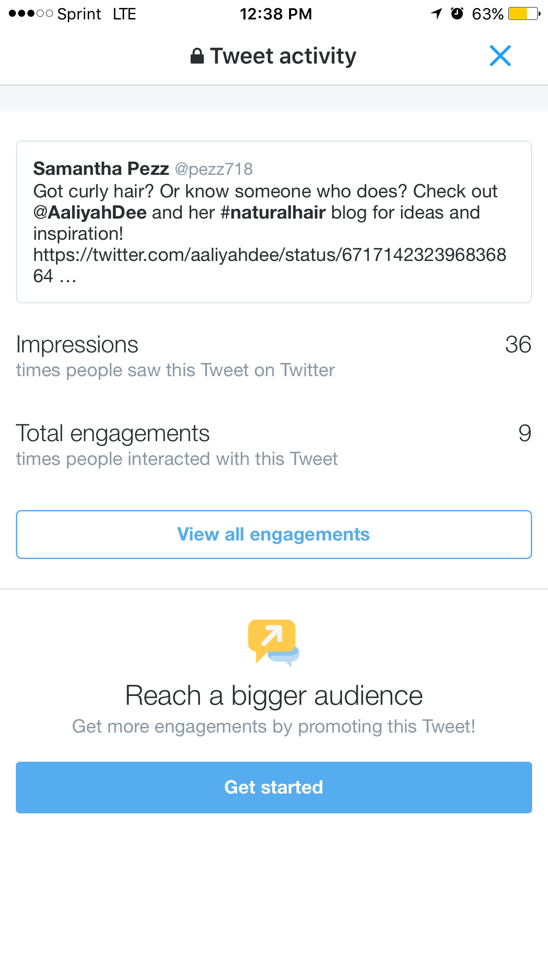
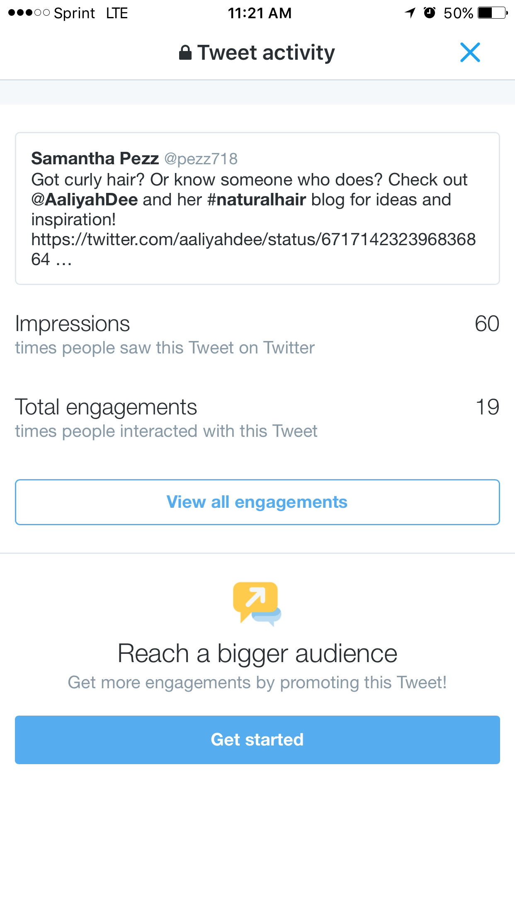

Slide 3
