Slide 1
The Process of Memes Undergoing Change
Folayemi Akinbolaji
Writing with New Media

Slide 2
“Y U NO” Guy Part of a series on Rage Comics
A well-known character in Rage Comics, “Y U NO” guy as he is referred to, has become a popular internet meme used often to depict different meme meanings.
“In an age of viral media, once produced and distributed in a networked pathway, images rapidly undergo change in terms of location, form, media, genre, and function” (Greis 335).
http://knowyourmeme.com/memes/y-u-no-guy

Slide 3
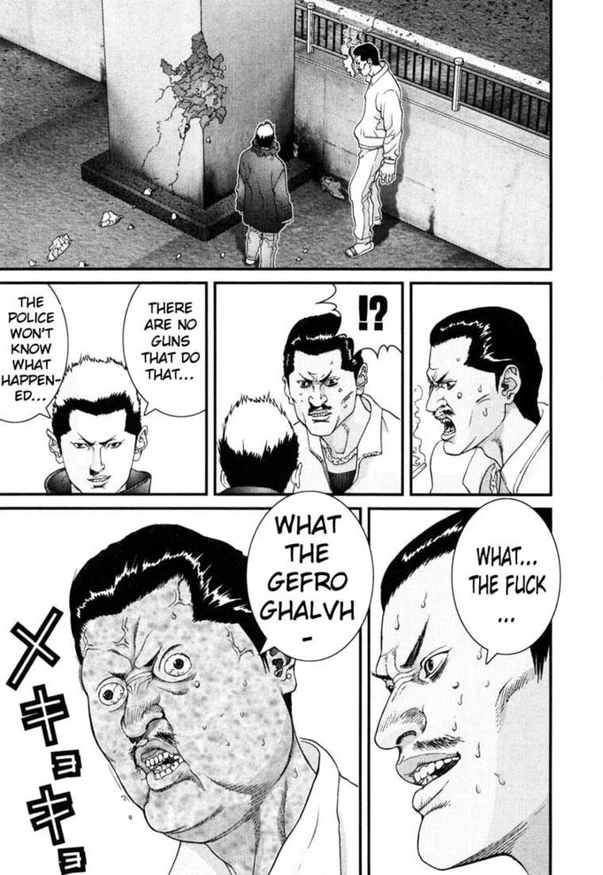
Origin of the Popular Meme
Featured in a Japanese magazine, the facial expression of the character is seen as frustrated and in rage. Once the English version was released, the image was traced and circulated within the web by fans which ultimately led to the “Y U NO’’ series of memes.
http://knowyourmeme.com/memes/y-u-no-guy

Slide 4
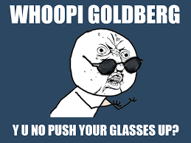
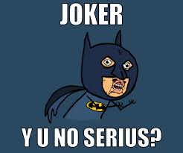
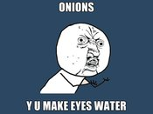
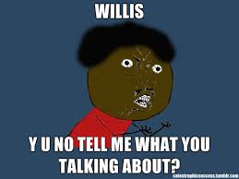
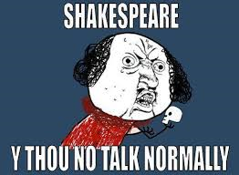
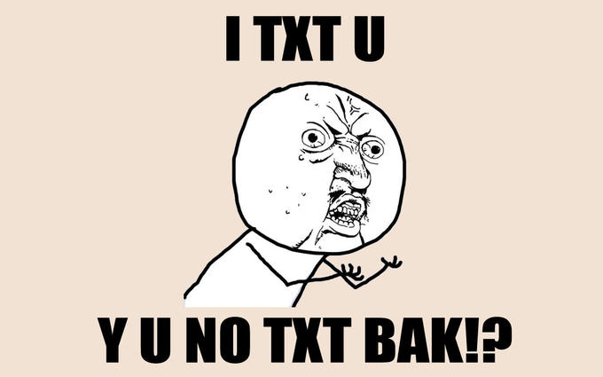
Variations of the “Y U NO” Guy
http://knowyourmeme.com/memes/y-u-no-guy

Slide 5
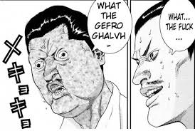
With “an image’s encounters with humans and other entities, images are often catapulted back into flow in divergent directions and generate even more configurations” (Greis 335).
Because of viral media, what initially began as just a photo in a comic book, quickly was circulated online and thrown into different directions of producing various memes; generating a proliferation of memes through this one image. The spread and popularity of the image also created the discourse community of the fans who appreciated the Japanese comic book and wanted to participate in generating a different context when it came to the image.
http://knowyourmeme.com/memes/y-u-no-guy

