Slide 1
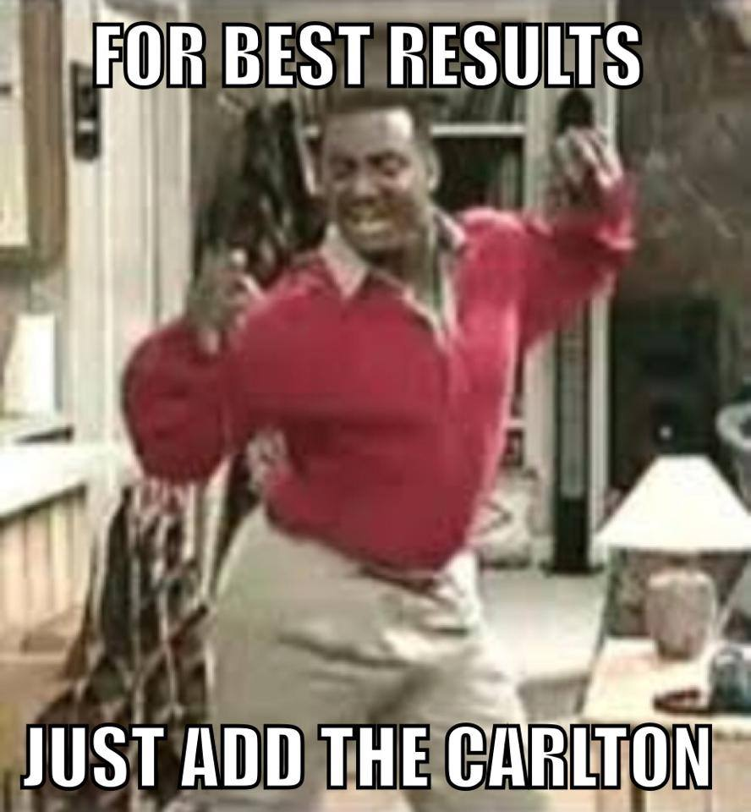
The art of the meme
A walk through memeology
by samantha pezzolanti

Slide 2
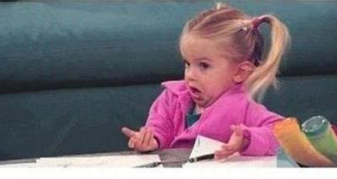
A look at what a meme is…
A meme is an image with text on or around it that is meant to convey a message. Sometimes powerful and thought provoking other times for humor and advertisement. There can sometimes be hundreds of variations on one image, often being edited by dozens of authors.

Slide 3
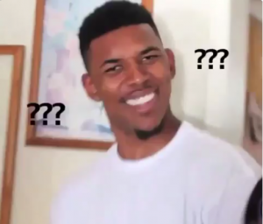
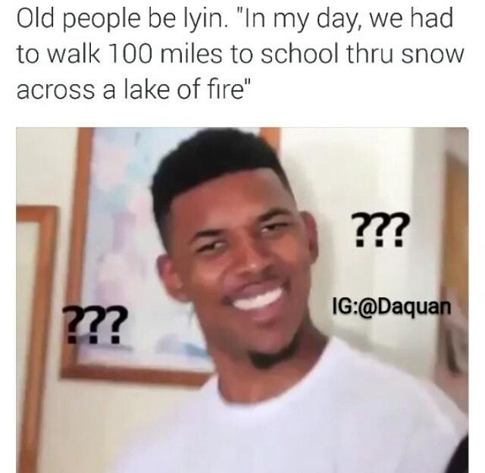
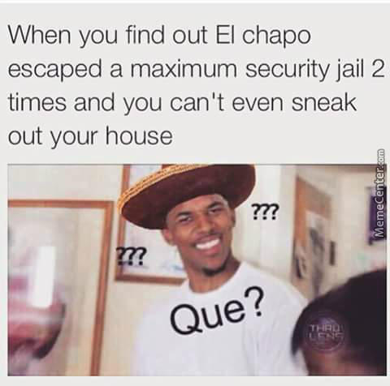
Oh the places a meme will go…
This idea relates to page 338 of the Gries article where she talks about the consequences of an image as it circulates. Think about the most popular memes out there right now and how many captions they’ve hosted or how many variations of that same meme you’ve come across in your scrolling. For example this picture has been apart of so many memes,

Slide 4
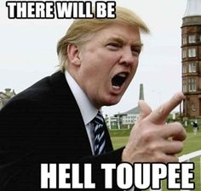
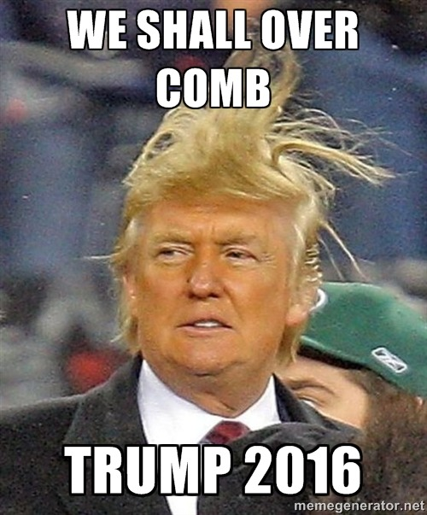
TO MEME OR NOT TO MEME
Though most memes are meant to make people laugh they can sometimes get into the political scene and be used to send political messages or convey opinions on the candidates. Donald Trump is the most popular meme out there right now, most poke fun at his outrageous comments and ideas and are often posted by Democratic affiliated users. Similar to “Obamicons” these memes are a spoof on the real messages Trump is trying to get out there.

Slide 5
