Slide 1
What’s So special about a meme
Ashley Dunlap
10/20/2015
Writing in New Media

Slide 2
What is a meme
The meme comes from the Ancient Greek word mimeme which means “imitated thing” (Cohen & Kenny 86)
Topoi, singularly topos, is a theme or connection piece. When tying this into the understanding of memes it all goes back to discourse communities.

Slide 3
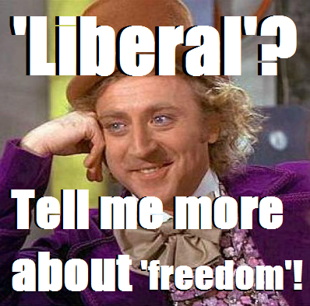
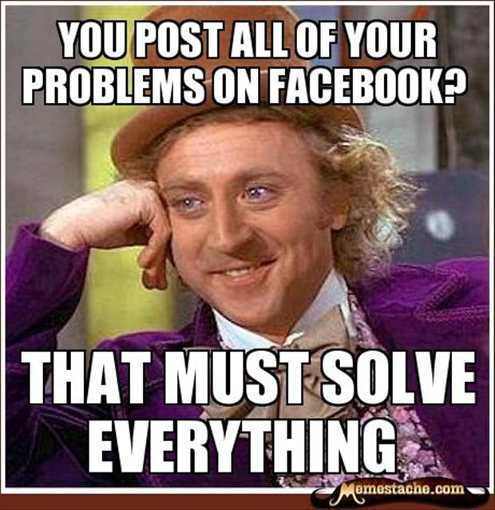
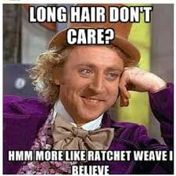
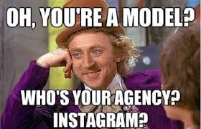

Slide 4
Transformation is studied by paying attention to how a circulating image changes in terms of design, form, medium,materiality, genre, and function as it enters into new associations. With the advent of the Internet and the expansionof participatory culture, in which remix is a foundational vehicle for communication, images trans-form at lightning speeds and in diverse ways. (Gries 343)
Circulation, to be clear, is largely beyond a designer’s control, unlike distribution, which is a deliberate process. (Gries 344)
If memes like “binders” fall squarely under the purview of rhetoric, we might begin to reconcile rhetoric and memetics by considering how some memes function as rhetorical topoi. (Wetherbee 3)

Slide 5
