Slide 1
Debate: Blogger vs journalist Can you have the best of both worlds?
Folayemi Akinbolaji
Writing with New Media

Slide 2
FashionBombDaily.com
The web’s destination for multicultural fashion. Created in August 2006 by journalist Claire Sulmers, Fashion Bomb Daily provides all the latest in celebrity fashion. Multiple posts put up a day include:
“Bomb Product of the Day
“Bomber of the Day”
“Bombshell of the Day”
“Mail Bombs”
And so much more.

Slide 3
Why is this blog such a success?
Consistency in updates (at least 10 posts a day)
Target a specific audience (Fashion enthusiasts)
Transparency and honesty
Engages with readers
Credible sources
Insider knowledge

Slide 4
Is a blogger a journalist?
In this instance, founder and editor-in-chief Claire Sulmers and her team cover different aspects of fashion and style from celebrity inspiration and shopping to reader-submitted “Looks of the Day” posts. Her commitment to her position and natural tendency for finding out the latest of all things celebrity news has made her a constant influence of the blogosphere. What started out as a hobby quickly became a full time job. Her blogging side finds the right topics to introduce to her readers and interprets them in a way to keep them engaged while her journalist side, continues to be dedicated and committed to her work.

Slide 5
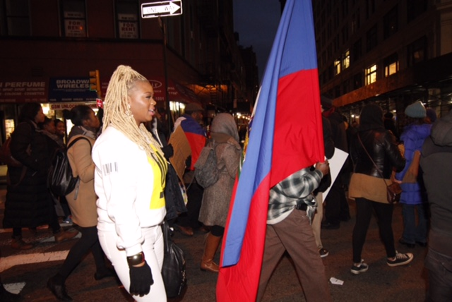
“So yesterday, I was internet shamed because of my choice of attire for the Millions March in New york. At the end of the day, regardless of what I wore or what people thought I was doing out there, I hope people are encouraged and inspired. I was touched to look at the pictures afterwards and see that black people aren’t the only ones who get that #BlackLivesMatter. Saying #BlackLivesMatter doesn’t mean that other lives don’t. The phrase just means that we need to start honoring, valuing, and uplifting black people and black lives instead of recklessly shooting or tearing them down..” – Claire Sulmers
Founder of fashionbombdaily takes to the streets to advocate for #blacklivesmatter but is criticized for her attire.

