Slide 1
Humans of New York
A photo blog

Slide 2
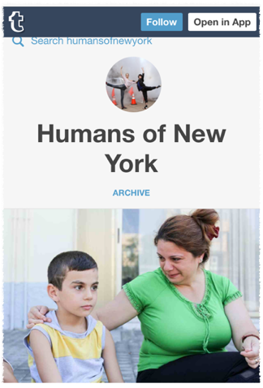
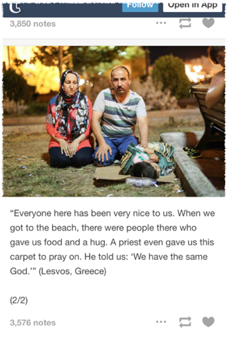
A picture is worth a thousand words
Humans of New York author Brandon Stanton captures people's photograph by randomly approaching them on the street. Asking them to share a story about themselves or their past or even some random witty observation. He then blogs or posts the photo with the persons story.

Slide 3
Unique
The blog which is hosted by tumblr also has extensions on Instagram and Facebook making it wildly popular and shared thousands of times across multiple platforms.
The amount of compassion and support that Stanton generates from a one paragraph description is unbelievable as well as heartwarming
In some instances followers of the blog and in the HONY community seek to start go fundme pages for individuals in hardship. This unique community started as a small project and has grown to global proportions.

Slide 4
Global Community
Since its launch on November 4, 2010 HONY has traveled across Europe capturing the lives of people all over the region.
Summer 2015 featured posts from Pakistan, Iran, Turkey and more. Stanton visited villages, towns and schools of regions torn by war or just poverty stricken and in one case managed to raise over one million dollars for a woman in need.
Currently though Stanton is photo blogging the refugee crisis in Syria and the boarding nations. Giving a human perspective to the migration of millions of people as opposed to a generic news article detailing the political struggles of it.

Slide 5
Why HONY?
Why did I choose HONY?
▶️ Well I browsed a variety of blogs like The Gothamist which is a news based blog. However a blog like HONY appeals to me because it's like a second hand diary. Stanton gives these people who would otherwise go unheard an outlet. I also love photography and his blog is all photo based.

Slide 6
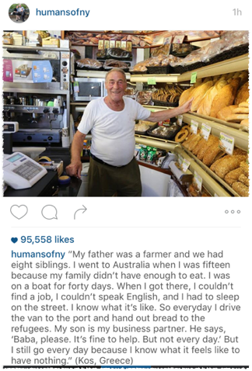
What's happening on HONY

Slide 7
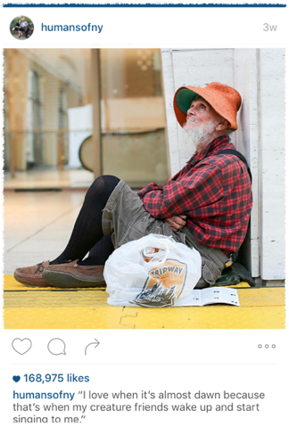
What's happening on HONY

Slide 8
Blogs like HONY appeal to people's emotional side and provokes compassion among one another that we may not see every day. It brings awareness to action, consequence and empowerment.
Blogs similar to HONY are blogs like undergroundnyc which uses the subway system to take artistic photos. Horacio Jones who talks about relationships, heart break and moving on. Poetic style who blogs about emotional crisis, hardship and coping.
All these blogs are personal yet can apply to so many lives. Making blogging seem human again and giving its readers a sense of comfort in knowing there is a community out there for them.

Slide 9
😊💛💻

