Slide 1
Tooth Dilacerations
Bianca DeFranco
Group 2 8218
October 30th 2012

Slide 2
What are tooth dilacerations
a developmental problem which involves the malformation of a tooth either at the crown or root portion.
This results in a tooth having sharply angulated roots.
* Also common to have crown dilacerations but root dilacerations are more common.

Slide 3
Cause of tooth dilacerations
Distortion of HERS ( Hertwig’s epithelial root sheath) due to an injury or pressure.
HERS = membrane that shapes the root(s) by inducing dentin formation in the root area so that it is continuous with the coronal dentin.
Can occur in any group of teeth during tooth development.

Slide 4
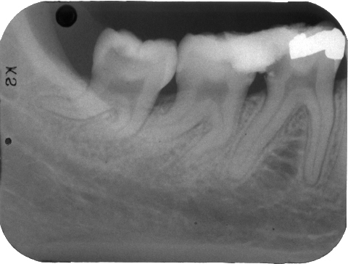
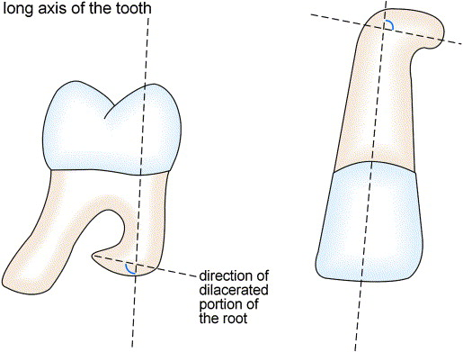

Slide 5
complications
Bend in root is so pronounced that teeth may fail to erupt.
cause problems during extraction and endodontic therapy.

Slide 6
How to prevent tooth dilacerations
Hard to avoid because accidents may happen at any time
* Do NOT replace baby teeth if they are knocked out. Replaced tooth may disturb permanent teeth from growing in or bacteria may infest the socket.

Slide 7
Treatment/Role of the dental team
Surgical extraction or repositioning
Root canals
* In case root canal or extraction is needed, the patient should be referred out to see an oral surgeon.
These treatments are a common practice but commits the patient to extensive future restorative care.

