Slide 1
Chapter 6 Fundamentals of Video
New York City College of Technology
Prof. Thelma Bauer

Slide 2


In the natural world, we perceive motion as a continuous flow of events. It is a combination of visual, auditory, and temporal experience. Video cameras have long been available to capture motion on analog media, such as film, VHS tapes, and Hi-8 tapes. Motion is captured as a sequence of pictures at a constant time interval. Each picture is called a frame. How fast the pictures are captured or how fast the frames are played back is determined by the frame rate, which is measured in frames per second (fps).There are broadcast standards for digital video’s resolution, color spaces, and frame rate television broadcast standards. In order to understand the rationale behind digital video standards, it is necessary to learn about analog television broadcast standards. The digital video standards have been influenced by the existing analog.

Slide 3
Motion Fast Facts
Motion is a sequence of pictures taken at constant time intervals
Each image is called a Frame
How fast the pictures are captured is determined by the frame rate, which is measured in Frames per Second (fps)
Three original Analog Broadcast Standards for Color TV:
1. NTSC (U.S. National Television Systems Committee)
2. PAL (Phase Alternating Line) and
3. SECAM (Sequential Couleur aver Memoire)

Slide 4
The concepts of sampling and quantization applied to still images also apply to the visual component of the video, and those applied to the digital audio also apply to the auditory component. In many situations, the available choices in digital video settings, such as frame size and frame rate, are influenced by digital video standards, which, in turn, are influenced by the analog television broadcast standards. There are three sets of broadcast standards for analog color televisions: NTSC, PAL, and SECAM. They differ in frame sizes, frame rates, and color spaces.
For an NTSC standard-definition DV frame, the frame size is 720 X 480 pixels. The frame size for a PAL standard DV frame is 720 X 576 pixels. For high-definition digital video, the HDV format, for example, has two frame sizes: 1,280 X 720 pixels and 1,440 X1,080 pixels.

Slide 5
Fig 6.1(your text)
Video Type Frame Rate (frames per second or fps)
NTSC 29.97
PAL 25
SECAM 25
Motion-picture film 24
NTSC - U.S. National Television Systems Committee, which designated this standard. It is used in North America, Japan, Taiwan, and parts of the Caribbean and South America. PAL stands for Phase Alternating Line, which refers to the way the signals are encoded. It is used in Australia, New Zealand, and most of Western Europe and the Asian countries. The frame size for a PAL standard DV frame is 720 X 576 pixels.
SECAM stands for Séquentiel Couleur avec Mémoire, which translates as sequential color with memory. It is used in France, the former Soviet Union, and Eastern Europe. The standards adopted in Africa and parts of Asia are mostly influenced by their colonial histories.

Slide 6
Frames Size
In digital Video, frame size is referred to as resolution and is given in pixels.
HDV format 1440 X 1080 pixels
1280 X 720 pixels
DVCPRO HD 1280 X 1080 pixels
1440 X 1080 pixels
960 X 720 pixels
NTSC DV Frame: 720 X 480 pixels
PAL DV Frame: 720 X 576 pixels

Slide 7
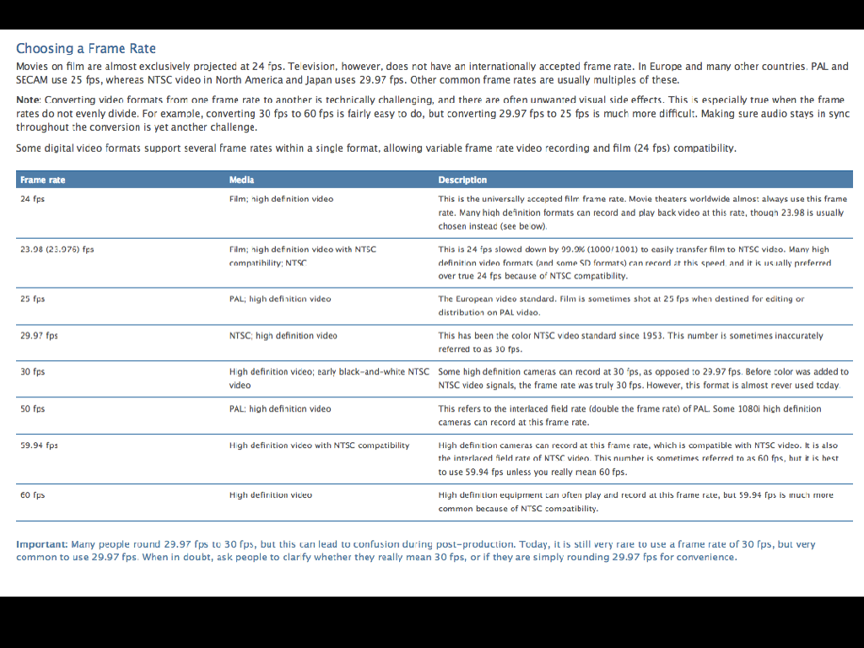

Slide 8
Digital television (DTV) refers to television signals that are broadcast or transmitted digitally. At the time of this writing, in the United States, there are 18 DTV formats developed by the Advanced Television Systems Committee, Inc. (ATSC). The 18 formats include 12 formats for standard definition television (SDTV) and 6 for high-definition television (HDTV). There are two frame aspect ratios for the SDTV format—4:3 and 16:9—whereas the frame aspect ratio of all six HDTV formats is 16:9. HDTV has higher resolution than the traditional analog TV and SDTV. It uses the MPEG-2 format.

Slide 9
The frame aspect ratio is the ratio of its width-to-height dimensions. For example, the frame aspect ratio for the standard-format NTSC DV is 4:3, whereas the wide-screen format is 16:9. The frame aspect ratio for high-definition digital video and high-definition television (HDTV) is 16:9. Some video formats use non-square pixels to make up the frame. The shape of the pixel can be described by an attribute called pixel aspect ratio. For a square pixel, its pixel aspect ratio is equal to 1. A pixel aspect ratio of less than 1 depicts a tall pixel, whereas a pixel aspect ratio of greater than 1 depicts a wide pixel. A video should be displayed on a system with the matching pixel aspect ratio; otherwise, the image will be distorted.

Slide 10
About aspect ratios
An aspect ratio specifies the ratio of width to height. Video and still picture frames have a frame aspect ratio. The pixels that make up the frame have a pixel aspect ratio (sometimes referred to as PAR). Different video recording standards use different aspect ratios. For example, you record video for television in either a 4:3 or 16:9 frame aspect ratio.
https://helpx.adobe.com/premiere-pro/using/aspect-ratios.html#Frameaspectratio

Slide 12
Timecode
Timecode is used to number frames in a video.
The two common formats of timecode used in digital video are drop frame and non-drop frame. No frame is dropped or lost in either timecode. The drop-frame timecode is preferable for the NTSC system to maintain the time accuracy.

Slide 13
Computers display the picture by displaying lines from top to bottom in one pass—progressive scan. Analog television standards for NTSC, PAL, and SECAM display the picture in two passes. For NTSC, the first pass traces the even-numbered lines, and the second pass traces the odd-numbered lines to fill in the alternating gaps left by the first pass. The set of the lines in the same pass (i.e., the set of even lines or odd lines) is called a field. This display method of using two alternating fields is called interlaced scan.

Slide 14
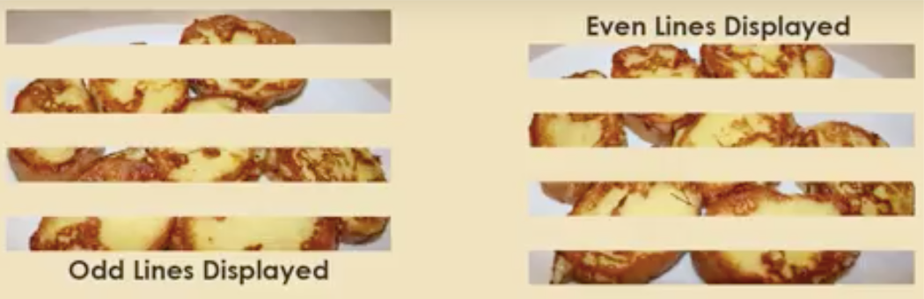

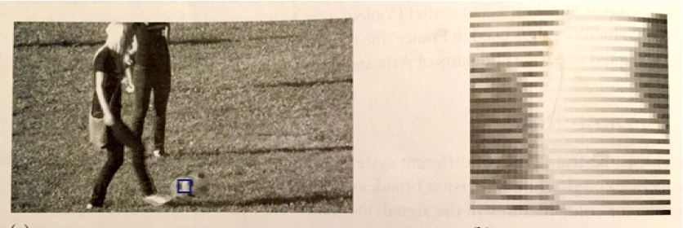
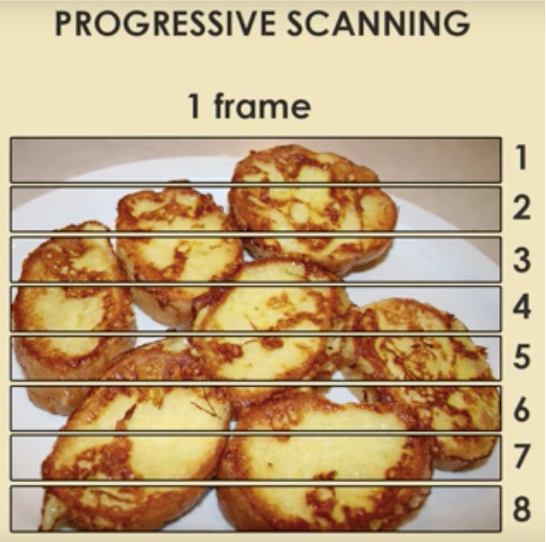
• A television / computer display is made up of horizontal lines traced across the screen one line at a time
• Interlaced Scan (Analog: NTSC, PAL, and SECAM) Displaying the picture in two passes. The first pass traces the even-numbered lines*, and the second pass traces the odd-numbered lines to fill in the alternating
gaps left by the first pass
Interlace Scan
• The set of the lines in the same pass (i.e., the set of even lines or odd lines) is called a field.
Interlace artifacts appear with fast moving objects that get caught captured between the two fields of a frame at slightly different moments in time:
• Progressive Scan (Computers) Displaying the picture using lines from top to bottom in one pass.
See video: https://youtu.be/jJmbwjVagEI

Slide 15
Over Scan and Safe Zones
When a video is displayed on a television set, the edge areas of the picture may not be displayed within the viewing area. The area that is outside of the screen is called the overscan. The signals are not “lost.” For example, if you record a digital television program and play it back on a computer, you will see the whole image. If you watch a DVD movie on a computer, you can see a whole frame. However, if the same DVD movie is played on a television set, the content at the edges of the frame may not be seen on the screen due to the overscan. As a consequence of overscan, if your target audience will be watching your video on consumer television sets, you should not place the important content too close to the edges when framing your shots. But how close is “too close”? There is no one exact number to fit all televisions, because the amount of overscanning is not consistent across consumer
television sets.

Slide 16
There are two common guides that can help you frame your shots: the safe action area and the safe title area. The safe action area is where the significant action takes place. The safe title area is where you should place critical text titles and critical content. The safe title area is visible on the majority of television sets. In general, the safe action area occupies the center 90% of the frame size and the safe title area 80% (Figure 6.3 from your text.). This means that the safe action area leaves
approximately a 5% border all around the frame and the safe title area leaves about a 10% border around.

Slide 17
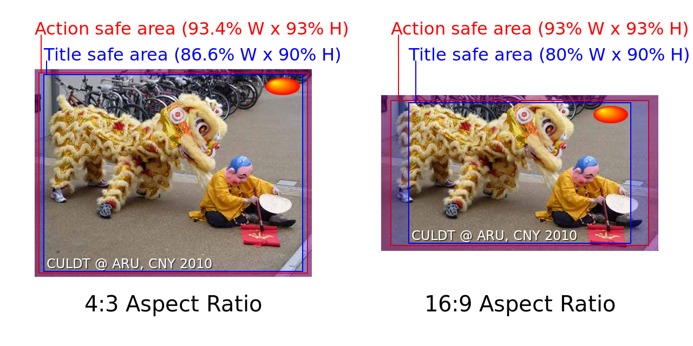
Illustration of Action Safe and Title Safe areas for 4:3 and 16:9 aspect ratios according to the BBC.

Slide 18
Color Format
RGB is a common color model used for still digital images, but for video, the luminance-chrominance color models are used (for example, YUV and YIQ color models):
These color models divide color into one luminance (brightness) component (Y)
and two chrominance color or hue) components (U and V in YUV, or I and Q in YIQ).
The luminance-chrominance color model was invented at the same time as color television for adding color signals to the television broadcast. By using this color model, the same signal could be used for both black-and-white and color television sets: the black-and-white television uses only the luminance (Y) signal, whereas the color set uses both the luminance and chrominance signals

Slide 19
YUV was originally the color model for analog television broadcasts of the PAL system.
YIQ is the model adopted by the National Television System Committee (NTSC) in the United States.
In addition, another luminance-chrominance model called YCbCr, which is closely related to YUV, is used in MPEG compression. MPEG compression is used in DVD videos and high-definition video formats.

Slide 20
WHAT DOES YUV 4:1:1 MEAN?
While RGB is a common color model used in digital photographs or any still digital images, the common color model used in digital video is a luminance-chrominance model, such as YUV, to represent the color of each pixel. The Y component is the luminance (brightness). The U and V components are the chrominance (color or hue).The human eye is more sensitive to changes of luminance than it is to chrominance changes. Digital video systems exploit this phenomenon to reduce the storage of information by using fewer bits to storing the chrominance components. In other words, some chrominance data will be discarded. This method is called chroma subsampling or color subsampling.

Slide 21
DIGITAL VIDEO STANDARDS
Standard Definition
The term DV is often used as an abbreviation for digital video. However, DV compression or DV format refers to specific types of compression. For example, DV25 is the most common DV compression for standard-definition digital video. DV25 is used by many digital video
camcorders. These camcorders compress the video
directly inside the camcorder. The video you get on tapes is already compressed into DV format. Table 6.3 in the text lists the specifications for the DV25 format. DV25 compresses the video at a fixed data rate of 25 megabits per second (Mbps) for the visual component of the video—hence the 25 in its name. This means the video takes up 3.125 MB of storage space per second. The total data rate for video, audio, and other control information is about 3.6 MB per second. The color space and color sampling method for NTSC is YUV 4:1:1. For NTSC, the frame size of the video is 720 X 480 pixels, and the frame rate is 29.97 fps.

Slide 22
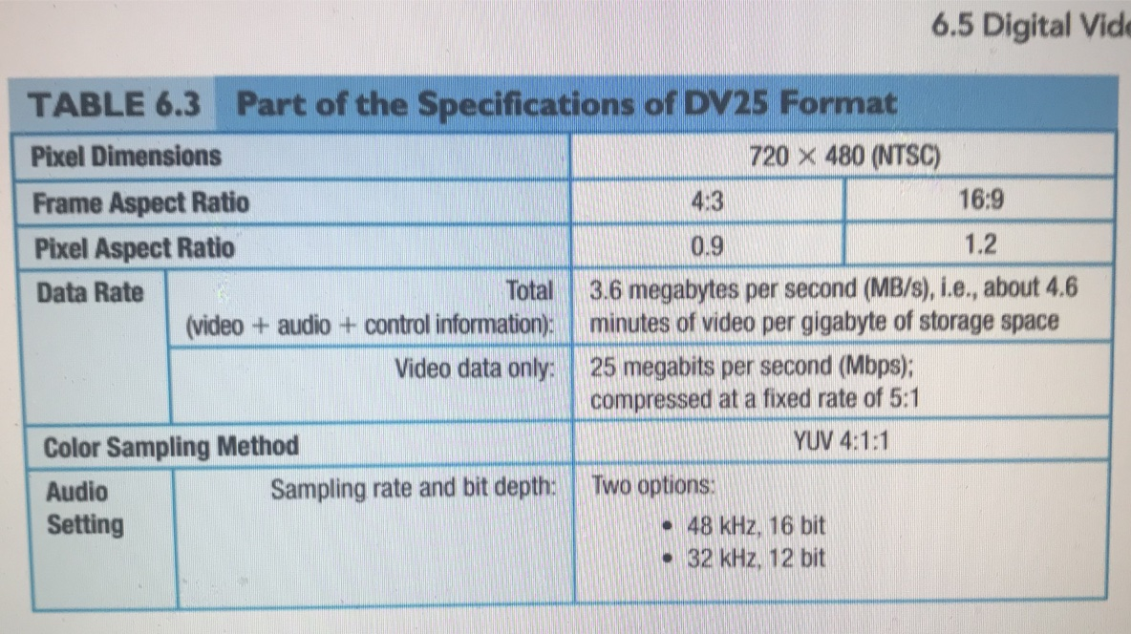

Slide 23
Color Ratios
There are several subsampling formats, depending on the ratio of the chrominance information to be discarded. The format is designated with three numbers separated by colons, for example, 4:2:2, to represent the ratio of the Y-component to the two chrominance components, Y:U:V. The full-color information for each pixel contains one sample each of Y, U, and V. Thus, there are a total of three samples per pixel related to color information.
4:4:4
The designation 4:4:4 means for each group of four pixels, four samples of the Y-component and four samples each of the two chrominance components will be stored—that is, a total of 12 samples for each group of four pixels. In other words, there is no saving in storage (no compression), that is, no subsampling.
4:2:2
The 4:2:2 subsampling method means that for every four pixels, it will use:
4 samples of Y
2 samples of U
2 samples of V
The total of samples used for every four pixels is now reduced from 12 to 8. This means a one-third reduction in storage requirements. This subsampling method is used in Digital Betacam video format.

Slide 24
4:2:0
The 4:2:0 subsampling method means that for every four pixels, it will use:
4 samples of Y
2 samples of either U or V
The total of samples used for every four pixels is now reduced from 12 to 6. This results in a 50% reduction in storage requirements. The selection of U and V are alternated by scan lines. In one scan line, the samples from the U are used. In the next scan line, the samples from the V are used. This subsampling format is used in HDV, MPEG-1, DVD MPEG-2, and PAL DV.
4:1:1
The 4:1:1 subsampling method means that for every four pixels, it will use:
4 samples of Y
1 sample of U
1 sample of V
The total of samples used for every four pixels is now reduced from 12 to 6. This means a 50% reduction in storage requirements. This subsampling method is used in NTSC DV. The DV format is used in the miniDV digital video camcorder.

Slide 25
MPEG stands for Moving Pictures Experts Group. It is a file format that allows high compression. There are several variations of MPEG: MPEG-1, MPEG-2, and MPEG-4. MPEG-1 supports the VideoCD format. MPEG-2 supports the DVD-video, Blu-ray, high-definition video, and HDTV standards. MPEG-4 is the newer standard of the MPEG family. It differs from MPEG-1 and MPEG-2 in the coding approach and the range of target data rate. MPEG-4’s low-end range of data rate targets the mobile applications, such as cell phones, that MPEG-1 and MPEG-2 standards do not support. The high-end supports the video quality for HDTV and high-definition video.

Slide 26
The data rate refers to the amount of video data to be processed per second. The average data rate of a video is calculated by dividing the file size by the total length of the video in seconds. It provides a measure for predicting the smoothness of the video playback on devices. If a video’s data rate is too high for a playback device to handle, the playback of the video will be choppy. Lowering the video data rate can be achieved by reducing the video file size. The general strategies to reduce video file size include: (1) lowering the frame size of the video, (2) lowering the frame rate of the video, and (3) using a compressor that allows higher compression.

Slide 27
Strategies for Reducing File Size
Shorten the Duration of the video IF the intended use allows for this. Unlike static image files, with audio files one has the extra dimension of time. Lower the frame rate of the video.
Lower the Frame size of the video
Lower the frame rate of the video
Lower the picture quality of the video
Lower the color depth
Lower the sampling rate, bit depth and number of channels for the audio
Compress the File; As with static image and audio file formats, there are both lossy and lossless types of compression. With video, there are spatial (pixels compressed independently) and temporal (compresses pixels in selective frames) compression methods.

Slide 28
There are two modes of video playback: play from the local storage of the user’s device and play over a network. When playing from the user’s device, an entire clip needs to be already on the device before it can be played. In playing over the network, the video will be displayed as the data stream arrives. In other words, a video file does not have to be downloaded in its entirety before it can be played. Streaming video and progressive down-load or pseudo streaming fall into this mode of video playback. True streaming requires a streaming server but progressive download does not.

Slide 29
Summary:
Review Questions
1. Which of the following is the television broadcast standard for the United States and Japan?
A. NTSC
B. PAL
C. SECAM
2. Which of the following is the most common color model for video?
A. RGB
B. HSV
C. CIE XYZ
D. luminance-chrominance
3. The frame rate for the NTSC system is _____ fps.
A. 24
B. 25
C. 28.9
D. 29.97
E. 30
4. Interlaced scan displays the frame by scanning the lines of a frame _____.
A. in one pass from top to bottom
B. in two passes: even-numbered lines in one pass and odd-numbered lines in the second
5. Progressive scan displays the frame by scanning the lines of a frame _____.
A. in one pass from top to bottom
B. in two passes: even-numbered lines in one pass and odd-numbered lines in the second

Slide 30
Summary: Continued…
6. The frame size of a video refers to the video’s _____.
A. aspect ratio
B. pixel aspect ratio
C. resolution
D. ppi
7. Pixel aspect ratio means _____.
A. the ratio of a frame’s width (in pixels) to its height (in pixels)
B. the ratio of a frame’s height (in pixels) to its width (in pixels)
C. the ratio of a pixel’s width to its height
D. the ratio of a pixel’s height to its width
8. The frame aspect ratio of a high-definition video is _____.
A. 4:3
B. 16:9
C. 1.0
D. 0.9
E. 1.2
9. Which of the following support the DVD-video, high-definition video, and HDTV standards?
A. MPEG-1
B. MPEG-2
C. MPEG-3
D. MPEG-4
10. Which of the following also targets mobile applications, such as cell phones?
A. MPEG-1
B. MPEG-2
C. MPEG-3
D. MPEG-4
Answers to Summary Questions
A, 2. D, 3. D, 4. B, 5. A, 6. C, 7. C, 8. B, 9. B, 10. D
Notes:
A, 2. D, 3. D, 4. B, 5. A, 6. C, 7. C, 8. B, 9. B, 10. D

