Slide 1
Fundamentals of Digital Audio
New York City College of Technology
Professor Thelma Bauer

Slide 2
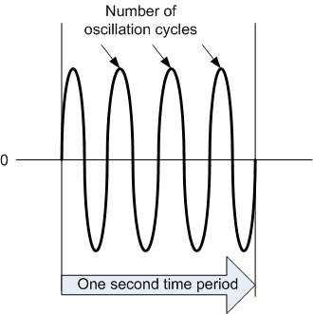
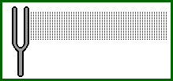
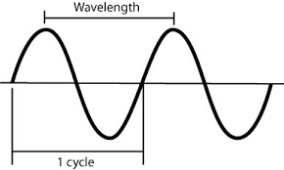
Sound is a wave that is generated by vibrating objects in a medium such as air. The vibrating objects can be the vocal cords of a person, a guitar string, or a tuning fork. An object vibrating in air creates a disturbance of the surrounding air molecules, causing periodic changes of air pressure—forming a sound wave. No matter what the vibrating object is, the object is vibrating or moving back and forth at a certain frequency. This causes the surrounding air molecules to vibrate at this same
frequency. The common unit for frequency is Hertz (Hz); 1 Hz refers to 1 cycle per second. The sound frequency is related to the pitch of the sound. Higher frequencies correspond to higher pitches.

Slide 3
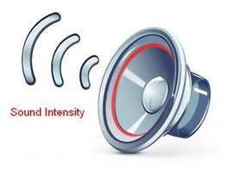
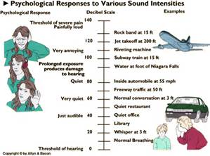
Sound intensity is related to, but not exactly the same as, the perceived loudness of a sound. The loudness of a sound is a subjective perception, but sound intensity is an objective measurement. Sound intensity is often measured in decibels (dB). A decibel is based on a ratio of a louder sound to a softer one; it is not an absolute measurement.
When two or more sound waves meet, their amplitudes add up, resulting in a more complex waveform. The waveforms of the sound we perceive every day (such as speech, music, and noise) are complex waveforms that result when multiple waveforms of different frequencies are added together.

Slide 4
Loudness Vs. Sound Intensity
Like color, the loudness of a sound is a subjective perception and factors such as the age of the listener affects the subjective perception of sound.
To measure loudness, a 1,000 Hz tone is used as a benchmark tone. The volume of this reference is adjusted until it is perceived as being as loud as the sound being measured.
Sound intensity, on the other hand, can be measured objectively by auditory devices with no need for a listener. Sound intensity is measured in decibels. The threshold of pain is 120 decibels.
Often, the higher the sound intensity the louder the sound is to the listener but not always.

Slide 5
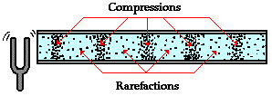
SOUND AS A MECHANICAL WAVE
Because the propagation of a sound wave in a medium relies on the mechanism of particle interactions, a sound wave is characterized as a mechanical wave. The implication of this property is that a sound wave does not propagate in a vacuum.
The motion of a particle in a sound wave is parallel to the direction of the wave. This type of wave is characterized as a longitudinal wave. Notice that it is the motion of the particles that propagates, not the particles themselves.
If you place a microphone in the path of the sound wave, the periodic air-pressure
change will be detected by the recorder and converted into varying electrical signals. The
changes of pressure in the propagating sound wave reaching the recorder are thus captured
as changes of electrical signals over time. The sound wave can be represented graphically with the changes in air pressure or electrical signals plotted over time—a waveform
(Figure 4.1). The vertical axis of the waveform represents the relative air pressure or electrical signals caused by the sound wave. The horizontal axis represents time.

Slide 6
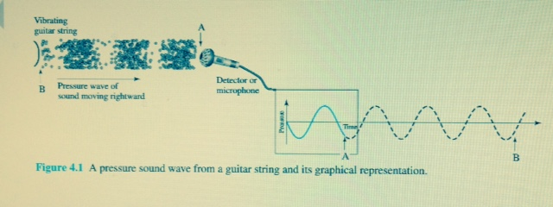
A vibrating guitar string in the air causes the string to move back and forth, causing periodic changes of air pressure. The changes of pressure in the propagating sound wave reaching the recorder are captured as changes of electrical signals over time. The sound wave can be represented graphically with the changes in air pressure or electrical signals plotted over time—a waveform. Be careful not to interpret the waveform as a representation of the sound wave in space. The picture at the bottom here in Figure 4.1 is a picture of the air molecules in space. On the right is a graph over time. The air-pressure information at point B is not where time is zero on the waveform graph. Instead, the pressure information of point B has not yet propagated to the microphone; it would have been after point A has been recorded—about three more cycles to the right of point A on the waveform.

Slide 7
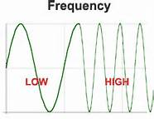
Frequency and Pitch
A sound wave is produced by a vibrating object in a medium, say air. No matter what the
vibrating object is, it is vibrating or moving back and forth at a certain frequency. This
causes the surrounding air molecules to vibrate at this same frequency, sending out the
sound-pressure wave. The frequency of a wave refers to the number of complete back-and-
forth cycles of vibrational motion of the medium particles per unit of time. The common
unit for frequency is Hertz (Hz) where the unit of time is 1 second.
1 Hz =1 cycle/second
Sound frequency is related to the pitch of the sound. Higher frequencies correspond to
higher pitches. Generally speaking, the human ear can hear sound ranging from 20 Hz to
20,000 Hz.
Sound Intensity and Loudness
Sound intensity is related to the perceived loudness of a sound, but the two are not exactly
the same. Sound intensity is often measured in decibels (dB). A decibel is based on a ratio
of a louder sound to a softer one.

Slide 8
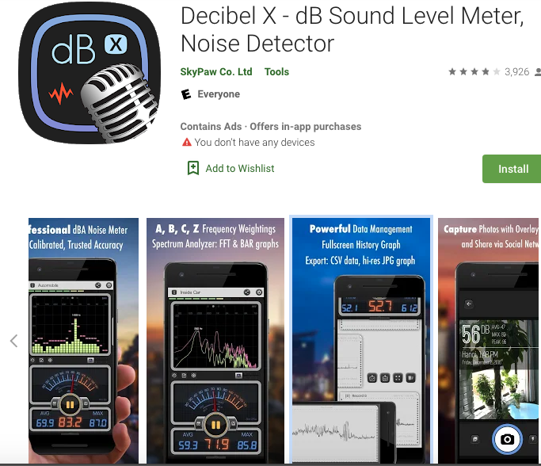

Decibel 10th app for free for measuring sound and at B & H, the professional version from Walmart communications for $19.59

Slide 9
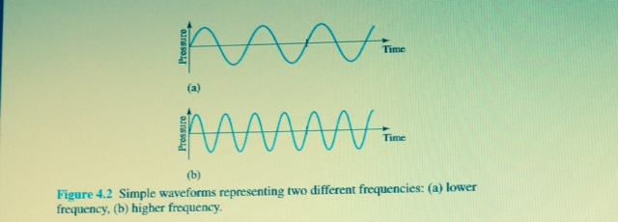

Slide 10
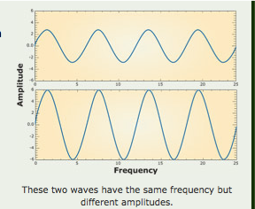
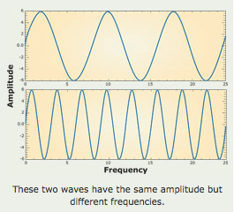
Images show Amplitude vs Frequency
Sound frequency and the pitch of a sound are linked. Higher frequencies = higher pitches. Human ear hears song ranging from 20 Hz to 20,000 Hz.

Slide 11

LOUDNESS VERSUS SOUND INTENSITY
The loudness of a sound is a subjective perception, but sound intensity is an objective measurement. Thus, loudness and sound intensity are not exactly the same properties.
To measure loudness, a 1,000-Hz tone is used as a reference tone. The volume of the reference tone is adjusted until it is perceived by listeners to be equally as loud as the sound being measured. Sound intensity, on the other hand, can be measured objectively by auditory devices independent of a listener.
The age of the listener is one of the factors that affect the subjective perception of
a sound. The frequency of the sound is also a factor because of the human ear’s sensitivity to different sound frequencies. The loudness of sound (as perceived by human ears) is only roughly proportional to the logarithm of sound intensity. However, in general, the higher the sound intensity, the louder the sound is perceived.

Slide 12
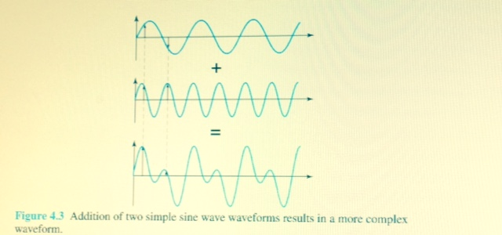
ADDING SOUND WAVES
A simple sine wave waveform represents a simple single tone—single frequency. When two or more sound waves meet, their amplitudes add up, resulting in a more complex waveform (Figure 4.3). The sound we perceive every day is seldom a single tone. The waveforms representing speech, music, and noise are complex waveforms that result from adding multiple waveforms of different frequencies. For example, Figure 4.4 shows a waveform of the spoken word “one.”

Slide 13
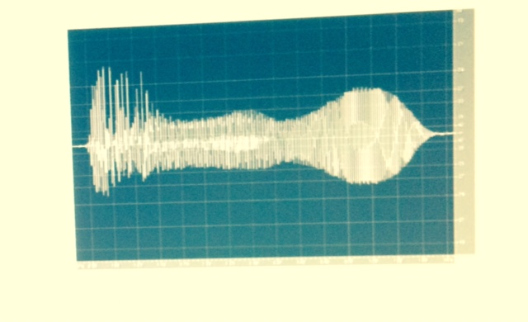
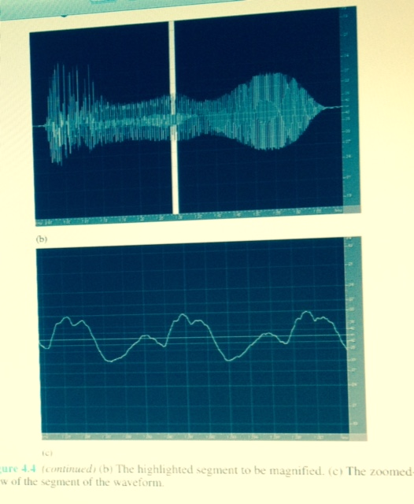

Slide 14
DECOMPOSING SOUND
When we record a sound, such as the spoken word “one” in Figure 4.4, the waveform recorded is a complex one. Can a complex wave be decomposed into its simple component parts—the different sine waves that make up the complex wave? Yes! One of the mathematical methods to accomplish this decomposition is called the Fourier transform.
But why would you want to decompose a complex wave into simple sine waves? The frequency of a simple sine wave can be determined easily. When you want to remove certain sounds that can be characterized by a range of frequencies, such as low-pitched noise, you can apply filters using the Fourier transform to selectively remove these unwanted sounds from a complex sound. These filters are available in many digital audio
processing programs and are used for breaking down a sound to remove unwanted frequencies.

Slide 15
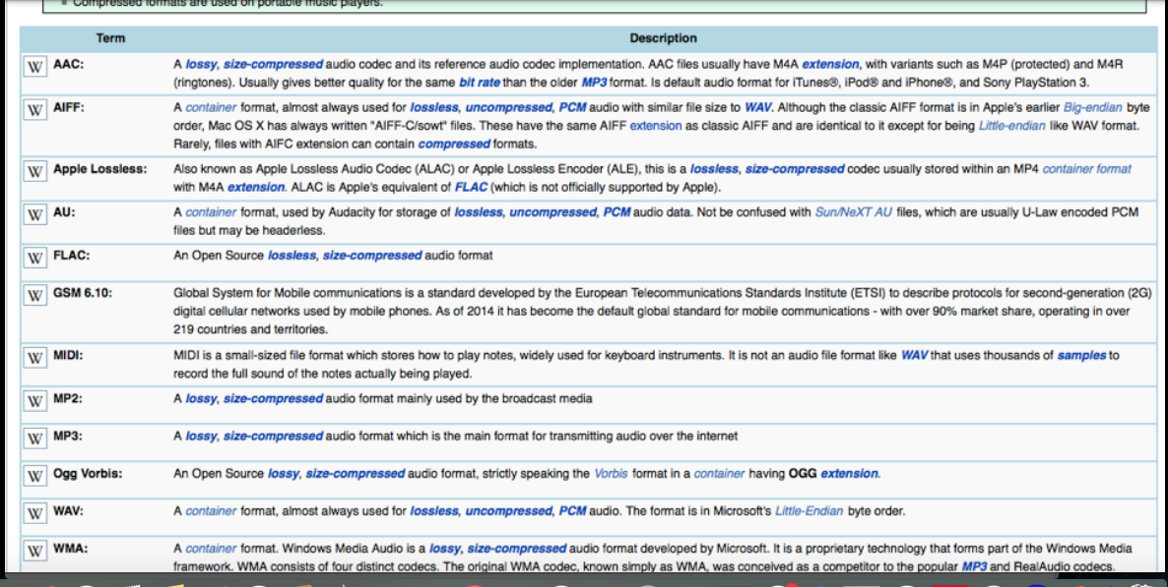

Slide 16
Like the process of digitizing any analog information, the process of digitizing a sound wave involves sampling and quantizing an analog sound wave. In the sampling step, the
sound wave is sampled at a specific rate into discrete samples of amplitude values. The higher the sampling rate, the higher the accuracy in capturing the sound. But a high sampling rate will generate more sample points, which will require more storage space and processing time. In the quantizing step, each of the discrete samples of amplitude values obtained from the sampling step will be mapped to the nearest value on a scale of discrete levels. Therefore, the more levels available in the scale, the higher the accuracy in reproducing the sound. For digital audio, having more levels means higher resolution. But higher
resolution requires more storage space for the same reason that higher bit depth for any digital media will increase the file size.

Slide 17
Audio files, such as speech and music, usually require long, continuous playback. Therefore, the file size increases very rapidly with higher sampling rate and bit depth. To reduce the file size, there are four general file optimization approaches: reduce the sampling rate, reduce the bit depth, apply compression, and reduce the number of channels. No matter which file size reduction strategies you want to apply to your audio file, you should always evaluate the acceptability of the audio quality of the reduced file based on the nature
of your audio project, and weigh the quality against the file size limitation. The intended use of your final audio dictates the consideration of the acceptable tradeoffs. Even working within a limitation of file size, you will get better results by recording or digitizing at a sampling rate and bit depth that produce good audio quality and then apply file size reduction strategies later.

Slide 18
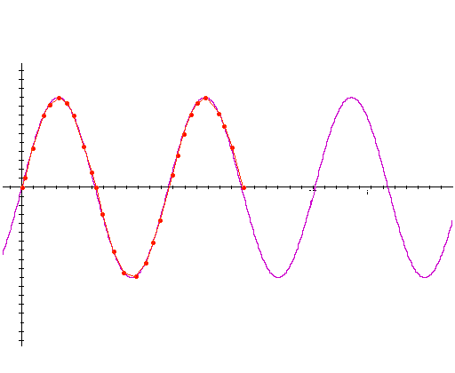
Reducing the number of channels.
Stereo audio has two channels. If you reduce a stereo audio file to mono—which becomes one channel—then you reduce the file size in half. This may suit speech and short sound
effects for online games. Your decision to reduce the audio from stereo to mono is very much dependent on the nature of your project. Reducing a channel causes a noticeable
difference unless your final product is expected to be listened to with a mono-speaker.
When reducing the sampling rate, according to a rule called Nyquist’s theorem, we must sample at least two points in each sound wave cycle to be able to reconstruct the sound wave satisfactorily. In other words, the sampling rate of the audio must be at least twice that of the audio frequency—called a Nyquist rate. Therefore, a higher-pitch sound requires a higher sampling rate than a lower-pitch sound. In reality, the sound we hear, such as music and speech, is made up of multiple-frequency components. Then the sampling rate can be chosen as twice the highest-frequency component in the sound in order to reproduce the audio satisfactorily. Reducing the sampling rate sacrifices the sound quality of the higher frequencies.
Sampling at many times per cycle
Nyquist rate -- For lossless digitization, the sampling rate should be at least twice the maximum frequency responses. Indeed many times more the better.
Sampling at 2 times per cycle

Slide 19
Reducing the bit depth.
The most common bit-depth settings you may encounter in a digital audio editing program are 8 bit and 16 bit. According to the file size equation, lowering the bit depth from 16 to 8 reduces the file size in half. In the example of a 1-minute CD-quality stereo audio, lowering the bit depth from 16 to 8 will reduce the file size from about 10 MB to about 5 MB. Suppose the sampling rate of the audio has been lowered from 44.1 kHz to 22.05 kHz, creating a 5-MB file. Lowering the bit depth of this file from 16 to 8 will reduce the file size further, from 5 MB to 2.5 MB. Eight-bit resolution is usually sufficient for speech. However, for music, 8-bit resolution is too low to accurately reproduce the sound satisfactorily. Our ears usually can notice the degradation in playback. Typically, 16-bit resolution is used for music.

Slide 20
Applying file compression.
An audio file can be compressed to reduce the audio file size. Compression can be lossless or lossy. Lossy compression gets rid of some data, but human perception is taken into consideration so that the data removed causes the least noticeable distortion. For example, the popular audio file format MP3 uses a lossy compression that gives a good
compression rate while preserving the perceptible quality of the audio by selectively removing the least perceptible frequency components of the audio. Keep in mind that
a file compressed with a lossy compression method should not be used as a source file for further editing. To achieve the best result in editing an audio file, you should always start with a source file that is uncompressed or compressed with lossless compression.

Slide 21
But consider carefully
the target audience for your audio—what equipment do they have? Will they be listening on a computer, a phone? What is their internet connection like? What is their age?
• The file size limits. Is the file being streamed used on the web?
• Keeping the file as a source file in case you need to make edits later
• Common Sampling Rates: 11.025 Hz Am radio Quality. 22.050 Hz FM radio quality (multimedia projects), 44,100 Hz, CD quality, 48,000 Hz DAT quality, 96,000 Hz and 192,000 Hz DVD audio quality

Slide 22
Digital Audio Editors
Garageband
• Audacity (Free)
• Adobe Audition
• Sony Sound Forge
https://www.techradar.com/search?searchTerm=Free+audio+program+software+that+you+recommend

Slide 23
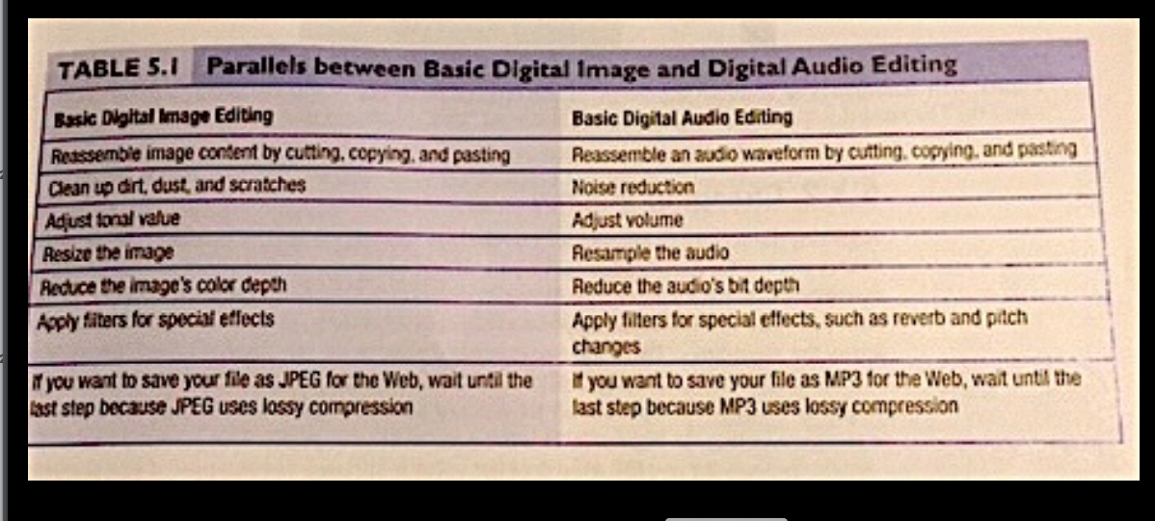

Slide 24
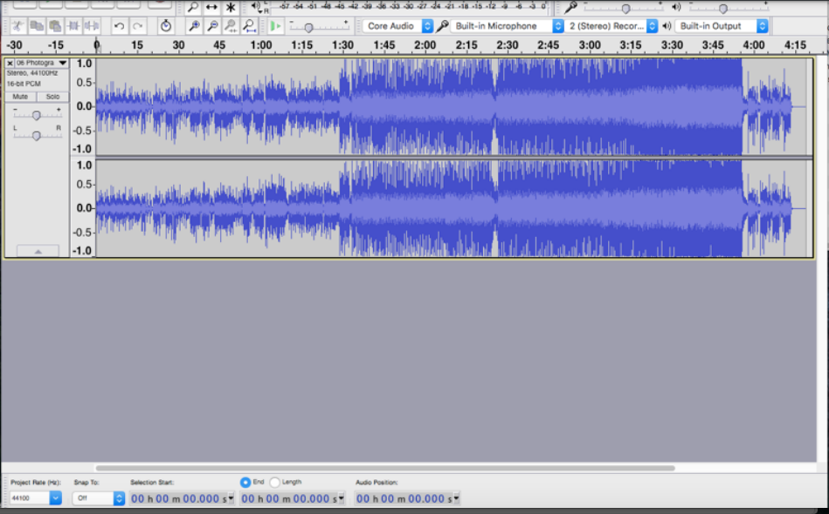
“Photograph” Before

Slide 25
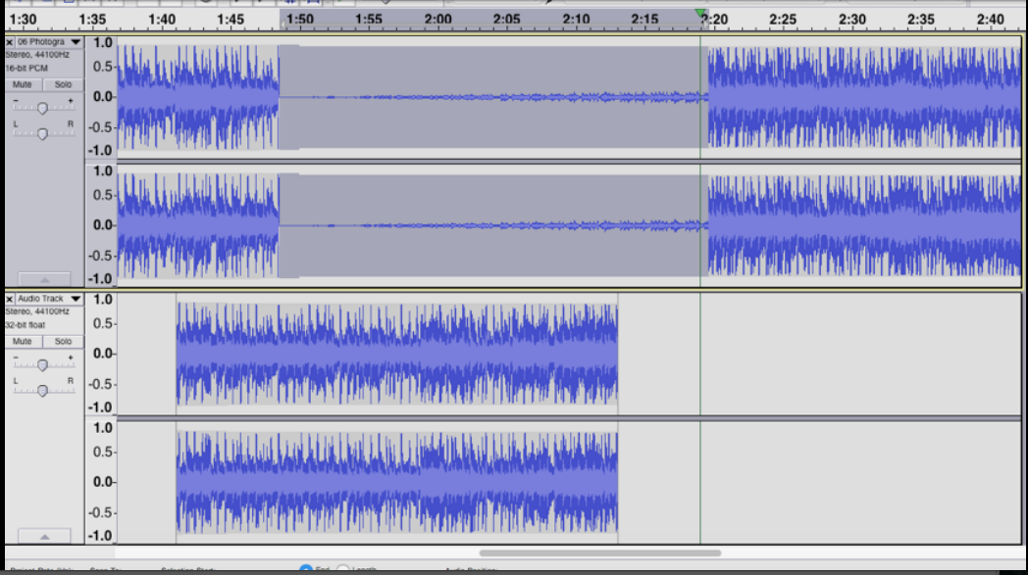
“Photograph” After

Slide 26
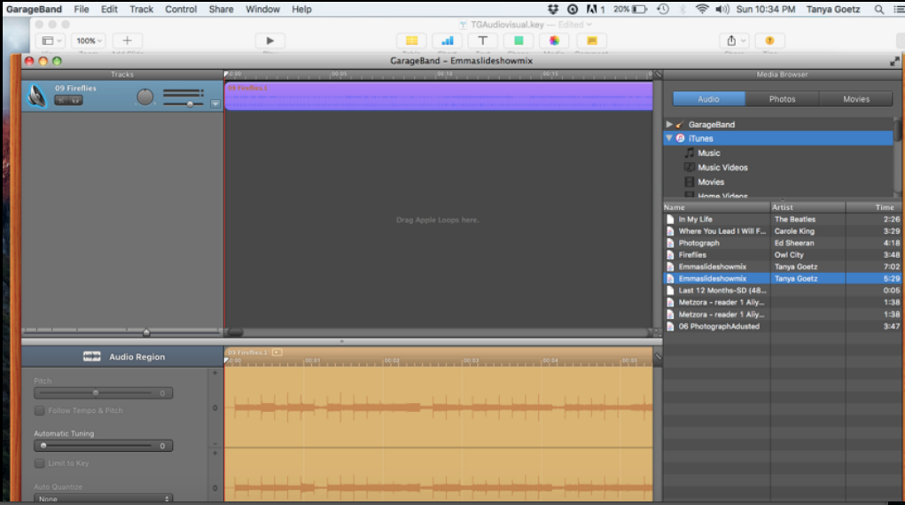
GarageBand Workspace

Slide 27

CLOUD COMPUTING FOR VIDEO AND AUDIO DELIVERY
The term “cloud” refers to the Internet and cloud computing refers to the technologies that provide computing services (such as storage, software, database access) to users
via the Internet. For online storage, you can download your files onto your devices whenever needed. The downloaded video and audio files can be played back from your devices. For video and audio files, cloud-based service providers often also support streaming the media—the media is played back over the Internet. For example, Amazon Cloud Drive offers online storage and supports downloading and streaming of music
files that are saved on your Cloud Drive. Apple iCloud lets you stream the music files stored on your iCloud and download them on any of your devices.

Slide 28
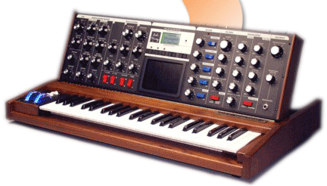
Another method of storing music information is in MIDI format. MIDI stands for Musical Instrument Digital Interface. MIDI files do not contain digitized audio sample points. Instead, they contain information about musical notes to be played with a virtual instrument. Such information includes the instrument being played, the note being played, the duration of the note, and how loud to play the note. Unlike digitized audio, MIDI music creation does not involve digitizing analog sound waves or any analog information. Therefore, there are no sampling rate and bit depth settings. MIDI music has the advantage of very small file size. Another advantage is that the music content can be edited easily. The disadvantage is that the sound depends on the synthesizer that plays back the composed music. Thus, you do not know how your MIDI file sounds on your target audience’s devices.

Slide 29
Please See The Videos For A Review.
https://www.youtube.com/watch?v=-0rIU9FHiU0
https://m.youtube.com/watch?v=g3tfly9mKhY
https://m.youtube.com/watch?v=RQc_frX50BA
https://www.khanacademy.org/science/physics/mechanical-waves-and-sound/sound-topic/v/production-of-sound
https://m.youtube.com/watch?v=BNVVq-iVPy8
Compliments to:
Digital Media Foundations, Yue-Ling Wong, Chapter 4
Tanya Goetz, Class Leader, Assistant Professor

