Slide 1
Is color in your head?
New York City College of Technology
Professor Bauer

Slide 2
Our vision of the world around us is inherently an analog phenomenon. Theoretically, an infinite number of color shades and tones is possible, and points of color in space are infinite because between every two points there is another. Because of the discrete and finite nature of computers, the analog information of natural images needs to be digitized in order to be stored on computers. Digitization involves a two-step process—sampling and quantizing.

Slide 3
You learned that digitization of analog information involves a two-step process: sampling and quantizing. Digitization of any digital medium—images, sound, or videos—always involves these two steps. However, if you have worked with digital image processing programs, you may have noticed that you never encounter the terms “sampling” and “quantizing” explicitly in the program. On the other hand, you may have already heard about pixels, resolution, and bit depth. So, what do sampling and quantizing have to do with pixels, resolution, and bit depth?

Slide 4
To understand pixels, resolution, and bit depth, we need to start with the concepts of sampling and quantizing. In fact, it is only by means of the two-step process of digitization that we ever arrive at pixels, resolution, and bit depth in digital imaging. Although you may not encounter the terms when you use digital imaging applications to work with pixels or manipulate the resolution or bit depth of digital images, you are applying the concepts of sampling and quantizing. Understanding these fundamental concepts and how they are applied to digital images will help you take full advantage of digital media tools and produce predictable results effectively in your creative process.

Slide 5
The sampling step is to record discrete point samples on an image plane. The point sample is called a picture element, or pixel for short. Each pixel stores the color information of the corresponding position in the image. The position is defined by its horizontal and vertical coordinates in the image. The sampling rate defines how frequently you take a sample. Imagine a two-dimensional grid is applied on the image and a single color sample is obtained from each tiny cell on the grid. The higher the sampling rate, the finer the grid and the more samples or pixels you will have in the digital image—that is, the higher the image resolution.

Slide 6
The quantizing step is to map an infinite number of colors and shades to a finite number of colors. The number of colors in this finite set is defined by the bit depth. Increasing the sampling rate or bit depth increases the file size of the image. For an uncompressed file, doubling the sampling rate or the bit depth can double the file size. Sampling and quantization errors are unavoidable results of the discrete, finite nature of digital media. It is not possible to create a digital version of a photograph or a real-world scene that has absolute fidelity to the original image. However, the human eye is not infinitely sensitive to differences in colors and color gradations across space, so it turns out that digital representations of pictures are often more than adequate for recreations of what we see in the world.

Slide 7
MEGAPIXEL
Often, the word megapixel is associated with the features of a digital camera. One mega- pixel is equal to 1,000,000 pixels. The total number of pixels in a 3,000 X 2,000-pixel digital image is 3,000 pixels X 2,000 pixels = 6,000,000 pixels This is sometimes referred to as 6 megapixels.
How frequently you take a sample is defined by the sampling rate. The words “frequency” and “rate” are often associated with time. However, for an image, frequency refers to how close neighboring samples are in a 2-D image plane.

Slide 8
If you sample the image with a finer grid, say 100 X 80, rather than 20 X 25 you are using a higher sampling rate because you are sampling more frequently within the same spatial distance. In digital imaging, increasing the sampling rate increases the image resolution. With higher resolution, you have more samples (pixels) to represent the same scene and thus you capture more details from the original scene. The pixel dimensions of the captured image are increased, and so is the file size of the digitized image

Slide 9
24-BIT, 32-BIT, AND 48-BIT COLOR DEPTH
A single 8-bit byte can be used to represent one of 256 different possible values. The values range from 0 to 255. An RGB (red, green, blue) color can be represented in three 8-bit bytes, one byte for each component of the R, G, and B. Thus, in this case, the color depth is 24 bits, which means it allows 2 ²⁴ =16,777,216 colors. Each of the R, G, and B components allows 2 ⁸ levels—that is, 256 levels (from 0 to 255). Although 24-bit color is often sufficient for human vision to represent colors, as computer processors get faster and storage media get cheaper, higher color depth (such as 48-bit color) is increasingly supported by scanners and image editing programs. Forty-eight-bit RGB color is represented using 16 bits per component of R, G, and B.

Slide 10
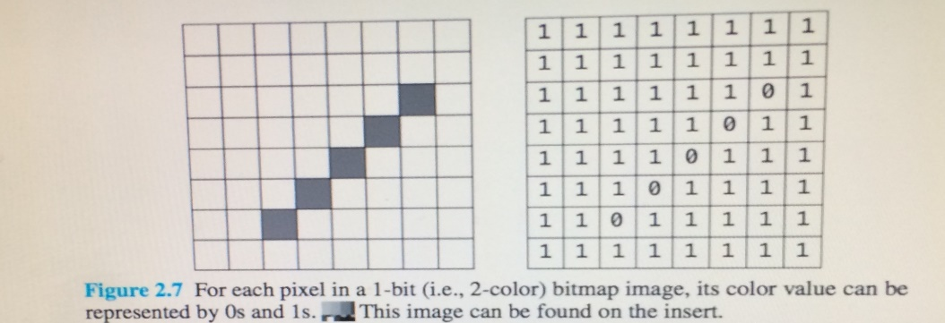
BITMAPPED IMAGES
Each pixel contains the color information using numeric values, which can be represented by a sequence of bits—1s and 0s. A 1-bit image allows two colors, which can be rep- resented by 1 and 0. The digit 1 can be used to designate a particular color and 0 another color. For example, a simple single-color diagonal line on a solid-color background can be represented in 1s and 0s, as shown in this example.

Slide 11
Digital images described by pixel values such as the one shown in Figure 2.7 (previous image slide) are called bitmapped images. The term bitmapping refers to how these bits representing the image are stored in computer memory. Bitmapped images also are called raster graphics. The term rastering refers to the way most video displays translate the images into a series of horizontal lines on the screen. Bitmapped images commonly are used in image editing applications. Because they are composed of pixels, the image content can be edited pixel by pixel easily. However, their size and appearance depend on their output resolution to the device, for example, dots per inch for a monitor and pixels per inch for a printer. Bitmapped images can appear jagged when they’re scaled up onscreen or printed at a low resolution.

Slide 12
VECTOR GRAPHICS
Besides using pixels to describe digital images, there is another way to create imagery—it is to describe the graphic mathematically. This type of digital image is called a vector graphic. For example, to describe a line like the one in Figure 2.8, (next slide) you can use a simple equation. Using equations to represent graphics is more concise than bitmapping. Consider this analogy in the context of getting directions for a trip: Bitmapped images are like getting driving directions on a printed Google map. Vector graphics, on the other hand, are analogous to written directions. Instead of tracing out a route on a map, someone could give you written directions that say, for example, “Head southwest on N Main St toward W Dalton Rd. When you come to the stoplight, turn right, It may take you more time to translate the written directions into a mental image of where you’re going, as compared to understanding a map that is already in visual form. An advantage of the written directions, however, is that they might actually be more concise and require less space than a full printed map.

Slide 13
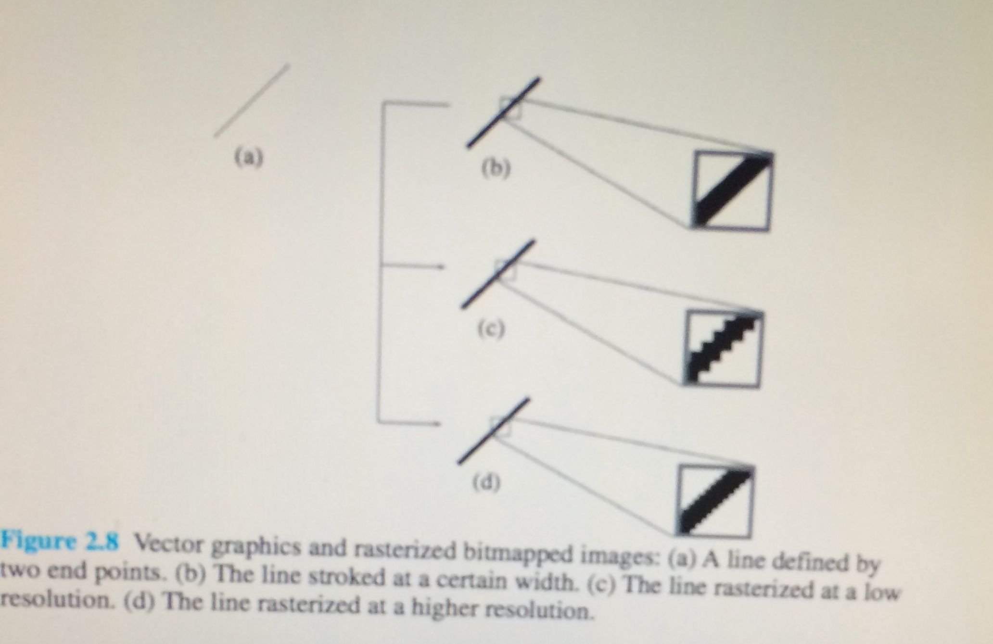

Slide 14
RASTERIZING VECTOR GRAPHICS
Most vector graphics programs let you rasterize, or convert, vector graphics into pixel- based bitmapped images. Because you are making a resolution-independent vector graphic into a resolution-dependent image, you need to specify a resolution for rasterizing, that is, how coarse or how fine the sampling. The rasterized image will appear jagged. This jagged effect is a form of aliasing caused by under sampling or insufficient sampling rate. In addition, as you see in Figure 2.9b, (next slide)the high contrast between black and white pixels makes the effect very noticeable. To soften the jaggedness, we can color the pixels with intermediary shades in the areas where the sharp color changes occur (Figure 2.9c). This technique is called anti-aliasing. With the same raster resolution setting, you can make the rasterized graphics appear smoother with anti-aliasing than without.

Slide 15
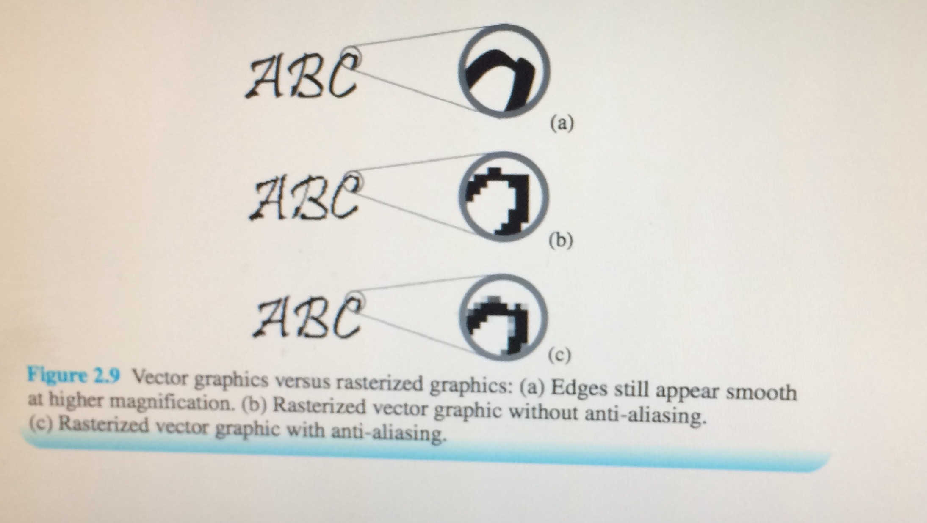

Slide 16
Let’s look at the file size of a typical digital photograph without compression. A 6-megapixel digital camera can produce digital images of 3,000 X 2,000 pixels in 24-bit color depth. The uncompressed file size can be computed as follows: Total pixels: 3,000 X 2,000 pixels =6,000,000 pixels File size in bits: 6,000,000 pixels X 24 bits/pixel =144,000,000 bits File size in bytes: 144,000,000 bits/(8 bits/byte) =18,000,000 bytes An uncompressed 6-megapixel image would require 144,000,000 bits, which is 18,000,000 bytes of disk space. There are three ways to reduce the file size of a digital image—reduce its pixel dimensions, lower its bit depth, and compress the file.

Slide 17
Reducing the pixel dimensions: This can be achieved by either of the following:
Capture the image at a lower resolution in the first place.
If you are capturing the image by scanning use a lower dpi. The scanned image will have smaller pixel dimension.
(a) If you are capturing the image by digital photography and your camera has an option for the image size – lower the dimension of the digital photo.
(b) Resample, or scale, the existing digital image to lower pixel dimensions. As you see in the file size calculation, the file size is directly proportional to the number of pixels in an image. This means that reducing the number of pixels in half will lower the file size to half of the original.

Slide 18
Exercise:
The pixel dimensions of the image used in this example of file size calculation are 3,000 X 2,000 pixels. If you scale both the width and the height of image to half (i.e. 1,500 X 1,000 pixels) how much will the file size be reduced?
The destined pixel dimension you choose depends on the amount of detail you need in your image and your intended use of the image—that is, whether you intend to print out the picture or display it on a computer. Lowering the pixel dimension sacrifices the image detail, which affects the image quality. Therefore, in reducing the pixel dimension to reduce file size, you need to weigh the image detail against the file size.
Answer: The number of pixels in the original image = 3,000 X 2,000
= 6,000,000. The number of pixels in the resized image =1,500 X 1,000 = 1,500,000. Thus, the file size is reduced to one-fourth (not one-half of the original.

Slide 19
Lowering the bit depth:
The bit depth determines the number of distinct colors available in your image. The available options of bit depth given to you during capturing depend on your scanner or digital camera. At the time of writing this chapter, the most common bit depth for color digital images is 24 bits. The 48-bit option is also available. As shown in the file size calculation for a 6-megapixel, 24-bit image, the bit depth is multiplied by the total number of pixels. This means that the file size is directly proportional to the bit depth. For example, reducing the bit depth from 24 bits to 8 bits will reduce the file size to one-third of the original. Depending on the content of your image, lowering the bit depth from 24 bits to 8 bits may produce a very noticeable degradation of the image’s aesthetics. Lowering the bit depth from 48 bits to 24 bits will reduce the file size to half but the degradation of the image may not be as noticeable.

Slide 20
A color depth of 24 bits allows 2 ²⁴ (i.e., 16,777,216) colors—about 16 million colors; 8 bits allows 2 ⁸ (i.e., 256) colors. In reducing 24-bit to 8-bit color depth, you can reduce the file size to one-third. However, you reduce the number of colors from 16,777,216 to 256. That is, you lose more than 16 million allowable colors in the image—this is about a factor of 65,000 decrease—to trade for a factor of 3 decrease in file size. On the other hand, some images do not need more than 256 colors. You do not have to keep a higher bit depth than the image needs.
Grayscale images, such as scanned images of black-and-white photos and hand- written notes in pen or pencil, can have a bit depth of 8 bits without much noticeable degradation in image quality.

Slide 21
An illustration graphic, such as a poster or logo, that contains only a few colors as large areas of solid colors can benefit from a lower bit depth. If you capture these graphics, whether by scanning or digital photography, solid colors will become continuous tones. In this case, if you consolidate all these slightly different colors into the one single color it is supposed to be, you may be able to reduce the bit depth, thus reducing the file size. The additional advantage of doing so is that the resulting digital image actually will be more faithful to the large areas of solid colors in the original analog source.

Slide 22
Compressing the file:
Compression is a method for reducing the size of a file by squeezing the same information into fewer bits. In a lossless compression algorithm, no information is lost. In a lossy compression algorithm, some information is lost. Lossy algorithms, however, are usually designed so that the information to be left out is the information that the human sensory system is not sensitive to anyway. When you choose a format in which to save a digital image, you are implicitly choosing whether and how to compress the file. When you scan in a picture, you might be given the option of opening it with an image editing program or saving it as a TIFF file, bitmapped picture, JPEG file, or GIF file. The file type is identified by a suffix on the file name: .tif or .tiff for a TIFF file, .bmp for a bitmapped picture, .jpg or .jpeg for a JPEG file, and .gif for a Graphics Interchange Format.

Slide 23
Generally, when working with digital images, it is best to keep the image in an uncompressed format. If you want to compress the image when you are still in the editing stage, you should use only a lossless compression method. For example, you can scan a color picture in as a TIFF file and open it in an image editing program to work on its tonal adjustment, contrast, color enhancement, refinements, and composition. After you have made the desired changes, you should save a copy of this final image either uncompressed or with lossless compression. When you are ready to save the image for distribution, you can choose a different file type with compression, even lossy, as is suitable for the intended use of the image. The file format depends on the type and use of the picture. For the Web, you can save the image as a JPEG, GIF, or PNG file. In the case of JPEG files, you also can choose the extent to which you want the file compressed, trading off image quality for a file size that is suitable for your needs.

Slide 24
Is Color all in you Head 2?
Professor Bauer
New York City College of Technology

Slide 25
Let’s shed some light on Color . . . •
When we see color,we are seeing light that has been modified into a new composition of wavelengths by an object. Without light, there is no color, only black.
• In a darkened room, only the rods (nerve cells in our retina) are operational, allowing us to detect variations in brightness even when there isn’t enough light to see color.

Slide 26
What do we see as light?
• Light is the visible part of the electromagnetic spectrum. Light can be seen as consisting of waves, each described by its wavelength - the length from wave crest to adjacent wave crest. These wavelengths are measured in nanometers (nm).A nanometer is one-billionth of a meter.
• Ultraviolet rays are “beyond” violet and infrared means literally “below red”

Slide 27
Okay, but what is light then?
• Light is the visible part of the electromagnetic spectrum. The region of the electromagnetic spectrum visible to the human eye ranges from about 400 to 700 nanometers. When our visual system detects a wavelength around 700nm, we see “red;”when awavelength around 450-500nm is detected,we see “blues;”a 400nm wavelength gives us “violet;”and so on.

Slide 28
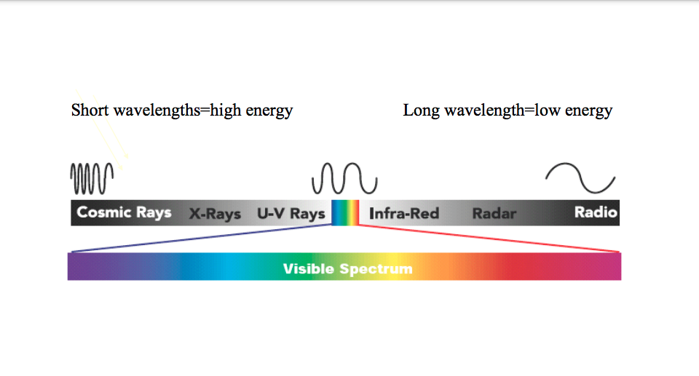

Slide 29
The Three Elements of Color
• Light
• Object
• Viewer
Without light, there are no wavelengths; without objects there would be only white,unmodified light; and without the viewer, there would be no sensory response that would recognize the wavelengths as a unique color. Color is a function of perception and highly subjective based on the viewer.

Slide 30
In the blink of an eye
• The cones, photoreceptive nerve cells in your retina break down the visible spectrum down into its most dominant regions of red, green, and blue, then use these colors to calculate color information

Slide 31
Objects Modify the Light Waves, Altering the Colors we Perceive
• Paper , Photographic Prints- Reflective objects
• Slide & Transparencies-Transmissive
• Emissive- Computer Monitors, Lightbulbs

Slide 32
Imitating the Eye. . .
• Scanners, monitors and RGB printers also use red, green, and blue light to create a wide range of colors.
• RGB is known as the additive color space because taken together in even proportions, they produce white light. Unfortunately, monitors differ from one another in their displays so we need to manage color better from monitor to monitor

Slide 33
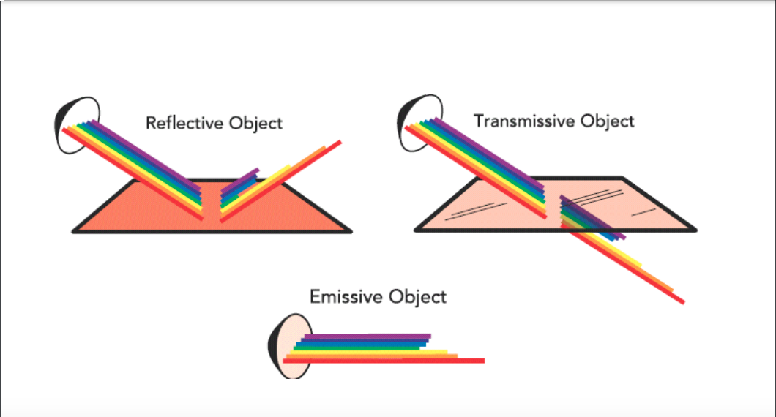

Slide 34
But we are also printing on paper. . .
• When we print, we are using the subtractive primaries, CMY. The inks or toners act as filters absorbing light being reflecting from the paper. If the inks (toners, etc.) were pure, black would be the result of full ink coverage. They aren’t, so we add black to the CMY for printing.
• In the graphic arts, we are always moving from RGB to CMYK and we need a way to manage this process effectively to ensure we achieve the results we want.

Slide 35
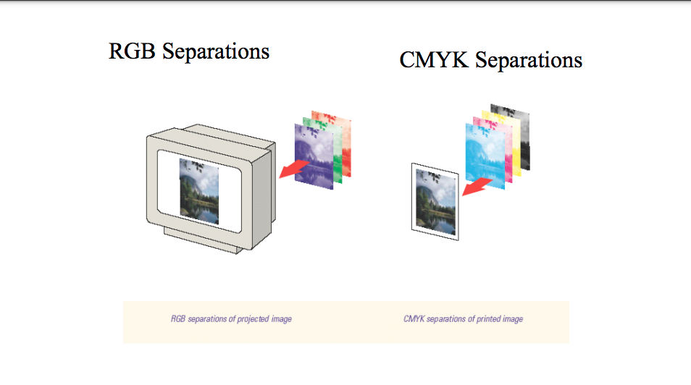

Slide 36
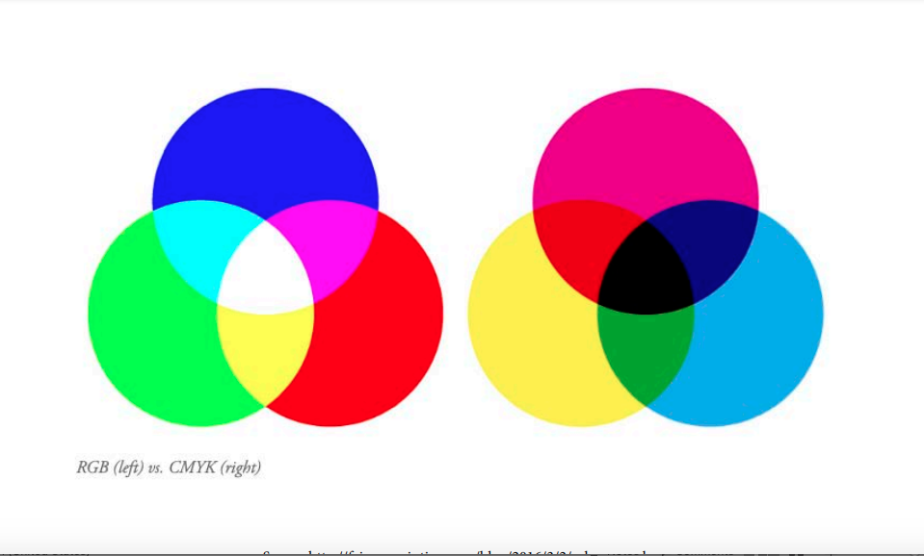

Slide 37
Connecting the spaces . . .
• RGB
• CMY
Write this two acronyms like this and you can easily remember how the two spaces interact. Yellow subtracts blue (short wavelengths), magenta absorbs green (medium wavelengths), and cyan absorbs red (long wavelengths).
But, RGB and CMYK are device dependent

Slide 38
Because Color is Highly Subjective. . .
• We can’t actually measure color because color happens in the observer’s mind.
• What we could/can do is measure instead the light that enters the observer’s eye . We also can use devices (such as densitometers, colorimeters and spectrophotometers) to measure light reflected from objects

Slide 39
Metamerism
• Metamerism-when two color samples are perceived to be identical under some, but not all, lighting conditions. So, a catalog picture that you view under florescent light looks different when you bring in home and view in under your home lighting conditions.
• Surrounding Colors affect color perception, just as light sources do.

Slide 40
Color Management is NOT New
• We have always attempted to manage color communication using standard viewing conditions to communicate color: viewing proofs under standard light source with gray walls, minimal ambient lighting & hoods on monitors. But fewer people and devices were involved. • With the elimination of film and the ever increasing number of input (scanners, digital cameras), display devices (monitors, projectors) and output devices (digital presses, offset presses, gravure presses), it becomes more critical to understand and manage color effectively to avoid disappointing results.

Slide 41
CIE color model- LAB
• The International Commission on Illumination (ICE) conducted many experiments since the 1920s and developed a model, LAB, in 1976 that allows us to numerically represent the color that people with normal color vision see in different lighting conditions. D50 and D65 are the standard illuminants that are most common.
• The CIE’s work forms the basis of color management systems --it is device independent

Slide 42
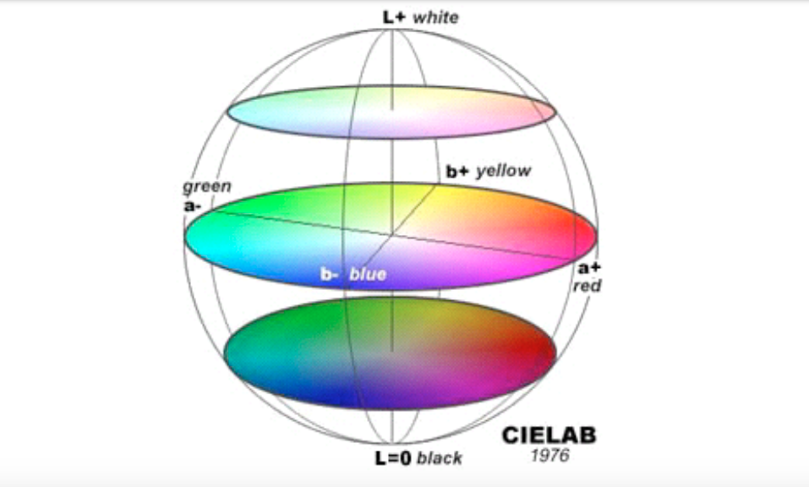

Slide 43
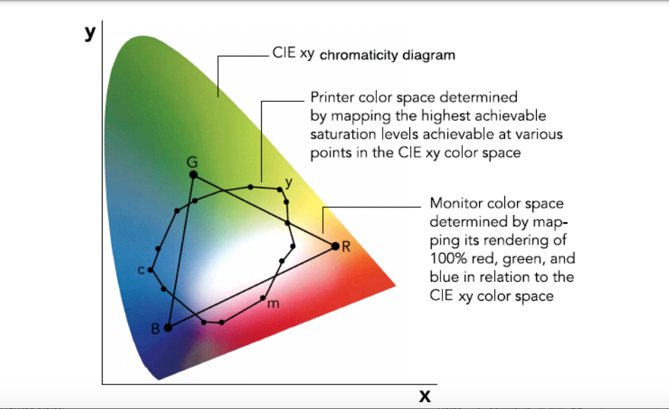

Slide 44
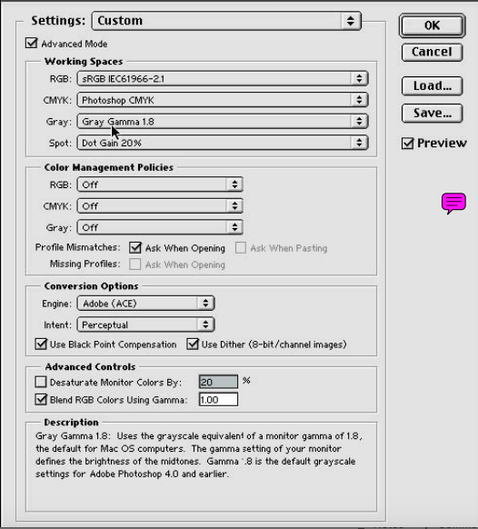

Slide 45
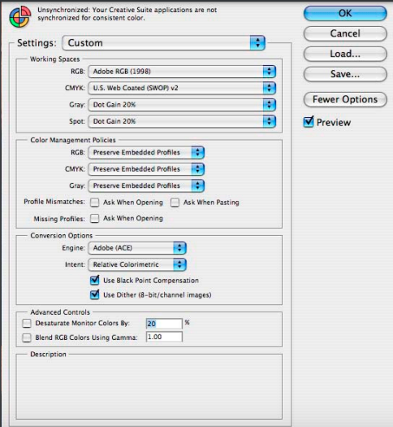

Slide 46
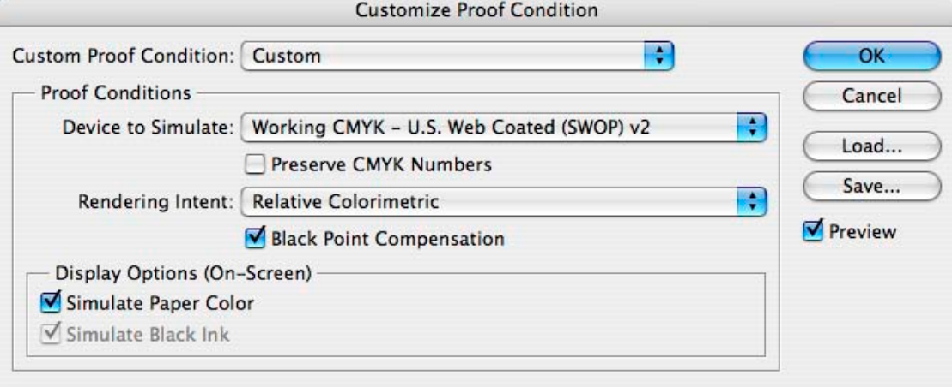

Slide 47


Slide 48
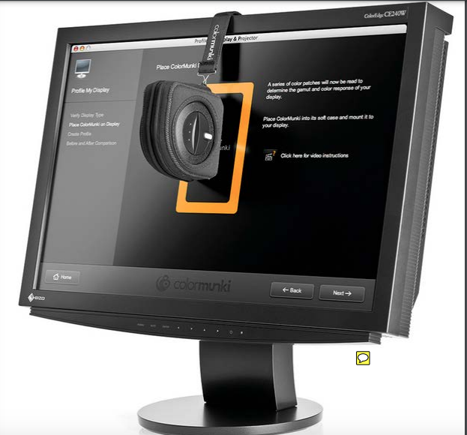

Slide 49
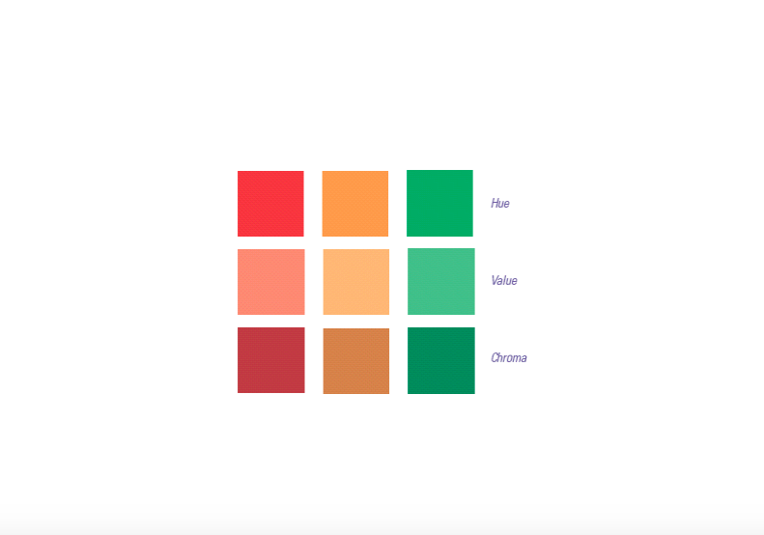

Slide 50
Color Schemes
Color Schemes are a organized way of putting colors together for specific effects… in your graphic designs, in fashion, and in interior design…..
monochromatic, complementary, analogous, warm, cool

Slide 51
Monochromatic
Mono” means “one”, “chroma” means “color”… this type of color scheme has only one color and its values. The following slide shows a painting done in a monochromatic color scheme

Slide 52
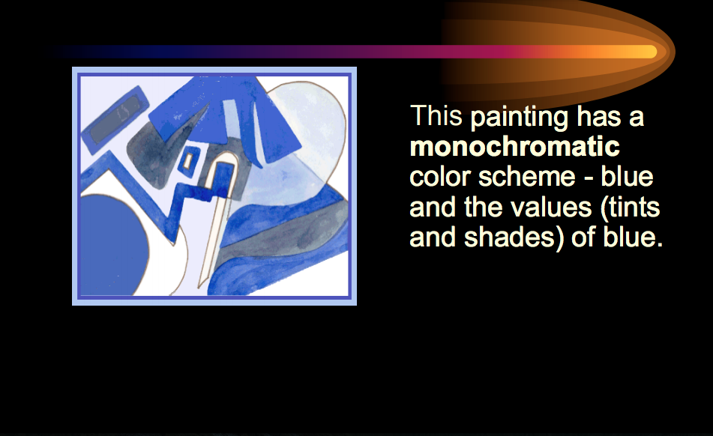
Monochromatic

Slide 53
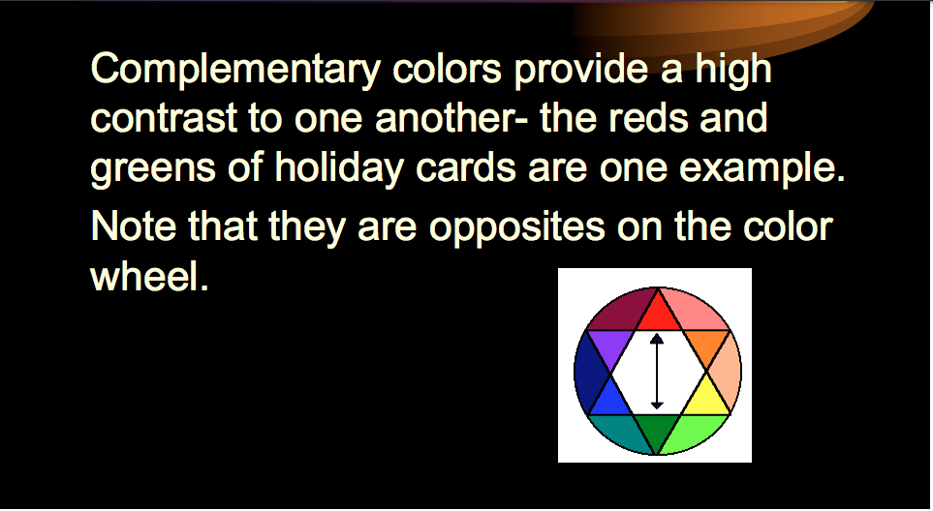
Complementary

Slide 54
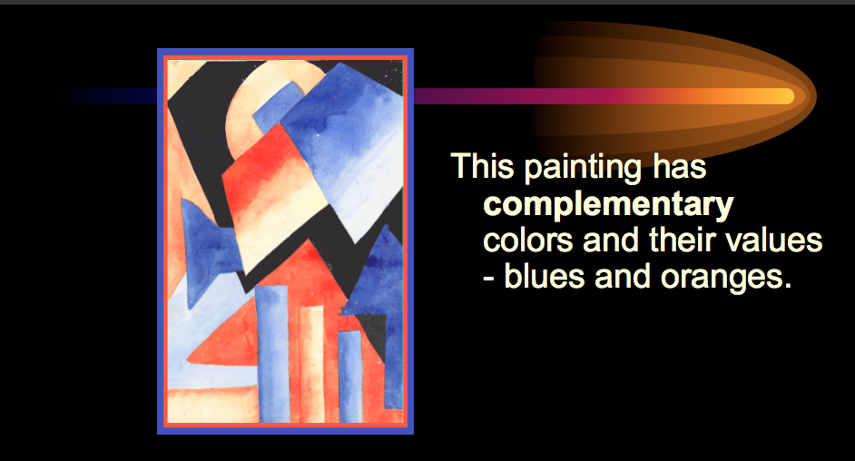
Complementary

Slide 55
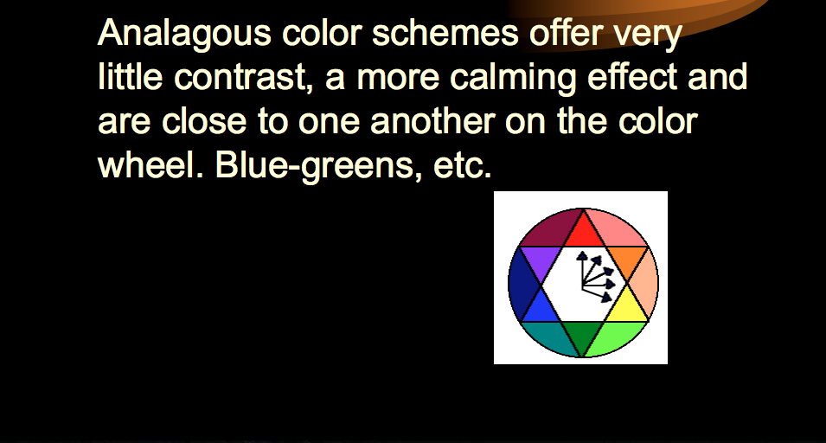
Analogous Colors

Slide 56
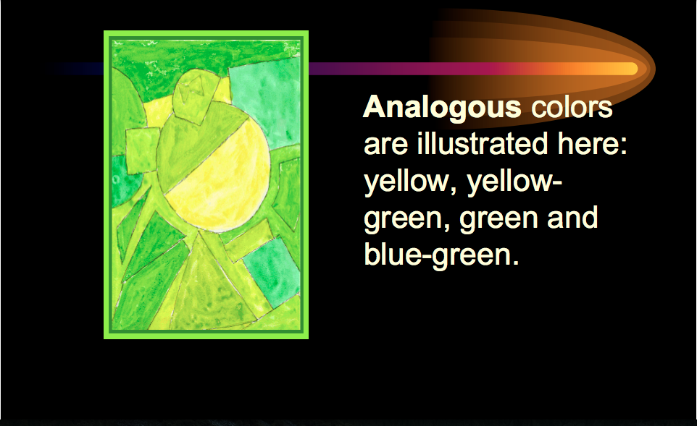
Analogous

Slide 57
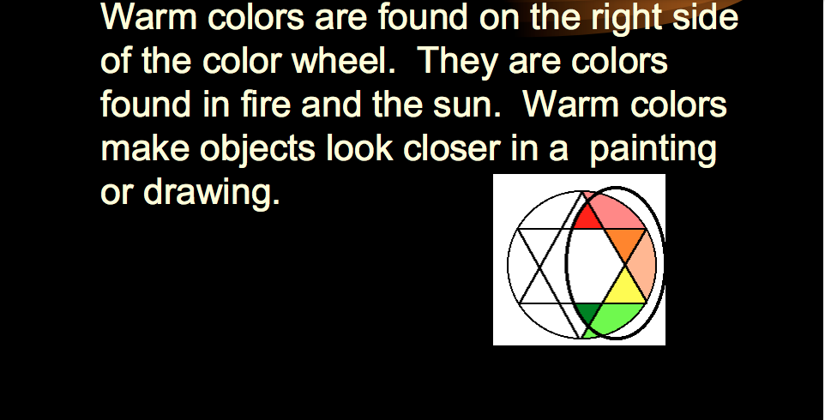
Warm Colors

Slide 58
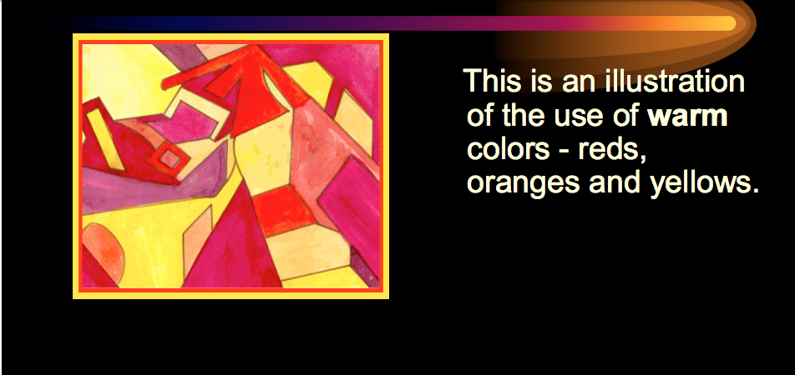
Warm Colors

Slide 59
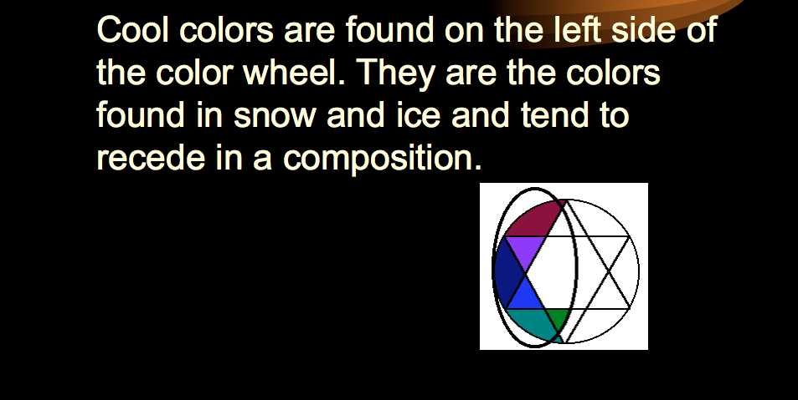
Cool Colors

Slide 60
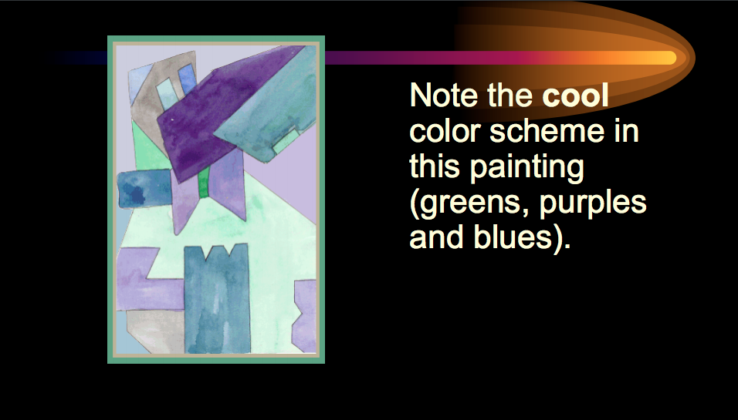
Cool Colors

Slide 61
References
Tanya Goetz, Assistant Professor-Part 2
Digital Media Primer, Pearson Education, by Yue-Ling Wong 2012.

