Slide 1
Technical Writing Coronavirus Challenge Part 1
Summer 2020
This is a new form of collaborative online structured learning. It is based on a program for journalism professionals developed by Douglas Smith, Charles Baum, and Quentin Hope for the Media Transformation Challenge at Harvard University and the Poynter Institute.

Slide 2
The Challenge At a Glance
Commit to a performance challenge that meets specified criteria and that relates to the current coronavirus crisis.
Describe to whom success matters and why.
Specify outcome-based goals describing success.
Shape a “story of success” that can help you communicate the significance of the challenge to others.
Describe the key “assumptions vs. knowledge.”
Give thought to early wins (outcome, process, insight, and capability).
Give thought to how best to “go public.”

Slide 3
Determine how you can
Break down big, complex challenges into achievable chunks…
Achieve reinforcing results – soon -- for energy, credibility, and momentum…
Try out new skills and concepts in a small-scale way… test and learn what works and what doesn’t (and why)
Steadily build a diverse cadre of change leaders…
Substantially increase your odds for success and greater impact…
… this is the TW Coronavirus Challenge

Slide 4
Core Concept
Design
Do
Notes:
4

Slide 5
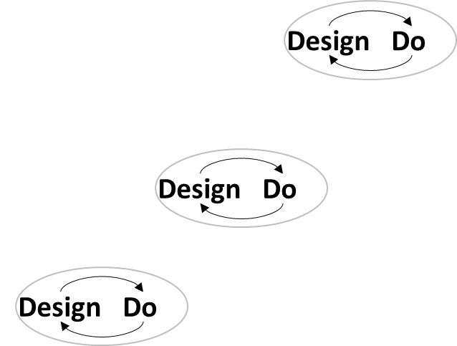
Design-do loops take you up the S-curve
Performance results
and
People contributing to performance results
Beginning of end
End of beginning
Time

Slide 6
A few notes…
The challenge is framed around multiple “assignments” for your chosen challenge area.
These include, but are not limited to, development of a website and related app, a podcast, a paper manual, and a video.
You cannot do this alone but must work with others in the class. Just because you are working remotely you cannot assume you are working alone.
“Just do it” with the assignments – don’t get hung-up debating things to death; make choices and move on.
This is the short version – but core!

Slide 7
Criteria for the TW challenge
Start with one of 2-3 most important challenges you face in informing people how to face the coronavirus pandemic.
Take a “CEO” perspective – whole enterprise, semester time frame.
Neither be too broad nor too narrow.
Always, four or five people must contribute – not just you, but other members of the class.
Imagine something that demands change to achieve performance – not “business as usual.”
Do something you’ll feel at risk for when you “go public.”
Is the idea “ripe” – does it really makes sense for now?

Slide 8
Introduction to 3-part challenge statements
Challenge statement
What will be done
What will be created, accomplished or established through your challenge; the transformation envisioned by the challenge.
How we will know success
How achievement of your challenge will be measured in terms of SMART outcome goals.
How we will do it
The key creations (“3 to 7 things”) for achieving your challenge – your strategies under which you can plan your tactics and wins.

Slide 9
A possible 3-part challenge statement
We will create new informational platforms about the coronavirus that include not only critical immediate information but a support system for discovering accurate background information along with avenues for research. The help possibilities will be available in downloadable podcasts and videos.
By July 1, 2020, we will have ‘gone live’ with a website and its support system. We will have presented our work to our colleagues (the class).
We will do this by (a) organizing teams of four or five students with one designated as “coach,” (b) working closely alongside each other to increase the rate of success for each subsidiary effort and will use feedback from each other to improve individual performance, and (c) creating structures not only for our end users but for ourselves as we proceed, including checklists and benchmarks for evaluation of progress along the way.
What will
be done
How we’ll
know
success
How we’ll
do it

Slide 10
Importance of the challenge formulation process…
PROBLEM DEFINITION IS
MORE THAN HALF OF…
THE PROBLEM SOLUTION

Slide 11
Technical Writing Coronavirus Challenge Part 2
Summer 2020

Slide 12
Here we go! Task 1 of the challenge
Take 5 minutes to write down your current thoughts on what might be your TW coronavirus challenge. Share it with other students. Create a team!

Slide 13
Defining part 1 of the challenge statement
Challenge Statement
What will be done
How we will know success
How we will do it

Slide 14
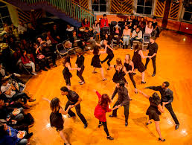
Step Back, Step down: Balcony and Dance Floor views
From the balcony
CEO and GM strategic perspective.
Pattern and trend recognition.
Longer-term perspective: one week, one month, one semester.
(Whose view?)
On the dance floor
Focus on tactical actions – yours and others.
Experience what it’s like on the front line.
Take a near term perspective: today, this week.
Notes:
Build

Slide 15
Forces at work from a balcony view -- external
View: External
 | External forces at work affecting your news enterprise
Positive
Negative
Uncertain at present

Slide 16
Challenges Focus on Gaps

Slide 17
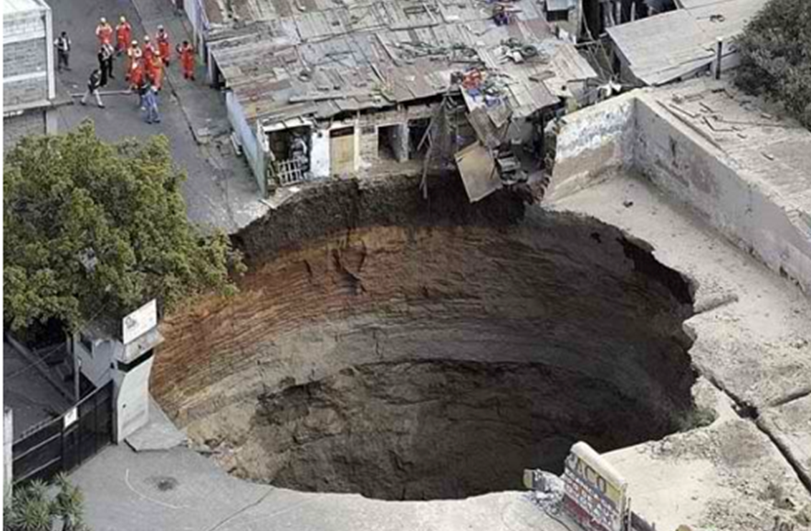
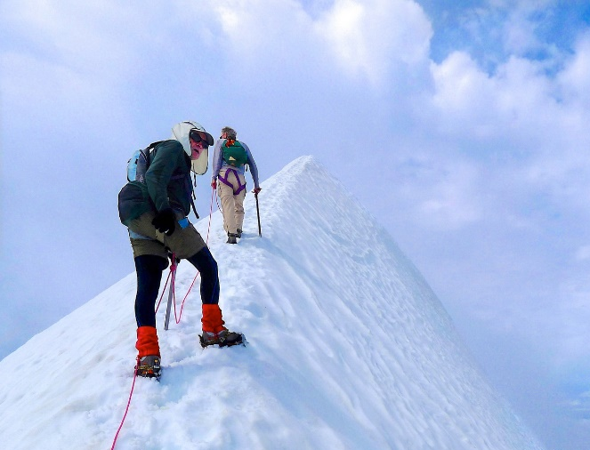
Performance gaps: two types
Deficiency gaps
Catching up.
Building basics.
Joining the game.
What types of gaps do you face in your challenge? See you “view from balcony” responses. Cold facts help.
Aspiration gaps
Winning.
Growing.
Creating “differentiators.”
Notes:
BUILD

Slide 18
Identify the gaps to be closed
Directions
Review your assessment of the forces at work in regard to your coronavirus challenge. Then identify the existing gaps that need to be addressed in your challenge area.
While much of the focus may be deficiency gaps, also consider aspirational gaps as well.
See next page for a blank template

Slide 19
Gaps to be closed
Gap

Slide 20
Technical Writing Coronavirus Challenge Part 3
Summer 2020

Slide 21
From > To statements for conveying your challenge (example)
FROM | TO
A description of a telling aspect of the current state | A description of the same aspect in the state your desire
People don’t know how to act during this crisis. | I understand what the needs are for individuals now.
Student are not used to working together. | Each student recognizes that they are part of a group.
I don’t know how to work with others when I don’t know them and can’t see them. | I have developed methods for working with others without seeing them personally.

Slide 22
Metrics for Information: From/to statement
From | To
Word-of-mouth, inquiry driven growth. | Active marketing strategy to reach those in need.
Setup takes weeks of consultation and manual configuration. | Setup is (mostly) self-directed and takes 1 day.
We keep what we do secret, closely held. | We shout about what we do, trust we can be best and first.
I do most of the development work. | Others do most of the development work and I work with them.
People depend on information about coronavirus they cannot be sure of. | People are confident in the source of the information about coronavirus.
People are not sure they really understand the coronavirus information they receive. | Coronavirus information is tailored to the needs, language and education of the targeted audience.

Slide 23
Tips for From > To statements
FROM | TO
A description of a telling aspect of the current state | A description of the same aspect in the state your desire
Tie the statements back to the gaps you have identified – what conditions with the gap, what conditions once the gap is closed
Think of observable conditions – e.g., what someone might observe visiting before the change and what they’d see and sense after the change
Use descriptive, visceral and meaningful language to bring the statements to life
Think of the “From > To” from the perspective of multiple stakeholders and the shift they would experience: audiences, advertisers, the community, employees, owners

Slide 24
Craft From > To statements to depict the change your are aiming to achieve
Assignment
# 1
Directions
Draft an initial set of From-To statements that describe the current state of information in your neighborhood regarding coronavirus – and the future state that once you have made a transformation in the challenge area. Share this with other students and come up with a common statement.
See next page for a blank template

Slide 25
From>To statements for closing the gaps
FROM | TO

Slide 26
Drafting part 1 of your challenge statement
Challenge statement
What will be done
what will be created, accomplished or established through your challenge; the transformation envisioned by the challenge
How we will know success
how achievement of your challenge will be objectively assessed in terms of SMART outcome goals
How we will do it
The key actions (“3 to 7 things”) for achieving your challenge – your strategies under which you can plan your tactics

Slide 27
An Example for part 1 - “what will be done”
We will expand available information on the coronavirus pandemic in a way both believable and accessible to people in our neighborhoods in New York City. We will do this in multiple forms so that people from all sorts of backgrounds can find one appropriate for themselves.

Slide 28
Draft part 1 of your challenge statement – “what will be done”
Assignment
# 2
Directions
Based on the forces at work you’ve listed, the gaps you’ve identified and the From>To statements you’ve developed, draft a sentence or short paragraph describing “what will be done” through the challenge – the vision or aspiration realized, the transformation achieved, the gaps closed. Coordinate with other student until a common statement is achieved.
See next page for a blank template

Slide 29
Challenge Statement Part 1: What will be done
What will be done:

Slide 30
Technical Writing Coronavirus Challenge Part 4
Summer 2020

Slide 31
Drafting part 2 of your challenge statement
Challenge Statement
What will be done
How we will know success
How we will do it

Slide 32
SMART outcome-based goals
Specific | Measurable | Aggressive yet Achievable | Relevant | Time bound
Improvement at what? For whom? | What measurement area? Which particular metric? | By how much? Over what baseline? | Ties back to performance gaps Links to strategies; measures their effectiveness | What time interval? By what end date?

Slide 33
Good SMART goal grammar
Good grammatical form for SMART goals:
Verb: the action achieved: build, grow, increase, improve, cut, expand, etc.
Object: what you wish to increase or improve
How much: target goals and metrics you will use
By when: time frame for achievement
Example:
By July 1, 2020, we will provide quick and easy access to information on how to act during the coronavirus crisis.
Verb: provide.
Object: Appropriate behavior in light of the crisis.
How much: Reaching 1% of NYC population.
By when: July 2020.

Slide 34
Measuring success by what matters
Resources
Activities
Outputs
Outcomes
Impact
Success is too often defined by activities …
or sometimes by the outputs produced
…
but far too rarely defined by the outcomes that matter …
and connected to whole enterprise outcomes and greater social results that matter…
Training
Meetings
Analysis
Reports
Amount of content
Number of partnerships
Movement to new platforms
Audiences
Revenue
Total audience
Total revenue
Market share
Brand value
Community good
Social justice action

Slide 35
Using RAOOI to get to outcome goals
Starting “goal”: Improve the social media skills of our newsroom
Resources
Activities
Outputs
Outcomes
Impact
Staff
Tools
Creation of sustainable and constantly updated resources for the public.
Every member of the team contributes to the dynamic information sources.
Sourced information that New Yorkers can turn to with confidence as long as the coronavirus crisis continues.
Growth in appropriate individual behavior.
Higher awareness of community needs.
Quick access to changing stories.
Positive community action.

Slide 36
If You Didn’t “Get” the Last Slide, Then…
Review it again. And again. And then again.
No passing Go!

Slide 37
Technical Writing Coronavirus Challenge Part 5
Summer 2020

Slide 38
Drafting part 2 of your challenge statement
Challenge statement
What will be done
what will be created, accomplished or established through your challenge; the transformation envisioned by the challenge
How we will know success
how achievement of your challenge will be objectively assessed in terms of SMART outcome goals
How we will do it
The key actions (“3 to 7 things”) for achieving your challenge – your strategies under which you can plan your tactics

Slide 39
Part 2 of the challenge statement: An example
We will expand the reliable points of access to information on the coronavirus pandemic in ways that will make it easy for all New Yorkers to find the information they need, no matter their digital access or lack thereof, no matter their education and no matter their language. By July 1, 2020, we will provide at least three separate but connected platforms, from paper handouts to digital chains.
We will measure success against the standards for behavior set out by the State of New York, standards that will evolve during the crisis requiring constant revision and monitoring. If people are following directives in behavior and activity, this project can assume it has contributed to that success.
What will
be done
How we’ll
know
success

Slide 40
Set your SMART outcome goals and draft part 2 – “how we’ll know success”
Assignment
# 3
Directions:
Based on the gaps you have identified and the challenge you have framed in “what will be done,” craft a set of SMART goals to measure success of the challenge.
See next page for a blank template

Slide 41
Part 2: How we'll know success
How we will know success:
Smart outcome goal
Smart outcome goal
____
___
__

Slide 42
Drafting part 3 of your challenge statement
Challenge Statement
What will be done
How we will know success
How we will do it

Slide 43
Technical Writing Coronavirus Challenge Part 6
Summer 2020

Slide 44
The “Snow-person”
describes what is sought and why (i.e., Part 1 of the challenge statement) – perhaps with From/To contrasts
memorable and compelling
Vision
defines the handful of key things needed for success at the vision/ challenge (i.e., Part 2 of the challenge)
Strategy
covers the multitude of details through which the things get done
gets into skills, roles, workflow, tools, technology and more
Tactics
(operations)

Slide 45
3-part challenge statement: An example
We will expand access to information on the coronavirus crisis to sections of the NYC population that do not yet have adequate information available..
By July 1, 2020, we survey groups previously underserved in terms of information access and will compare results to those of a survey taken in early June.
We will do this by (a) creating information venues appropriate to the population, (b) working closely alongside audience to assure that impact, satisfaction, and retention and use their feedback to make our product more valuable, and (c) creating flexible structures so we can maintain excellence.
What will
be done
How we’ll
know
success
How we’ll
do it

Slide 46
That’s Strategy!
The 3-7 things to do that you have identified.

Slide 47
Three helpful strategy frameworks in developing 3-7 strategies
Where to operate / How to operate / How to sustain.
Value promise, delivery and experience cycle.
Core competencies (operational efficiency, innovation, customer intimacy).

Slide 48
Applying the strategy frameworks to you challenge
Assignment
# 4
Directions
Consider how the three challenge frameworks are applicable to your challenge and in what ways.
Based on these new perspectives identify changes and additions to your strategies (“3 to 7 things”) in the “how we will do it” part of your challenge statement.

Slide 49
Drafting part 3 of your challenge statement
Challenge statement
What will be done
what will be created, accomplished or established through your challenge; the transformation envisioned by the challenge
How we will know success
how achievement of your challenge will be objectively assessed in terms of SMART outcome goals
How we will do it
The key actions (“3 to 7 things”) for achieving your challenge – your strategies under which you can plan your tactics

Slide 50
3-part challenge statement: An example
We will expand Metrics for News from a small program to a scaled business, in a quest to empower thousands more journalists to engage audiences and sustain their enterprises and to generate net income to underwrite API’s other programs that support journalism.
By Jan. 31, 2020, we will triple the number of active customer organizations to 100, reach at least 3,500 active monthly users, and document at least 6 cases of customers generating new revenue aided by our program. At this scale we will generate $750,000 in annualized revenue (up more than 6x from $120,000) including at least $200,000 that is reinvested in other API programs.
We will do this by (a) improving and formalizing our processes for marketing and information dissemination, (b) working closely alongside our users to increase their impact, satisfaction, and retention and use their feedback to make our product more valuable[, and (c) creating scalable technology and staffing structures so we can maintain excellence as our customer base booms].
What will
be done
How we’ll
know
success
How we’ll
do it

Slide 51
Draft part 3 of your challenge statement – “how it will be done”
Assignment
# 5
Directions:
Based on “what will be done” and “how you will measures success,” identify 3 to 7 strategies by which you will achieve the challenge.
See next page for a blank template

Slide 52
Part 3: How we will do it
How we will do it:
Strategy
Strategy
_____
___
__

Slide 53
Technical Writing Coronavirus Challenge Part 6
Summer 2020

Slide 54
Pulling together your complete challenge statement
Challenge statement
What will be done
what will be created, accomplished or established through your challenge; the transformation envisioned by the challenge
How we will know success
how achievement of your challenge will be objectively assessed in terms of SMART outcome goals
How we will do it
The key actions (“3 to 7 things”) for achieving your challenge as further developed in your strategies and tactics

Slide 55
Tips on shaping a complete challenge statement
Cohesion and flow – the three parts hang together and make a compelling case;
Language – meaningful, powerful, compelling and clear (write to engage and energize your internal audience);
Apply your editing skills – keep it lean and concise without losing meaning.

Slide 56
Pull the three parts you’ve drafted into a complete challenge statement
Assignment
# 6
Directions
Shape the three parts of the challenge you have drafted separately into a complete, compelling challenge statement.
Use meaningful language –write to engage and energize your audience.
Apply your editing skills – keep it clear and concise without losing meaning.
See next page for a blank template

Slide 57
Complete challenge statement
What we will do:
_
How we will know success:
_
How we will do it:
_

Slide 58
Technical Writing Coronavirus Challenge Part 7
Summer 2020

Slide 59
Share your draft challenge statement with class partners for reactions and feedback and then combine and create to put together a final challenge statement for the class as a whole.
Sharing session

Slide 60
Now that you know your performance challenge…
Assumptions versus knowledge
People, politics, change
Social map
Power/opinion matrix
Getting off to a good start
S-curve
Early wins
Going public
Power of story

Slide 61
Assumptions vs. knowledge
What must go right for your challenge to succeed?
What are you assuming will be true about …
audience segments and needs? competitors? | publishing platforms? technology? costs? | needed partners? advertisers? needed funding? | people in your org? your org’s capabilities? your owners support? yourselves?
How certain are you of each of these assumptions? Where would you rate them based on current evidence?
1 | 2 | 3 | 4
pure gut just a hunch hopeful thinking | a few insights some evidence many remaining questions | mounting evidence a few remaining questions | extensive evidence known facts absolute certainty

Slide 62
Tips on capturing and using Assumptions
State in the affirmative, as an hypothesis.
Calibrate your ratings across your team and with others.
Keep discussing them as circumstances change and new factors emerge.
Use them to drive your plan. What data gathering or experiments need to be done to advance your assumptions to knowledge?

Slide 63
Identify and rate the key assumptions underlying your challenge
Assignment
# 7
Directions
Think through the assumptions you are making to be able to succeed in your challenge – what must go right, what must prove true.
Based on your current level of actual knowledge, rate each of the assumptions.
Share one of your most “oh, yeah” assumptions.
See next page for a blank template

Slide 64
Assumptions vs. knowledge for your challenge
Assumption | Current rating (1-4)
1 | 2 | 3 | 4
pure gut just a hunch hopeful thinking | a few insights some evidence many remaining question | mounting evidence a few remaining questions | extensive evidence known facts absolute certainty

Slide 65
Technical Writing Coronavirus Challenge Part 8
Summer 2020

Slide 66
So how does it look??
Good enough to go??
Enough sources of readiness??
Not a total disaster??

Slide 67
The DVP model for getting people on board
CH
D
V
P
=
X
X
Pressure to CHange
Dissatisfaction with current state
Clear, shared vision of desired state
Process that provides the pathway and clears obstacles
to the desired state
Source: Eric Abramson, Columbia Business School
Notes:
BUILD

Slide 68
Additional notes on the “D” of DVP
CH
D
V
P
=
X
X
It needs to be their “D” not yours.
Dissatisfaction doesn't need to be negative and only about deficiency gaps. It can be positive energy about an aspiration that hasn’t been realized.
While “dissatisfaction” has a useful grittiness to it, you can also think of D in terms of a person’s motivations and interests.
There can be “pass-through Ds” – e.g. an immediate boss with very high dissatisfaction

Slide 69
Think through DVP for getting people on board
Assignment
# 9
Directions
Look at the individuals on your power/opinion matrix who are “opponents” (high power, unfavorable). Pick a few and think about which part of DVP may be missing and how you can work with it:
The “D” that they have or you can generate for them
The “V” that they need to see of a better future and get excited by
The “P” they need to see to understand how this change will happen and what they need to do
See next page for a blank template

Slide 70
Using DVP to get people on board
Person/ Group | D, V or P at issue | What’s missing for them and possible approaches to get them on board”*
*
Possible sources of their “D” (dissatisfaction)?
Possible lack of seeing or agreeing with the “V” (vision)?
Possible lack of understanding or fearing the “P” (process)?

Slide 71
Technical Writing Coronavirus Challenge Part 9
Summer 2020

Slide 72
Moving Into Action: Getting Off to a Great Start
Notes:
Describe how program started -- the quid pro quo; avoid mind candy problem

Slide 73
The S-Curve
Articulated the performance challenge
Tested it with key stakeholders
Own the challenge as a leadership team and aren’t turning back
Gone public
Achieved early wins
Stopped doing things to gain needed time, attention and capacity
Established momentum
Performance results
and
People contributing to performance results
Beginning of End
Major performance outcomes accomplished
Everyone needed actively participating
New routines in place of old
The once foreign now known and familiar
Uncertainties and risk largely gone
Performance
End of Beginning
Time

Slide 74
The real S-Curve
Performance results
and
People contributing to performance results
Beginning of End
Performance
End of Beginning
Time

Slide 75
Design-do loops take you up the S-curve
Performance results
and
People contributing to performance results
Performance
Time

Slide 76
4 types of Wins
Insight
Process/Milestone
Capability
Outcome
Calibrating direction by converting assumptions to knowledge
Getting past major steps required to build capabilities and achieve outcomes
Locked-in improve-ments in individual and organizational capabilities and capacity
Achieving results that matter (i.e., your SMART, outcome-based goals)
Learnings gleaned from quick experiments and trials
Analysis with actionable findings completed
Workable solutions found
“Ah ha’s” realized
Resources secured
Authorizations received
Plans developed and agreed to
Commitments made to SMART goals
Key opponent converted to backer
Skills developed and in use
Products launched and working
Technologies in place and working
Audience data available and in daily use
Improved workflows in place
Increased audience reach, engagement, loyalty, habituation
Increased revenue
Growth in customer base or market share
First mover advantage established

Slide 77
Identify potential “early wins” for your challenge
Assignment
# 10
Directions
Given your challenge and “how you will do it,” think of any early wins you could achieve over the next week.
Note which of the 4 types of win each would be. While “insight” and “process” wins are most likely in this starting time frame, look hard for “capability” and “outcome” wins (even if small) that will build momentum and help get people on board.
See next page for a blank template

Slide 78
Early wins for your challenge
Win | By when | Type*
* Insight, Process (milestone), Capability or Outcome win

Slide 79
Going public
Role of “going public” in performance driven change
Value of committing publicly to performance
Notion of personal risk

Slide 80
Technical Writing Coronavirus Challenge Part 10
Summer 2020

Slide 81
Outline a plan for “going public” with your challenge
Assignment
# 11
Directions
Identify the groups or individual you need to go public with.
Determine what your objective is and “what’s your ask” in going public with the group.
Think of the timing, sequence and forum that may be best for going public with them.
Beyond sharing your challenges statements with them, think of your “story” for them – how it matters to them and why. And consider what element of DVP you may need to address.
See next page for a blank template

Slide 82
Going public planning
Group or individual | Timing, sequence and forum | Points to cover: Why your challenge matters to them Elements of DVP to address

Slide 83
The Power of Story in Going Public

Slide 84
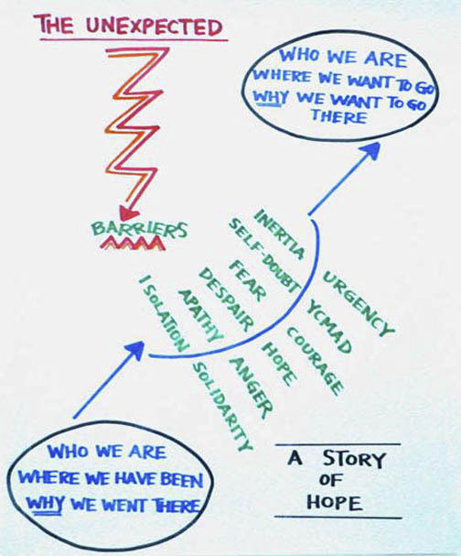

Slide 85
Telling your story – the case in classic form
Situation:
Essence of our organization’s past – the founding story, initial realization of the vision and mission, sense of cumulative impact
Core competencies developed during this time frame – what we have “gotten good at”
Complication:
Major changes that have taken place in the service area and broader authorizing environment – “view from the balcony” and “forces at work”
Crystallization of the strategic challenge
Resolution:
Appropriate strategic responses to these circumstances – what we will do about it (your challenge statement) and what it means for you
What needs to change in the organization to realize a potentially different or enhanced strategic future (your from > to’s)
Set of goals that build to a productive future (your SMART outcome goals as part of your challenge)
Grand conclusion! (good story ending; an ask for getting involved)

Slide 86
Telling your story
Assignment
# 12
Directions
Take a crack at the story of your challenge.
Read it aloud and see if it hangs together and is compelling
Be prepared to share it with the group to test their reactions.

Slide 87
Your challenge story line
The story of your challenge
_

Slide 88
So how’s it going? Look back to see if you…
Committed to a performance challenge that meets the criteria
Described to whom success matters and why
Specified outcome goals describing success
Shaped a “story of success” to help you communicate the significance of the challenge to others
Identified who must be involved in your challenge and what specifically you need from them
Assessed who’s favorable and unfavorable to your challenge and begun engaging “enough” people as supporters
Identified key assumptions underlying your challenge, and your confidence in them
Identified early wins to build momentum – and achieved some
Given thought to how best to “go public”

