Slide 1
Plastic Pollution in the Ocean
SIKANDER IQBAL
3 March 2016

Slide 2
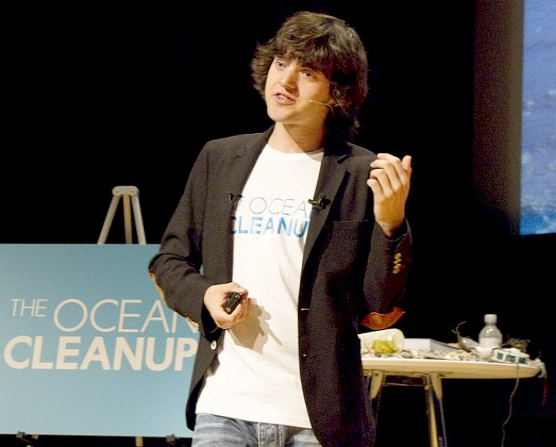
Lets Dive In The Plastic Ocean
What is the project about?
This project is about plastic pollution in the ocean, which is effecting environment, economy and health.
Define the goal of this project
Clean up the ocean and get rid of these problems.
Define the scope of this project
Use of our Brains and Technology to cleanup the ocean.
Notes:
What is the project about?
Define the goal of this project
Is it similar to projects in the past or is it a new effort?
Define the scope of this project
Is it an independent project or is it related to other projects?
* Note that this slide is not necessary for weekly status meetings

Slide 3
PLASTIC POLLUTION FACTS
1. In the Los Angeles area, 10 metric tons of plastic are carried into the Pacific Ocean every day. 2. 50 percent of the plastic we use, we use just once and throw away. 3. We currently recover only five percent of the plastics we produce. 4. The average American throws away approximately 185 pounds of plastic per year. 5. Plastic accounts for around 10 percent of the total waste we generate. 5. The production of plastic uses around eight percent of the world’s oil production. 6. Americans throw away 35 billion plastic water bottles every year. 8. Approximately 500 billion plastic bags are used worldwide every year. 9. 46 percent of plastics float (EPA 2006) and drift for years before concentrating in the ocean gyres. 10. It takes 500-1,000 years for plastic to degrade.

Slide 4
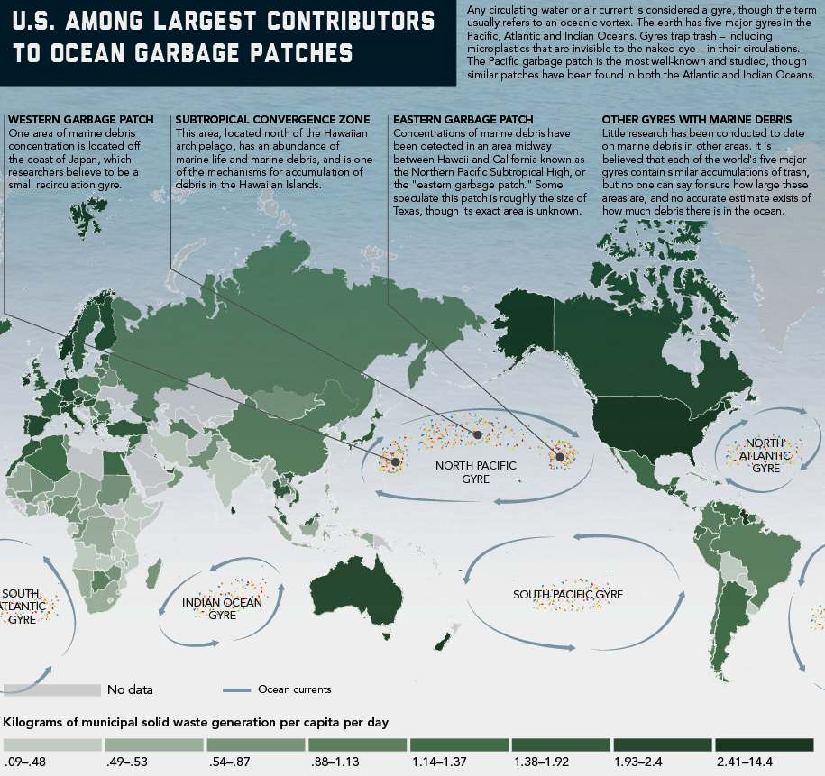
Notes:
INTERNATIONAL WASTE MANAGEMENT - This is a superb illustration of the North and South Pacific garbage patches, compared to the North and South Atlantic gyres. The North Pacific gyre is just one of several swirling trash zones (gyres) in our oceans, and it's where a lot of our plastic litter ends up. While these debris patches aren't visible piles of floating trash in the water, they are inverted mountains - a bit like landfill sites at sea - hidden from view. The reality of what they are and how they got there is mind boggling and extremely harmful to marine life. We can't (at the moment) do much about nuclear waste in the oceans (except appeal to reason), but we can act to vacuum up solids.

Slide 5
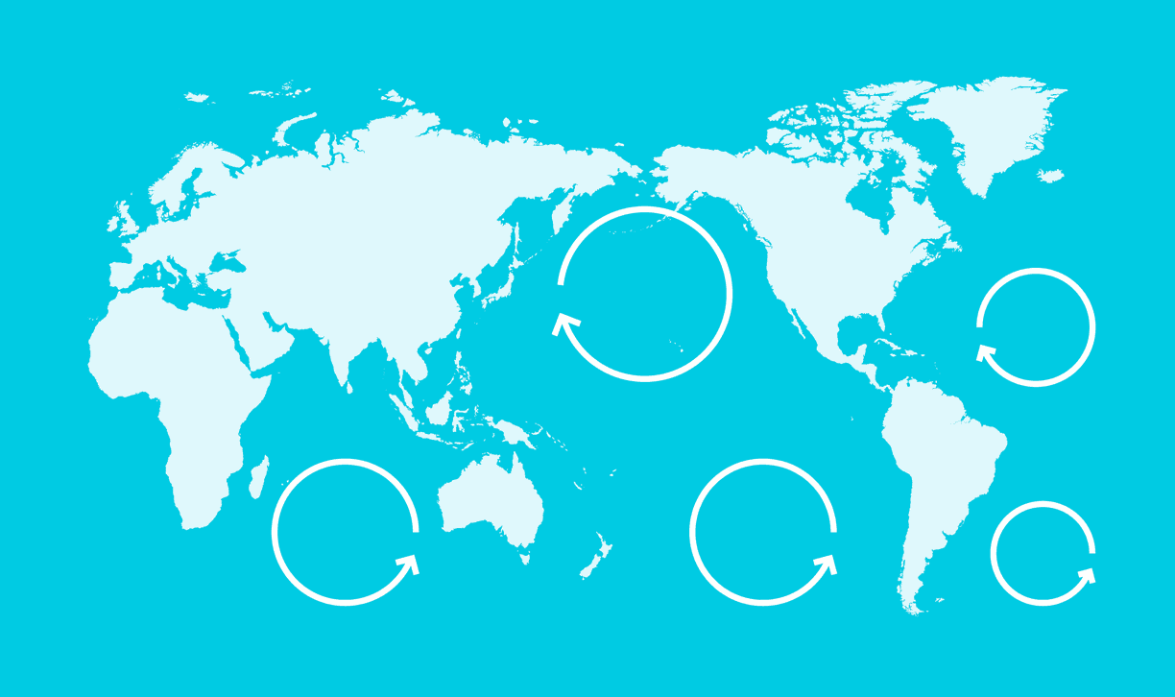
About 8 million tons of plastic enters the ocean every year (Jambeck et al., 2015). Part of this accumulates in 5 areas where currents converge: the gyres. At least 5.25 trillion pieces of plastic are currently in the oceans (Eriksen et al., 2014), a third of which is concentrated in the infamous Great Pacific Garbage Patch (Cózar et al., 2014).
This plastic pollution will continue to inflict damage on the following in the decades to come:
Notes:
* If any of these issues caused a schedule delay or need to be discussed further, include details in next slide.

Slide 6
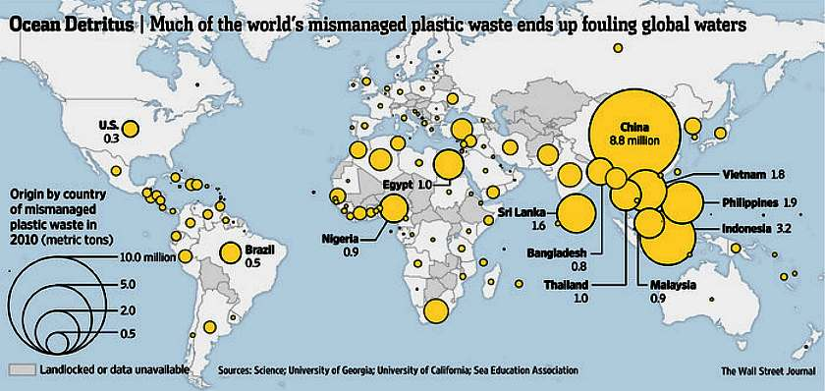
Notes:
PLASTIC WASTE PRODUCERS 2010 - This map of the world illustrates plastic waste producers in relation to poor management - hence, the likelihood of pollution of international waters. It is a useful visualization, telling us where to begin cleaning up for maximum results globally. The problem with this approach may be that the biggest polluters may not want to tackle their problem patch, relying on the efforts of other countries to do their dirty work for them. In theory, the culprit sovereign state could be prosecuted for allowing their manufacturers to mismanage waste to this degree. How about it chaps. It's no rocket science. You need to set a case precedent, to create an example of what will follow if a more responsible attitude is not adopted. Money talks!

Slide 7
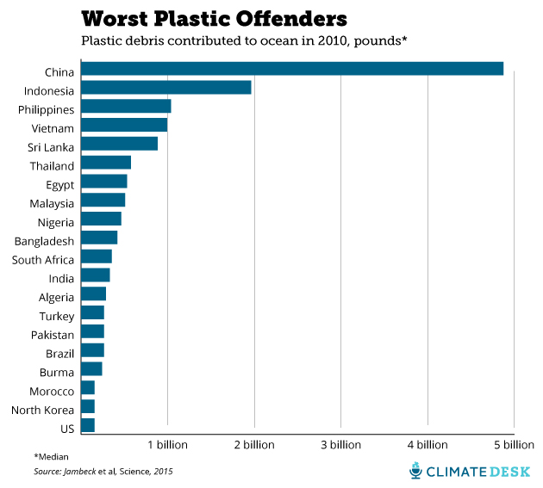
Notes:
That's right: China alone dumped nearly 5 billion pounds of plastic waste into the ocean in 2010. But what's even worse is just how much the study projects these numbers will grow in the future, based on predictions of population growth in each country by 2025. The chart below shows the top-ranked countries in terms of total mismanaged plastic waste (in other words, not all of this plastic is necessarily winding up in the ocean). China is still very much in the lead, and India shows a disturbing explosion of plastic pollution:

Slide 8
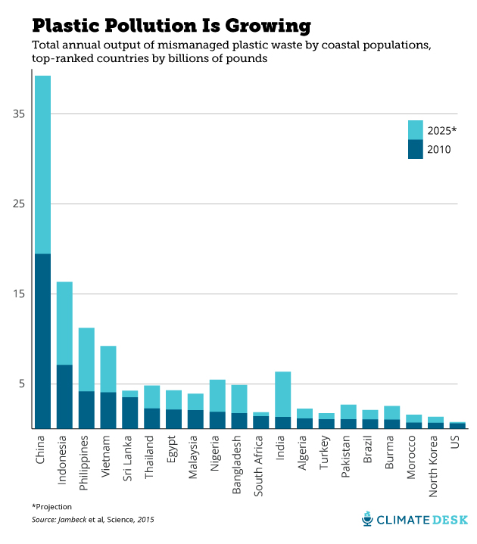

Slide 9
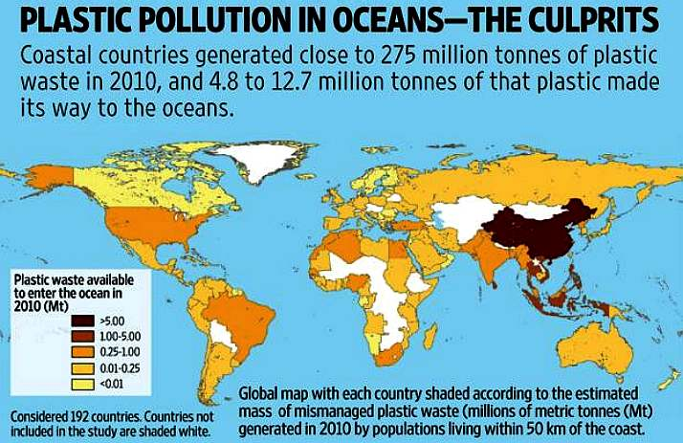
Notes:
STUDY IN PLASTIC 2010 - It is fair to assume that some countries are unlikely to produce waste that would end up in the oceans in great quantities. The above world map shows us, at a glance, who is producing serious concentrations of waste. These are the culprits that international law enforcement agencies should target. A first stage of such operations would be to educate the governments responsible, with a recommendation that they in turn educate their manufacturers and then end users. If that has little effect, then prosecution with heavy fines is likely to bring up short, those who refuse to deal with their waste responsibly. Education is likely to reduce the time it would take for a fleet of SeaVax machines to clean up the oceans - to restore a circular ocean economy. Asia and the Americas are clearly the most polluting geographical regions.

Slide 10
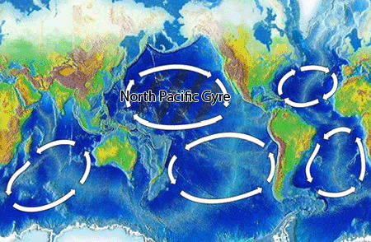
North Pacific Subtropical Gyre
“Great Pacific Garbage Patch”
Estimate: 46,000 pieces of floating garbage/mi².

Slide 11
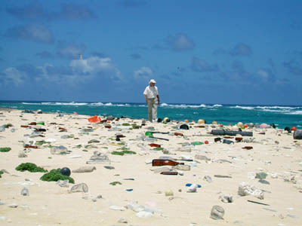
Laysan Island

Slide 12
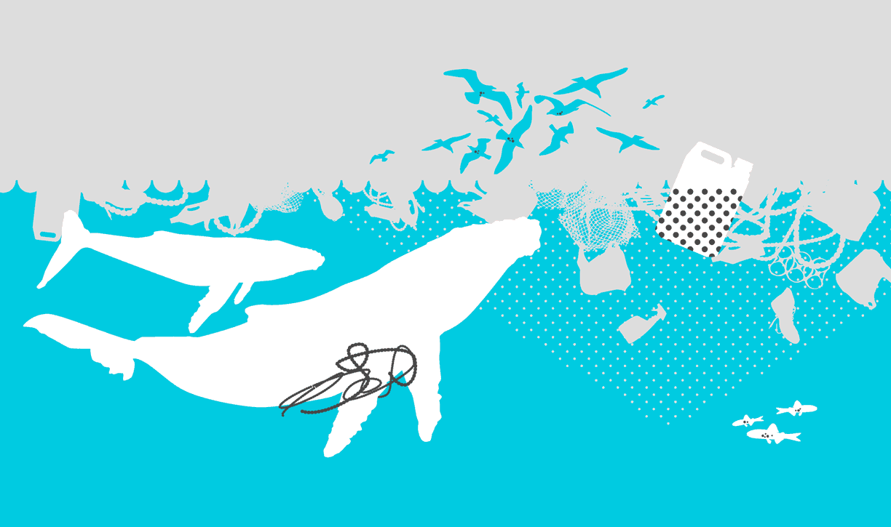
ENVIROMENT IS OUR FIRST ISSUE
At least one million seabirds and one hundred thousand marine mammals die each year due to plastic pollution (Laist, 1997). The survival of at least 100 species (Gall et al., 2015), including the Hawaiian Monk Seal and Loggerhead Turtle, could be jeopardized by plastic debris (Derraik, 2002). Plastic pollution is also a carrier of invasive species, threatening native ecosystems (Barnes, 2005).

Slide 13
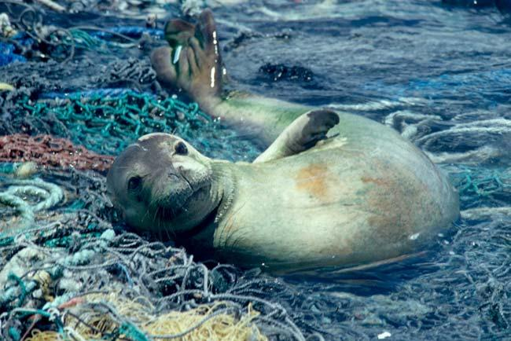
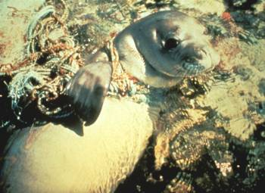
Plastics
100,000 marine mammals & 2 million sea birds die each year after ingesting or being trapped in plastic debris

Slide 14
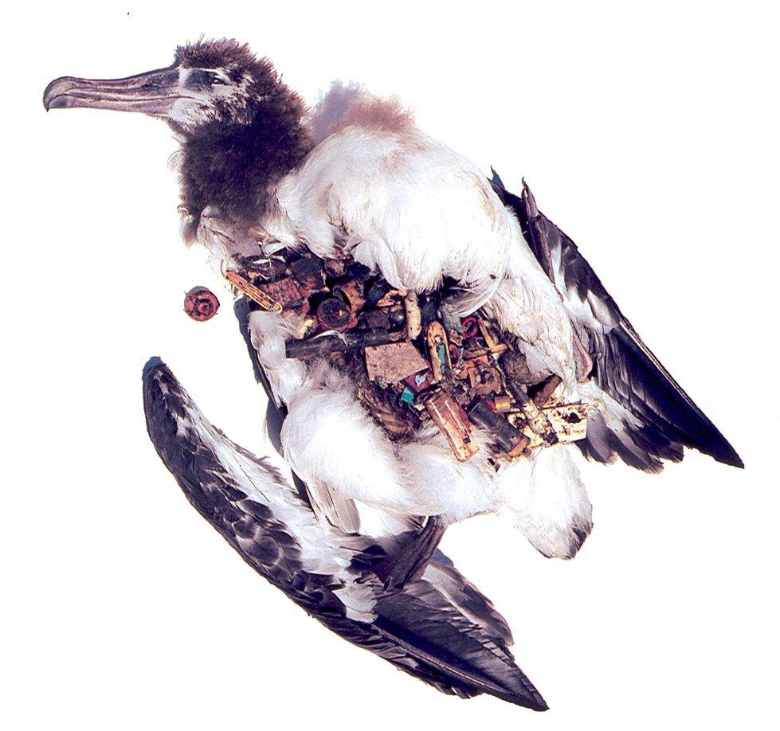
Results of Plastic in Albatross Chick

Slide 15
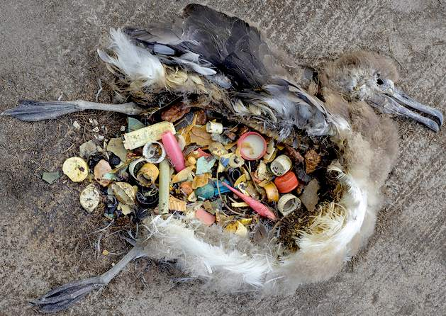

Slide 16
SECOND PROBLEM IS ECONOMY
Plastic pollution causes at least 13 billion U.S. dollars in damage every year to industries that include fishing, shipping and tourism (UNEP 2014). The US West Coast states spend approximately $500 million every year to clean up their beaches. The cost of removing debris from beaches averages $1,500 per ton and can reach up to $25,000 per ton (APEC 2009).

Slide 17
We cannot allow marine litter to affect our economy
Problems with propeller fouling, blocked intake pipes and damaged drive shafts have been reported in the North Sea, Alaska and the East Coast of North America. According to two studies done in the Bering Sea and the Gulf of Alaska, 40–60% of bottom trawls collected plastic and metal debris. Inshore fishing is particularly important for Orkney, Shetland and the West Coast of Scotland, where the majority of small vessels are based. Scotland's fishing industry handled 71% of all UK fish landings into the UK in 1994, with a market value of some £279.3 million. Peterhead, Scotland’s major fish market, is the largest in Western Europe. The fishing industry is also a vital source of employment in Scotland with over 8,500 people directly employed as fishermen and a further 13,000 employed onshore in fishing related activity. Many of these people live around the coastline of Scotland.

Slide 18
Some statistics to digest...
Shetland fishermen have estimated the value of one hour of their time to £30–120 per hour (average £67). Using the average figure, the losses to an average Shetland fishing vessel would, annually, be as follows:
£3,500–7,000 due to lost time clearing nets of debris
£250–1,000 cleaning equipment and nets of contaminants
£100–10,000+ due to time lost fixing nets
£60–500 due to time lost with fouled propeller
£2,000–10,000+ to repair nets
£50–300 to un-foul propeller
£100 for gear box inspection
£6,000 – 30,000 per vessel assuming only one incident per year and working only 40 hours per week.

Slide 19
THIRD AND BIG PROBLEM IS HEALTH
Ocean plastic adsorbs toxic chemicals (including PCBs and DDTs), increasing their concentration by a million (Mato et al., 2001). These persistent organic pollutants enter and bio-accumulate in the food chain, resulting in an even higher concentration of pollutants in fish (Tanaka et al., 2013), including species consumed by humans.

Slide 20
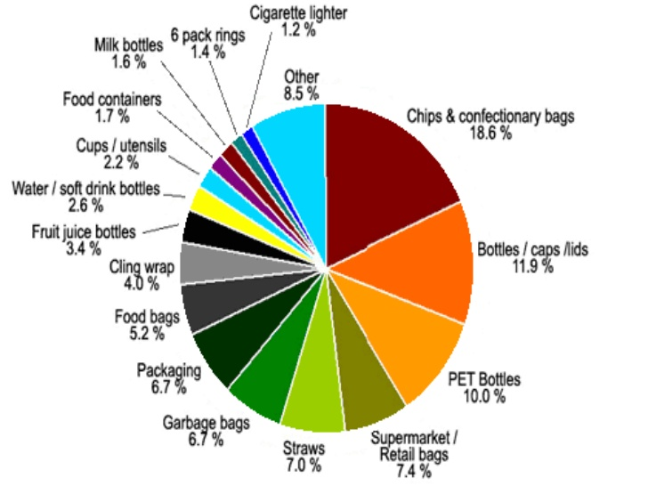

Slide 22
Phthalates (pronounced "thal - eights")
Phthalates are chemicals used in many plastics to make them soft or flexible, i.e. plasticizers. They are widely used in plastic products in the food and construction industries, plus they are used extensively in beauty products, pesticides, wood finishes, insect repellents, solvents and lubricants. There are a number of phthalates with differing though often overlapping health effects. Studies have showed various phthalates to abnormal male sexual development, male infertility, premature breast development, cancer, miscarriage, premature birth and asthma. Because phthalates are not chemically bound to the plastic polymer, they can easily migrate out.`

Slide 23
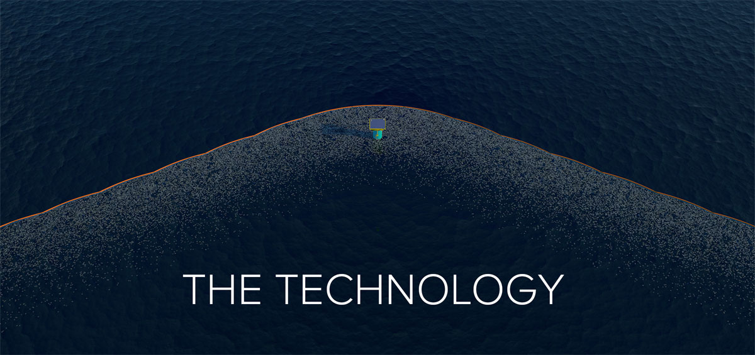
LET USE THE TECHNOLOGY TO CLEANUP
Notes:
Duplicate this slide as necessary if there is more than one issue.
This and related slides can be moved to the appendix or hidden if necessary.

Slide 24
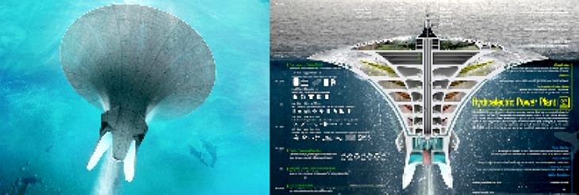
A) SEAWER SKYSCRAPER

Slide 25
SEAWER SKYSCRAPER - The Seawer is a self-supported hydroelectric power station that can generate electricity using seawater at the same time that it cleans up plastic waste.
The huge structure separates plastic particles and fluids, recycles seawater and releases it back into the ocean.
The structure receives energy from the sun, ocean and plastics and moves slowly from one polluted area to the next.
The project received an honorable mention in the 2014 eVolo Skyscraper. Millions of tons of trash enter the ocean each year and cluster in particular areas of the world’s oceans.
One of the most infamous plastic debris patches is located in the North Pacific Subtropical Gyre, commonly referred to as the Great Pacific Garbage Patch (GPGP).

Slide 26
This piece of “plastic soup” is twice the size of Texas and contains six times more plastic than plankton biomass. Seawer skyscraper was designed to tackle this issue while generating electricity at the same time.
South Korean designer Sung Jin Cho submitted the Seawer Skyscraper project as his proposal for this year’s eVolo Skyscraper Competition.
The project includes a huge drainage hole 550 meters in diameter and 300 meters in depth that would be located at the heart of the GPGP.
The structure consists of five layers of baleen filters that separate plastic particles and fluids.
The particles are taken to an onboard recycling plant while purified seawater is stored in a large sedimentation tank at the bottom of the structure before it is released back into the ocean.

Slide 27
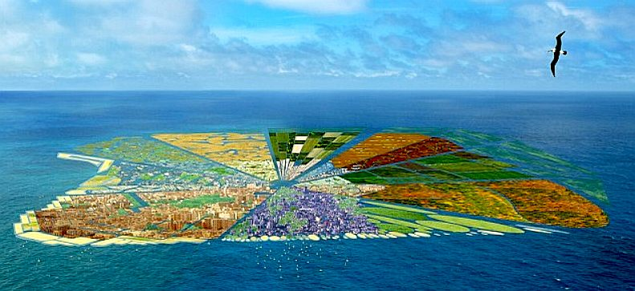
B) Plastic Island

Slide 28
An island the size of Hawaii made entirely from plastic bottles could become the hottest postcode on earth, and is part of an incredible environmental vision for the future.
CGI images show how a team of Dutch scientists plan to take 44 million kilos of plastic waste currently bobbing around in the Pacific Ocean and transform it into Recycled Island.
Solar and wave energy will be used to sustain the island and its 500,000 inhabitants.
A spokesman for the project said: 'The proposal has three main aims; cleaning our oceans from a gigantic amount of plastic waste; creating new land; and constructing a sustainable habitat. 'Recycled Island seeks the possibilities to recycle the plastic waste on the spot and to recycle it into a floating entity.
The Pacific Ocean currently holds the largest amount of plastic waste in the world. Ocean currents keep the plastic in the sea in giant rubbish dumps, which are fatal to sea life.

Slide 29
The team plans to recycle plastic on the spot - in the North Pacific Gyre - into hollow, floating blocks.
These will become the foundation blocks to the 10,000 square kilometre (3,861 square mile) island.
Alongside the modern city, planners hope to create a large area preserved for agriculture.
The island will be designed as self-sufficient, providing food and work for the inhabitants.
The spokesman added: 'Recycled Island should be seen as a unique opportunity to create a new floating habitat from scratch, yet at the same time the ocean is cleaned from a huge part of its plastic pollution.

Slide 30
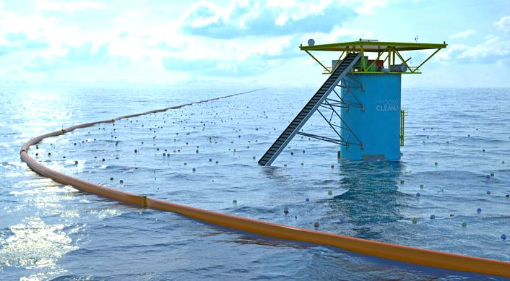
C) Ocean Cleanup Boom

Slide 31
The Ocean Cleanup project is to develop technologies to extract, prevent, and intercept plastic pollution. The Ocean Cleanup’s goal is to fuel the world’s fight against oceanic plastic pollution, by initiating the largest cleanup in history. Small scale model tests indicated The Ocean Cleanup Boom to perform significantly better than conventional booms, while deploying a 40 m long boom near the Azores showed that a boom can capture and concentrate plastic pollution.
https://youtu.be/6IjaZ2g-21E

Slide 32
What we can do as an individual?
The most effective way to stop plastic pollution in our oceans is to make sure it never reaches the water in the first place.
We all need to do our fair share to stop plastic pollution: individuals need to recycle and never litter, but producers of single use plastic packaging need to do more too.
We need producers to design packaging so that it is fully recyclable, and so there is less waste.
We also need producers to help cover the costs of keeping their products out of the ocean.
https://youtu.be/02WjKxk1veQ

Slide 33
Sources
There's More Than One Ocean Trash Gyre! 5 Gyres Project Switches...
treehugger.com›clean…ocean-trash-gyre-5…video.html
5 Gyres of Plastic Trash Pollutes the World's Oceans » EcoWatch
ecowatch.com›2014/04/21/5-gyres…trash…oceans/
5 Gyres - Socialphy
socialphy.com›posts/off-topic/14979/5-Gyres.html
Garbage Patch Primer: What's an Ocean Gyre? : Discovery News
news.discovery.com›earth/oceans…patch…ocean-gyre…
Ocean junk is largely concentrated in five ocean gyres
cbc.ca›news/technology…mh370…ocean-trash-1.2594539
5 Gyres: Plastic in the World’s Oceans
electrolux.pl›sv/Innovation/Campaigns/Vac…5-Gyres/

