Slide 1
2015 Sustainable Chicago
ARCH 3551 – Sustainability: HISTORY & Practices
PRESENTOR: BOB MENDEZ

Slide 2
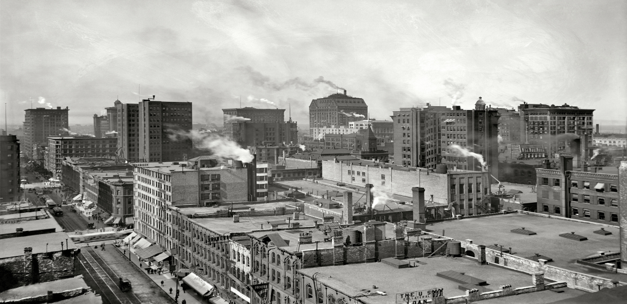
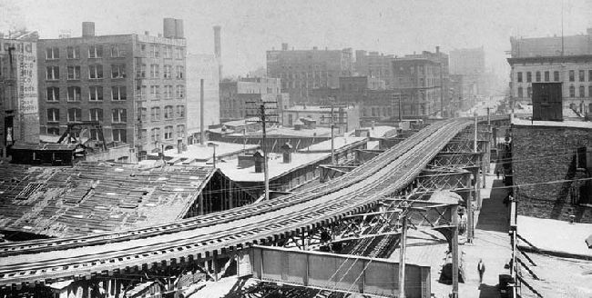
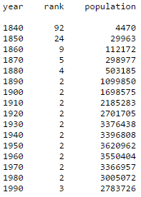
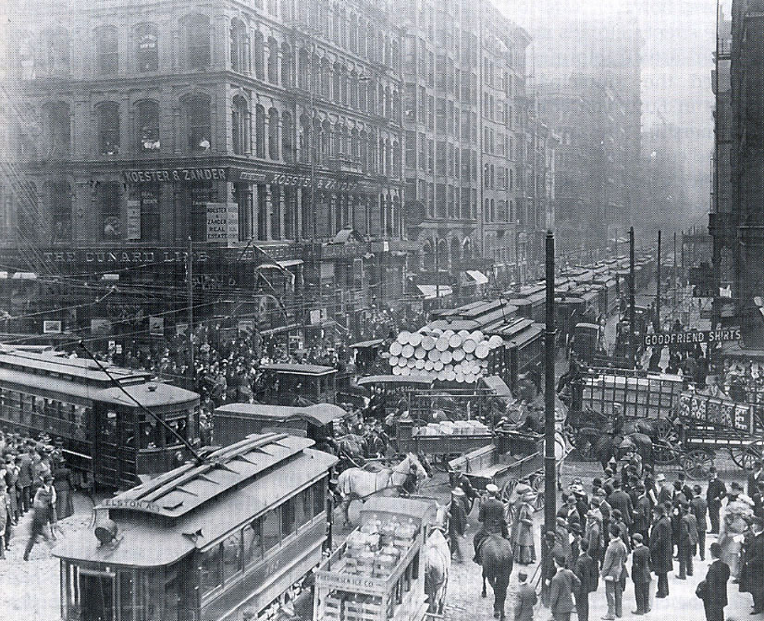
BRIEF History
Chicago is currently the third largest city in the United States, rapidly growing during the Industrial Age at the turn of the 20th Century.
The current population of Chicago is 2,718,782 .
As illustrated in the book Cradle to Cradle, by William McDonough, Chicago is a good example how urbanization affected the environment and health of the people negatively.
Environmentalism made aware to the public the environmental concerns which promoted change.

Slide 3
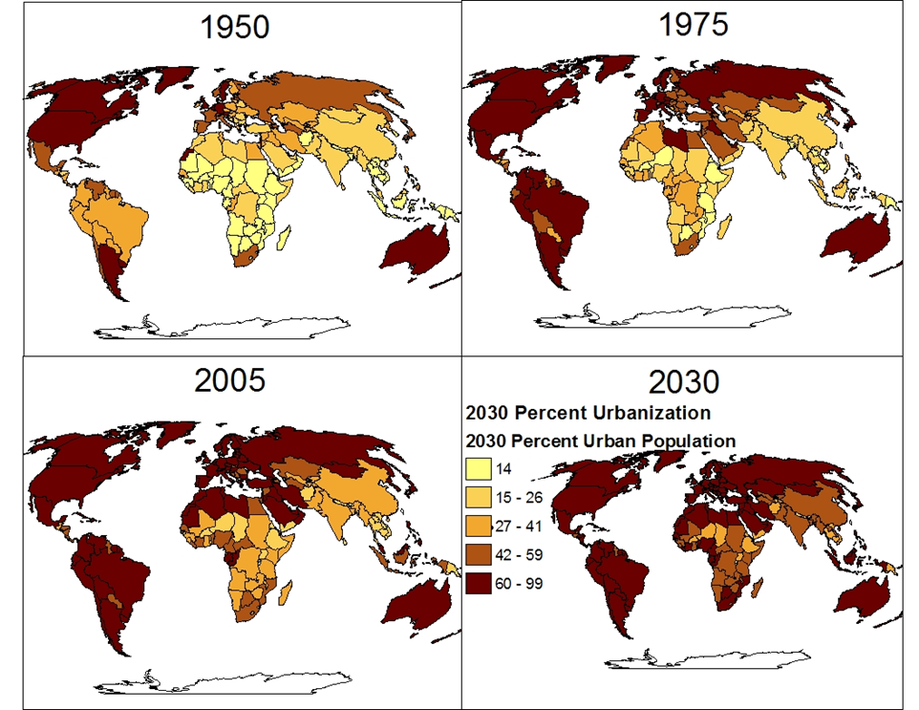
urbanization
Urbanization is increasing in currently developed and developing countries. Today, about 50% of the global population live in urban areas. This is because people are drawn to cities in search of employment.
With the rapid growth of population, cities are in need for improved infrastructure and construction of buildings. If the idea of building sustainably is not incorporated into these cities, then the economy, environment, and society will turn for its worst.

Slide 4
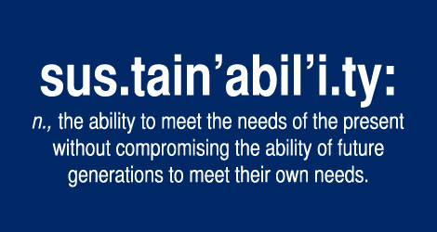

Slide 5
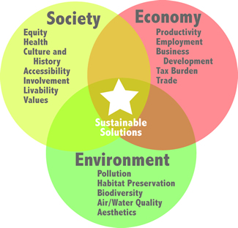

SUSTAINABILTY
TRIPLE BOTTOM LINE : Environmental preservation, economical performance, & social equity.
Chicago’s main goal is to focus on green landscaping, land use, and transportation.
I want Chicago to be the greenest city in the world, and I am committed to fostering opportunities for Chicagoans to make sustainability a part of their lives and their experience in the city." -- Mayor Rahm Emanuel

Slide 6
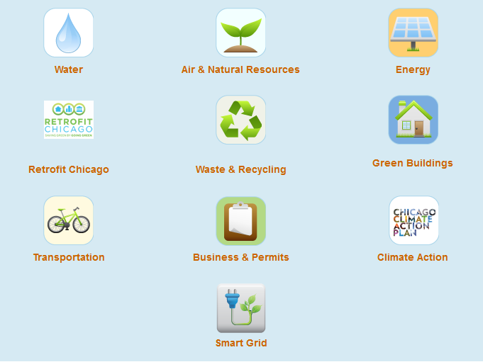
2015 Sustainable Chicago Action Agenda

Slide 7
2015 Sustainable Chicago Action Agenda
Organized into seven categories critical to the sustainability of the city. It sets 24 specific goals and identifies key actions to take to reach those goals by 2015. It is a clear commitment of what government needs to and will do. It is also a roadmap for how citizens of Chicago can get involved.
The seven sustainability categories are related and reinforce each other – success in one can lead to or increase success in another.
1. Economic Development and Job Creation
2. Energy Efficiency and Clean Energy
3. Transportation Options
4. Water and Wastewater
5. Parks, Open Space, and Healthy Food
6. Waste and Recycling
7. Climate Change

Slide 8
2015 Sustainable Chicago Action Agenda
The Chicago Climate Action Plan (CCAP), six years ago, made publicly aware of the issue of climate change. The plan proactively responded to the challenges of climate change with local actions that had global resonance. Through CCAP, Chicago committed to reducing greenhouse gas emissions by 80% by 2050 and preparing the city for the impacts of climate change.
Chicago ranks #1 in buildings certified under the LEED (Leadership in Energy and Environmental Design) rating systems, has 26 miles of public lakefront and is home to a growing group of clean energy businesses. Chicago was recently named the most sustainable large community in America by Siemens and the U.S. Chamber of Commerce.

Slide 9

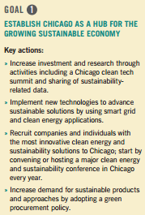
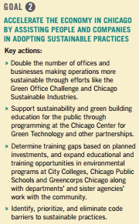
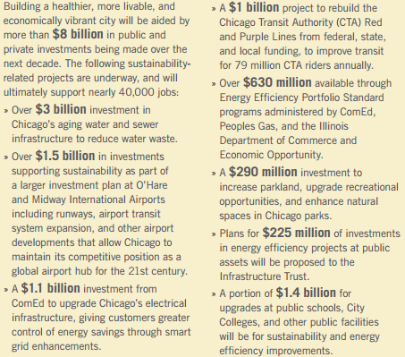
BREAKDOWN OF INVESTMENTS $$$$$$$

Slide 10
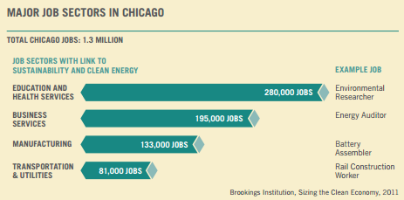
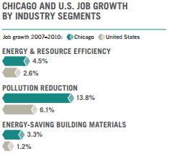
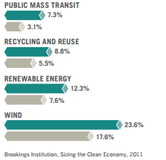

Slide 11
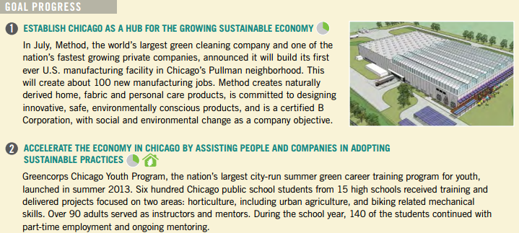
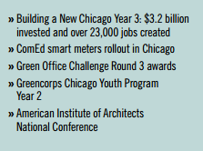
Progress Report: 2013 & 2014

Slide 12

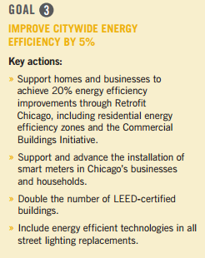
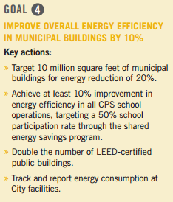
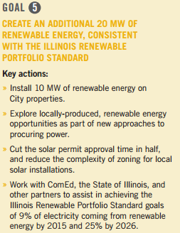

Slide 13
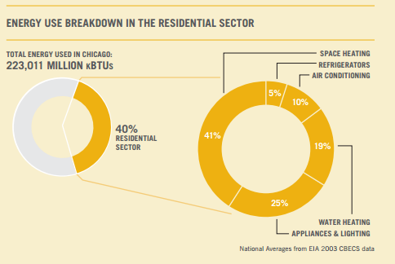
Energy efficiency holds the potential to address the long-term energy needs of a growing city while promotioning economic development and job creation. In Chicago, approximately $3 billion is spent on energy each year, and energy used by buildings creates 71% of the city’s carbon emissions.

Slide 14
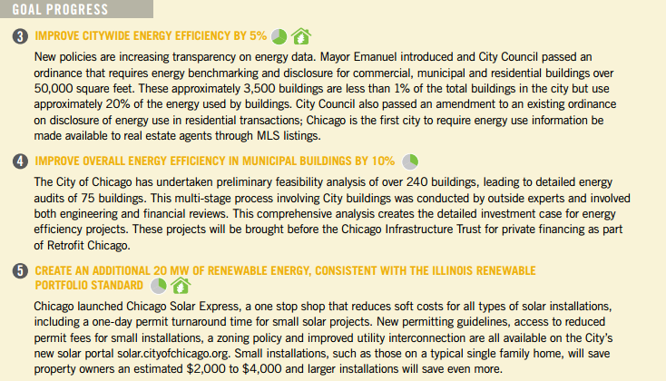
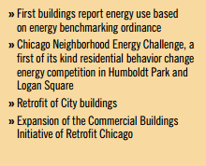
Progress Report: 2013 & 2014

Slide 15

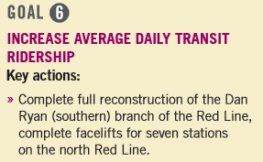
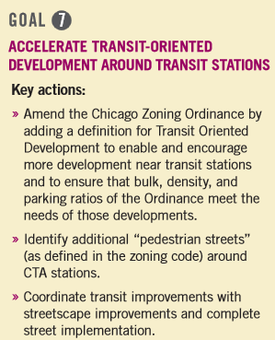
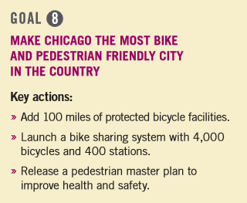
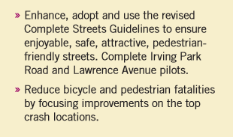

Slide 16
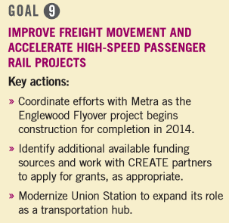
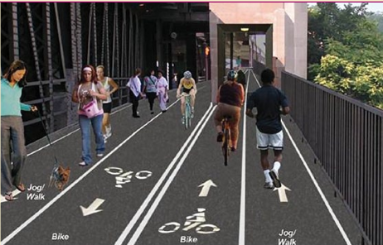
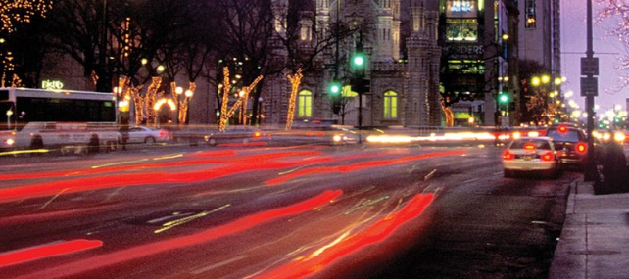

Slide 17
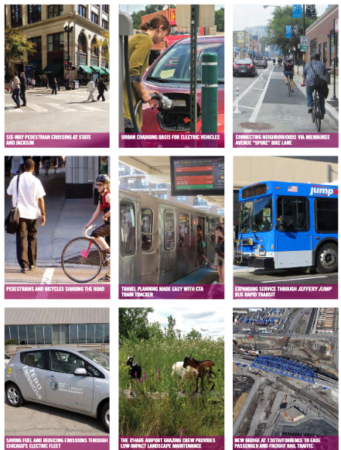
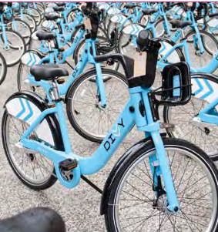

Slide 18
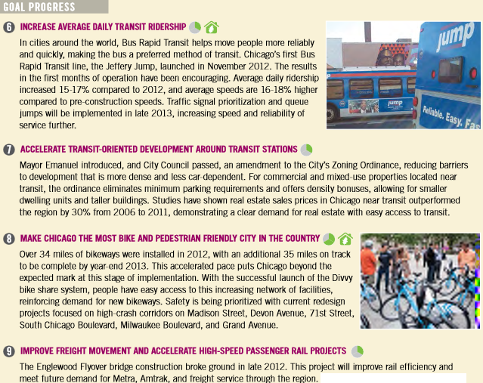
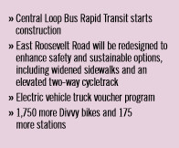
Progress Report: 2013 & 2014

Slide 19
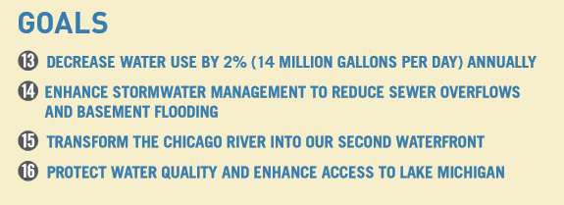
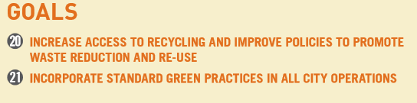
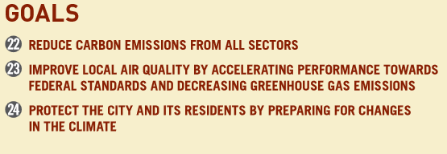
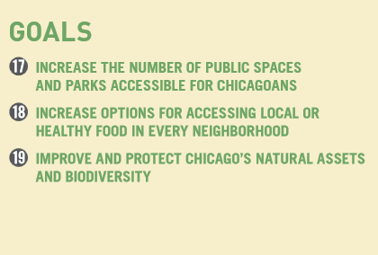
CATEGORIES 4 – 7 GOALS

Slide 20
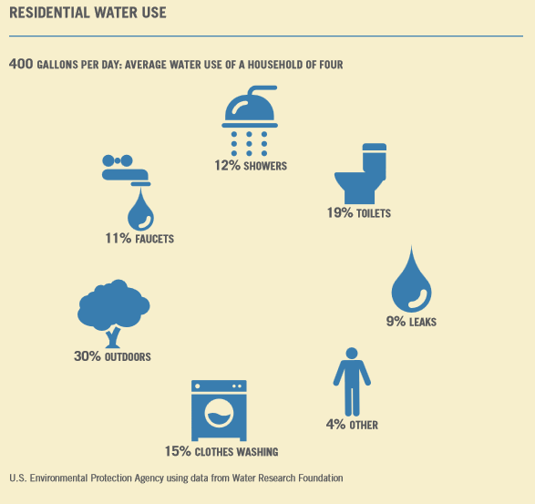
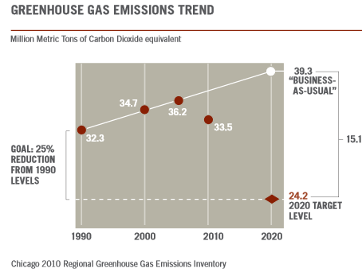
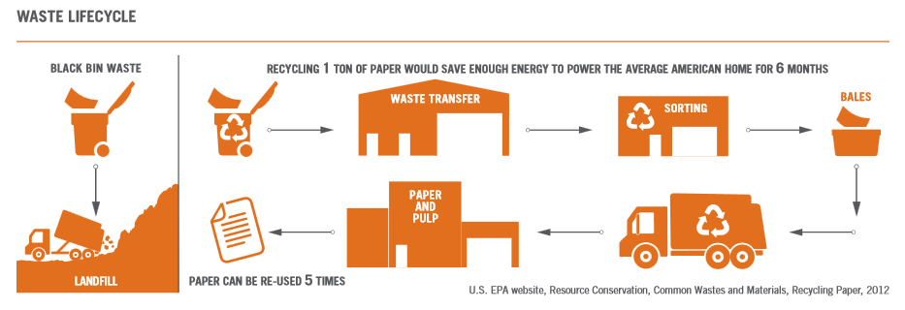

Slide 21
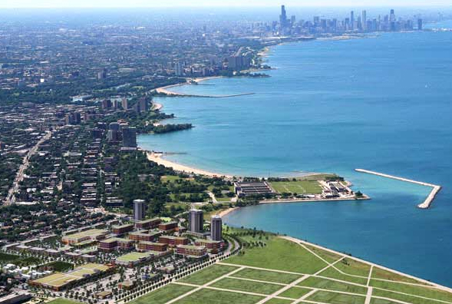
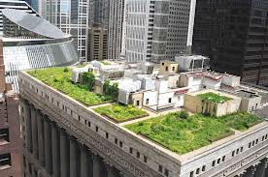
BIBLIOGRAPHY
http://www.cityofchicago.org/city/en/progs/env/sustainable_chicago2015.html
http://www.cityofchicago.org/content/dam/city/progs/env/SCYear1Report.pdf
http://www.cityofchicago.org/content/dam/city/progs/env/SustainableChicago6MonthProgress.pdf
http://www.cityofchicago.org/content/dam/city/progs/env/SustainableChicago2015.pdfhttp://www.cityofchicago.org/content/dam/city/progs/env/SustainableChicago2015.pdf
http://www.sustainable-chicago.com/
http://www.chicagoclimateaction.org/
http://www.epa.gov/sustainability/

Slide 22

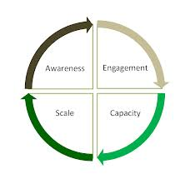

THANK YOU

