Slide 1
ECO FOOTPRINT
WATER
ADVOCATES
ORGANIZATIONS
“Buildings fundamentally impact people’s lives and the health of the planet. In the United States, buildings use one-third of our total energy, two-thirds of our electricity, one-eighth of our water, and transform land that provides valuable ecological resources.”
-LEED-NC V 2.2 Introduction

Slide 2
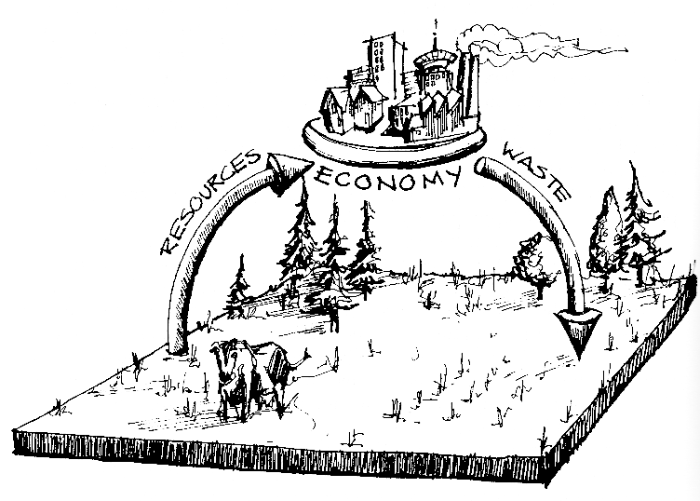
ECOLOGICAL FOOTPRINT
ECO FOOTPRINT
WATER
ADVOCATES
ORGANIZATIONS
The Ecological Footprint is a measure of the “load” imposed by a given population on nature. It represents the land area necessary to sustain current levels of resource consumption and waste discharged by that population.
Wackernagel & Rees, p. 5

Slide 3
REVIEW ECOLOGICAL FOOTPRINT
ECO FOOTPRINT
WATER
ADVOCATES
ORGANIZATIONS
www.footprintnetwork.org/gfn_sub.php?content=calculator
What does population growth mean?
What does the spreading of wealth mean?
Distribution of resources?
What is Biocapacity?
http://www.gapminder.org/videos/what-stops-population-growth/
Try it yourself: Design and Data!
http://www.gapminder.org/

Slide 4
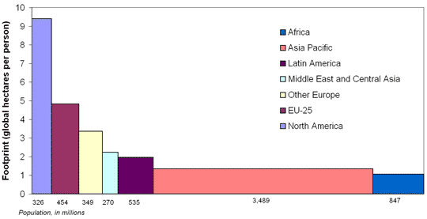
ECOLOGICAL FOOTPRINT
ECO FOOTPRINT
WATER
ADVOCATES
ORGANIZATIONS
National Footprints:
Wealthy, industrialized nations have a higher ecological footprint.
As more nations industrialize and the standard of living increases, there is increased pressure on the earth’s resources

Slide 5
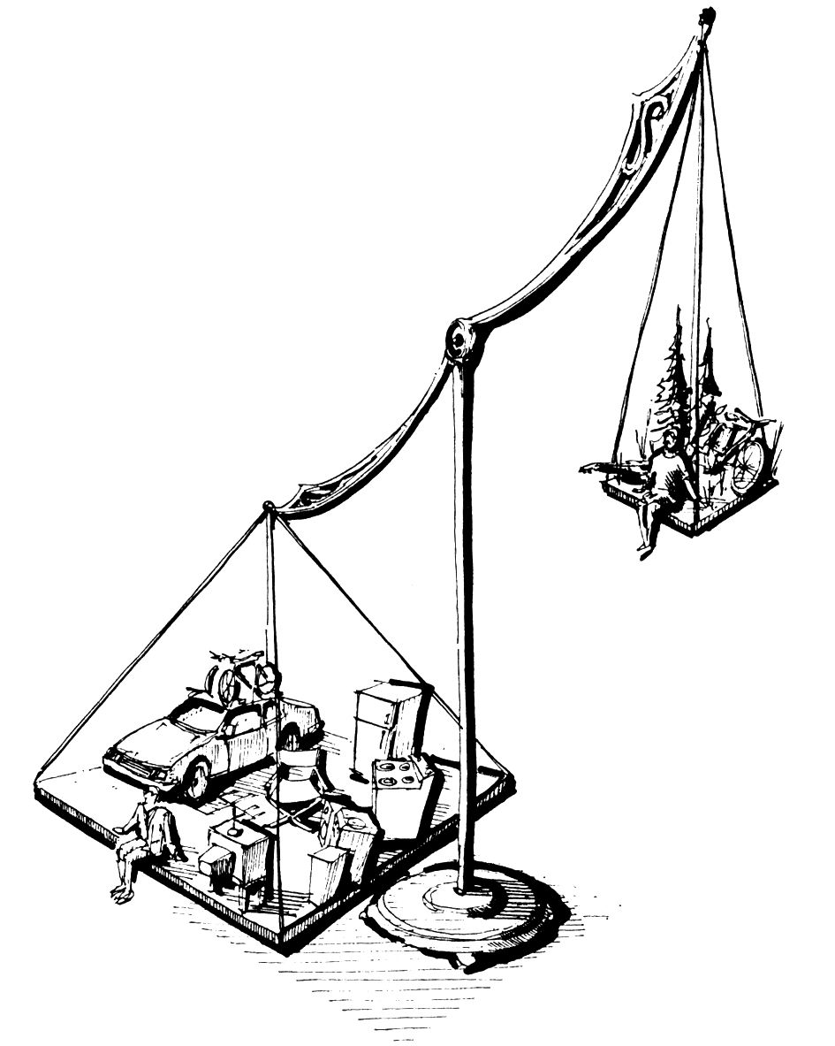
ECOLOGICAL FOOTPRINT
ECO FOOTPRINT
WATER
ADVOCATES
ORGANIZATIONS
Individual Footprints:
Personal affluence is often associated with an increase in material possessions, and access to rare materials and luxuries
An urban lifestyle results in a lower individual footprint
What can we do as individuals
to reduce our impact
on the earth?

Slide 6
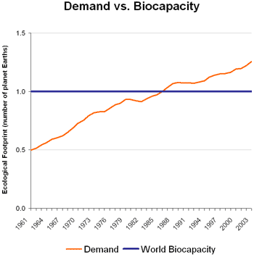
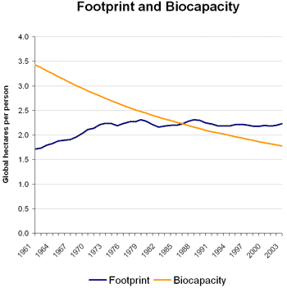
ECOLOGICAL FOOTPRINT
ECO FOOTPRINT
WATER
ADVOCATES
ORGANIZATIONS
Effect of Industrialization on Ecological Footprint:
Prolonged excavation of non-renewable resources reduces the earth’s overall capacity to support life, while at the same time human’s are increasing demand.

Slide 7
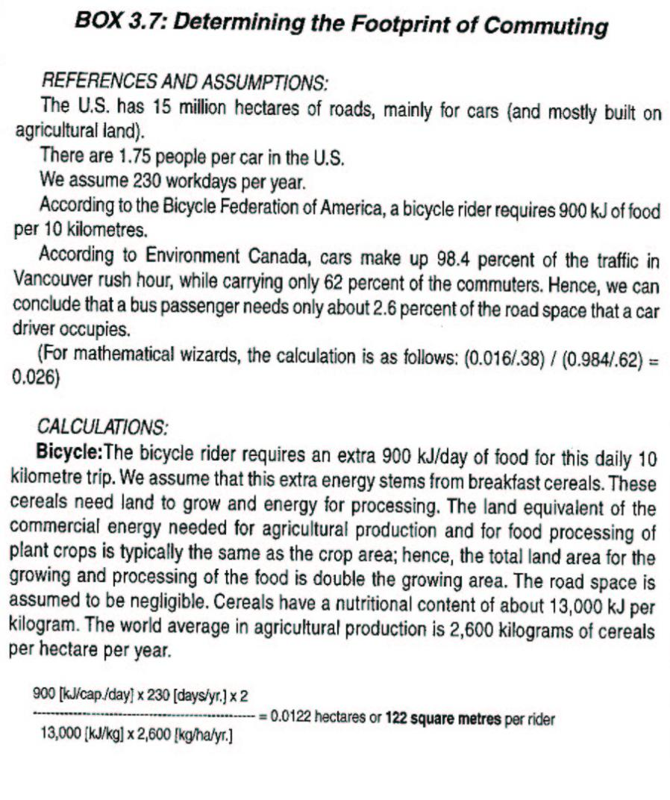
ECO FOOTPRINT
WATER
ADVOCATES
ORGANIZATIONS

Slide 8
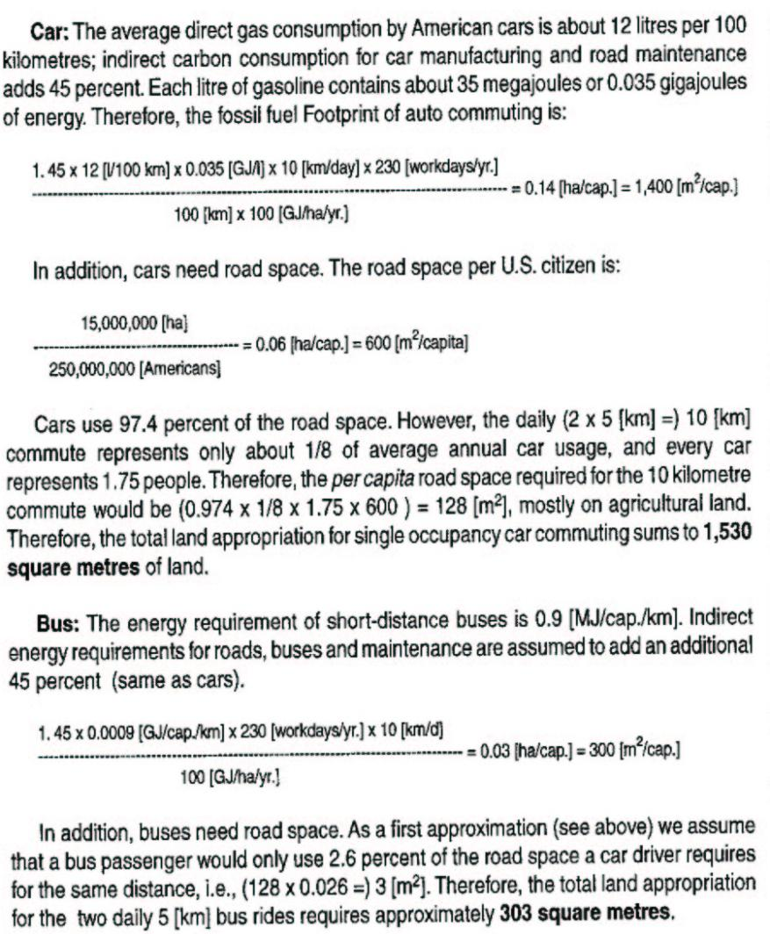
ECO FOOTPRINT
WATER
ADVOCATES
ORGANIZATIONS

Slide 9
ADVOCATES & GREEN ORGANIZATIONS

Slide 10
OUTLINE
ECO FOOTPRINT
WATER
ADVOCATES
ORGANIZATIONS
Review: vocabulary & ecological footprint homework
The Voices Behind Sustainability in Architecture
Rachel Carson
Jane Jacobs
Ian McHarg
Buckminster Fuller
William McDonough & Michael Braungart
New Urbanists, Andres Duany, Elizabeth Plater-Zyberk
The USGBC
Green Vocabulary
Homework

Slide 11
http://www.heartland.org/events/NewYork09/news.html
What is the debate over Sustainability?
“Its snowing like crazy here, so there certainly can’t be global warming!!!”
Free market vs. Governmental Influence.
What is the role of the Government?
What is the role of the consumer?
What is the role of the Business?
Who benefits?
The Heartland Institute:
Reducing greenhouse gas emissions even modestly is estimated to cost the average household in the U.S. approximately $3,372 per year and would destroy 2.4 million jobs. Electricity prices would double, and manufacturers would move their factories to places such as China and India that have cheaper energy and fewer environmental regulations.
If global warming is indeed a crisis, billions of dollars taken from taxpayers will flow into the coffers of radical environmental groups, giving them the resources and stature to implement other parts of their anti-technology, anti-business agenda. None of that money will go to actually reduce greenhouse gas emissions. This explains the paradox that even though the scientific community is deeply divided over the causes and consequences of global warming, every single environmental advocacy group in the U.S. (and probably the world) believes it is a crisis.

Slide 12
ADVOCATES: THE VOICES BEHIND SUSTAINABILITY IN ARCHITECTURE
ECO FOOTPRINT
WATER
ADVOCATES
ORGANIZATIONS

Slide 13
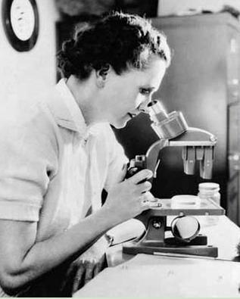
RACHEL CARSON (1907-1964)
ECO FOOTPRINT
WATER
ADVOCATES
ORGANIZATIONS
Biologist, Writer, Ecologist
Named one of the top 100 most influential people of the 20th Century by Time magazine in 1999¹
Mother of the environmental movement
Authored Silent Spring in 1962
Challenged the misuse of chemical pesticides1
Empowered individuals by providing otherwise “secret” government information
Spreading pesticide:
http://youtube.com/watch?v=z7Lr1pCEcNU&feature=related
Effects of Pesticide:
http://www.youtube.com/watch?v=LQ64sV0nSVU&feature=related
Image Credit: www.rachelcarson.org

Slide 14
RACHEL CARSON (1907-1964)
ECO FOOTPRINT
WATER
ADVOCATES
ORGANIZATIONS
On April 3, 1963, the Columbia Broadcasting System's television series "C.B.S. Reports" presented the program "The Silent Spring of Rachel Carson." In it, Miss Carson said:
"We still talk in terms of conquest. We still haven't become mature enough to think of ourselves as only a tiny part of a vast and incredible universe. Man's attitude toward nature is today critically important simply because we have now acquired a fateful power to alter and destroy nature.
"Now, I truly believe, that we in this generation, must come to terms with nature, and I think we're challenged as mankind has never been challenged before to prove our maturity and our mastery, not of nature, but of ourselves." ²

Slide 15
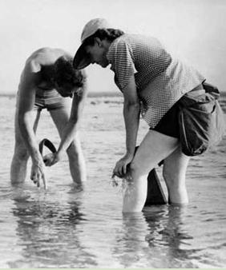
WASHINGTON POST, 1953
ECO FOOTPRINT
WATER
ADVOCATES
ORGANIZATIONS
“….It is one of the ironies of our time that while concentrating on the defense of our country against enemies from without, we should be so heedless of those who would destroy it from within.”
-Rachel Carson in response to election of President Eisenhower (R) and McCarthyism
Image Credit: www.rachelcarson.org

Slide 16
RACHEL CARSON (1907-1964)
ECO FOOTPRINT
WATER
ADVOCATES
ORGANIZATIONS
Carson’s writings are responsible for the:
Environmental Protection Agency¹
Inspiration of nearly every piece of environmental legislation¹

Slide 17
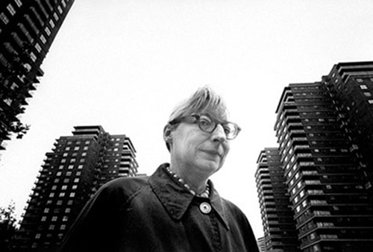
JANE JACOBS (1916-2006)
ECO FOOTPRINT
WATER
ADVOCATES
ORGANIZATIONS
Writer, Activist, Philanthropist, Urban Dweller
Authored The Death and Life of Great American Cities, 1961
“She was this wacky housewife. Then she wrote this tome that changed the world.” – Mary Rowe ¹
Image Credit: www.curbed.com/archives/2006_04_janejacobs.jpg

Slide 18
JANE JACOBS (1916-2006)
ECO FOOTPRINT
WATER
ADVOCATES
ORGANIZATIONS
Proponent of vernacular architecture and self-organized cities – BOTTOM-UP DESIGN
Opposed to master planning and overnight development of “communities” – TOP-DOWN DESIGN
Thought of the city as an ecological system, not as a mathematical problem
“Human beings are, of course, a part of nature, as much so as grizzly bears or bees or whales or sorghum cane. The cities of human beings are as natural, being a product of one form of nature, as are the colonies of prairie dogs or the beds of oysters.” – Jane Jacobs

Slide 19
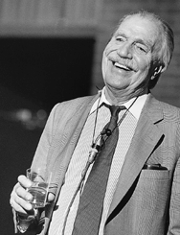
IAN McHARG (1920-2001)
ECO FOOTPRINT
WATER
ADVOCATES
ORGANIZATIONS
Landscape Architect, Writer
Founded Department of Landscape Architecture at University of Pennsylvania
Authored Design with Nature in 1969 ⁴
Pioneered the idea of ecological planning
“His aim was to discipline human purposes and growth through a thorough understanding of natural processes. It’s a lesson we still struggle to learn.” – David Orr ⁵
Image Credit: en.wikipedia.org/wiki/Image:IanMcHarg.gif

Slide 20
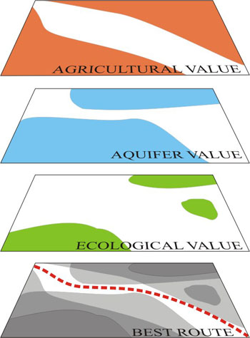
IAN McHARG (1920-2001)
ECO FOOTPRINT
WATER
ADVOCATES
ORGANIZATIONS
“My role in every case is to find, of all environments the most fit, and to adapt the environment and themselves to accomplish creative fitting.” –Ian McHarg ⁵
Created the basis for Geographic Information Systems (GIS) ⁵
Developed the idea of “Environmental Impact Statements” ⁵
Image Credit: http://www.gardenvisit.com/history_theory/

Slide 21
THE NEW URBANISTS
ECO FOOTPRINT
WATER
ADVOCATES
ORGANIZATIONS
Image Credit http://www.urbaneng.com/projectimages/cin shore aerial perspective05-01-0611x171.jpg

Slide 22
THE NEW URBANISTS
ECO FOOTPRINT
WATER
ADVOCATES
ORGANIZATIONS
Giving people many choices for living an urban lifestyle in sustainable, convenient and enjoyable places, while providing the solutions to peak oil, global warming, and climate change ^{(www.newurbanism.org)}
Image Credit http://www.urbaneng.com/projectimages/cin shore aerial perspective05-01-0611x171.jpg

Slide 23
THE NEW URBANISTS
ECO FOOTPRINT
WATER
ADVOCATES
ORGANIZATIONS
Founded by Andres Duany & Elizabeth Plater-Zyberk in the early 1980’s
Established urban planning principals to overcome sterile, car centered, socially inadequate suburban developments:
Walkable Communities
Diversity of housing types (mixed-use, single family, multi-family)
Close proximity of schools, shopping, and other commercial uses
Often use traditional architectural style for buildings
Promote public transportation
Promote increase in density over traditional suburban plan
Provide universal access public space
http://www.youtube.com/watch?v=LRrl7LwNUtw

Slide 24
WILLIAM McDONOUGH & MICHAEL BRAUNGART
ECO FOOTPRINT
WATER
ADVOCATES
ORGANIZATIONS
William McDonough
Architect, designer, writer
Michael Braungart
Chemist, material scientist
Authored Cradle to Cradle in 2002
cradle-to-cradle cycles are those whose materials are perpetually circulated in closed loops which maximizes material value without damaging ecosystems⁸
“eco-effective” not “eco-efficient” design
Debunks the idea that just doing better is good enough
Promotes systems thinking to improve productivity, profitability, and long term health

Slide 25
CRADLE TO CRADLE PRODUCTS
ECO FOOTPRINT
WATER
ADVOCATES
ORGANIZATIONS
Cradle to Cradle Greeting cards
Made from a C2C Certified plastic material
Come with a return postage envelope to send the card back after user is finished with it
The material is then “up-cycled” into Shaw carpet tiles⁹
Image Credit www.mcdonough.com/full.htm

Slide 26
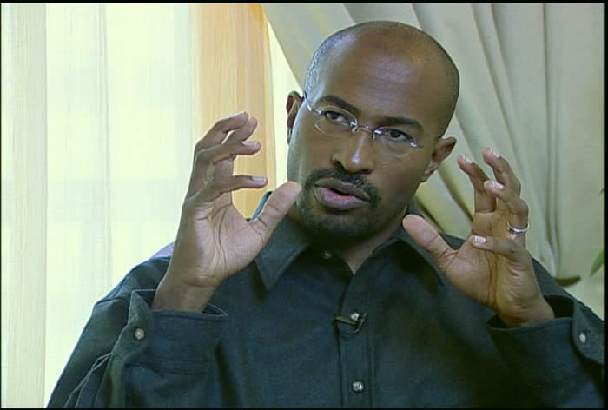
Current Voices
ECO FOOTPRINT
WATER
ADVOCATES
ORGANIZATIONS
Van Jones
(1968-
Green Jobs + Environment
Civil Rights Attorney
Special Advisor to President Obama on Green Jobs (resigned)
“The time has come to move beyond eco-elitism to eco-populism.”
“We need to send hundreds of millions of dollars down to our public high schools, vocational colleges, and community colleges to begin training people in the green-collar work of the future -- things like solar-panel installation, retrofitting buildings that are leaking energy, wastewater reclamation, organic food, materials reuse and recycling.”
http://www.youtube.com/watch?v=2SmF3B3734E
http://www.youtube.com/watch?v=22FquY2ujMw&feature=related

Slide 27
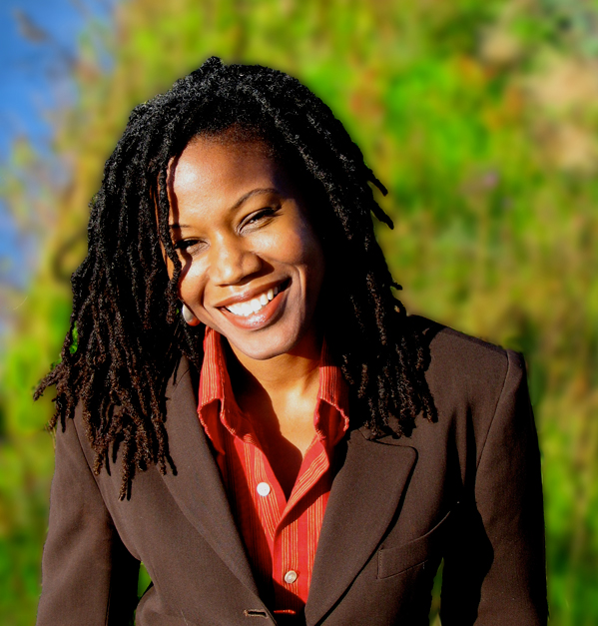
Current Voices
ECO FOOTPRINT
WATER
ADVOCATES
ORGANIZATIONS
Marjora Carter
(1967-
Environmental Justice
Created “Sustainable South Bronx”
Awarded MacArthur Genius Grant
Transformed Illegal Garbage Dump into Community Park : Hunts Point Riverside Park
“Environmental justice for all is civil rights in the 21st century..”
“People are aching for leaders who inspire them to believe that there is a better way:
We need to create strong markets for healthy consumers and healthy producers so that it is possible to be both
http://www.ted.com/talks/majora_carter_s_tale_of_urban_renewal.html

Slide 28
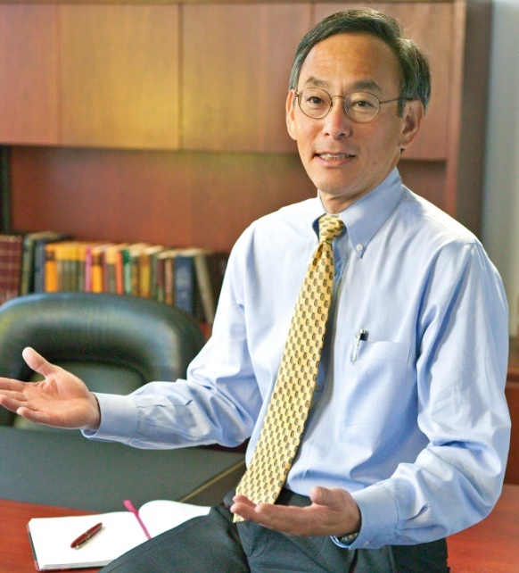
Current Voices
ECO FOOTPRINT
WATER
ADVOCATES
ORGANIZATIONS
Steven Chu
(1948-
United States Secretary of Energy
Director of Lawrence Berkeley National Laboratory
Awarded Nobel Prize in Physics in 1997
Scientist and Professor of Physics and Molecular Biology
Vocal advocate for more research in alternative energy and nuclear energy
Conceived of a “glucose economy” where glucose from tropical plants is shipped like oil is today!
http://www.thedailyshow.com/watch/tue-july-21-2009/steven-chu

Slide 29
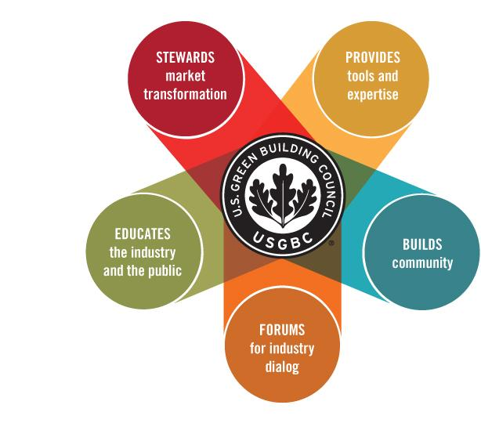
THE USGBC
ECO FOOTPRINT
WATER
ADVOCATES
ORGANIZATIONS
The US Green Building Council
A non-profit organization that works with professionals, cities, states, the federal government and politicians to expand sustainable building practices.

Slide 30
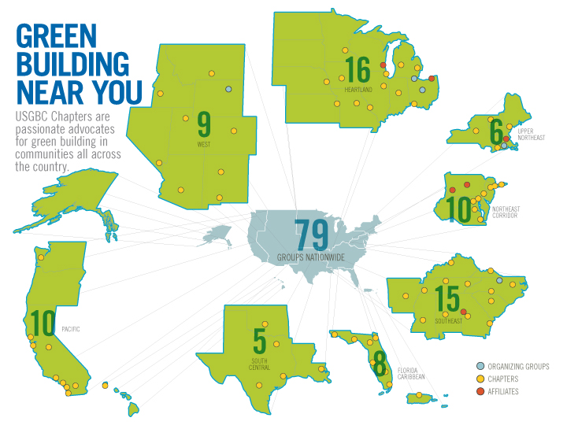
THE USGBC
ECO FOOTPRINT
WATER
ADVOCATES
ORGANIZATIONS
The US Green Building Council
A national organization with local chapters

Slide 31
THE USGBC
ECO FOOTPRINT
WATER
ADVOCATES
ORGANIZATIONS
The US Green Building Council
Guiding Principles:
SUSTAINABILITY – respect the limits of natural systems and non-renewable resources by seeking solutions that produce an abundance of natural and social capital.
EQUITY – respect all communities and cultures and aspries to an equal socio-economic opportunity for all.
INCLUSIVENESS – practice and promote openness, broad participation and full consideration of consequence in all aspects of decision making processes.
PROGRESS – strive for immediate and measurable indicators of environmental, social and economic prosperity.
CONNECTEDNESS – recognize the critical linkage between humanity and nature as well as the importance of place-based decision-making to effect stewardship.

Slide 32
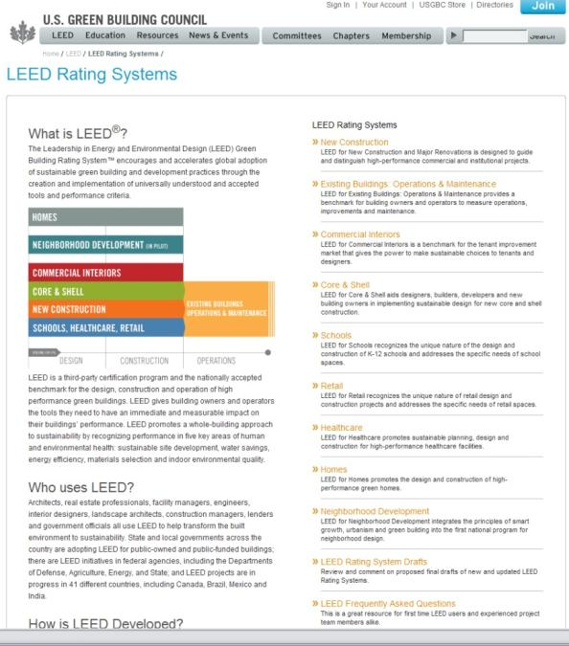
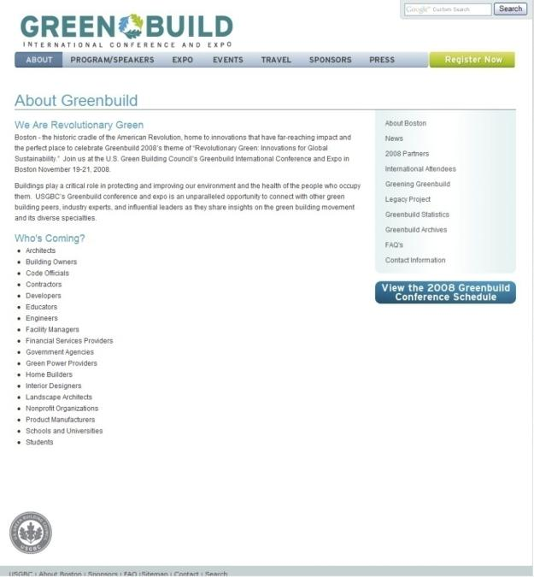
THE USGBC
REVIEW
DISCUSS
VOICES OF SUSTAINABILITY
VOCABULARY
HOMEWORK
The US Green Building Council
Created the LEED rating system
Hosts Greenbuild,
an annual conference and expo on green building.

Slide 33
THE USGBC
ECO FOOTPRINT
WATER
ADVOCATES
ORGANIZATIONS
The LEED rating system
The LEED (Leadership in Energy and Environmental Design) rating system was formalized 1998.
LEED rating is a points based system that gives certification level from lowest to highest of CERTIFIED, SILVER, GOLD, PLATINUM.
Notes:
Case study: Aldo Leopold Foundation, Legacy Center
Home Depot Foundation – awards for sustainable affordable housing

Slide 34
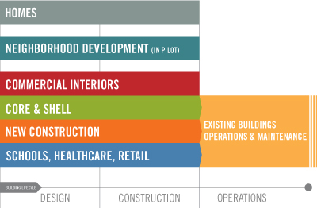
THE USGBC
ECO FOOTPRINT
WATER
ADVOCATES
ORGANIZATIONS
The LEED rating system
Until 2006 was only applicable to new construction, now covers 6 areas of the construction and development process.
LEED has grown from 6 volunteers, to 200 volunteers on 20 committees and 150 professional staff.
Notes:
Case study: Aldo Leopold Foundation, Legacy Center
Home Depot Foundation – awards for sustainable affordable housing

Slide 35
OTHER GREEN ORGANIZATIONS
ECO FOOTPRINT
WATER
ADVOCATES
ORGANIZATIONS
World Green Building Council
Founded in 1999 with meeting of 8 countries (US, Australia, Spain, UK, Japan, UAE, Russia, Canada)
WorldGBC formalized in 2002 as a coalition of GBC’s from around the world
World Health Organization
Authority for health within the United Nations system
Green Building Certification Institute
GBCI is a USGBC organization created specifically to oversee Professional Accreditation.
January 2009 full launch
Cradle to Cradle
Certification provides a company with a means to tangibly measure achievement in environmentally-intelligent design

Slide 36
BIBLIOGRAPHY
ECO FOOTPRINT
WATER
ADVOCATES
ORGANIZATIONS
Gould, Kira & Lance Hosey, Women in Green: Voices of Sustainable Design, ECOtone Publishing Company, 2007
Lear, Lina, www.rachelcarson.org, 2008
http://www.who.int/dg/brundtland/bruntland/en/index.html, 2008
http://en.wikipedia.org/wiki/Ian_McHarg, 2008
Margulis, Lynn, James Corner, and Brian Hawthorne, Ed. Ian McHarg: Conversations with Students, Princeton Architectural Press, 2007
http://en.wikipedia.org/wiki/Buckminster_Fuller
http://www.awakenedwoman.com/toms_trim_tab.htm
http://mbdc.com/c2c_home.htm
http://www.mcdonough.com/full.htm

Slide 37
