Slide 1
OVERVIEW AND INTRODUCTION TO SUSTAINABILITY AND PRACTICE

Slide 2
OUTLINE
INTRODUCTIONS
PROCEDURE, GOALS, & REQ’S
SUSTAINABILITY
HISTORY
ORGANIZATIONS
VOCABULARY
FOOTPRINTS
Introductions
Review class procedure, goals, and requirements
What is SUSTAINABILITY?
History of current problems in NYC vs. global
The USGBC and green organizations
Green vocabulary
Ecological & carbon footprints

Slide 3
INTRODUCTIONS
INTRODUCTIONS
PROCEDURE, GOALS, & REQ’S
SUSTAINABILITY
HISTORY
ORGANIZATIONS
VOCABULARY
FOOTPRINTS
Illya Azaroff AIA
+LAB Architects
Associate Professor, New York City College of Technology
DfRR
Please tell us about yourself…

Slide 4
CLASS PROCEDURE, GOALS & REQUIREMENTS
INTRODUCTIONS
PROCEDURE, GOALS, & REQ’S
SUSTAINABILITY
HISTORY
ORGANIZATIONS
VOCABULARY
FOOTPRINTS
Course Description: Sustainability describes an approach to the design, construction and stewardship of products and environments that align human need and ecological resourcefulness. This course focuses on built work of the last 200 years, which grew from a new consciousness of ecological limits, living system dynamics and understanding of human well-being. The practice of sustainability has understandably developed numerous and sometimes competing logics. We will explore how sustainable criteria are influenced by outlook (and self-interest) and how the prioritization of health, social agendas, economics, aesthetics, environmental protection or resource efficiency have shaped selected buildings, landscapes and city plans.
Notes:
The annual U.S. market in green building products and services was more than $7 billion in 2005, $12 billion in 2007 and projected to increase to $60 billion by 2010. (www.usgbc.org/DisplayPage.aspx?CMSPageID-124)

Slide 5
CLASS PROCEDURE, GOALS & REQUIREMENTS
INTRODUCTIONS
PROCEDURE, GOALS, & REQ’S
SUSTAINABILITY
HISTORY
ORGANIZATIONS
VOCABULARY
FOOTPRINTS
Learning Objectives: upon successful completion the student should be able to:
Describe the evolution of sustainability over the last 200 years and develop familiarity with the key landmark projects that define this evolution.
Trace how sustainability criteria have changed and identify the influences behind these changes.
Demonstrate how changes to these sustainability criteria have impacted sustainability practices and the marketplace.
Develop an understanding of how ethical positions place different values on the environment, human and nonhuman life and how this informs the logics of sustainability.

Slide 6
CLASS PROCEDURE, GOALS & REQUIREMENTS
INTRODUCTIONS
PROCEDURE, GOALS, & REQ’S
SUSTAINABILITY
HISTORY
ORGANIZATIONS
VOCABULARY
FOOTPRINTS
Attendance
No more than 2 absences are permitted
2 tardies (more than 10 minutes late) equal 1 absence
What’s the penalty? Potential failure of the class
Grading
Class Participation 20%,
Class Presentations 20%,
Written Assignments 30%,
Final Research Paper 30%
Copied, borrowed, or shared work will be considered cheating, and will result in an F for the project, and possibly for the course.

Slide 7
CLASS PROCEDURE, GOALS & REQUIREMENTS
INTRODUCTIONS
PROCEDURE, GOALS, & REQ’S
SUSTAINABILITY
HISTORY
ORGANIZATIONS
VOCABULARY
FOOTPRINTS
Assignments
Assignments must be turned in the day they are due, even if the student is absent.
Exchange email addresses and phone numbers with two students in the class. It is the student’s responsibility to find out what was missed in class when absent.
Late assignments will be penalized by 1/3 grade for each class period that it is late. (A+, A, A-, B+, B, B-)
Quizzes
Will begin promptly at the beginning of class and will last for 20 minutes.
A student arriving 10 minutes late will only have 10 minutes to complete their quiz.
A student arriving 20 minutes or more late, will miss the quiz, and receive a score of 0.

Slide 8
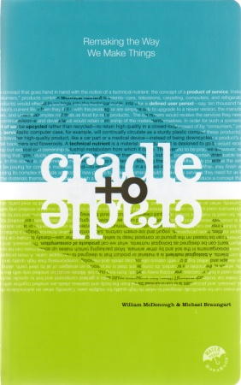
CLASS PROCEDURE, GOALS & REQUIREMENTS
INTRODUCTIONS
PROCEDURE, GOALS, & REQ’S
SUSTAINABILITY
HISTORY
ORGANIZATIONS
VOCABULARY
FOOTPRINTS
Required readings
Cradle to Cradle: Remaking the Way We Make Things
William McDonough and Michael Braungart

Slide 9
CLASS PROCEDURE, GOALS & REQUIREMENTS
INTRODUCTIONS
PROCEDURE, GOALS, & REQ’S
SUSTAINABILITY
HISTORY
ORGANIZATIONS
VOCABULARY
FOOTPRINTS
Bibliography
Campbell, Lindsay and Anne Wiesen editors, Creating Health and Well-being through Urban Landscapes, USDA Forest Service 2009
Capra, Fritjof, The Web of Life. Anchor Books, 1996
Di Chiro, Giovanna. "Nature as Community: The Convergence of Environment and Social Justice", in ed., William Cronon, Uncommon Ground: Rethinking the Human Place in Nature. New York: W. W. Norton and Company, 1996.
Fein, Albert. Frederick Law Olmstead and the American Environmental Tradition. New York: George Braziller, 1972.
Fishman, Robert. Urban Utopias in the Twentieth Century: Ebeneezer Howard, Frank Lloyd Wright and Le Corbusier. Cambridge: MIT Press, 1982.
Fox, Tom, Ian Koeppel and Susan Kellam. Struggle for Space, The greening of N.Y.C. 1970-1984. New York; Neighborhood Open Space Coalition, 1985.
Guy, Simon. “Reinterpreting Sustainable Architecture: The Place of Technology”, Journal of Architectural Education. February 2001.
Hester, Randolph. Design for Ecological Democracy. Cambridge: MIT Press, 2006
Howard, Ebeneezer. Garden Cities of To-morrow. ed. F.J. Osborn. London: Faber and Faber, 1945.
Jacobs, Jane. The Death and Life of Great American Cities. New York: Random House, 1961.
Leopold, Aldo. A Sand County Almanac. New York: Oxford University Press, 1949.

Slide 10
CLASS PROCEDURE, GOALS & REQUIREMENTS
INTRODUCTIONS
PROCEDURE, GOALS, & REQ’S
SUSTAINABILITY
HISTORY
ORGANIZATIONS
VOCABULARY
FOOTPRINTS
McCleary, Peter. "Some Characteristics of a New Concept of Technology." Journal of Architectural Education. 42, No. 1 (Fall 1988).
McDonough, William and Michael Braungart, Cradle to Cradle: Remaking the Way We Make Things. North Point Press; April 22, 2002
McHarg, Ian. Design With Nature. New York: Doubleday, 1969.
Nash, Roderick. The Rights of Nature: A History of Environmental Ethics. University of Wisconsin Press, 1989.
Rehmann, Elsa. "An Ecological Approach." Landscape Architecture. 23, No. 4 (July 1933) pp. 239-245.
Shiva, Vandana. "The Enclosure of the Commons" in Third World Resurgence, Penang, Malaysia: vol. 84 - August 1997.
Spirn, Anne. The Granite Garden, Urban Nature and Human Design. Basic Books, 1984
Steele, James, Ecological Architecture, A Critical History, London, England: Thames and Hudson, 2005
Waugh, Frank A. "Ecology of the Roadside." Landscape Architecture. 21, No. 2 (January 1931) pp. 80-92.
Wines, James. Green Architecture. Koln: Taschen, 2000.
White, Lynn Jr. "The Historical Roots of Our Ecologic Crisis." Science, 155, no. 3767 (10 March 1967), p. 1203-1207.
World Commission on Environment and Development. Our Common Future. Oxford: Oxford University Press, 1987.
Worster, Donald. Nature's Economy: The History of Ecological Ideas. New York: Cambridge University Press, 1977.
Wright, Frank Lloyd. The Disappearing City. 1932; facsim with Wright's corrections. New York: Horizon Press, 1969.
Doepel, Duzan. Creating Comfortable Climactic Cities. 2012. Rotterdam University Press, Rotterdam the Netherlands.

Slide 11
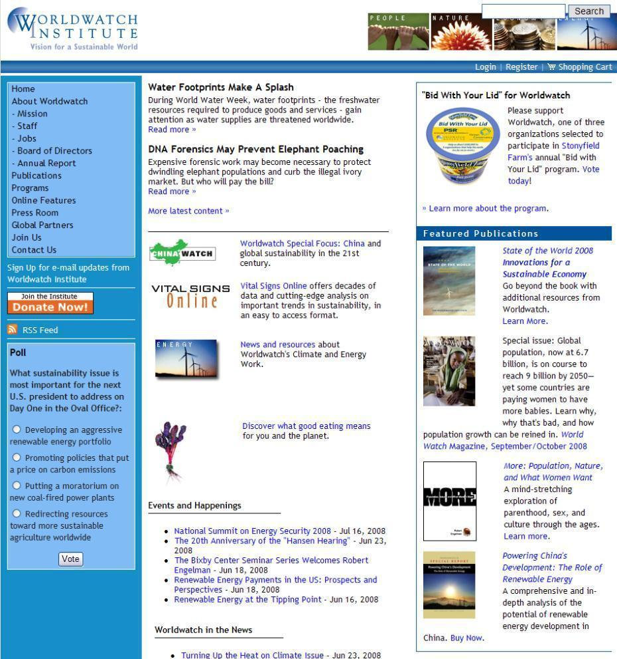
CLASS PROCEDURE, GOALS & REQUIREMENTS
INTRODUCTIONS
PROCEDURE, GOALS, & REQ’S
SUSTAINABILITY
HISTORY
ORGANIZATIONS
VOCABULARY
FOOTPRINTS
Web Readings
www.worldwatch.org

Slide 12
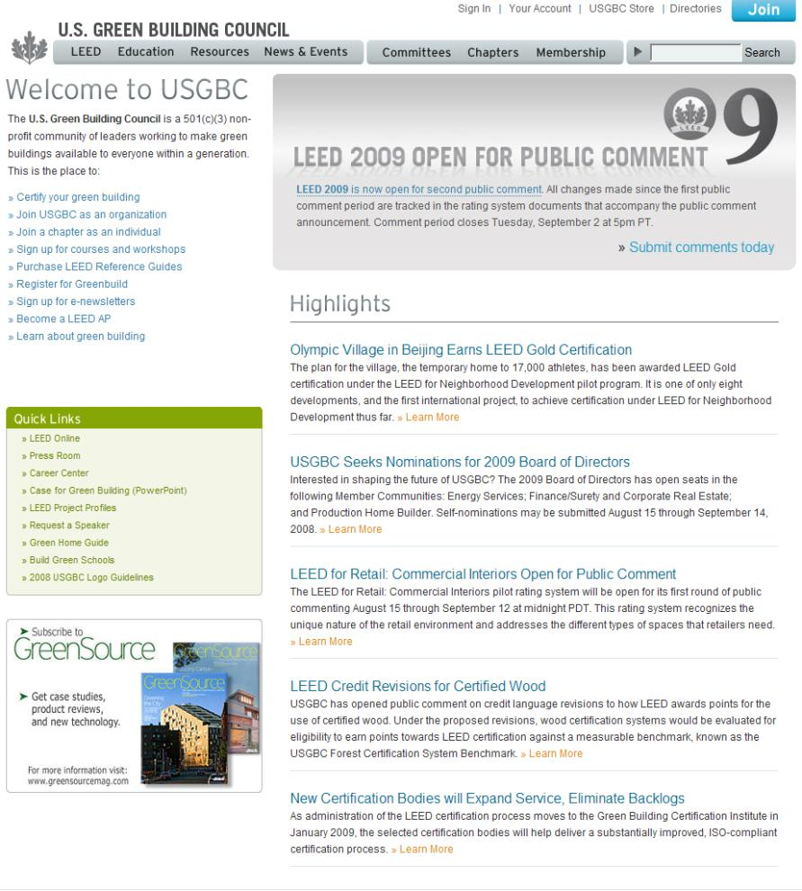
CLASS PROCEDURE, GOALS & REQUIREMENTS
INTRODUCTIONS
PROCEDURE, GOALS, & REQ’S
SUSTAINABILITY
HISTORY
ORGANIZATIONS
VOCABULARY
FOOTPRINTS
Web Readings
www.usgbc.org

Slide 13
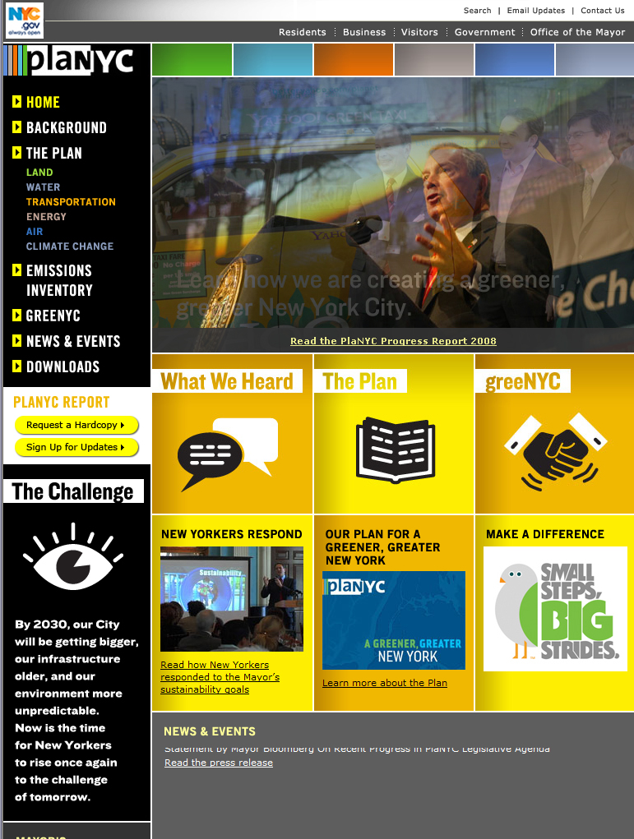
CLASS PROCEDURE, GOALS & REQUIREMENTS
INTRODUCTIONS
PROCEDURE, GOALS, & REQ’S
SUSTAINABILITY
HISTORY
ORGANIZATIONS
VOCABULARY
FOOTPRINTS
Web Readings
http://www.nyc.gov/html/planyc2030/

Slide 14
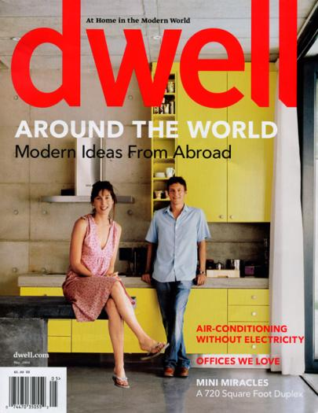
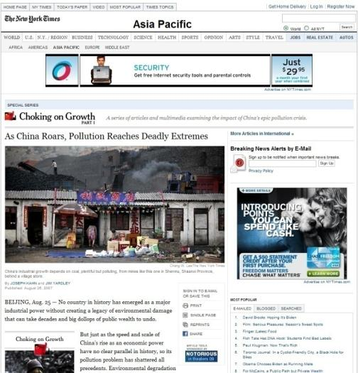
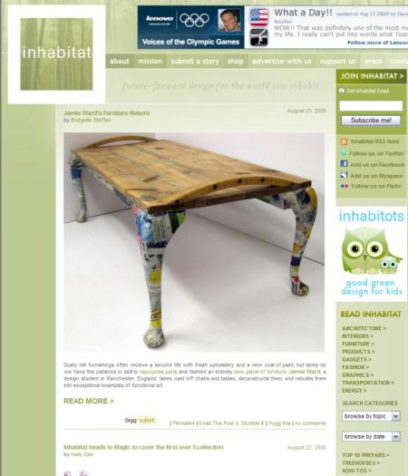
CLASS PROCEDURE, GOALS & REQUIREMENTS
INTRODUCTIONS
PROCEDURE, GOALS, & REQ’S
SUSTAINABILITY
HISTORY
ORGANIZATIONS
VOCABULARY
FOOTPRINTS
Additional recommended readings
Current Periodicals (Dwell, Green Review)
Current News (NYT, Newsweek)
Emerging web content (Inhabitat, Building Green, Gizmag)

Slide 15
OVERVIEW AND INTRODUCTION TO SUSTAINABILITY

Slide 16
OUTLINE
INTRODUCTIONS
PROCEDURE, GOALS, & REQ’S
SUSTAINABILITY
HISTORY
ORGANIZATIONS
VOCABULARY
FOOTPRINTS
Introductions
Review class procedure, goals, and requirements
What is SUSTAINABILITY?
History of current problems in NYC vs. global
The USGBC and green organizations
Green vocabulary
Ecological & carbon footprints

Slide 17
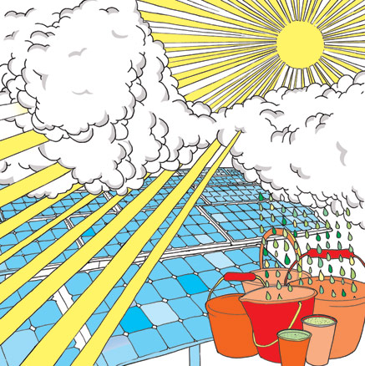
WHAT IS SUSTAINABILITY?
INTRODUCTIONS
PROCEDURE, GOALS, & REQ’S
SUSTAINABILITY
HISTORY
ORGANIZATIONS
VOCABULARY
FOOTPRINTS
What have you heard?

Slide 18
WHAT IS SUSTAINABILITY
INTRODUCTIONS
PROCEDURE, GOALS, & REQ’S
SUSTAINABILITY
HISTORY
ORGANIZATIONS
VOCABULARY
FOOTPRINTS
A strategy by which communities seek economic development approaches that also benefit the local environment and quality of life. (www.sactaqc.org)
http://www.nytimes.com/packages/html/science/20071024_DOTEARTH_FEATURE/index.html

Slide 19
WHAT IS SUSTAINABILITY
INTRODUCTIONS
PROCEDURE, GOALS, & REQ’S
SUSTAINABILITY
HISTORY
ORGANIZATIONS
VOCABULARY
FOOTPRINTS
Meeting the needs of the present without depleting resources or harming natural cycles for future generations. (www.cdc.gov/healthyplaces/)

Slide 20
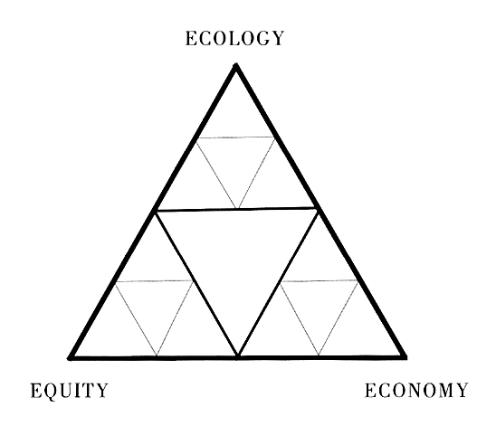
WHAT IS SUSTAINABILITY
INTRODUCTIONS
PROCEDURE, GOALS, & REQ’S
SUSTAINABILITY
HISTORY
ORGANIZATIONS
VOCABULARY
FOOTPRINTS
…the principles of sustainability integrate three closely interlinked elements—the environment, the economy, and the social system—into a system that can be maintained in a healthy state indefinitely (nfdp.ccfm.org)

Slide 21
OUTLINE
INTRODUCTIONS
PROCEDURE, GOALS, & REQ’S
SUSTAINABILITY
HISTORY
ORGANIZATIONS
VOCABULARY
FOOTPRINTS
Introductions
Review class procedure, goals, and requirements
What is SUSTAINABILITY?
History of current problems in NYC vs. global
The USGBC and green organizations
Green vocabulary
Ecological & carbon footprints

Slide 22
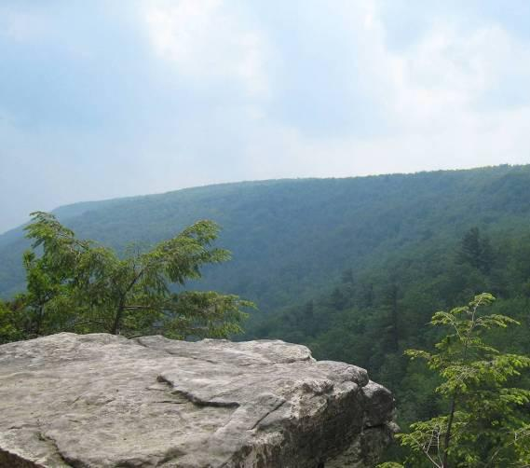
HISTORY OF CURRENT PROBLEMS
INTRODUCTIONS
PROCEDURE, GOALS, & REQ’S
SUSTAINABILITY
HISTORY
ORGANIZATIONS
VOCABULARY
FOOTPRINTS
Pre-development Vision

Slide 23
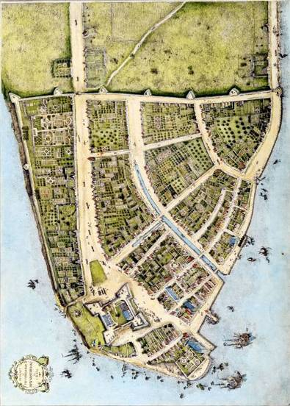
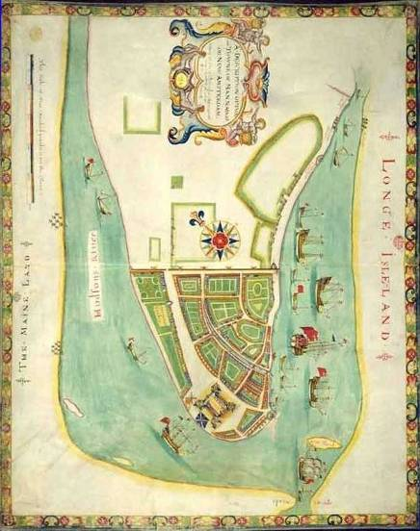
HISTORY OF CURRENT PROBLEMS
INTRODUCTIONS
PROCEDURE, GOALS, & REQ’S
SUSTAINABILITY
HISTORY
ORGANIZATIONS
VOCABULARY
FOOTPRINTS
1660
1661
SETTLERS + COMMERCE = DEVELOPMENT

Slide 24
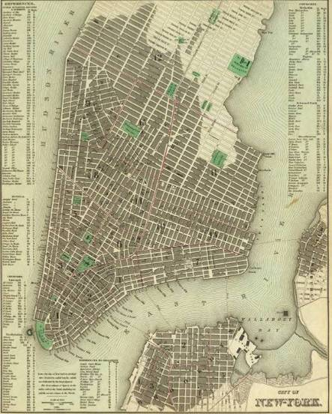
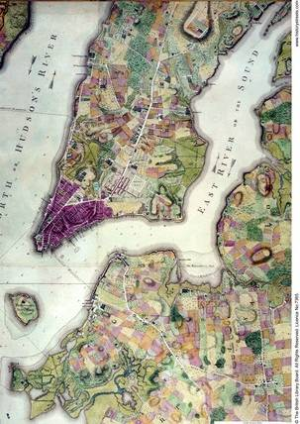
HISTORY OF CURRENT PROBLEMS
INTRODUCTIONS
PROCEDURE, GOALS, & REQ’S
SUSTAINABILITY
HISTORY
ORGANIZATIONS
VOCABULARY
FOOTPRINTS
1835
1776

Slide 25
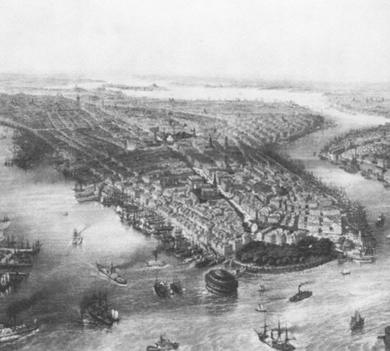
HISTORY OF CURRENT PROBLEMS
INTRODUCTIONS
PROCEDURE, GOALS, & REQ’S
SUSTAINABILITY
HISTORY
ORGANIZATIONS
VOCABULARY
FOOTPRINTS
-ORIGIN OF THE CITY GRID
-BUILDING TO WATERS EDGE
-LACK OF GREEN SPACE
-POOR VEHICULAR TRANSPORT
-LACK OF FIRE DEPARTMENT
-LACK OF CENTRAL POLICE DEPARTMENT

Slide 26
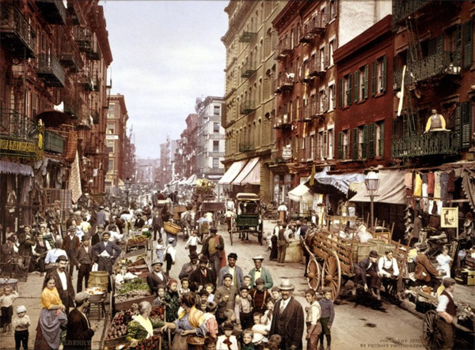
HISTORY OF CURRENT PROBLEMS
INTRODUCTIONS
PROCEDURE, GOALS, & REQ’S
SUSTAINABILITY
HISTORY
ORGANIZATIONS
VOCABULARY
FOOTPRINTS

Slide 27
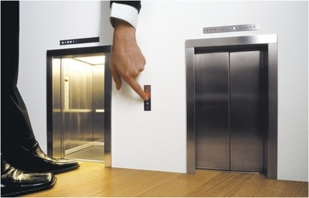
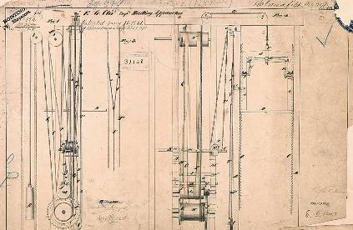
HISTORY OF CURRENT PROBLEMS
INTRODUCTIONS
PROCEDURE, GOALS, & REQ’S
SUSTAINABILITY
HISTORY
ORGANIZATIONS
VOCABULARY
FOOTPRINTS
STEEL + ELEVATORS = DENSITY

Slide 28
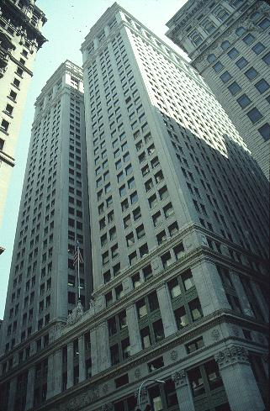
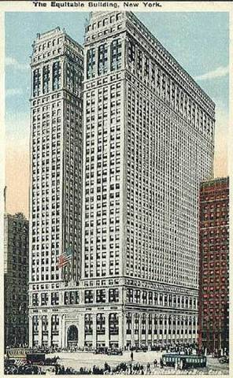
HISTORY OF CURRENT PROBLEMS
INTRODUCTIONS
PROCEDURE, GOALS, & REQ’S
SUSTAINABILITY
HISTORY
ORGANIZATIONS
VOCABULARY
FOOTPRINTS
BUILT1919
STEEL CONSTRUCTION
USE OF ELEVATORS
40 STORIES
40 ACRES OF OFFICE SPACE OR APPROX. 1,500,000SF OF OFFICE SPACE!
LAST BUILDING BEFORE ZONING LAWS IMPLEMENTED
THE EQUITABLE BUILDING 120 BROADWAY BETWEEN PINE AND CEDAR

Slide 29
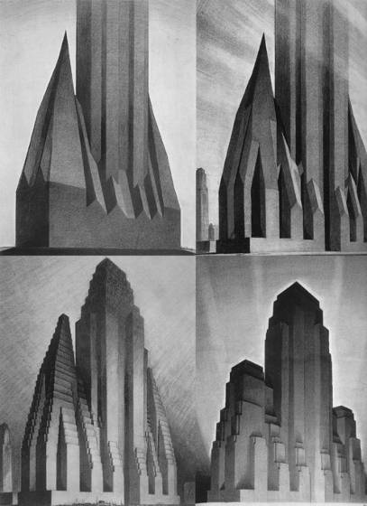
HISTORY OF CURRENT PROBLEMS
INTRODUCTIONS
PROCEDURE, GOALS, & REQ’S
SUSTAINABILITY
HISTORY
ORGANIZATIONS
VOCABULARY
FOOTPRINTS
CONCERN FOR PUBLIC WELL BEING : LIGHT AND AIR REQUIREMENTS
BUILDING HEIGHT AND BULK ARE REGULATED
ZONING STUDIES BY HUGH FERRISS

Slide 30
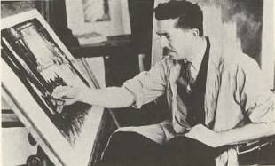
HISTORY OF CURRENT PROBLEMS
INTRODUCTIONS
PROCEDURE, GOALS, & REQ’S
SUSTAINABILITY
HISTORY
ORGANIZATIONS
VOCABULARY
FOOTPRINTS

Slide 31
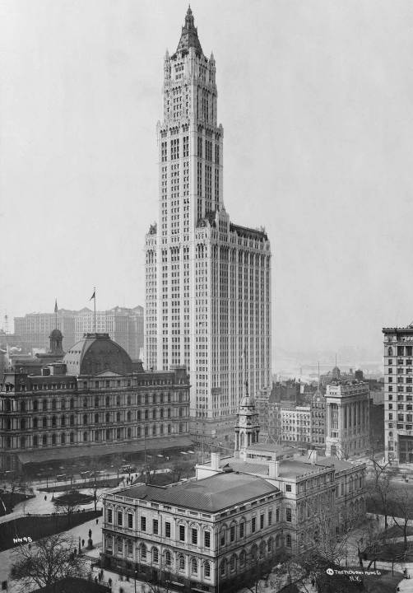
HISTORY OF CURRENT PROBLEMS
INTRODUCTIONS
PROCEDURE, GOALS, & REQ’S
SUSTAINABILITY
HISTORY
ORGANIZATIONS
VOCABULARY
FOOTPRINTS
STEEL CONSTRUCTION
USE OF ELEVATORS
SETBACKS
PUBLIC PLAZAS AND DRAMA
GLAMOROUS IMAGE OF THE CITY BEING CREATED

Slide 32
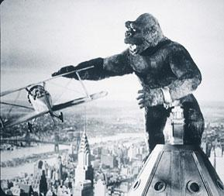
HISTORY OF CURRENT PROBLEMS
INTRODUCTIONS
PROCEDURE, GOALS, & REQ’S
SUSTAINABILITY
HISTORY
ORGANIZATIONS
VOCABULARY
FOOTPRINTS
NATURE VS. TECHNOLOGY

Slide 33
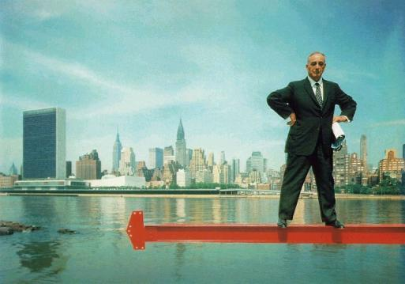
HISTORY OF CURRENT PROBLEMS
INTRODUCTIONS
PROCEDURE, GOALS, & REQ’S
SUSTAINABILITY
HISTORY
ORGANIZATIONS
VOCABULARY
FOOTPRINTS
Robert Moses
Neither an architect, a planner, a lawyer nor even, in the strictest sense, a politician, he changed the face of the state more than anyone who was.
Triborough Bridge,
Jones Beach State Park
Verrazano-Narrows Bridge
West Side Highway or Long Island parkway system
http://www.nytimes.com/learning/general/onthisday/bday/1218.html

Slide 34
As chief of the state park system he created 2,567,256 acres of parkland. He built 658 playgrounds in New York City, 416 miles of parkways and 13 bridges.
In the 1930's he built hundreds of playgrounds, 10 swimming-pool complexes, the Grand Central Parkway and the Interborough, Gowanus and Henry Hudson Parkways, among others. He built the Bronx-Whitestone Bridge and the West Side Highway and the 79th Street Boat Basin.
To do so, he held several appointive offices and once occupied 12 positions simultaneously, including that of New York City Parks Commissioner, head of the State Parks Council, head of the State Power Commission and chairman of the Triborough Bridge and Tunnel Authority.
INTRODUCTIONS
PROCEDURE, GOALS, & REQ’S
SUSTAINABILITY
HISTORY
ORGANIZATIONS
VOCABULARY
FOOTPRINTS
Robert Moses

Slide 35
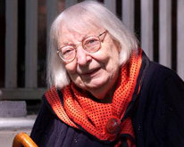
HISTORY OF CURRENT PROBLEMS
INTRODUCTIONS
PROCEDURE, GOALS, & REQ’S
SUSTAINABILITY
HISTORY
ORGANIZATIONS
VOCABULARY
FOOTPRINTS
JANE JACOBS
Jane Jacobs (1916-2006) was an urban writer and activist who championed new, community-based approaches to planning.
Her 1961 treatise, The Death and Life of Great American Cities, became the most influential American text about the inner workings and failings of cities. Her efforts to stop downtown expressways and protect local neighborhoods invigorated community-based urban activism and helped end Parks Commissioner Robert Moses's reign of power in New York City.
Jacobs had no professional training in the field of city planning, nor did she hold the title of planner. She instead relied on her observations and common sense to illustrate why certain places work, and what can be done to improve those that do not.

Slide 36
HISTORY OF CURRENT PROBLEMS
INTRODUCTIONS
PROCEDURE, GOALS, & REQ’S
SUSTAINABILITY
HISTORY
ORGANIZATIONS
VOCABULARY
FOOTPRINTS
"Old ideas can sometimes use new buildings. New ideas must use old buildings.“
"Whenever and wherever societies have flourished and prospered rather than stagnated and decayed, creative and workable cities have been at the core of the phenomenon… Decaying cities, declining economies, and mounting social troubles travel together. The combination is not coincidental."
"In our American cities, we need all kinds of diversity.“
"Intricate minglings of different uses in cities are not a form of chaos. On the contrary, they represent a complex and highly developed form of order.“
Jane Jacobs

Slide 37
HISTORY OF CURRENT PROBLEMS
INTRODUCTIONS
PROCEDURE, GOALS, & REQ’S
SUSTAINABILITY
HISTORY
ORGANIZATIONS
VOCABULARY
FOOTPRINTS
Cities as Ecosystems
Jacobs approached cities as living beings and ecosystems. She suggested that over time, buildings, streets and neighborhoods function as dynamic organisms, changing in response to how people interact with them. She explained how each element of a city - sidewalks, parks, neighborhoods, government, economy – functions together synergistically, in the same manner as the natural ecosystem. This understanding helps us discern how cities work, how they break down, and how they could be better structured.

Slide 38
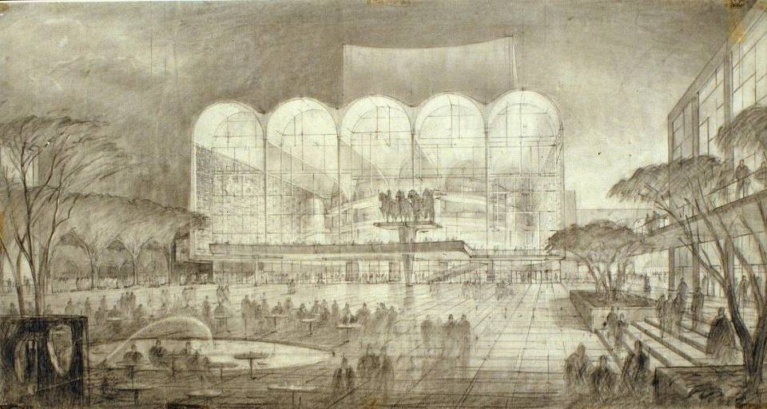
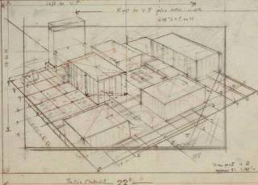
HISTORY OF CURRENT PROBLEMS
INTRODUCTIONS
PROCEDURE, GOALS, & REQ’S
SUSTAINABILITY
HISTORY
ORGANIZATIONS
VOCABULARY
FOOTPRINTS
CIVIC MINDED BUILDINGS OF THE 1960’S
OPEN PLAZAS CREATED IN EXCHANGE FOR SPECIAL BUILDING ALLOWANCES (BONUS FAR)
COLLABORATION AMONG SEVERAL ARCHITECTS
civic minded buildings

Slide 39
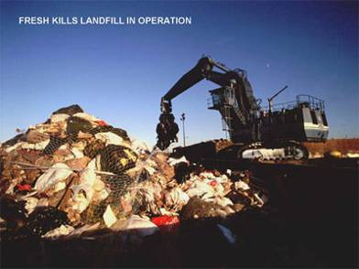
HISTORY OF CURRENT PROBLEMS
INTRODUCTIONS
PROCEDURE, GOALS, & REQ’S
SUSTAINABILITY
HISTORY
ORGANIZATIONS
VOCABULARY
FOOTPRINTS
POPULATION GROWTH +
WASTE +
ENERGY DEMANDS+

Slide 40
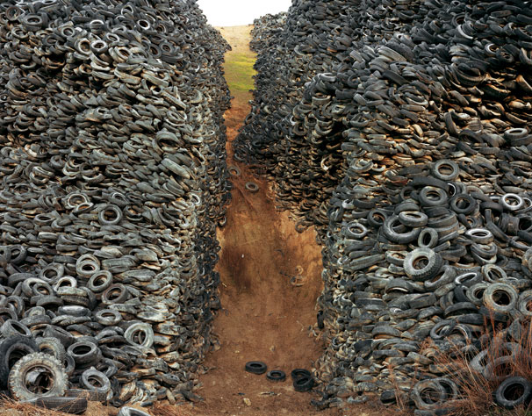
INTRODUCTIONS
PROCEDURE, GOALS, & REQ’S
SUSTAINABILITY
HISTORY
ORGANIZATIONS
VOCABULARY
FOOTPRINTS
Edward Burtynsky: Manufactured Landscapes
http://www.youtube.com/watch?v=Jv23xwe0BoU

Slide 41
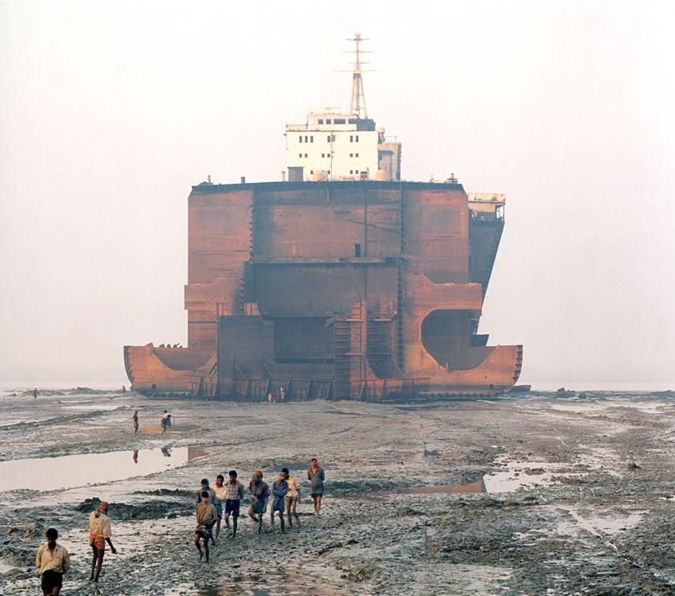
HISTORY OF CURRENT PROBLEMS
INTRODUCTIONS
PROCEDURE, GOALS, & REQ’S
SUSTAINABILITY
HISTORY
ORGANIZATIONS
VOCABULARY
FOOTPRINTS

Slide 42
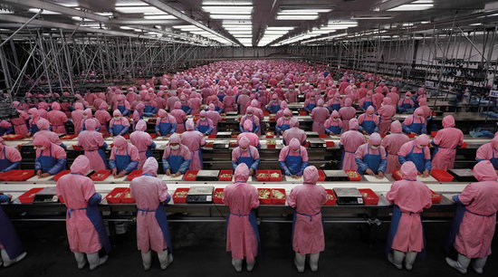
INTRODUCTIONS
PROCEDURE, GOALS, & REQ’S
SUSTAINABILITY
HISTORY
ORGANIZATIONS
VOCABULARY
FOOTPRINTS

Slide 43
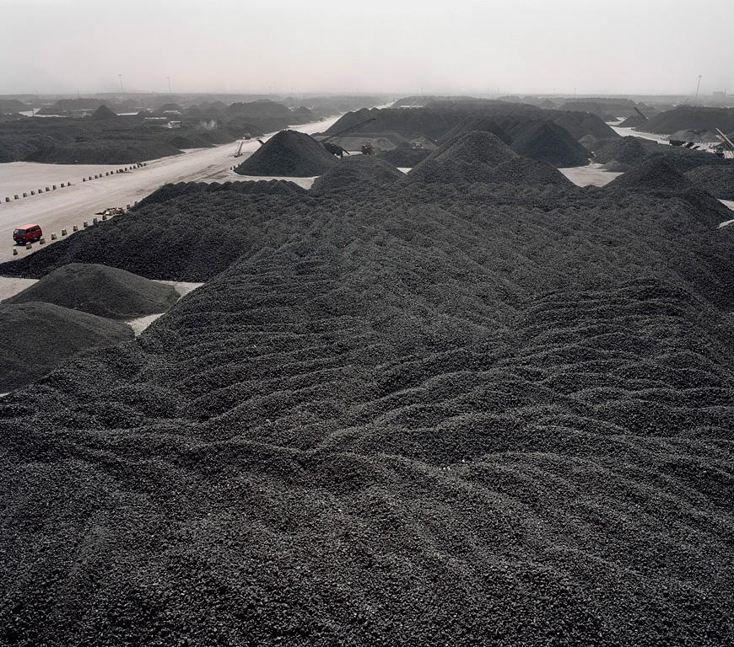
INTRODUCTIONS
PROCEDURE, GOALS, & REQ’S
SUSTAINABILITY
HISTORY
ORGANIZATIONS
VOCABULARY
FOOTPRINTS

Slide 44
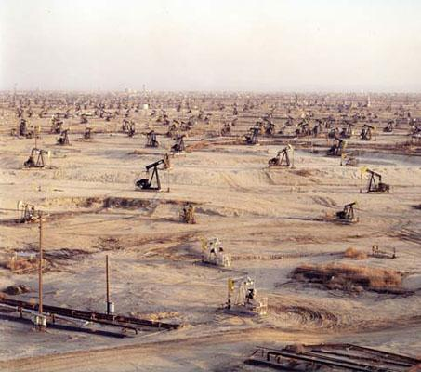
INTRODUCTIONS
PROCEDURE, GOALS, & REQ’S
SUSTAINABILITY
HISTORY
ORGANIZATIONS
VOCABULARY
FOOTPRINTS

Slide 45
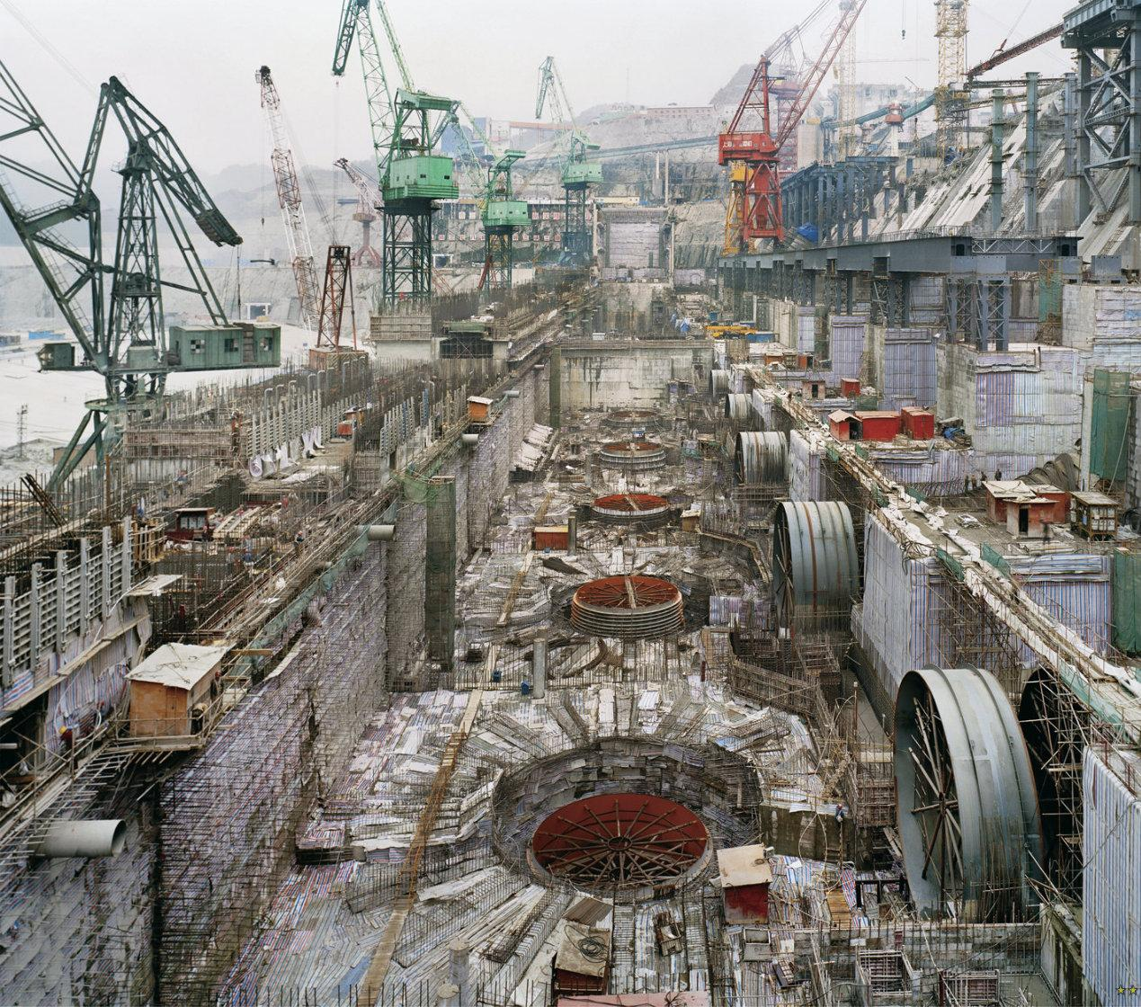
INTRODUCTIONS
PROCEDURE, GOALS, & REQ’S
SUSTAINABILITY
HISTORY
ORGANIZATIONS
VOCABULARY
FOOTPRINTS

Slide 46
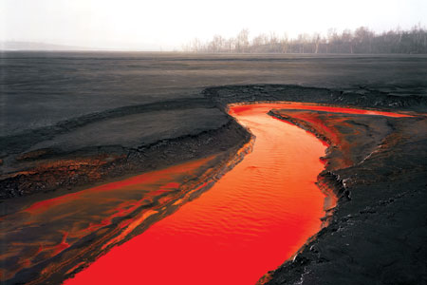
INTRODUCTIONS
PROCEDURE, GOALS, & REQ’S
SUSTAINABILITY
HISTORY
ORGANIZATIONS
VOCABULARY
FOOTPRINTS

Slide 47
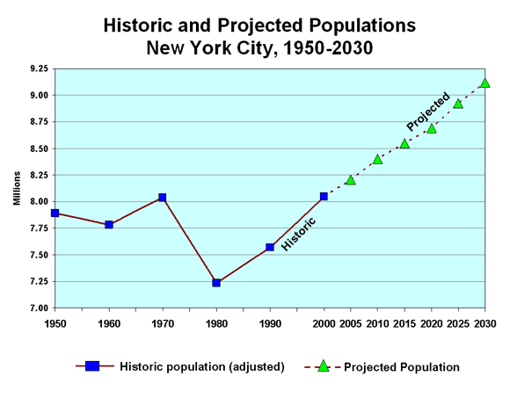
HISTORY OF CURRENT PROBLEMS
INTRODUCTIONS
PROCEDURE, GOALS, & REQ’S
SUSTAINABILITY
HISTORY
ORGANIZATIONS
VOCABULARY
FOOTPRINTS
8.2 MILLION PEOPLE CURRENTLY IN NYC
9.0 MILLION PROJECTED FOR 2030

Slide 48
HISTORY OF CURRENT PROBLEMS
INTRODUCTIONS
PROCEDURE, GOALS, & REQ’S
SUSTAINABILITY
HISTORY
ORGANIZATIONS
VOCABULARY
FOOTPRINTS
BLOOMBERG’S NYC_2030 PLAN:
LAND USE
WATER
TRANSPORTATION
ENERGY
AIR
CLIMATE CHANGE
http://www.nyc.gov/html/planyc2030/html/home/home.shtml

Slide 49
HISTORY OF CURRENT PROBLEMS
INTRODUCTIONS
PROCEDURE, GOALS, & REQ’S
SUSTAINABILITY
HISTORY
ORGANIZATIONS
VOCABULARY
FOOTPRINTS
Urban Sustainability + Technology Targets
LARGE= zoning regulations
mass transportation
infrastructure expansion
green space
clean water and air initiatives
MEDIUM= building construction materials + methods building energy consumption
recycling
vehicle efficiency + emissions
SMALL= public awareness + improved knowledge base
reduce consumption
increase public demand for sustainable products + buildings

Slide 50
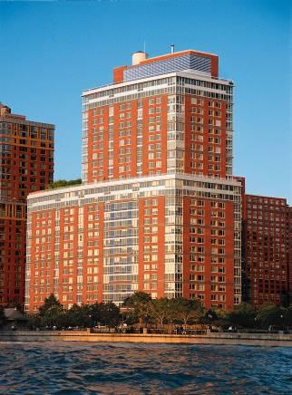
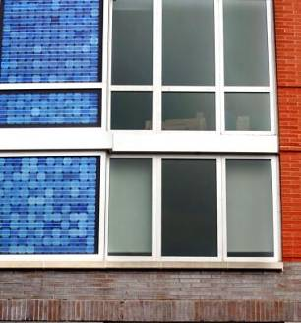
HISTORY OF CURRENT PROBLEMS
INTRODUCTIONS
PROCEDURE, GOALS, & REQ’S
SUSTAINABILITY
HISTORY
ORGANIZATIONS
VOCABULARY
FOOTPRINTS
MEDIUM SCALE : CASE STUDIES
357,000 SF RESIDENTIAL BUILDING
27 STORIES: 293 APT UNITS
SOLAR PANELS BUILT INTO WINDOW FRAMING
HIGH PERFORMANCE FLOOR TO CEILING WINDOWS
THE SOLAIRE BUILDING
by Cesar Pelli Associates

Slide 51
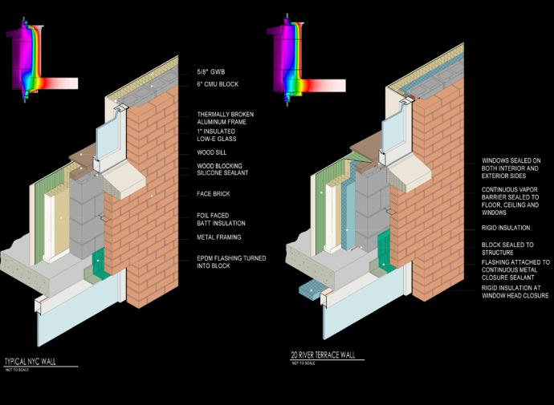
HISTORY OF CURRENT PROBLEMS
INTRODUCTIONS
PROCEDURE, GOALS, & REQ’S
SUSTAINABILITY
HISTORY
ORGANIZATIONS
VOCABULARY
FOOTPRINTS
MEDIUM SCALE : CASE STUDIES

Slide 52
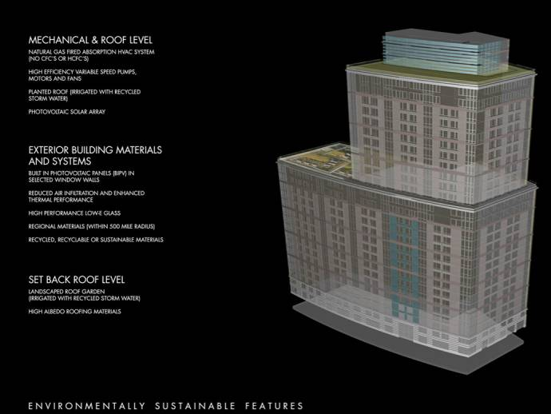
HISTORY OF CURRENT PROBLEMS
INTRODUCTIONS
PROCEDURE, GOALS, & REQ’S
SUSTAINABILITY
HISTORY
ORGANIZATIONS
VOCABULARY
FOOTPRINTS
MEDIUM SCALE : CASE STUDIES

Slide 53
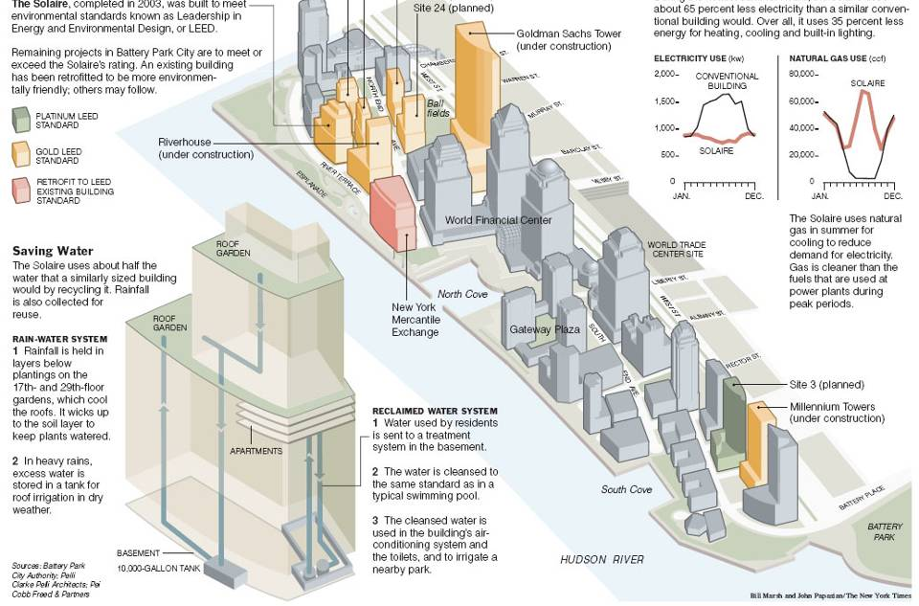
HISTORY OF CURRENT PROBLEMS
INTRODUCTIONS
PROCEDURE, GOALS, & REQ’S
SUSTAINABILITY
HISTORY
ORGANIZATIONS
VOCABULARY
FOOTPRINTS
MEDIUM SCALE : CASE STUDIES

Slide 54
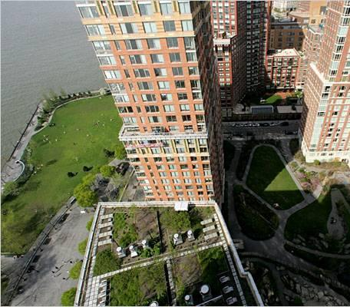
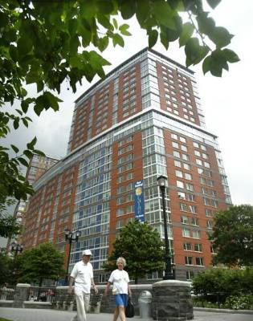
HISTORY OF CURRENT PROBLEMS
LOW VOC INTERIOR FINISH MATERIALS
RAINWATER HARVESTING
ON-SITE BLACK WATER TREATMENT AND REUSE TO SUPPLY TOILETS AND COOLING SYSTEM
MATERIALS LIMITED TO 500MILE SOURCE
INTERIOR FINISH WOODS OBTAINED FROM CERTIFIED FORESTS PROMOTING RE-GROWTH
ACHIEVES GOLD LEVEL LEED CERTIFICATION
93% OF CONSTRUCTION WASTE WAS RECYCLED
INTRODUCTIONS
PROCEDURE, GOALS, & REQ’S
SUSTAINABILITY
HISTORY
ORGANIZATIONS
VOCABULARY
FOOTPRINTS
MEDIUM SCALE : CASE STUDIES
THE SOLAIRE BUILDING
by Cesar Pelli Associates

Slide 55
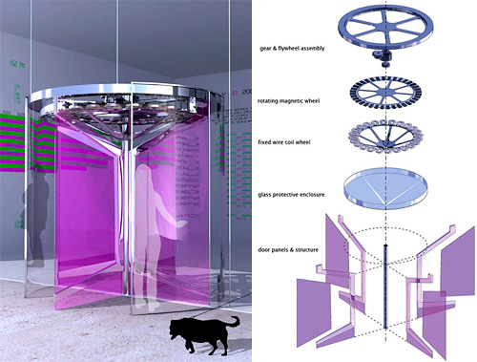
HISTORY OF CURRENT PROBLEMS
INTRODUCTIONS
PROCEDURE, GOALS, & REQ’S
SUSTAINABILITY
HISTORY
ORGANIZATIONS
VOCABULARY
FOOTPRINTS
SMALL SCALE : CASE STUDIES
HARNESSES HUMAN ENERGY TO ILLUMINATE AN OUTPUT DEVICE WHICH MAPS ENERGY USAGE
ILLUSTRATES CONNECTION BETWEEN SIMPLE TASKS AND ENERGY PRODUCTION
THE REVOLUTION DOOR by Fluxxlab

Slide 56
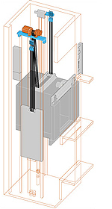
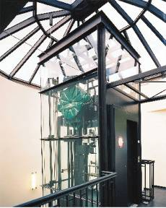
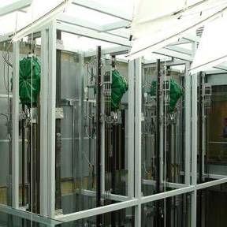
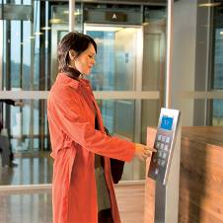
HISTORY OF CURRENT PROBLEMS
INTRODUCTIONS
PROCEDURE, GOALS, & REQ’S
SUSTAINABILITY
HISTORY
ORGANIZATIONS
VOCABULARY
FOOTPRINTS
SMALL SCALE : CASE STUDIES
DESTINATION CONTROL: COMPUTER GUIDED USAGE ALLOW IDLE ELEVATORS TO SWITCH OFF TO CONSERVE ENERGY.
LESS SPACE REQUIRED: MACHINE ROOM LESS, SMALLER GEARING
LESS CARBON EMISSIONS: LIGHTWEIGHT, LESS MACHINERY, EFFICIENT OPERATION, LESS MAINTENANCE AND OIL PRODUCTS USED
THE NEW ELEVATOR

Slide 57
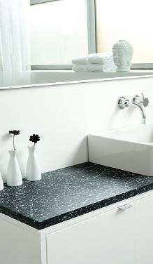
HISTORY OF CURRENT PROBLEMS
INTRODUCTIONS
PROCEDURE, GOALS, & REQ’S
SUSTAINABILITY
HISTORY
ORGANIZATIONS
VOCABULARY
FOOTPRINTS
SMALL SCALE : CASE STUDIES
recycled plastic
recycled aluminum
recycled glass
RECYCLED MATERIALS

Slide 58
HISTORY OF CURRENT PROBLEMS
INTRODUCTIONS
PROCEDURE, GOALS, & REQ’S
SUSTAINABILITY
HISTORY
ORGANIZATIONS
VOCABULARY
FOOTPRINTS
SMALL SCALE : CASE STUDIES
BEFORE
AFTER
REDUCE BUILDING HEAT GAIN
REDUCE ‘GREENHOUSE’ EFFECT
REDUCE CO2
REDUCE STORM WATER RUNOFF
THE ROOF GARDEN

Slide 59
HISTORY OF CURRENT PROBLEMS
INTRODUCTIONS
PROCEDURE, GOALS, & REQ’S
SUSTAINABILITY
HISTORY
ORGANIZATIONS
VOCABULARY
FOOTPRINTS
SMALL SCALE : CASE STUDIES
schematic section
THE ROOF GARDEN

Slide 60
HISTORY OF CURRENT PROBLEMS
INTRODUCTIONS
PROCEDURE, GOALS, & REQ’S
SUSTAINABILITY
HISTORY
ORGANIZATIONS
VOCABULARY
FOOTPRINTS
SMALL SCALE : CASE STUDIES
SMALLER, LIGHTER, MORE EFFICIENT
INSTALLED VERTICALLY AND HORIZONTALLY
PERFORMS IN LOW LIGHT CONDITIONS
SOLAR PANELS

Slide 61
HISTORY OF CURRENT PROBLEMS
INTRODUCTIONS
PROCEDURE, GOALS, & REQ’S
SUSTAINABILITY
HISTORY
ORGANIZATIONS
VOCABULARY
FOOTPRINTS
FUTURE VISIONS
OF THE CITY

Slide 62
INTRODUCTIONS
PROCEDURE, GOALS, & REQ’S
SUSTAINABILITY
HISTORY
ORGANIZATIONS
VOCABULARY
FOOTPRINTS
AFFORDABLE + SUSTAINABLE HOUSING

Slide 63
HISTORY OF CURRENT PROBLEMS
INTRODUCTIONS
PROCEDURE, GOALS, & REQ’S
SUSTAINABILITY
HISTORY
ORGANIZATIONS
VOCABULARY
FOOTPRINTS
THE HIGHLINE COMPETITION

Slide 64
HISTORY OF CURRENT PROBLEMS
INTRODUCTIONS
PROCEDURE, GOALS, & REQ’S
SUSTAINABILITY
HISTORY
ORGANIZATIONS
VOCABULARY
FOOTPRINTS
"Old ideas can sometimes use new buildings. New ideas must use old buildings.“

Slide 65
HISTORY OF CURRENT PROBLEMS
INTRODUCTIONS
PROCEDURE, GOALS, & REQ’S
SUSTAINABILITY
HISTORY
ORGANIZATIONS
VOCABULARY
FOOTPRINTS
NEW YORK CITY 2106 BY ARO

Slide 66
HISTORY OF CURRENT PROBLEMS
INTRODUCTIONS
PROCEDURE, GOALS, & REQ’S
SUSTAINABILITY
HISTORY
ORGANIZATIONS
VOCABULARY
FOOTPRINTS
NEW YORK CITY 2106 BY ARO

Slide 67
HISTORY OF CURRENT PROBLEMS
INTRODUCTIONS
PROCEDURE, GOALS, & REQ’S
SUSTAINABILITY
HISTORY
ORGANIZATIONS
VOCABULARY
FOOTPRINTS
NEW YORK CITY 2106 BY ARO

Slide 68
HISTORY OF CURRENT PROBLEMS
INTRODUCTIONS
PROCEDURE, GOALS, & REQ’S
SUSTAINABILITY
HISTORY
ORGANIZATIONS
VOCABULARY
FOOTPRINTS
NEW YORK CITY

Slide 69
OUTLINE
INTRODUCTIONS
PROCEDURE, GOALS, & REQ’S
SUSTAINABILITY
HISTORY
ORGANIZATIONS
VOCABULARY
FOOTPRINTS
Introductions
Review class procedure, goals, and requirements
What is SUSTAINABILITY?
History of current problems in NYC vs. global
The USGBC and green organizations
Green vocabulary
Ecological & carbon footprints

Slide 70
THE USGBC & OTHER GREEN ORGANIZATIONS
INTRODUCTIONS
PROCEDURE, GOALS, & REQ’S
SUSTAINABILITY
HISTORY
ORGANIZATIONS
VOCABULARY
FOOTPRINTS
The US Green Building Council
A non-profit organization that works with professionals, cities, states, the federal government and politicians to expand sustainable building practices.

Slide 71
THE USGBC & OTHER GREEN ORGANIZATIONS
INTRODUCTIONS
PROCEDURE, GOALS, & REQ’S
SUSTAINABILITY
HISTORY
ORGANIZATIONS
VOCABULARY
FOOTPRINTS
The US Green Building Council
A national organization with local chapters

Slide 72
THE USGBC & OTHER GREEN ORGANIZATIONS
INTRODUCTIONS
PROCEDURE, GOALS, & REQ’S
SUSTAINABILITY
HISTORY
ORGANIZATIONS
VOCABULARY
FOOTPRINTS
The US Green Building Council
Guiding Principles:
SUSTAINABILITY – respect the limits of natural systems and non-renewable resources by seeking solutions that produce an abundance of natural and social capital.
EQUITY – respect all communities and cultures and aspries to an equal socio-economic opportunity for all.
INCLUSIVENESS – practice and promote openness, broad participation and full consideration of consequence in all aspects of decision making processes.
PROGRESS – strive for immediate and measurable indicators of environmental, social and economic prosperity.
CONNECTEDNESS – recognize the critical linkage between humanity and nature as well as the importance of place-based decision-making to effect stewardship.

Slide 73
THE USGBC & OTHER GREEN ORGANIZATIONS
INTRODUCTIONS
PROCEDURE, GOALS, & REQ’S
SUSTAINABILITY
HISTORY
ORGANIZATIONS
VOCABULARY
FOOTPRINTS
The US Green Building Council
Created the LEED rating system
Hosts Greenbuild,
an annual conference and expo on green building.

Slide 74
THE USGBC & OTHER GREEN ORGANIZATIONS
INTRODUCTIONS
PROCEDURE, GOALS, & REQ’S
SUSTAINABILITY
HISTORY
ORGANIZATIONS
VOCABULARY
FOOTPRINTS
The LEED rating system
The LEED (Leadership in Energy and Environmental Design) rating system was formalized 1998.
LEED rating is a points based system that gives certification level from lowest to highest of CERTIFIED, SILVER, GOLD, PLATINUM.
Notes:
Case study: Aldo Leopold Foundation, Legacy Center
Home Depot Foundation – awards for sustainable affordable housing

Slide 75
THE USGBC & OTHER GREEN ORGANIZATIONS
INTRODUCTIONS
PROCEDURE, GOALS, & REQ’S
SUSTAINABILITY
HISTORY
ORGANIZATIONS
VOCABULARY
FOOTPRINTS
The LEED rating system
Until 2006 was only applicable to new construction, now covers 6 areas of the construction and development process.
LEED has grown from 6 volunteers, to 200 volunteers on 20 committees and 150 professional staff.
Notes:
Case study: Aldo Leopold Foundation, Legacy Center
Home Depot Foundation – awards for sustainable affordable housing

Slide 76
THE USGBC & OTHER GREEN ORGANIZATIONS
INTRODUCTIONS
PROCEDURE, GOALS, & REQ’S
SUSTAINABILITY
HISTORY
ORGANIZATIONS
VOCABULARY
FOOTPRINTS
Other Sustainable Architecture Organizations
World Green Building Council
Founded in 1999 with meeting of 8 countries (US, Australia, Spain, UK, Japan, UAE, Russia, Canada)
WorldGBC formalized in 2002
A coalition of GBC’s from around the world
Canada Green Building Council
Initially a member of the USGBC, Canada now has it’s own GBC which promotes the LEED rating system.
Green Building Certification Institute
Launched in November 2007, the GBCI is a USGBC organization created specifically to oversee Professional Accreditation.
January 2009 full launch

Slide 77
OUTLINE
INTRODUCTIONS
PROCEDURE, GOALS, & REQ’S
SUSTAINABILITY
HISTORY
ORGANIZATIONS
VOCABULARY
FOOTPRINTS
Introductions
Review class procedure, goals, and requirements
What is SUSTAINABILITY?
History of current problems in NYC vs. global
The USGBC and green organizations
Green vocabulary
Ecological & carbon footprints

Slide 78
ECOLOGICAL FOOTPRINT
INTRODUCTIONS
PROCEDURE, GOALS, & REQ’S
SUSTAINABILITY
HISTORY
ORGANIZATIONS
VOCABULARY
FOOTPRINTS
The Ecological Footprint is a measure of the “load” imposed by a given population on nature. It represents the land area necessary to sustain current levels of resource consumption and waste discharged by that population.
Wackernagel & Rees, p. 5

Slide 79
ECOLOGICAL FOOTPRINT
INTRODUCTIONS
PROCEDURE, GOALS, & REQ’S
SUSTAINABILITY
HISTORY
ORGANIZATIONS
VOCABULARY
FOOTPRINTS
National Footprints:
Wealthy, industrialized nations have a higher ecological footprint.
As more nations industrialize and the standard of living increases, there is increased pressure on the earth’s resources

Slide 80
ECOLOGICAL FOOTPRINT
INTRODUCTIONS
PROCEDURE, GOALS, & REQ’S
SUSTAINABILITY
HISTORY
ORGANIZATIONS
VOCABULARY
FOOTPRINTS
Individual Footprints:
Personal affluence is often associated with an increase in material possessions, and access to rare materials and luxuries
An urban lifestyle results in a lower individual footprint
What can do as individuals
to reduce our impact
on the earth?

Slide 81
ECOLOGICAL FOOTPRINT
INTRODUCTIONS
PROCEDURE, GOALS, & REQ’S
SUSTAINABILITY
HISTORY
ORGANIZATIONS
VOCABULARY
FOOTPRINTS
Effect of Industrialization on Ecological Footprint:
Increase in fossil fuel consumption
Technological advancement leads to a reduction in crop area

Slide 82
ECOLOGICAL FOOTPRINT
INTRODUCTIONS
PROCEDURE, GOALS, & REQ’S
SUSTAINABILITY
HISTORY
ORGANIZATIONS
VOCABULARY
FOOTPRINTS
Effect of Industrialization on Ecological Footprint:
Prolonged excavation of non-renewable resources reduces the earth’s overall capacity to support life, while at the same time human’s are increasing demand.

Slide 83
INTRODUCTIONS
PROCEDURE, GOALS, & REQ’S
SUSTAINABILITY
HISTORY
ORGANIZATIONS
VOCABULARY
FOOTPRINTS

Slide 84
INTRODUCTIONS
PROCEDURE, GOALS, & REQ’S
SUSTAINABILITY
HISTORY
ORGANIZATIONS
VOCABULARY
FOOTPRINTS

Slide 85
HOMEWORK
The 19th Century development of the Green ideal
Define the following terms and historic landmarks:
Pastoralism,
The Industrial Revolution and Cities,
Nature as Commodity and the Ecological Picturesque,
the American Suburb and Natural Urban Park
Homework assignment: Describe a recently designed city that has been shaped by one or more of these ideas. Conclude with how NYC must change to become sustainble.
Reading assignment: Reading from Fein or Howard
Purchase your text book

