Slide 1
New York City College of Technology Department of Dental Hygiene Case Presentation
Angie Vargas-Kawall

Slide 2
Patient Profile
Ms. V is a 46 year-old African-American female.
The patient’s status is single, self-employed, and lives in the city with her son. She does have access to dental care.
Her last dental and dental hygiene visit was in March 2019. A dental prophylaxis was fulfilled and a total of 5 films were exposed.
The patient states that she uses an electric toothbrush twice a day with Parodontax toothpaste. She flosses 5-6 times per day due to localized removal of stuck food, although she does not eat 5-6 times a day. It was addressed that it is not necessary to floss so many times, and in the OHI we will observe and instruct flossing. She stated that she uses Listerine mouth rinse twice a day.

Slide 3
Chief Complaint
Patient states “Bleeding from the gums”.
Ms. V bleeds from her gums every time she toothbrushes.
Ms. V was really concerned about the gum bleeding. She would like to have a deep cleaning in hopes that the bleeding would minimize.
Ms. V mentioned she did not feel great with the overall appearance of her teeth.

Slide 4
Health History Overview
Blood Pressure: 126/81, Pulse: 85, ASA: II.
Medical Conditions:
Heart Murmur- when she was a baby but it resolved on its own.
Pituitary Adenoma.
Hypothyroidism.
Current Medications:
Cabergoline: 0.5mg/day for the treatment of Pituitary Adenoma.
Levothyroxine: 0.05mg/day for the treatment of Hypothyroidism.

Slide 5
Heart Murmur
According to Dr. Alaina Kipps from the Stanford’s Children’s Hospital, she states, “Heart murmurs are extra or abnormal sounds made by turbulent blood flowing through the heart”.
There are different types of heart murmurs. The systolic murmur is when the heart contracts, the diastolic murmur is when the heart relaxes, and the continuous murmur is throughout the whole heartbeat. A heart murmur may be considered innocent or pathological.
The causes of a heart murmur may be due to an infection, fever, anemia, or hyperthyroidism. According to Harvard Medical School, the signs and symptoms are syncope, weight gain, shortness of breath, episodes of rapid heartbeat, and a decreased tolerance to physical activities.
References:
https://www.stanfordchildrens.org/en/topic/default?id=heart-murmurs-in-children-90-P01806
https://www.health.harvard.edu/a_to_z/heart-murmur-a-to-z

Slide 6
Heart Murmur
The treatment depends on if it is a child or an adult, and if it is diagnosed as an innocent or pathological murmur.
The treatment for a child is based on the symptoms, age, and severity of the condition. If it is diagnosed as an innocent/normal murmur, no treatment is necessary, but the doctor should monitor it on a regular basis. Unlike the pathological murmur, treatment must be considered. Based on the severity, it will be either medications or surgery.
Ms. V is not currently taking any medications nor did she have any surgeries because she was diagnosed with an innocent murmur when she was a baby and it resolved on its own.
References:
https://www.health.harvard.edu/a_to_z/heart-murmur-a-to-z
https://www.cedars-sinai.org/health-library/diseases-and-conditions---pediatrics/h/heart-murmurs-in-children.html

Slide 7
Pituitary Adenoma
Pituitary adenomas are known as the fourth most common intracranial tumors. A pituitary adenoma is a benign, slow growing tumor that arises from the pituitary gland.
They are classified based on their size, aggressiveness, and hormone secretion. They affect people between the ages of 30-40, but can also be seen in children. Pituitary adenomas are caused spontaneously, therefore are not inherited.
The signs and symptoms are abnormal changes in the body due to increased levels of hormones, unexplained weight gain or loss, sexual dysfunction, muscle weakness, growth problems, osteoporosis, blurred or double vision, carpal tunnel syndrome, and infertility.
References:
http://pituitary.ucla.edu/pituitary-adenomas
https://www.aans.org/en/Patients/Neurosurgical-Conditions-and-Treatments/Pituitary-Gland-and-Pituitary-Tumors

Slide 8
Pituitary Adenoma
The treatment is based on the patients age, overall health and the extent of the benign tumor. The first line of treatment is medication. The two most common medications prescribed to the patients with pituitary adenoma are Bromocriptine and Cabergoline. Bromocriptine is used once a day and Cabergoline is used twice a week.
Cabergoline is the most used medication out of the two previously mentioned due to less side affects.
Surgery is considered only when it is required. The most common surgery is the endoscopic endonasal technique.
Ms. V is currently being treated using the medication Cabergoline 0.5mg/day.
References:
http://pituitary.ucla.edu/pituitary-adenomas
https://www.aans.org/en/Patients/Neurosurgical-Conditions-and-Treatments/Pituitary-Gland-and-Pituitary-Tumors

Slide 9
Hypothyroidism
According to the American Thyroid Association, it states; “Hypothyroidism means that the thyroid gland can’t make enough thyroid hormone to keep the body running normally. People are hypothyroid if they have little thyroid hormone in the blood”.
Women are more likely to develop hypothyroidism than men.
The causes of hypothyroidism are radiation treatment to the thyroid, Hashimoto’s Disease, thyroiditis, surgical removal of part or all of the thyroid, and some medications. The signs and symptoms are fatigue, weight gain, puffy face, cold intolerance, depression, dry skin, and slow heart rate.
References:
https://www.thyroid.org/hypothyroidism/
https://www.niddk.nih.gov/health-information/endocrine-diseases/hypothyroidism

Slide 10
Hypothyroidism
Hypothyroidism cannot be cured, but it can be controlled. The treatment is to replace the amount of hormone the persons thyroid cannot make on his/her own.
Synthetic thyroxine pills contain hormone similar to T4 (hormone that the thyroid produces). The most common medication is Levothyroxine. The dose is based on what is ideal for the patient.
Ms. V is currently being treated with Levothyroxine 0.05mg/day.
References:
https://www.thyroid.org/hypothyroidism/
https://www.niddk.nih.gov/health-information/endocrine-diseases/hypothyroidism

Slide 11
Dental Hygiene Management
The dental hygienist should consult with the physician before proceeding with any dental hygiene treatment for all medical conditions.
There are no contraindications to any dental hygiene care for heart murmur, pituitary adenoma and hypothyroidism.
Cabergoline may effect dental treatment due to causing xerostomia, toothaches, and throat irritation. Vasoconstrictor should be used with caution because Cabergoline may cause vasoconstricting effects.
No precautions are necessary when using a vasoconstrictor for a patient who is controlled under Levothyroxine. The clinician must take into consideration delayed healing for patients with Hypothyroidism.
References:
http://www.jscisociety.com/article.asp?issn=0974-5009;year=2016;volume=43;issue=1;spage=34;epage=37;aulast=Kothiwale
Lexicomp Drug Information Handbook for Dentistry- Including Oral Medicine for Medically Compromised Patients & Specific Oral Conditions 24th Edition

Slide 12
Comprehensive Assessments

Slide 13
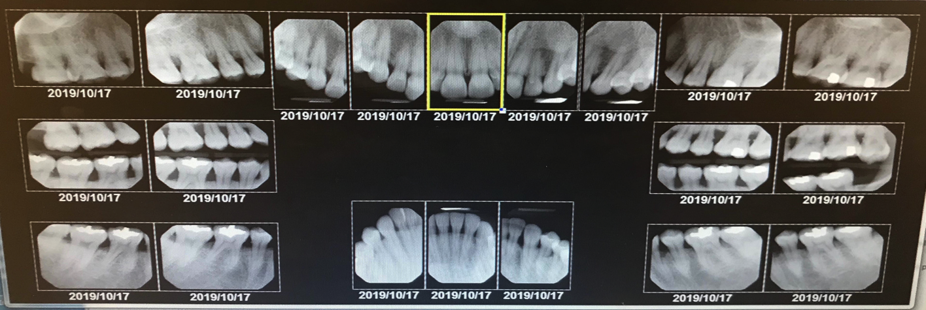
Radiographs
Radiographic evidence of localized moderate bone loss present on molars/premolars on all quadrants. Localized minimal bone loss on upper and lower anterior teeth.
Radiographic evidence of suspicious carious lesions on #2-M, #3-D, #4-D, #11-D, #13-D, #14-D, #15-M, #16-O, and #30-M.
Composite restoration on #3-OL.
Amalgam restorations on #14-O, #15-O, #18-O, #19-OB, #30-O, #31-O, and #32-O.
Extrusion on #16.
Localized interproximal subgingival calculus on molars and premolars.

Slide 14
Summary of Clinical Findings
Extraoral/Intraoral Findings: Bilateral submandibular nodes mobile (asymptomatic), and fibrotic. Patient verbally reported that she had a cold less than a week ago. Bony exostosis adjacent to the lower anteriors. Bilateral linea alba adjacent to the lower molars. Bilateral mandibular tori (more pronounced on the the left side), and slight coated/grooved tongue.
Occlusion: Class II- right side/Class I- left side, overjet 7mm and overbite 50%.
Deposits: Generalized heavy subgingival calculus on all quadrants. Localized moderate supragingival calculus on the upper and lower anterior teeth. Localized moderate extrinsic stains on the lingual aspect of the upper anterior teeth. Localized visible biofilm on the facial of the upper and lower anterior teeth.

Slide 15
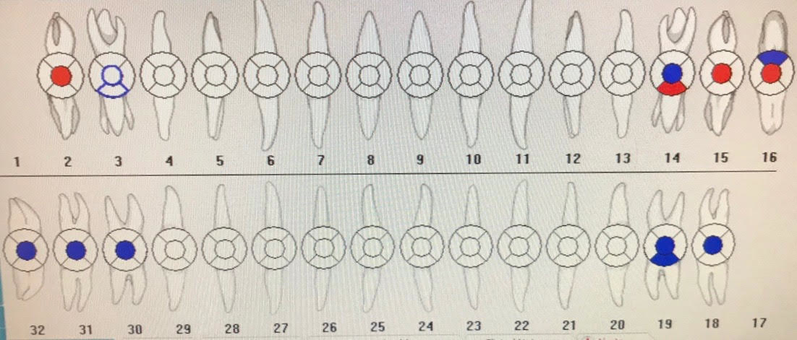
Dental Charting
Composite restoration on #3-OL.
Amalgam restorations on #14-O, #16-B, #18-O, #19-OB, #30-O, #31-O, and #32-O.
Suspicious carious lesions on #2-O, #14-L, #15-O, and #16-O.
Localized attrition on #23-26. Extrusion on #16.
Very slight lower anterior crowding.

Slide 16
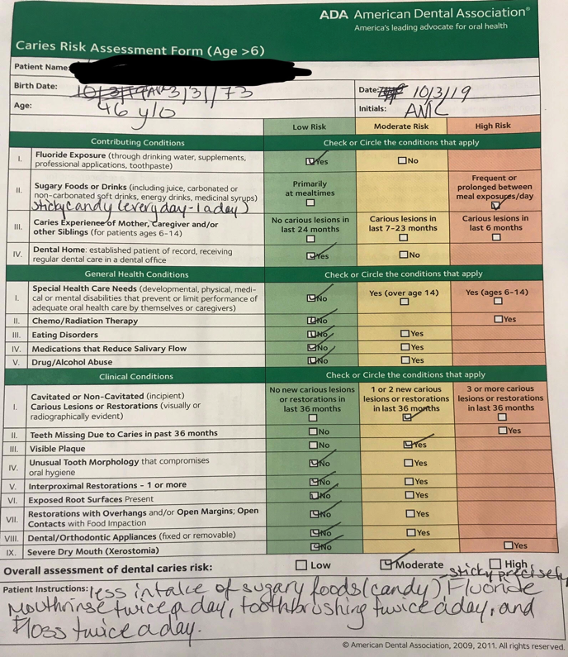
Caries Risk Assessment
Clinically visible suspicious carious lesions on #2-O, #14-L, #15-O, and #16-O.
Radiographic evidence of suspicious carious lesions on #2-M, #3-D, #4-D, #11-D, #13-D, #14-D, #15-M, #16-O, and #30-M.

Slide 17
Gingival Description and Periodontal Status
Gingival Description: Generalized pigmented gingiva, shiny, and blunted interproximals on buccal/facial. Moderate localized erythematous rolled gingival margins on the palatal of the right and left upper molars. Generalized moderate bleeding on probing and inflammation.
Periodontal Status: Active Periodontal Type II/Localized III with clinical and radiographic evidence.

Slide 18
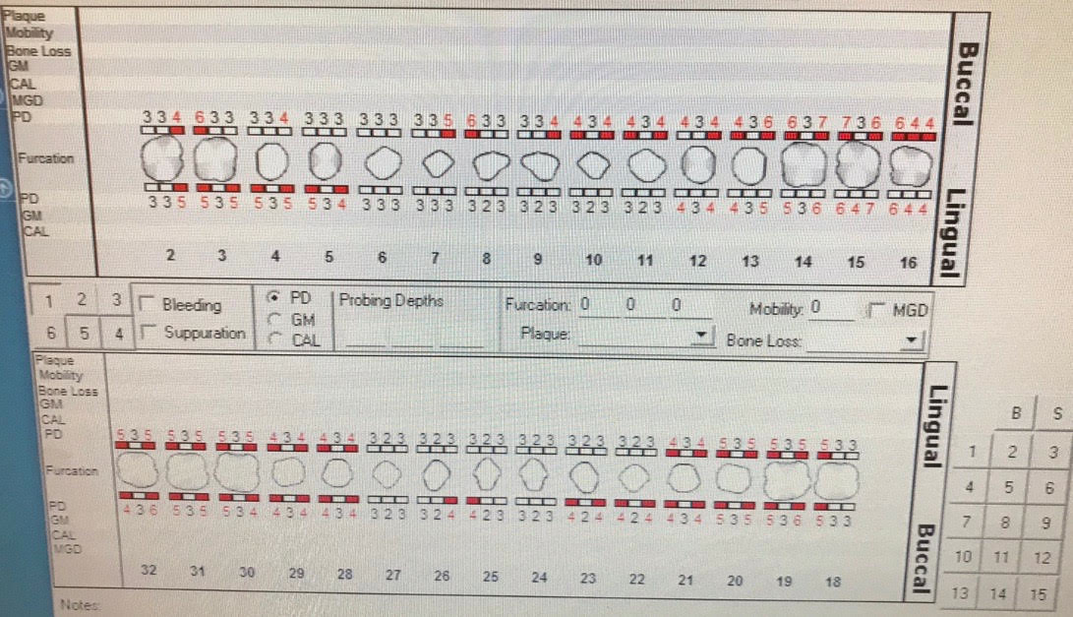
Periodontal Charting
Generalized moderate bleeding on all quadrants.
Localized probing depth readings of 5-7mm found on the molars/premolars and upper anterior teeth.
Generalized probing depth readings of 4mm on all quadrants.
No gingival recession, no furcations and no mobility present.

Slide 19
Dental Hygiene Diagnosis
Periodontal Diagnosis:
Type II/Localized III Active Periodontitis due to multiple factors:
Patients chief complaint was based on her concern of bleeding gums.
Generalized moderate bleeding on probing and exploring.
Radiographic evidence of localized moderate bone loss on molars/premolars on all quadrants. Localized minimal bone loss on upper and lower anterior teeth.
Generalized moderate inflammation on all quadrants. Localized probing depth readings of 5-7mm found on the molars/premolars and maxillary teeth.
Generalized probing depth readings of 4mm on all quadrants.
Generalized heavy subgingival calculus on all quadrants. Localized moderate supragingival calculus on the upper and lower anterior teeth.
Localized visible biofilm on the facial of the maxillary and mandibular anterior teeth.
Very slight mandibular crowding which gave the patient difficulty to maintain free of biofilm.

Slide 20
Dental Hygiene Diagnosis
Risk for Caries:
Patient is at high risk for caries due to multiple factors:
Clinical and radiographic evidence of suspicious carious lesions.
The medication Cabergoline is known to cause xerostomia.
Her diet consists of eating prolonged sticky candy at least once a day.
The patient reported using dental floss 5-6 times a day, but the technique was not adequate. As previously mentioned, it was stated to the patient that flossing 5-6 times was not necessary. It was recommended to Ms. V to floss at least twice per day.

Slide 21
Dental Hygiene Care Plan
Visit One:
PI/OHI: Sulcular toothbrushing. Although Ms.V has mentioned that she uses an electric toothbrush; she wanted to learn how to use properly a soft manual toothbrush.
Exposure of digital radiographs FMS.
Debridement of quadrants UR and LR with hand instruments and ultrasonics.
Visit Two:
PI/OHI: Dental Flossing.
Debridement of quadrant UL with hand instruments and ultrasonics.
Visit Three:
Mock Board- Debridement of quadrant LL with hand instruments and ultrasonics.
Visit Four:
Engine polish with fine paste and administration of topical neutral sodium fluoride 2% (tray method).

Slide 22
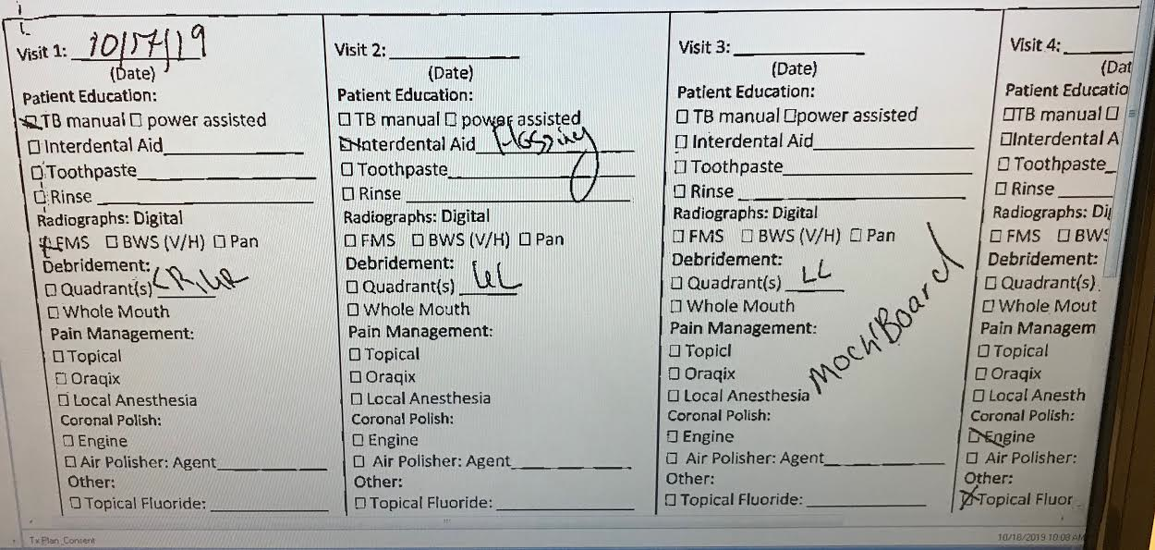
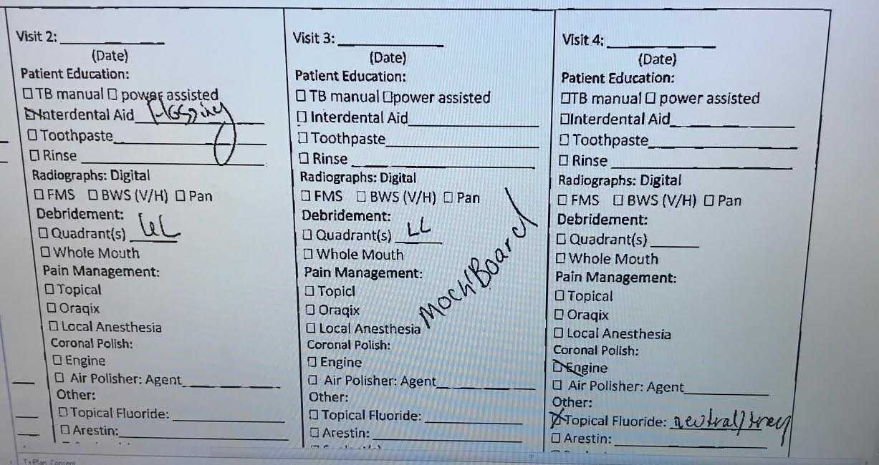

Slide 23
Implementation
Visit One:
Exposure to FMS digital radiographs were completed. The professor and I both demonstrated to Ms. V the radiographs and explained to her the bone loss, suspicious carious lesions, and the amount of subgingival calculus observed interproximally. She understood better how the calculus contributed to her bleeding.
At first I was going to show Ms. V how to use an electric toothbrush with a typhodont. Ms. V preferred learning how to use the soft manual toothbrush for a few reasons. One reason was because she saw the soft manual toothbrush that was in the oral hygiene homecare bag. The other reason was due to her concern of her bleeding gums. She wanted to learn the Sulcular technique, and see if it would help minimize the gum bleeding.
Debridement of the UR and LR with hand instruments and ultrasonics were initiated but not completed due to finding residual calculus on #3-D, #31-D, #30-D, and #29-D. No pain management was necessary.
*An adult referral was given to her to see a general dentist for the suspicious carious lesions, an oral surgeon for extraction of #16, and a periodontist.

Slide 24
Implementation
Visit Two (revisit):
*Due to the patient cancelling on her second visit, we did not do what was originally scheduled for visit two. The Mock Board exam was done on visit two.
Pt. reported that there was no changes in medical history, no recent hospitalizations/surgeries. BP was 136/79, P:82. Intraoral: WNL.
Gingival statement on the quadrants previously scaled: Generalized pigmented, shiny and moderate inflamed gingiva. Generalized blunted interproximals on buccal/facial. Generalized moderate bleeding on exploring. Minimal improvement was observed.
Debridement of quadrant LL with hand instruments and ultrasonics with pain management Lidocaine HCL 2%. A mandibular block and infiltration were administered for patient comfort. The treatment plan had to be modified due to the patient not being able to tolerate the removal of the subgingival calculus on the LL quadrant during the mock board exam. Engine polish with medium grit on quadrant LL was completed.

Slide 25
Implementation
Visit Three (revisit):
Pt. reported no changes in medical history, no recent hospitalization/surgeries. Ms. V mentioned that she was using both the electric toothbrush and soft manual toothbrush. She stated that she has been flossing and noticed less bleeding on the quadrants previously scaled.
BP: 129/85, P:92. IO: WNL. Gingival Statement on previous scaled quadrants: generalized moderate bleeding on exploring, pigmented gingiva, rolled and erythematous gingival margin on palatal of molars. Residual calculus on #3-D, #31-D, #30-D, #21-D, #22-D and #29-D.
Review of the Sulcular method and demonstration of flossing were completed. Ms. V demonstrated the technique on a typodont and inside her mouth. She understood why her flossing technique was not adequate. The consumption of prolonged sticky candy was addressed through a verbal conversation. It was recommended to not consume sticky candy everyday.
Debridement of residual calculus on #3-D, #31-D, #30-D, #21-D, #22-D and #29-D were completed. After all the residual calculus were scaled, I proceeded to debride the UL quadrant with hand instruments and ultrasonics. Oraqix (2.5mg lidocaine/2.5mg prilocaine) was administered for pain management.
After the quadrant was checked for residual calculus, engine polish with fine paste and administration of topical neutral fluoride 2% (tray method) for four minutes were finished. Post-op instructions were given to the patient of no drinking, no eating, and no rinsing for 30 minutes.
*A copy of Ms. V digital radiographs were given to her.

Slide 26
Implementation
The challenge that I faced throughout her treatment was the use of the ultrasonics.
Ms. V was a very cooperative patient, but she did not like the noise of the ultrasonics.
She was a heavy case with tenacious subgingival calculus, and hand scaling alone was very difficult to accomplish. I was able to use the ultrasonics, but only for a period of time until she would say she could not tolerate it anymore.
Most of the debridement had to be accomplished through hand scaling.

Slide 27
Evaluation of Care- Outcome of Care-Prognosis
Ms. V was trying her best to implement the oral hygiene care that was demonstrated to her throughout the treatment. Her main concern was the gum bleeding, and she was very interested in learning on how to stop it completely or at least minimize it.
If she continues to implement the oral hygiene care and use the referral that was given to visit the general dentist, oral surgeon and a periodontist to treat the suspicious carious lesions and periodontal concerns; she should accomplish having a stable oral cavity.

Slide 28
Referrals
A referral was given to the patient because of the suspicious carious lesions (clinically and radiographically visible), extrusion of #16, generalized moderate inflammation, the subgingival calculus and the bone loss observed on the FMS.
The patient was referred to the general dentist, oral surgeon and the periodontist.

Slide 29
Continued Care Recommendations
The recare recommendation interval given to the patient is four months.
A 4-month recare was recommended to the patient due to the radiographic evidence of bone loss and the generalized subgingival calculus. We would like to be updated about the patients incorporation of the oral hygiene instructions and diet in her daily routine because our goal is to help her achieve a stable oral health.

Slide 30
Final Reflection
As I reflect on Ms. V’s case, I realized that she was a patient who wanted to improve and wanted to learn. She was eager in learning different ways of toothbrushing.
I learned from her case that it is important to explain to the patient the reasons of why it is important for them to address their periodontal disease/carious lesions. If the clinician does not address them in a manner that the patient can understand; there is a great chance the patient will not cooperate to improve their oral healthcare.

Slide 31
Final Reflection
Due to Ms. V cancelling her appointment once, we had to modify her treatment. If the original treatment plan would have been accomplished, visit four would have been implemented, and it would have given me the opportunity to follow up on the flossing technique before completing her treatment.
The BP was assessed at each visit, and it was addressed to the patient. The patient had no knowledge of the slight elevation. It was recommended that she visit her primary physician, and to limit her salt intake.
I would have incorporated the “after-five” Gracey’s into the instrument selection. Her calculus was very tenacious, and the “after-five” Gracey’s would have helped, especially since I had to do more hand scaling than ultrasonics. Overall, the treatment was a success, and the patient and I learned a lot from each other.

